Slide 1
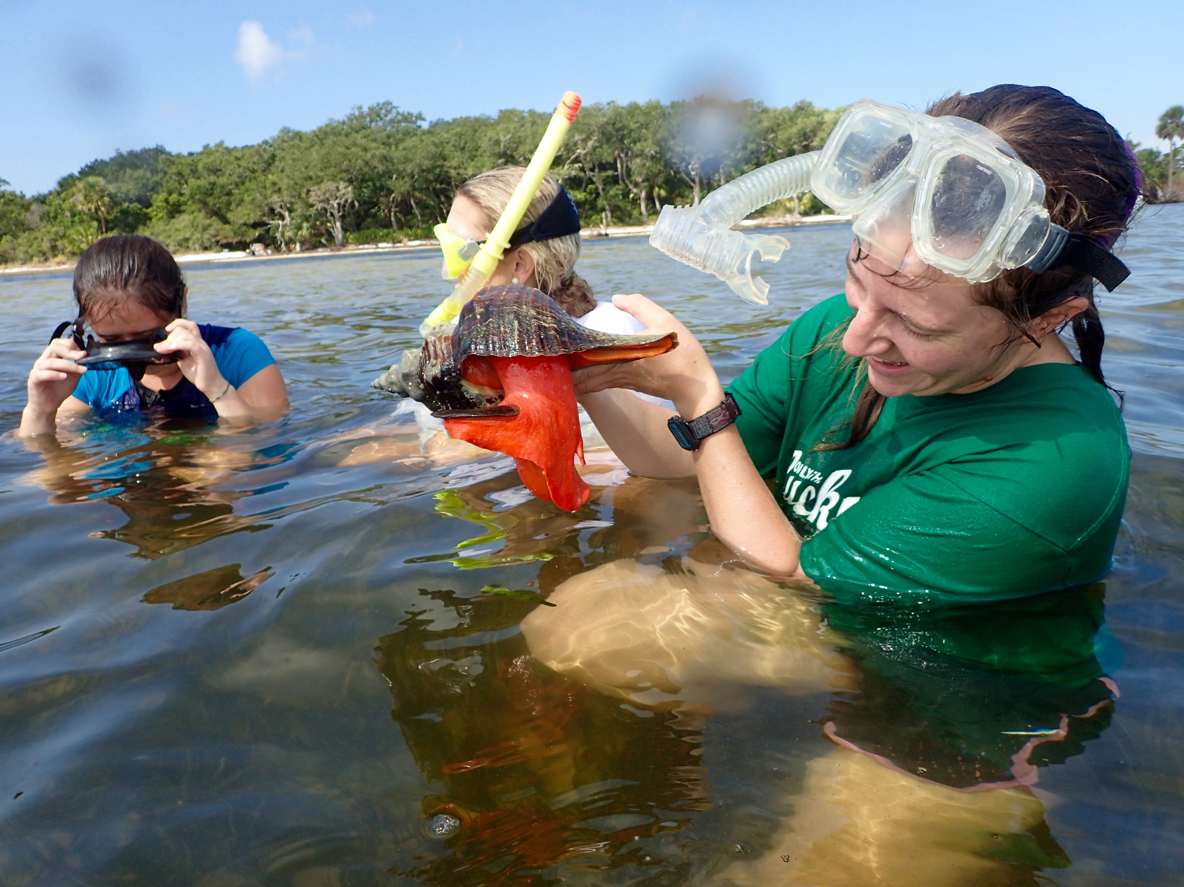
4th Lecture – September 16, 2016
Thursday, September 15, 4:00 pm, 1024 KIN—BIOLOGICAL SCIENCE COLLOQUIUM, "On the long-term effects of habitat loss and fragmentation," Dr. Nick Haddad, North Carolina State University
Thursday, September 15, 7:30pm, 1024 KIN—Audubon Society Seminar, ”Sustaining the Florida Aquifer," Dr. Todd Kincaid, GeoHydros Company.
Friday, September 16, 4:00 pm, 1024 KIN—ECOLOGY AND EVOLUTION SEMINAR, "Butterfly restoration and recovery in dynamic landscapes," Dr. Nick Haddad, North Carolina State University
-- Tegrity videos should be available, if you’d like another perspective.

Slide 2
exponential
logistic
Population size
Population growth rate
(slope)
Per-capita growth rate

Slide 3



Examples of Population Ecology used in Medicine
In medicine: modeling of growth of tumors
One application of logistic curve is in medicine, where the logistic differential equation is used to model the growth of tumors. This application can be considered an extension of the above mentioned use in the framework of ecology. Denoting with X(t) the size of the tumor at time t, its dynamics are governed by:
where F(X) is the proliferation rate of the tumor. If a chemotherapy is started with a log-kill effect, the equation may be revised to be
where c(t) is the therapy-induced death rate. In the idealized case of very long therapy, c(t) can be modeled as a periodic function (of period T) or (in case of continuous infusion therapy) as a constant function, and one has that
i.e. if the average therapy-induced death rate is greater than the baseline proliferation rate then there is the eradication of the disease. Of course, this is an over-simplified model of both the growth and the therapy (e.g. it does not take into account the phenomenon of clonal resistance).

Slide 4
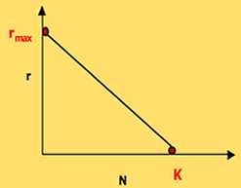
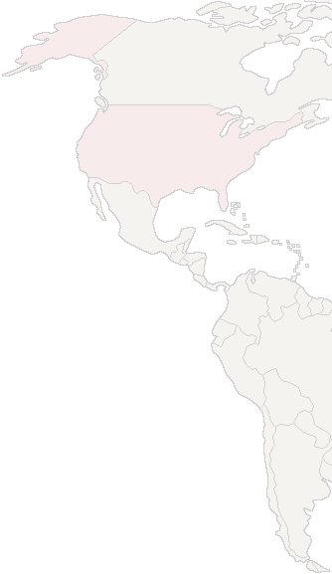
Here are a couple of websites with interactive programs:
Help with exponential and logistic growth
Population Dynamics - University of Wisconsin–Madison
http://ats.doit.wisc.edu/biology/ec/pd/pd.htm
Help with population pyramids and demographic transitions
Demographics Lab | The Habitable Planet
http://www.learner.org/courses/envsci/interactives/demographics/demog.html
Notes:
Some version of these curves will undoubtably be on the first exam.

Slide 5
exponential
logistic
Population size
Population growth rate
(slope)
Per-capita growth rate

Slide 6
Logistic growth equation is very useful because it describes density dependent growth in a very simple way.
Forget the math, for a moment. Biologically, what is going on?

Slide 7
Logistic growth equation is very useful because it describes density dependent growth in a very simple way.
Forget the math, for a moment. Biologically, what is going on?
Competition – a biological interaction between two or more individuals for a resource in short supply.
Competition can be intraspecific (within species) OR interspecific (between different species). Density dependent growth generally involves intraspecific competition.

Slide 8
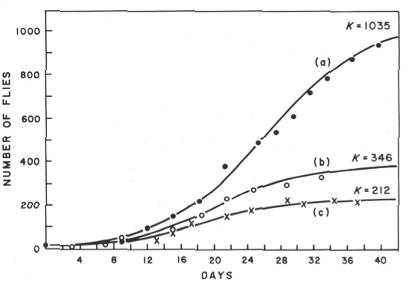
Growth of populations of Drosophila melanogaster with (a) wild type in a pint bottle, (b) vestigial wings in pint bottle, or (c) wild type in a half-pint bottle (from Pearl via Hutchinson). Example of how genetics or environment can affect the carrying capacity (K).

Slide 9

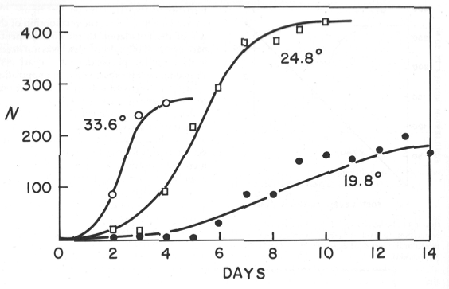
Growth of populations of Moina macrocopa at three temperatures (from Hutchinson). Does temperature affect r or K?

Slide 10
II. Tools for Ecology
A. Population demography: describing populations.
1. Definitions
2. Demography
a. distribution, dispersion, and density
b. gender and age
c. population growth and regulation
i) density independent growth (exponential)
ii) density dependent growth (logistic)
The key trait of a density
dependent population is that
there is a relationship between
the per-capita growth rate and
density. Usually this is a
negative relationship (negative
slope).

Slide 11
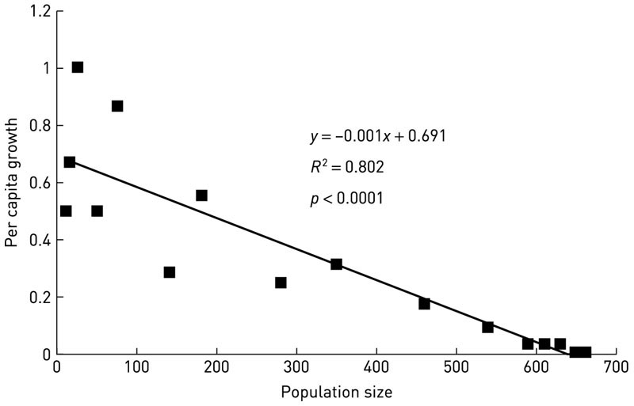
How do we test populations for density dependence? The best way is to see if the per-capita growth rate declines with density.
Per-capita test for density dependence in a yeast population

Slide 12
II. Tools for Ecology
A. Population demography: describing populations.
1. Definitions
2. Demography
a. distribution, dispersion, and density
b. gender and age
c. population growth and regulation
i) density independent growth (exponential)
ii) density dependent growth (logistic)
Do real populations show logistic growth?

Slide 13
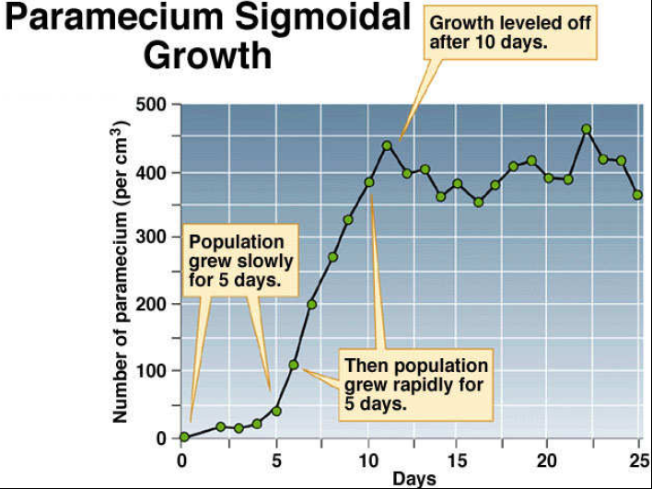
Resource competition

Slide 14
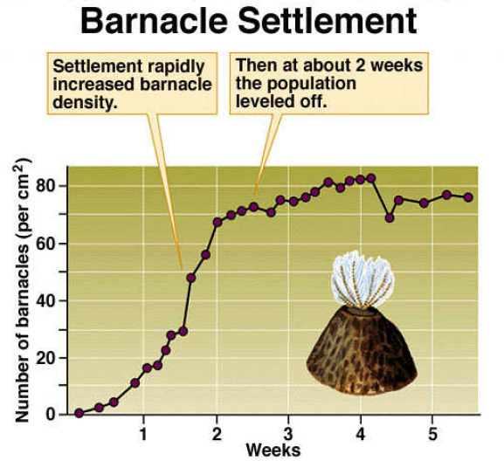
Interference
competition?

Slide 15
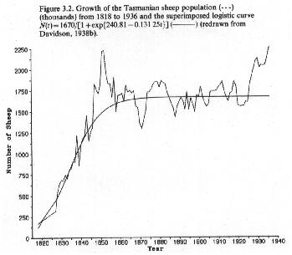

Slide 16
Does it happen in real populations?
Yes. Often. Lots of examples (but it isn’t quite as simple as it seems). But, other factors also affect growth other than competition. These other factors are not necessarily related to density. What might these other factors be? Or, put another way, when might a population NOT grow logistically?

Slide 17
Possible other factors are:
The carrying capacity is not constant (environmental stochasticity).
Birth and death rates (or r and R) do not change in a linear way with density.
There are time lags between when the population grows and when it experiences effects on density.
Population is not at a stable age distribution, so you have disproportionate effects of some age classes (more later!).

Slide 18
Possible other factors are:
The carrying capacity is not constant (environmental stochasticity).
Another source of variation can be caused by chance events of colonization or behavior. If we just put two people on an island, will the population grow? And, how fast? (depends on sex and age).
Demographic stochasticity – variation in population growth rates arising from differences among individuals in survival and reproduction. (Example: While the average female may give birth to 2.0 offspring, some may have none while others may have 4. Or some could have all male offspring). This type of variation is particularly important in small populations.

Slide 20
Possible other factors are:
The carrying capacity is not constant (environmental stochasticity).
Birth and death rates (or r and R) do not change in a linear way with density.
There are time lags between when the population grows and when it experiences effects on density.
Population is not at a stable age distribution, so you have disproportionate effects of some age classes (more later!).

Slide 21
3. Birth and death rates (or r and R) change linearly with population size.
Remember:
1/N dN/dt = r(K-N)/K
= r(1-N/K)
= r – N (r/K)
This last equation describes a straight line
(i.e., y = mx +b), with the per-capita growth
rate (1/N dN/dt) being a linear function of the
population size (N) with a slope of r/K and an
intercept (maximum growth rate) of r.

Slide 22
These simple equations assume r is constant, which assumes that b and d are constant (since r=b-d).
In fact, in many cases the effects of density aren’t experienced by individuals until the densities get sufficiently high. This gives you a curved line.

Slide 23
Allee proposed that many species have a problem with low population size also reducing r. This is called an Allee effect.
Allee effect mechanisms arise from cooperation or facilitation among individuals in the species. Examples of such cooperative behaviors include better mate finding, environmental conditioning, and group defense against predators.

Slide 24
If sufficiently severe, allee effects can require some minimum population size for the population to grow.
This is the concept of a minimum viable population size (MVP). Note that for a population described by the dashed line, there must be at least 14 individuals, or the population goes extinct. This would be the MVP for that species.

Slide 25
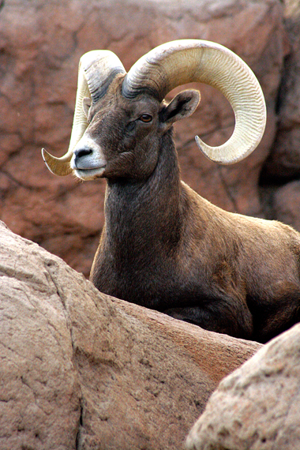
Minimum viable population (MVP)
Smallest population that can be predicted to have some probability (e.g., 95%) chance of persisting for some number of years (e.g., 100 or 1000 years).
Most of the extinctions are due to environmental stochasticity when populations are small.
MVP varies among organisms and takes years of research to determine.
One of the best documented cases of MVP size comes from a study of Bighorn sheep by Berger (1990) where some of these populations have been studied for 70 years
Populations with fewer than 50 individuals went extinct within 50 years.

Slide 27
Possible other factors are:
The carrying capacity is not constant (environmental stochasticity).
Birth and death rates (or r and R) do not change in a linear way with density.
There are time lags between when the population grows and when it experiences effects on density.
Population is not at a stable age distribution, so you have disproportionate effects of some age classes (more later!).

Slide 28
Time lags are weird. They occur when populations do not respond immediately to changes in density. One example is gestation time – when times are good, animals may mate, but the effects on density may not occur until those individuals are born and achieve some size. The actual amount of time in the lag period is the Greek letter tau (τ). We can build this into our standard continuous equation as:
Note that this means that growth is slowed by the population size at an earlier time.
We won’t discuss time lags much in this class. What I want you to remember is what they are AND that they cause oscillations.

Slide 29
I recommend that you use excel for some exercises in this class. A few simple tricks include:
Writing an “=“ as the first character in a cell tells Excel that you are writing an equation.
If you combine = with the name of another cell (e.g., “B3” or “E23”) in a cell, then it gives that value to the cell or uses that value in an equation.
If you have an equation such as “=B3*4.2” in cell C3, then excel will take the value in cell B3, multiply it by 4.2, then place that value in cell C3.
You can copy and paste the contents of C3 into other cells, such as C4. However, it will automatically change the equation to “=B4*4.2”
You can prevent this by using “$” signs in front of the row and column information that defines a cell. For example, writing “=$B$3*4.2” will allow you to pasted this exact equation wherever you wish.
Notes:
Some version of these curves will undoubtably be on the first exam.

Slide 30
Time lags can cause oscillations. As the lag x r increases, the population will first have damped oscillations, then fixed oscillations, then 2-point oscillations, then CHAOS.
A deterministic equation is thus producing something that looks random (it’s not!).

Slide 31
Excel Example of oscillations and chaos.
Check out the “Eudaemonic Pie” on wikipedia
Notes:
This is another file to run during lecture, called “logistic.xls”

Slide 32
Possible other factors are:
The carrying capacity is not constant (environmental stochasticity).
Birth and death rates (or r and R) do not change in a linear way with density.
There are time lags between when the population grows and when it experiences effects on density.
Population is not at a stable age distribution, so you have disproportionate effects of some age classes (more later!).

Slide 33
II. Tools for Ecology
A. Population demography: describing populations.
1. Definitions
2. Demography
a. distribution, dispersion, and density
b. gender and age
c. population growth and regulation
i) density independent growth (exponential)
ii) density dependent growth (logistic)
So, we have this big question – are populations density independent or density dependent?

Slide 34
II. Tools for Ecology
A. Population demography: describing populations.
1. Definitions
2. Demography
a. distribution, dispersion, and density
b. gender and age
c. population growth and regulation
i) density independent growth (exponential)
ii) density dependent growth (logistic)
So, we have this big question – are populations density independent or density dependent?
This is a false dichotomy, as populations can be both, to varying degrees!

Slide 36
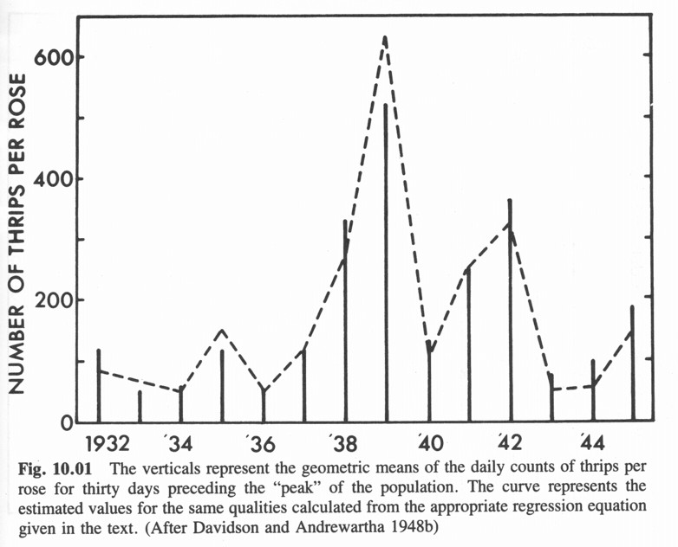
Andrewartha and Birch in Australia worked on thrips (an insect) that lives on roses and suggested that populations were primarily controlled by density independent factors such as rainfall.

Slide 37
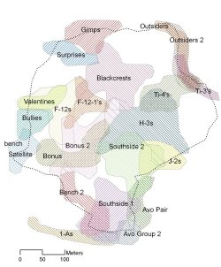
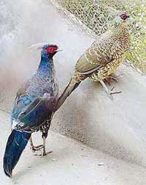
Density dependence is common in other species and was particularly promoted by David Lack, who worked on bird populations in England..
Territoriality is common in many species and is one mechanism that inforces density-dependent growth.
Kaliz pheasants are invasive species in Hawaii where they are being studied to determine management methods.
Notes:
One of the early classic studies of territorial behaviour in a passerine species was conducted by David Lack on the European Robin (Lack 1939, 1940, 1943, 1965). Lack used stuffed 'intruding' Robins to elicit agonistic encounters in territory-holding birds. Responses from territory holders to the 'intruder' varied considerably in intensity from failing to react, to aggressive chest expansion and fluffing of breast feathers, through singing directly at the decoy, to causing serious physical damage.

Slide 38
Andrewartha and Birch worked on insects and felt abiotic factors were determining population abundances. Populations are density independent and relatively unregulated.
Lack worked with territorial birds and felt that competition, a biotic factor, helped to regulate population numbers. Populations are density dependent.
Who is right?

Slide 39
Ecologists continue to wrestle with these two views of population regulation. Clearly, for some populations at given times, either DD or DI may dominate. One view is density vagueness (D. Strong, formerly at FSU).
Density vagueness suggests that there is some average population level around which a regulated population fluctuates. As the populations is perturbed further from this average level, density becomes more important in “pushing” the population back towards the average.
How much it fluctuates depends on the relative importance of density dependent and independent factors.

Slide 40
Modern Synthesis of DD vs. DI (from Strong). The strength of DD increases away from equilibrium, where as the strength of DI is independent of density.
DD strong (-)
K
density
DD weak
DD strong (+)
time

Slide 41
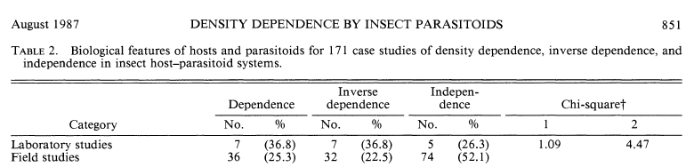
There are lots of studies since Eisenberg testing for density dependence in populations. Peter Stiling reviewed 172 studies of insect-parastiod systems (Ecology 68:844-856, 1987) and demonstrated that:
-- 25% showed density dependence
-- 23% showed inverse density dependence
-- 52% showed no evidence of density dependence.

Slide 42
Peter Stiling (formerly at FSU, now at USF) reviewed 172 studies of insect-parastiod systems (Ecology 68:844-856, 1987) and demonstrated that:
-- 25% showed density dependence
-- 23% showed inverse density dependence
-- 52% showed no evidence of density dependence.
Huh? Not great support for the density dependence that ecologists think MUST occur?

Slide 43
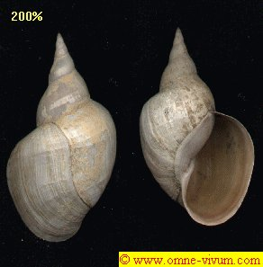
Tests of Density dependence
in the real world
Robert Eisenberg’s study of snails in Michigan was one of the first experimental tests of DD vs DI in the field. He conducted a simple experiment in 1966 to see if snails in a pond exhibited density dependent growth and to determine what factors might limit the snail population growth (e.g., competition or predation).
(1) He used cages placed in the shallow water around a pond to study the effects of density. In 4 cages, he left the normal density (about 1000 snails/cage. In 4 other cages, he reduced snails to 1/5 normal and in 4 cages he increased snails to 5X normal.

Slide 44
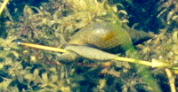
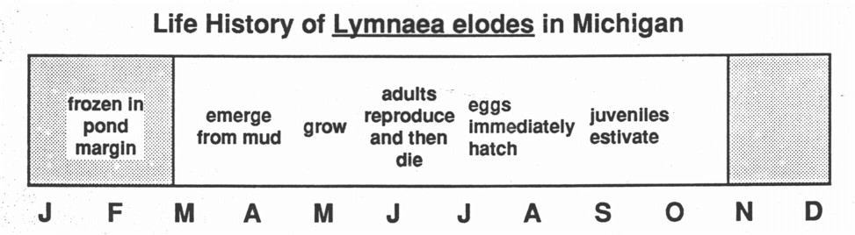

Slide 46
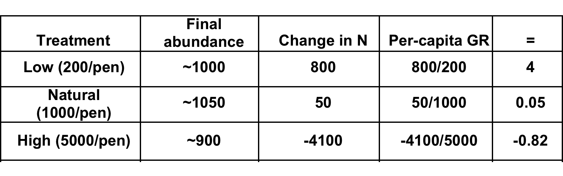

Slide 47

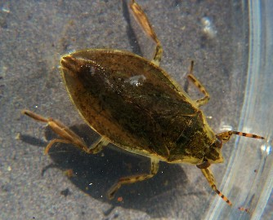
  Eisenberg conducted a second experiment by throwing frozen spinach into some 2 cages. Added food did not affect the number of adults/cage (no effect on lx) but did produce a 25X increase in fecundity and a subsequent 4x-9x increase in numbers of young (effect on bx). This suggests that food is a major limiting factor behind the DD
  (3) The third experiment was to throw a predator into
  some cages. He tossed in about 100 Belostoma
  that had no effect.
  Is this DD? Is this DI?

Slide 48
Study Guide Items from Lecture 4
Terms:
Concepts:
  Discrete logistic growth (Beverton-Holt equation used in fisheries)
  Logistic growth does occur in nature, examples of barnacles and sheep
  Assumptions of logistic growth
  Per-capita growth rates are a linear function of population size (N)
  Allee effects (especially the graph!) and minimum viable population size
  Effects of time lags on population growth, especially oscillations
Case Studies:
  Bighorn sheep and MVP
  Eisenberg’s snails
environmental stochasticity Allee effects survivorship intraspecific competition resource competition minimum viable population size | demographic stochasticity time lag chaos interspecific competition interference competition
Notes:
48

