Slide 1

3rd Lecture – September 13, 2016
Thursday, September 15, 4:00 pm, 1024 KIN—BIOLOGICAL SCIENCE COLLOQUIUM, "On the long-term effects of habitat loss and fragmentation," Dr. Nick Haddad, North Carolina State University
Friday, September 16, 4:00 pm, 1024 KIN—ECOLOGY AND EVOLUTION SEMINAR, "Butterfly restoration and recovery in dynamic landscapes," Dr. Nick Haddad, North Carolina State University
-- Vilas paper, writing assignment were posted on blackboard last week.
-- Tegrity videos should be available, if you’d like another perspective.

Slide 2

II. Tools for Ecology
A. Population demography: describing populations.
1. Definitions
2. Demography
a. distribution, dispersion, and density
b. gender and age
Notes:
Disappear like Anasazi native americans.

Slide 3
II. Tools for Ecology
A. Population demography: describing populations.
1. Definitions
2. Demography
a. distribution, dispersion, and density
b. gender and age
c. population growth
So, now we have a convenient way of measuring population growth, either for the entire population:
dN/dt = rN or dN/dt = bN – dN (since r = b-d)
Or we can express this as per capita (per individual) growth by dividing by N:
1/N dN/dt = r

Slide 4
Now, here comes an important conceptual step. We have a lot of contrasting principles in ecology, such as “open vs. closed” populations. We also have two very different ways of modeling or understanding population growth, discrete vs. continuous, each of which is more appropriate for different types of species.
Let’s consider two sorts of insects. In one species, everyone overwinters as an adult, finds mates in the spring, has babies and dies. Individuals of the other species are not tied to seasons. They have the same lifespan, but mate, make babies, and die all year round.
The two insects will have very different population dynamics.

Slide 5
Continuous growth
1 generation
Discrete growth
1 generation
0 1 2 3 4 5 6
Year

Slide 6
Discrete growth
1 generation
Discrete growth = all individuals pass through life stages at the same time, often common in organisms affected by seasons.
Continuous growth = individuals in a population are relatively independent in terms of when they are born, reproduce, and die. This results in overlapping generations.
Continuous growth
0 1 2 3 4 5 6
Year

Slide 7
Discrete growth
1 generation
0 1 2 3 4 5 6
Year
N_{t+1} = N_{t} x R₀
R₀ (“R sub O”) is another growth rate (remember, we already had “little r”) and it is called the multiplicative (per generation) growth rate. It is primarily used for populations that have discrete growth patterns.
Note that since it is multiplicative, if R₀ = 1, the population is stable.

Slide 8
Finally, let’s consider what kind of growth would occur if R₀ was constant.
N₁ = N₀ x R
N₂ = N₁ x R = (N₀ x R) x R = N₀ x R²
N₃ = N₂ X R = (N₀ x R²) x R = N₀ x R³
etc. . . . Which can be generalized as:
N_{t} = N₀ x R^{t}

Slide 9
N_{t} = N₀ x R^{t}
This equation also describes exponential growth! As long as R is constant, then any given population will just keep getting bigger by the multiplier R each generation. This gives us two exponential growth equations (remember dN/dt = rN).
N or Population Size
Time

Slide 10
Continuous exponential growth rate:
N_{t} = N₀e^{rt} or dN/dt = rN
Discrete exponential population growth:
N_{t} = N₀ x R^{t}
One is continuous, one is discrete. (Remember that some equations describe population growth rate, others describes the actual population size.)

Slide 11
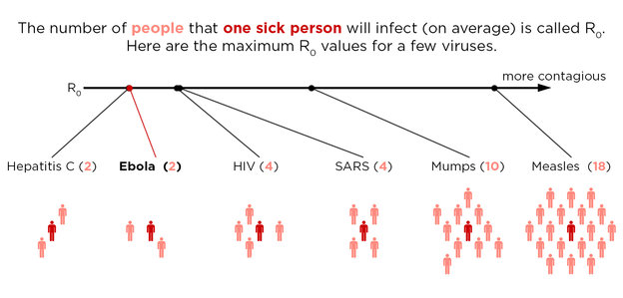
Scientific terms are annoying, as they are often used to mean very different things (or sometimes there are several different terms for the same thing). For example, in epidemiology, R0 is used for a related but different purpose.

Slide 12
II. Tools for Ecology
A. Population demography: describing populations.
1. Definitions
2. Demography
a. distribution, dispersion, and density
b. gender and age
c. population growth
We get exponential growth with continuous growth if r is constant:
dN/dt = rN
We can convert this to also predict population size at a later time by integrating both sides from 0 to t (don’t worry about the math here):
N_{t}=N₀e^{rt}
Notes:
Recognize that these patterns are caused by differential mortality of different age groups. Each age group can have a different rate of death and that this can be important in creating difference among populations US vs. Afghanistan). So, lets consider B-D not for entire populations, but for each age group within a population.

Slide 13
With this equation, we can again predict the population at some later time, t, based on its initial size, N0, and the growth rate, r.
N_{t}=N₀e^{rt}
And, again, we see
exponential growth.
Compare to:
N_{t} = N₀ x R₀^{t}
A key component of
exponential growth is
a constant growth rate
(either r or R₀)

Slide 14
With this equation, we can again predict the population at some later time, t, based on its initial size, N0, and the growth rate, r.
N_{t}=N₀e^{rt}
We can also have
negative exponential
Growth if r is negative
and constant.

Slide 15
Now, take this exponential growth equation:
If we divide both sides by N, we get a per-capita growth equation:
With exponential growth the per-capita growth is constant (it equals r).

Slide 16
I know that all these equations can be confusing. Just be careful and think about the axes. Ecologists sometimes just want to know the population size, which is N. So, for example, we may want:
N_{t}=N₀e^{rt}
Or, we may want the population growth rate:
dN/dt=rN

Slide 17
N_{t}=N₀e^{rt}
dN/dt=rN
Finally, an ecologist may be more interested in what is happening to individuals. These are per-capita rates:
1/N dN/dt = r
Notes:
This is a great place to comment on math phobia. To some of you, this just seems like a bunch of confusing letters with an equal sign. Stop. You can conquer this. Always think about equations in two ways – make sure the math makes sense. But also step aside and just think about the biology. What is the biological meaning of dN/dt? 1/N dN/dt? The whole equation? Now answer that last sentence.

Slide 18
Little r is instantaneous and can be used to compare growth rates (since R is a per-generation measure, it can’t be used to compare different species or populations unless they have the same generation time).

Slide 19
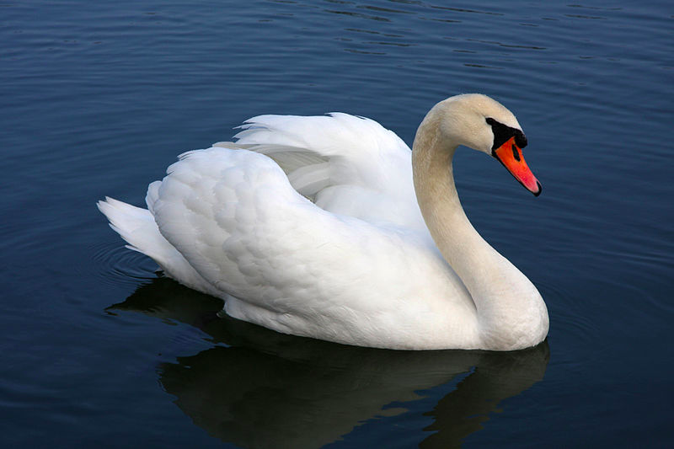
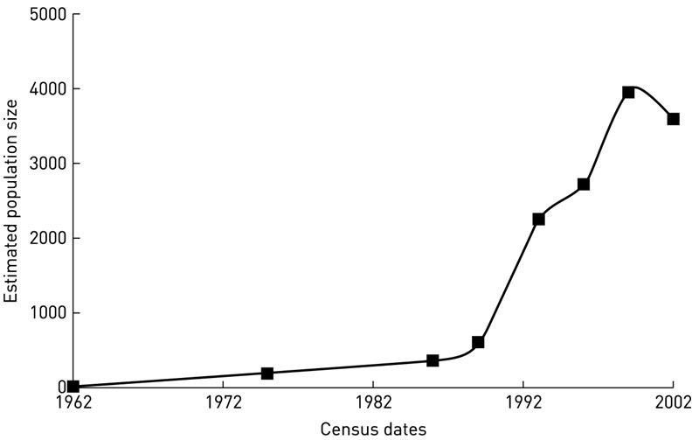
Do any species really grow at exponential rates?
-- lots of examples from invasive species
-- and diseases
Offspring of 5 mute swans that escaped in Chesapeake Bay in 1962. Control methods were put in places in 2001.
Notes:
Exponential growth seems a little crazy, if you think about it. Population ultimately grow at absurdly high rates, apparently without limit. So, do real populations every grow exponentially? Sure, there are lots of examples of populations growing exponentially, at least for some period of time. Here is an example of an European swan species that has invaded Chesapeake Bay. Ultimately, these swans started chasing native species off nesting areas. Note the initial apparently slow growth (actually little r was probably constant). Also note that the population sizes to level off at some point, when apparently they started controlling the birds by killing eggs and adults.

Slide 20
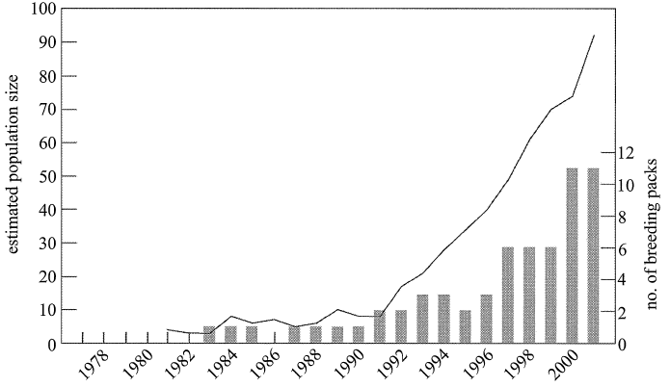
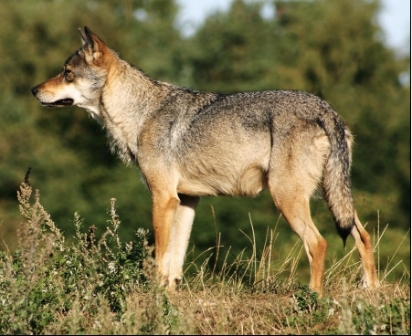
Vilà, C., A. Sundqvist, Ø. Flagstad, J. Seddon, S. Björnerfeldt, I. Kojola, A. Casulli, H. Sand, P. Wabakken and H. Ellegren. 2003. Rescue of a severely bottlenecked wolf (Canis lupus) population by a single Immigrant. Proceedings: Biological Sciences 270:91-97.

Slide 21
I have found more data on the wolves, as the populations have continued to grow. Here it is through 2012.

Slide 22
Things you need to remember from the Vila et al. paper are:
Wolves were thought to be extinct in Northern Europe due to hunting, poisoning, and trapping.
A previously unknown pack of <10 wolves was discovered in 1983
Without any external changes in management, the population began increasing in 1991 by 29% annually
Genetic data suggest there were only two founding wolves, probably from Russia or Finland (not a relic population)
Genetic data also suggests that, in 1991, a lone immigrant wolf from Russia migrated to the area and restored genetic diversity to the population. Of the 72 wolves born between 1993 and 2001, 68 could be traced to this lone migrant wolf. Genetic bottleneck!
In 2003, there were 10-11 packs and around 100 wolves. A census in 2011 showed that this number is now up to 250-300 wolves.
This is causing problems for sheep, moose, and reindeer; management would like to hold these abundances to ~125.

Slide 23
A population or genetic bottleneck is when a population severely declines due to environmental events (e.g., disease or hurricanes) or human activities. Such events reduce the genetic variation of a population. These population size reductions and the loss of genetic variation leave the populations susceptible to environmental changes, like climate change or a shift in available resources. Due to the smaller population size after a bottleneck event, inbreeding increases and unfavorable alleles can accumulate.
Conversely, depending upon the causes of the bottleneck, the survivors may have been the genetically fittest individuals, hence increasing the frequency of the fitter genes within the gene pool, while shrinking it. This genetic drift can change the proportional distribution of an allele by chance and even lead to fixation or loss of alleles.
Many examples exist, such as northern sea lions (crashed to 30 individuals in 1890) and lions in the Nogorongoro crater (disease reduced the population to 10 individuals in 1962)

Slide 24
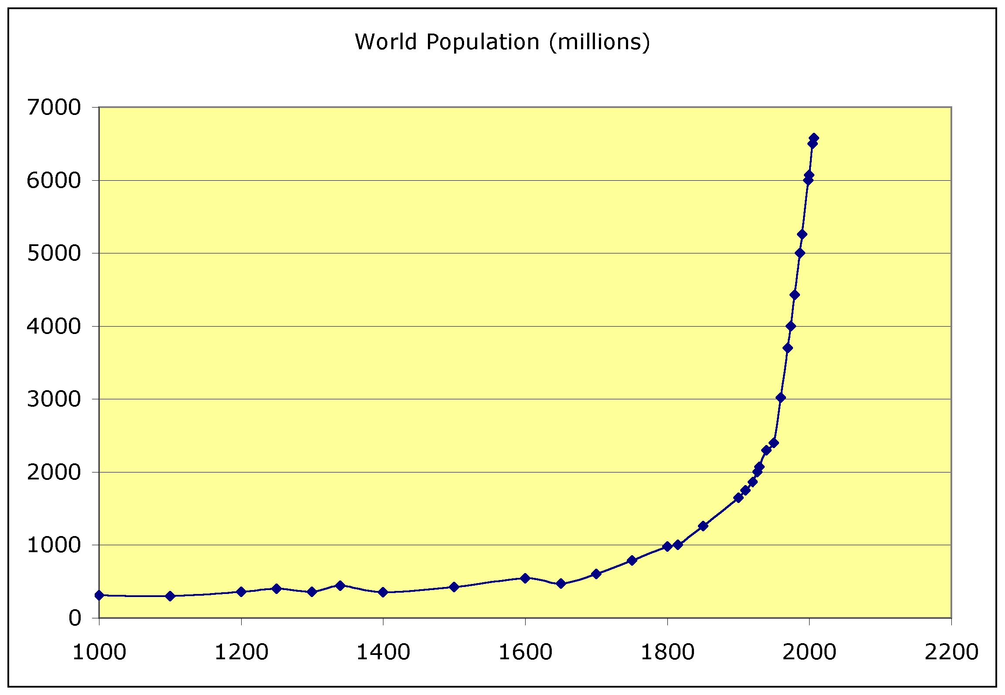
Plague kills off ¼ of all humans at the time!
How would a similar plague affect the growth pattern now?
Notes:
Yep, it is humans. In fact, we haven’t had exponential growth – instead human growth from the 1800 to 1990 or so has been great than exponential. That is, a constant little r > 0 will produce exponential growth. For humans, little r hasn’t been constant, but has instead increased over that time, yielding a sort of “super exponential growth” pattern. Note the effects of the plague in the mid 1300’s, killing off as much as a quarter of the human population at the time. What would that look like if it happened now?

Slide 25
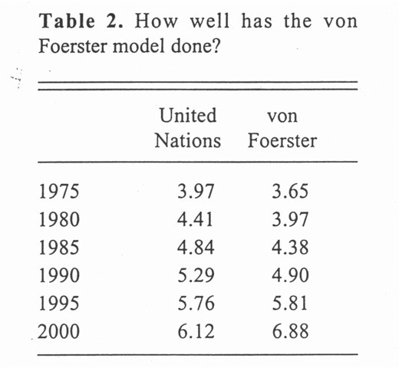
Graphically, we can easily see that the earth’s population is growing at an unprecedented rate. It looks exponential, with no end in sight.
In fact, Heinz von Foerster pointed this out in 1960. He determined that the population growth rate was actually greater than exponential -- r is increasing. In fact, he predicted that eventually the population size would go to infinity -- on Nov. 13, 2026.
Clearly this is silly. But here are Foerster’s predictions made in 1960 of the future population size. They are pretty good – until about 2000.
We will come back to discuss human population growth a bit later.

Slide 26
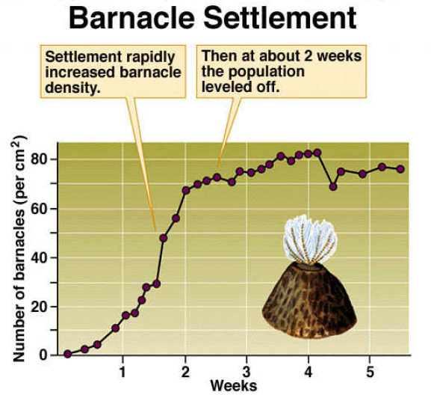
Notes:
Of course, organisms can’t continue to grow exponentially. Here, for example, is barnacle growth on cleared rocks. At some point, the critical resource (empty rock space) runs out and the population size has to level off. So, the growth rate of the population is initially quite high, but eventually has to go to zero if the population levels off. Note that we no longer have the “hockey stick”, but now have an S shaped curve.

Slide 27
II. Tools for Ecology
A. Population demography: describing populations.
1. Definitions
2. Demography
a. distribution, dispersion, and density
b. gender and age
c. population growth
i) density independent growth (exponential)
ii) density dependent growth
Up until now, we have assumed that the growth rate is constant, so the population just keeps getting larger. Now, we are going to add some realism to our model and recognize that population growth must slow down.

Slide 28
II. Tools for Ecology
A. Population demography: describing populations.
1. Definitions
2. Demography
a. distribution, dispersion, and density
b. gender and age
c. population growth
i) density independent growth (exponential)
ii) density dependent growth
So, there must be limits to growth. Growth slows when the population density gets higher (i.e., density dependent). How does it do this?
Remember, with exponential growth (dN/dt = rN), the per-capita growth rate (1/N dN/dt =r) is a constant.
But, when resources are limiting, the per-capita growth rate must somehow decline.

Slide 29
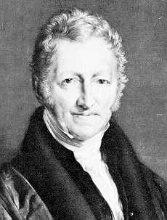
    Populations are ultimately regulated to control exponential growth -- Malthus’ book in 1798
Malthus(1766-1834) was a English economist and demographer who noted that potential for populations to increase rapidly and often faster than the available food supply. His book “An essay on the Principle of a Population” greatly influenced Darwin when Darwin was coming to grasp with the theory of natural selection.
"...in all societies, even those that are most vicious, the tendency to a virtuous attachment is so strong that there is a constant effort towards an increase of population. This constant effort as constantly tends to subject the lower classes of the society to distress and to prevent any great permanent amelioration of their condition."
Notes:
Virtuous attachment, indeed. Quite the romantic!

Slide 30
Malthus thought that higher growth rates in the U.S. were due to better living conditions, ”where the means of subsistence have been more ample, the manners of the people, more pure, and consequently the checks on early marriage fewer.”
On the other hand, Malthus imagined an Englishman considering whether he can afford to marry and have children or whether “he may not see his offspring in rags and misery, and clamouring for the bread that he cannot give them..... These considerations are calculated to prevent a very great number from pursuing the dictate of nature in an early attachment to one woman. And this restraint almost necessarily, though not absolutely so, produces vice.”
Thomas Malthus, 1798, from his book “An essay on the principle of population.”

Slide 31
What you need to remember is:
Malthus was a demographer from around 1800 who studied population growth in England and the United States.
He wrote an influential book on population dynamics in which he suggested that food or other resources limit population growth.
He also specifically noted that as population density increases, the quality of conditions decrease because of competition for resources.
For humans, he suggested that this leads to men postponing marriage, increases in crime and disease, while also lowering moral standards.

Slide 32
What happens if 1/N dN/dt isn’t constant, but changes with density?
Remember that r = b-d
Exponential -- r is constant
1/N dN/dt
density

Slide 33
What happens if 1/N dN/dt isn’t constant, but changes with density?
Remember that r = b-d
Exponential -- r is constant
declines with density
1/N dN/dt
0
density

Slide 34
What happens if 1/N dN/dt isn’t constant, but changes with density?
Remember that r = b-d
Exponential -- r is constant
declines with density
0
1/N dN/dt
b
b
d
d
density

Slide 35
What happens if 1/N dN/dt isn’t constant, but changes with density?
Remember that r = b-d
Exponential -- r is constant
declines with density
0
1/N dN/dt
b
Death controls abundances
b
d
d
Birth controls abundances
density

Slide 36
II. Tools for Ecology
A. Population demography: describing populations.
1. Definitions
2. Demography
a. distribution, dispersion, and density
b. gender and age
c. population growth
i) density independent growth (exponential)
ii) density dependent growth

Slide 37
How do we model limits to growth? We know that growth slows when the population density gets higher (i.e., density dependent). How does it do this?
The math is actually easy and make sense, with a little thought. Remember that continuous exponential growth is:
We can model simple density dependent growth by adding a term to slow growth as density increases:

Slide 38
If r = 1 and we start with 1 individual (note that with exponential growth, the population would just double)
This is called the logistic equation:
As the population increases, the population growth rate first increases, then decreases

Slide 39
Three ways to look at logistic growth
time
Density or time
r
density (N)
K

Slide 40
Logistic growth equation is very useful because it describes density dependent growth in a very simple way.
Forget the math, for a moment. Biologically, what is going on?
What does r represent?
What does K represent?
What might affect each?
innate ability to grow if unrestricted
N that can be supported by envir.
Both r and K can be affected by factors such as resources and climate. Or genetics, as the Vila paper demonstrated.

Slide 41

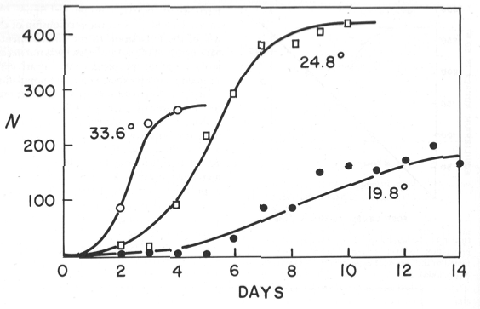
Growth of populations of Moina macrocopa at three temperatures (from Hutchinson). Does temperature affect r or K?
Notes:
Here is one of my favorite examples showing how temperature affects r and K for the growth of small crustaceans Moina (kind of like Daphnia). How does temperature affect r? (r increases with temperature). How does it affect K (there is an intermediate peak in K with temperature).

Slide 42
Exponential Growth
dN/dt = rN
N_{t} = N₀e^{rt}
Logistic Growth
Notes:
Some version of these curves will undoubtably be on the first exam.

Slide 43
Study Guide Items from Lecture 3
Terms:
Concepts:
  Malthus and limits to population growth
  Different equations and graphs for growth curves (slide 42)
  What do terms mean in growth equations (r and K)
  Different species or conditions can change r and K
  Density dependent vs. density independent growth
Case Studies:
  human population growth (including Von Foerster doomsday equation)
  Vilas et al, growth in Scandanavian wolf populations (bottleneck)
  Logistic growth in Moina, where r and K were affected by temperature.
Exponential growth Continuous growth Density dependent growth R₀ Overlapping generations | Logistic growth Discrete growth Density independent growth Per-capita growth Genetic bottleneck
Notes:
43

