Slide 1
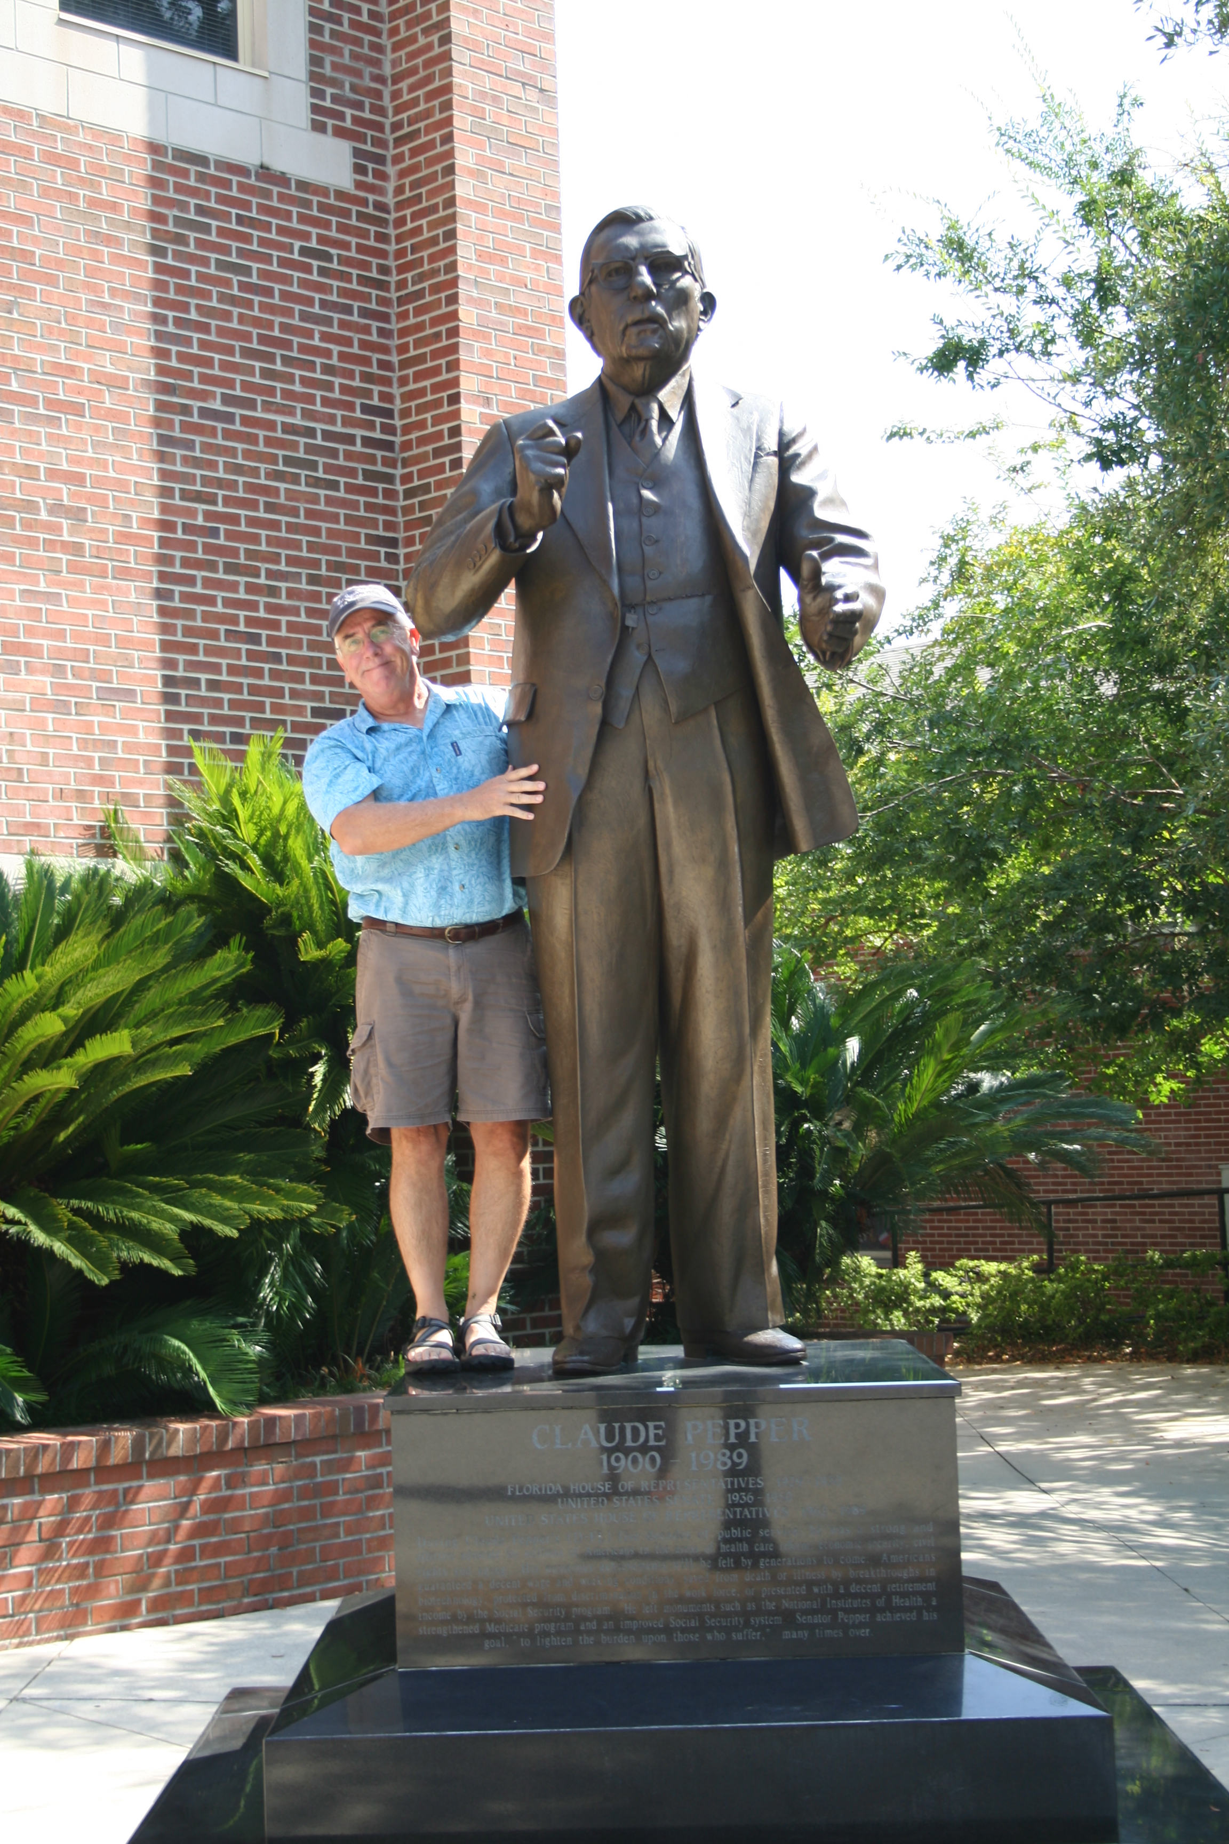
Lecture 2. September 8, 2016
-- Friday, September 9, 4:00 pm, 1024 KIN—Seminar by Abigail Pastore on how competitors evolve.
-- The Seminar Report assignment is posted on blackboard.
-- First Outside Assignment is posted on Blackboard and is NOW due Sept 13th.
-- A scientific paper to read for class is now also posted to blackboard. This paper is by Carles Vila and co-authors and looks at grey wolf populations in Scandanavia.

Slide 2
I. What is Ecology? (last week)
A. Definition of Ecology
B. History of Ecology

Slide 3
I. What is Ecology?
II. Tools for Ecology (think – how can we compare populations?)
A. Population demography: describing populations.
1. Definitions:
Population = a group of (interbreeding) individuals found in the same space or area at the same time
Demography = the study of the age structure and growth rate of populations

Slide 4
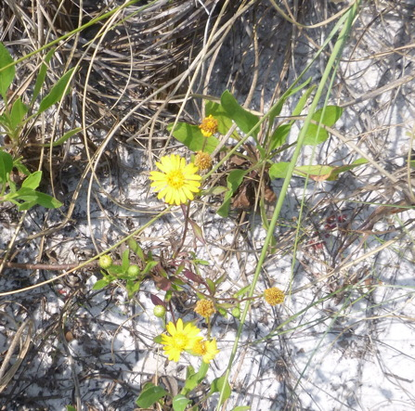
Percent cover of Camphor Weed on St. George Island since 1999

Slide 5
Percent cover of Camphor Weed on St. George Island since 1999
Hurricane years!

Slide 6
II. Tools for Ecology
A. Population demography: describing populations.
1. Definitions
2. Demography -- tools to describe populations
a. 3 - D’s: Distribution, dispersion, and density
Density = the number of individuals in relation to the space or volume in which they occur
Distribution = the geographic and ecological range of a population
Dispersion = the spacing of individuals with respect to one another.
Notes:
Distribution of a population describes its geographic and ecological range, primarily determined by suitable conditions or “habitats” for individuals of the species. We might say that the distribution of the American Crocodile was quite limited, mostly in the peninsula of Florida, the Big Cypress Swamp and in the Everglades. The example from the book discusses the European starling and how its distribution has changed through the first half of the 20th century (Figure 14.1).
Dispersion refers to the spacing of individuals with respect to one another. That is, are individuals clumped or highly dispersed. For example, some birds are highly territorial and nests are overdispersed. Other birds tend to nest in colonies and have clumped distributions. And, of course, patterns of dispersion can vary with factors such as time of the season or food availability. The example in the book shows difference scales of the distribution of the shrub, Clematis (leather leaf), showing that individuals are clustered into glades and to clumps within glades.
Density is the number of individuals per unit area. For example, there is something like 24 Florida Panthers thought to remain in the Everglades. Divide this into the total size of the everglades (10,000 km2) and you would get numbers of panthers per square kilometer (0.0025). This is density. Another example is the density of humans on earth. Here I add another factor, time, showing that the numbers of individuals are somewhat increasing as of late.

Slide 7
II. Tools for Ecology
A. Population demography: describing populations.
1. Definitions
2. Demography -- tools to describe populations
a. 3 - D’s: Distribution, dispersion, and density
Density = the number of individuals in relation to the space or volume in which they occur
Distribution = the geographic and ecological range of a population
Dispersion = the spacing of individuals with respect to one another.
Notes:
Distribution of a population describes its geographic and ecological range, primarily determined by suitable conditions or “habitats” for individuals of the species. We might say that the distribution of the American Crocodile was quite limited, mostly in the peninsula of Florida, the Big Cypress Swamp and in the Everglades. The example from the book discusses the European starling and how its distribution has changed through the first half of the 20th century (Figure 14.1).
Dispersion refers to the spacing of individuals with respect to one another. That is, are individuals clumped or highly dispersed. For example, some birds are highly territorial and nests are overdispersed. Other birds tend to nest in colonies and have clumped distributions. And, of course, patterns of dispersion can vary with factors such as time of the season or food availability. The example in the book shows difference scales of the distribution of the shrub, Clematis (leather leaf), showing that individuals are clustered into glades and to clumps within glades.
Density is the number of individuals per unit area. For example, there is something like 24 Florida Panthers thought to remain in the Everglades. Divide this into the total size of the everglades (10,000 km2) and you would get numbers of panthers per square kilometer (0.0025). This is density. Another example is the density of humans on earth. Here I add another factor, time, showing that the numbers of individuals are somewhat increasing as of late.

Slide 8
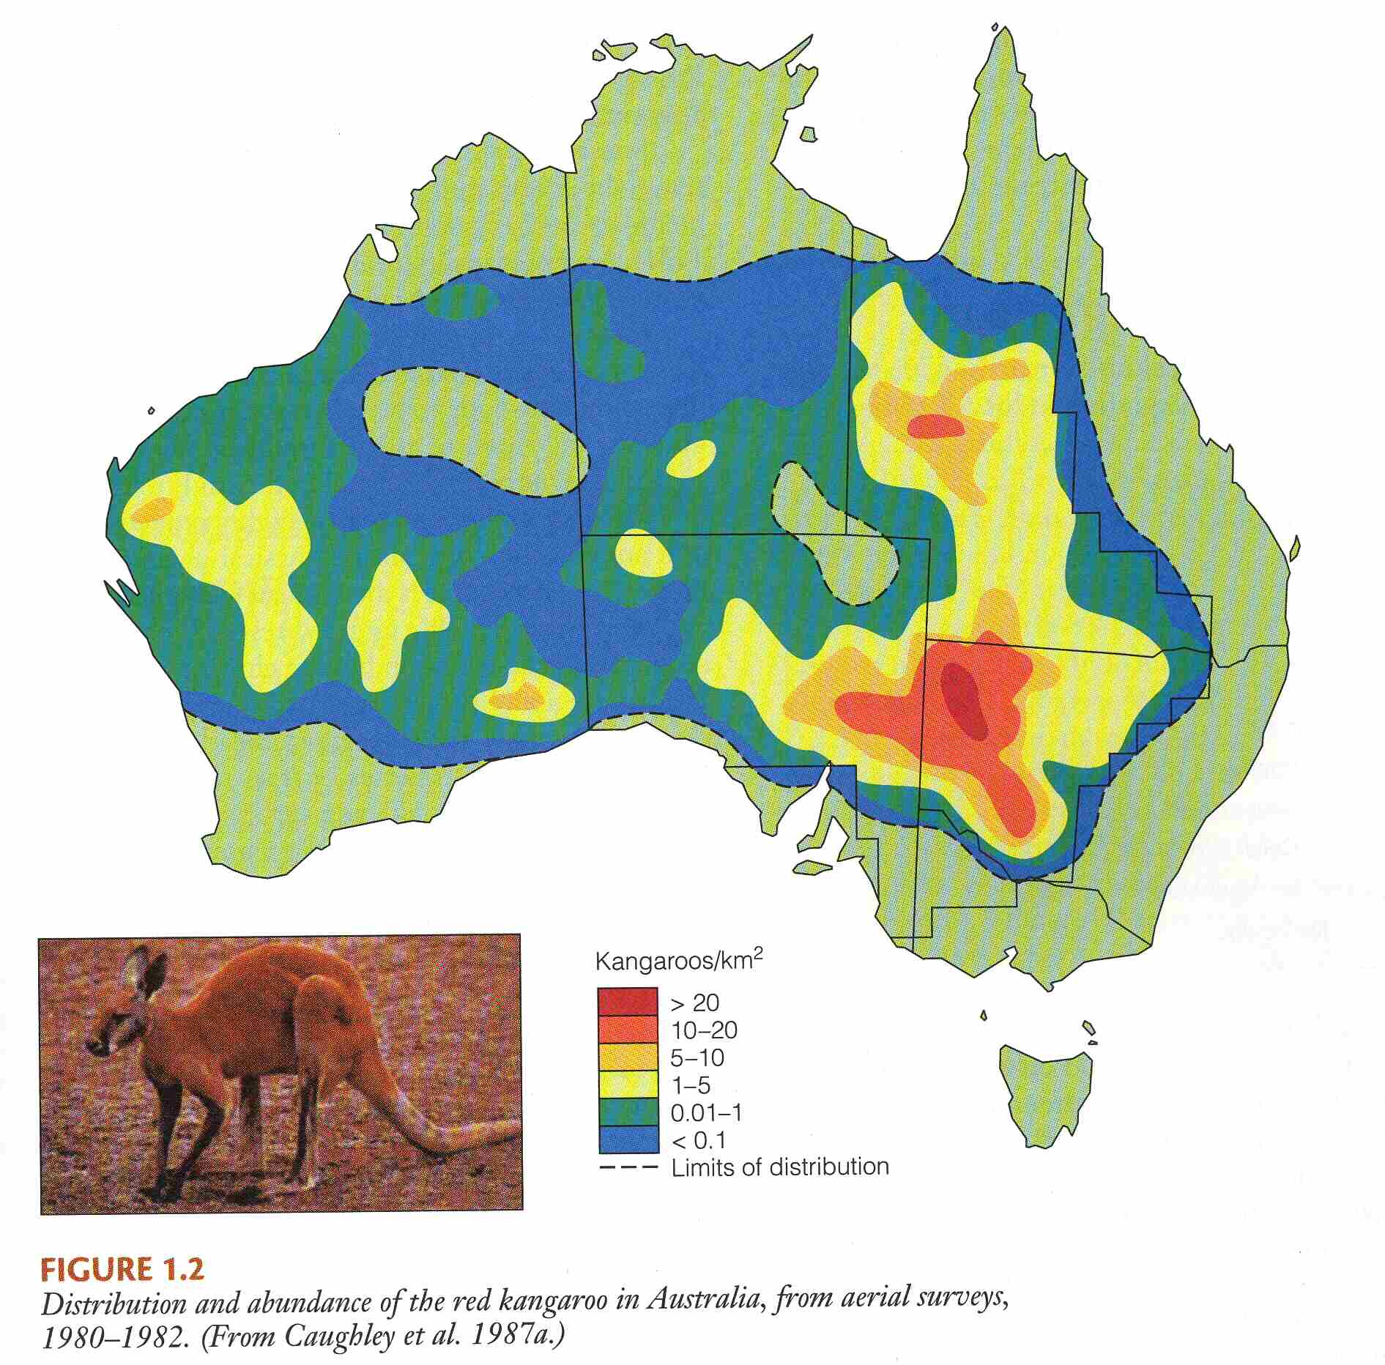
Density and Distribution of
Red Kangaroos in Australia

Slide 9
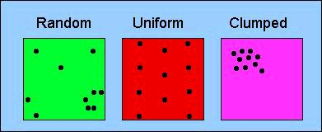
II. Tools for Ecology
A. Population demography: describing populations.
1. Definitions
2. Demography -- tools to describe populations
a. 3 - D’s: Distribution, dispersion, and density
Dispersion = the spacing of individuals with respect to one another.
Notes:
Distribution of a population describes its geographic and ecological range, primarily determined by suitable conditions or “habitats” for individuals of the species. We might say that the distribution of the American Crocodile was quite limited, mostly in the peninsula of Florida, the Big Cypress Swamp and in the Everglades. The example from the book discusses the European starling and how its distribution has changed through the first half of the 20th century (Figure 14.1).
Dispersion refers to the spacing of individuals with respect to one another. That is, are individuals clumped or highly dispersed. For example, some birds are highly territorial and nests are overdispersed. Other birds tend to nest in colonies and have clumped distributions. And, of course, patterns of dispersion can vary with factors such as time of the season or food availability. The example in the book shows difference scales of the distribution of the shrub, Clematis (leather leaf), showing that individuals are clustered into glades and to clumps within glades.
Density is the number of individuals per unit area. For example, there is something like 24 Florida Panthers thought to remain in the Everglades. Divide this into the total size of the everglades (10,000 km2) and you would get numbers of panthers per square kilometer (0.0025). This is density. Another example is the density of humans on earth. Here I add another factor, time, showing that the numbers of individuals are somewhat increasing as of late.

Slide 10
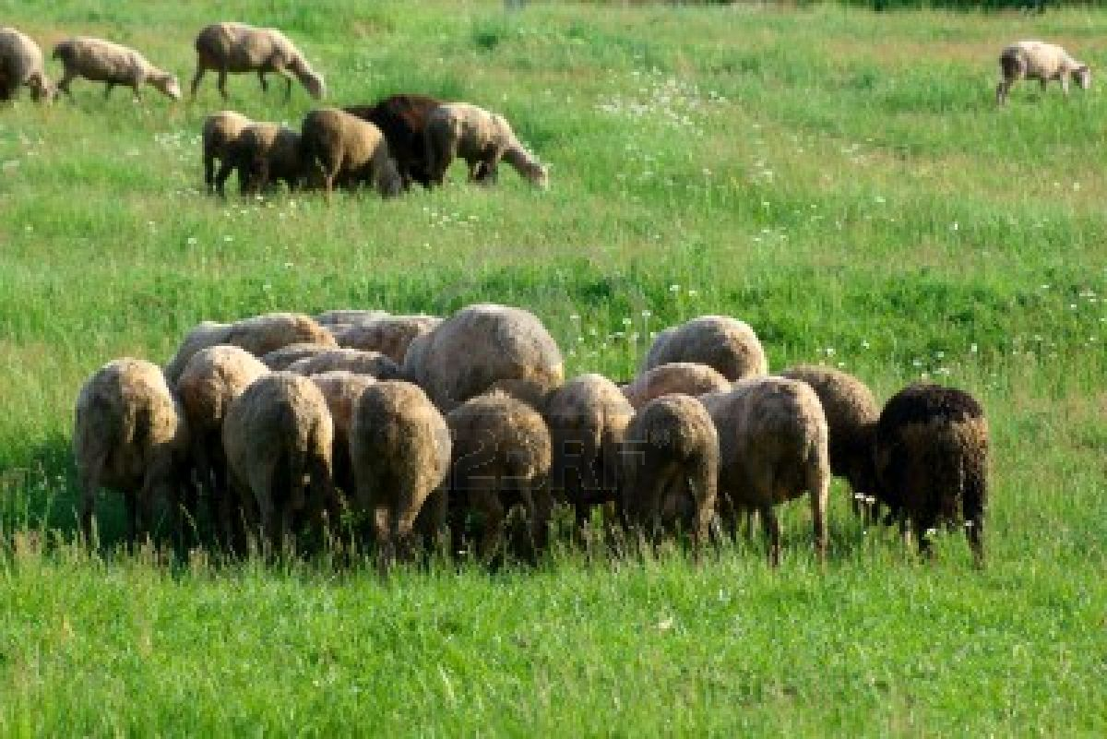
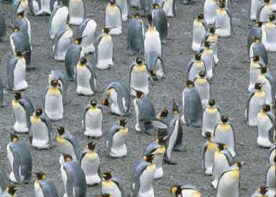
II. Tools for Ecology
A. Population demography: describing populations.
1. Definitions
2. Demography -- tools to describe populations
a. 3 - D’s: Distribution, dispersion, and density
Dispersion = the spacing of individuals with respect to one another.
Notes:
Distribution of a population describes its geographic and ecological range, primarily determined by suitable conditions or “habitats” for individuals of the species. We might say that the distribution of the American Crocodile was quite limited, mostly in the peninsula of Florida, the Big Cypress Swamp and in the Everglades. The example from the book discusses the European starling and how its distribution has changed through the first half of the 20th century (Figure 14.1).
Dispersion refers to the spacing of individuals with respect to one another. That is, are individuals clumped or highly dispersed. For example, some birds are highly territorial and nests are overdispersed. Other birds tend to nest in colonies and have clumped distributions. And, of course, patterns of dispersion can vary with factors such as time of the season or food availability. The example in the book shows difference scales of the distribution of the shrub, Clematis (leather leaf), showing that individuals are clustered into glades and to clumps within glades.
Density is the number of individuals per unit area. For example, there is something like 24 Florida Panthers thought to remain in the Everglades. Divide this into the total size of the everglades (10,000 km2) and you would get numbers of panthers per square kilometer (0.0025). This is density. Another example is the density of humans on earth. Here I add another factor, time, showing that the numbers of individuals are somewhat increasing as of late.

Slide 11
II. Tools for Ecology
A. Population demography: describing populations.
1. Definition: the study of the changing structure of populations
2. Demography -- tools to describe populations
a. 3 - D’s: Distribution, dispersion, and density
Density = the number of individuals in relation to the space or volume in which they occur
Distribution = the geographic and ecological range of a population
Dispersion = the spacing of individuals with respect to one another.
Notes:
Distribution of a population describes its geographic and ecological range, primarily determined by suitable conditions or “habitats” for individuals of the species. We might say that the distribution of the American Crocodile was quite limited, mostly in the peninsula of Florida, the Big Cypress Swamp and in the Everglades. The example from the book discusses the European starling and how its distribution has changed through the first half of the 20th century (Figure 14.1).
Dispersion refers to the spacing of individuals with respect to one another. That is, are individuals clumped or highly dispersed. For example, some birds are highly territorial and nests are overdispersed. Other birds tend to nest in colonies and have clumped distributions. And, of course, patterns of dispersion can vary with factors such as time of the season or food availability. The example in the book shows difference scales of the distribution of the shrub, Clematis (leather leaf), showing that individuals are clustered into glades and to clumps within glades.
Density is the number of individuals per unit area. For example, there is something like 24 Florida Panthers thought to remain in the Everglades. Divide this into the total size of the everglades (10,000 km2) and you would get numbers of panthers per square kilometer (0.0025). This is density. Another example is the density of humans on earth. Here I add another factor, time, showing that the numbers of individuals are somewhat increasing as of late.

Slide 12
Density = the number of individuals in relation to the space or volume in which they occur. This is often estimated, as it is really hard to count every individual in natural populations:
Example of how we estimate density using a “mark-recapture method”:
Individuals (numbering M) are captured, marked, and released.
We assume that they mix freely and completely with the rest of the population.
Then we capture some individuals again
Count the total number of individuals caught (n) and the number of those that were marked previously (x).
We now have three numbers: how many were originally marked, how many we captured and how many of the captured are marked. Now, what do we do?
Notes:
There are lots of ways to measure density. One that the book mentions and is kind of cute is the Peterson method or Lincoln index. When it is impossible to count entire populations because of their large size or area of distribution, one can estimate the total density using what are called “mark-recapture” or “capture-recapture” methods. Ideally, what the ecologist does is to set traps and capture individuals. These individuals (numbering M) are then released and we assume that they mix freely and completely with the rest of the population. Then we set up our traps again and count the total number of individuals caught (n) and the number of those that were marked previously (x). Then the total population size can be estimated as:
N=nM/x
Note that the units here are numbers*numbers/numbers. That is, this isn’t a density until the area in which the population exists is known and used to derive numbers/area. PAY ATTENTION TO UNITS.

Slide 13
Density = the number of individuals in relation to the space or volume in which they occur
Estimated population size is : N=nM/x
Basically, this is just using a simple equality:
Class Example:
# students in class = (# resampled * # Marked)/ # marked in resample

Slide 14
What problems exist with this method?
It made certain (poor) assumptions about:
-- distribution
-- dispersion
-- better with more marked individuals and larger re-sample
Similar but refined methods are still commonly used; many fisheries methods are referred to collectively as Jolly-Seber mark-recapture methods.

Slide 15
II. Tools for Ecology
A. Population demography: describing populations.
1. Definitions
2. Demography
a. distribution, dispersion, and density
How else might we usefully describe a population?
Notes:
Gender and Age: A population can be even better described by breaking down the population into subclasses. Give example from overhead of age/sex distributions of three countries from Krebs. Remember that we are trying to predict how populations will change with time, so what characteristics are important for determining births and deaths (as well as immigration and emigration)?

Slide 16
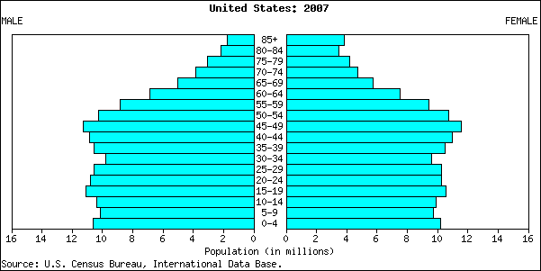
II. Tools for Ecology
A. Population demography: describing populations.
1. Definitions
2. Demography
a. distribution, dispersion, and density
b. gender and age
Notes:
What would this look like for students at FSU?

Slide 17
Notes:
55% women, as of 2010

Slide 18
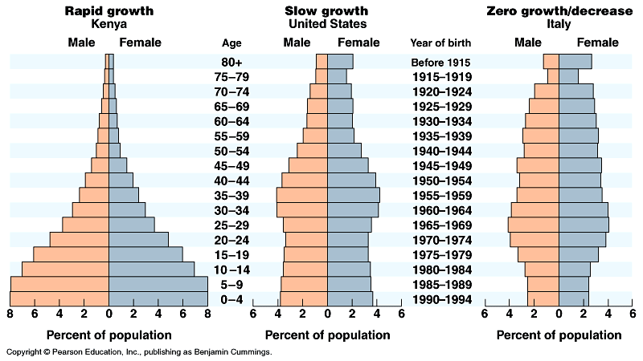
The age structure of populations affects their growth rate
About 80% of the human population is in countries where growth is rapid
Notes:
A great way to see how populations differ in age and gender simultaneously is to use what are called population pyramids. These show the number of individuals (or percent in different age classes) going up and down, with males on the left and females on the right. Here are population pyramids for three different countries, Kenya, the US, and Italy. The first two illustrate a really interesting difference between undeveloped and developed countries. In undeveloped countries, a combination of higher birth rates and higher mortality cause a larger proportion of the population to be in younger age classes, producing these broad based pyramids. Overall, countries with this sort of pattern have a much higher population growth rate. Countries like the United States have much lower birth rates and mortality (due to better access to health care), resulting in steep-sided pyramids, illustrating much longer life expectancy. Older people make up much more of the population in such countries. Italy is an extreme case of this, common to many European contries, which have a very low birth rate and now a net negative population growth rate.

Slide 19
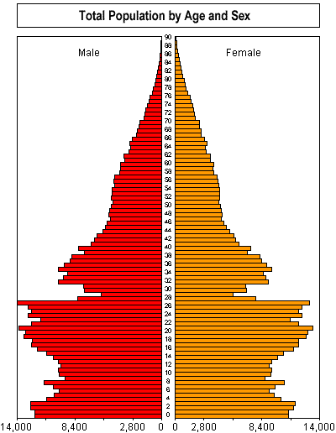
Population age-structure in China
http://www.iiasa.ac.at/Research/SRD/ChinaFood/data/anim/pop_ani.htm
1970 “Later-longer-fewer”
1979 “One child Policy”
Birth rate 1949 = 6 per female
Birth rate 1990 = 1.8 per female
Life expectancy 1949 = 35 yr
Life expectancy 1990 = 71.3
Current growth rate = 0.9% per yr
# in reproductive age classes expected to peak in 2010
Notes:
You can go online and find animated versions of these pyramids, showing how countries can shift from pyramids to more flat sided patterns as they develop (http://www.iiasa.ac.at/Research/SRD/ChinaFood/data/anim/pop_ani.htm). In particular, try countries like Mexico or Brazil that have developed quite a bit over the last 50 years. Here is an interesting example from China, which illustrates this sudden transition caused by political changes. China instituted extreme laws on the the number of children that couples could have. For a number of years, this really suppressed any children from being born, but ultimately the one-child policy has resulted in a fairly stable population structure, with a much longer expected life-span. The current population growth rate is still quite high, but coming down rapidly.

Slide 20
II. Tools for Ecology
A. Population demography: describing populations.
1. Definitions
2. Demography
a. distribution, dispersion, and density
b. gender and age
population pyramid link
Examples:
-- United States
-- Nigeria
-- Mexico
-- China

Slide 21
II. Tools for Ecology
A. Population demography: describing populations.
1. Definitions
2. Demography
a. distribution, dispersion, and density
b. gender and age
c. population growth
We already talked about this some – remember that:
growth rate = births – deaths
Notes:
Recognize that these patterns are caused by differential mortality of different age groups. Each age group can have a different rate of death and that this can be important in creating difference among populations US vs. Afghanistan). So, lets consider B-D not for entire populations, but for each age group within a population.

Slide 22
It is easy to confuse growth rates, birth rates, or death rates that are measured for populations OR for individuals.
Per individual rates are also called per-capita rates:
So the probability of an individual having offspring during some time period is:
b= per-capita birth rate
And the probability of an individual dying is:
d = per-capita death rate
Notes:
Recognize that these patterns are caused by differential mortality of different age groups. Each age group can have a different rate of death and that this can be important in creating difference among populations US vs. Afghanistan). So, lets consider B-D not for entire populations, but for each age group within a population.

Slide 23
We can just multiple each of these per-capita rates by the populations size (N) to get a rate for whole populations:
bN=population birth rate
dN = population death rate
With population, rather than per-capita rates, we can now figure out the growth rate of the entire population:
dN/dt = population births – population deaths
dN/dt = bN – dN (confusing use of “d” here!)
Notes:
Recognize that these patterns are caused by differential mortality of different age groups. Each age group can have a different rate of death and that this can be important in creating difference among populations US vs. Afghanistan). So, lets consider B-D not for entire populations, but for each age group within a population.

Slide 24
N =
Population
Size
time
But, what really is dN/dt?
Notes:
How does that relate to what can observe when we just follow density or population size through time? What is the growth rate of this population?

Slide 25
N =
Population
Size
Growth rate is a ratio of change in population size per unit time:
time
Slope of this relationship is also growth rate of the population, dN/dt

Slide 26
N =
Population
Size
dN
dt
time

Slide 27
dN
N =
Population
Size
time
dt

Slide 28
dN = 0
N =
Population
Size
time
dt

Slide 29
1 generation
Population Size
0 1 2 3 4 5 6
Year
We recognize that growth rate can change all the time (think of the population of Tallahassee), just as the slope of this line changes
Note that dN/dt is how much the population grows or changes. However, we may also want a measure of how each individual contributes to this growth, since it is the individuals that experience the “ecology” of their environment.

Slide 30
You have already had to think about per-capita rates. Remember a couple of slides back:
b= per-capita birth rate, d = per-capita death rate
bN=population birth rate, dN = population death rate
And, so . . . . . dN/dt = bN – dN
Well, now we want a per-capita term that includes both births and death contributions. If we move things around in the above equation, we get:
dN/dt = (b-d)N
We are going to call (b-d) by a new name, r (often called “little r”).
r = b-d
dN/dt = rN

Slide 31
Continuous growth
1 generation
Population Size
0 1 2 3 4 5 6
Year
Note that, if we divide dN/dt by N, we get the per-capita growth rate
dN/dt = r x N
or
1/N dN/dt = r
r is defined as the intrinsic rate of increase. Remember this, because we are going to use 3 different measures of population growth in this class and you need to keep them all straight!

Slide 32
Continuous growth
1 generation
Population Size
0 1 2 3 4 5 6
Year
dN/dt = r x N
What does r equal when the population is increasing?
What does r equal when the population is decreasing?
What does r equal when the population is stable?

Slide 33
Continuous growth
1 generation
Population Size
0 1 2 3 4 5 6
Year
dN/dt = r N
What does r equal when the population is increasing? positive
What does r equal when the population is decreasing? negative
What does r equal when the population is stable? 0

Slide 34
dN/dt = rN
is a very important equation that we will build on later. It is usually called the exponential growth equation because if r remains constant, it will describe a population that grows exponentially.
Note that the equation above is not the equation for this line, but for the slope of this line. Here is the equation for this line:
N_{t} = N₀e^{rt}
N or Population Size
Time

Slide 35
Do populations ever grow exponentially?
Notes:
NOTE that b is a per-individual rate. Often it is expressed as numbers per 1000 because it is easier to think about large numbers. So, for example, the fertility rate of humans is now around 22 births per 1000 individuals. This is easier to think about than
B = 0.022

Slide 36
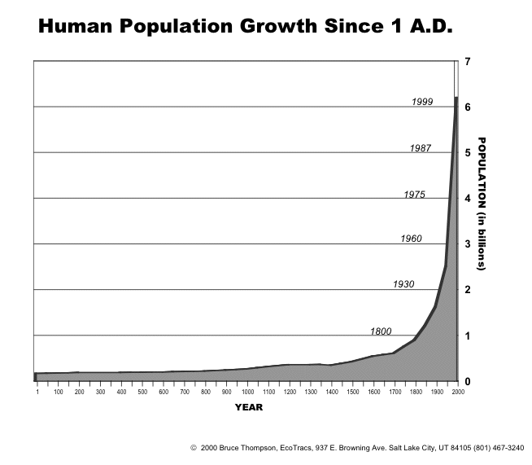
Notes:
NOTE that b is a per-individual rate. Often it is expressed as numbers per 1000 because it is easier to think about large numbers. So, for example, the fertility rate of humans is now around 22 births per 1000 individuals. This is easier to think about than
B = 0.022

Slide 37
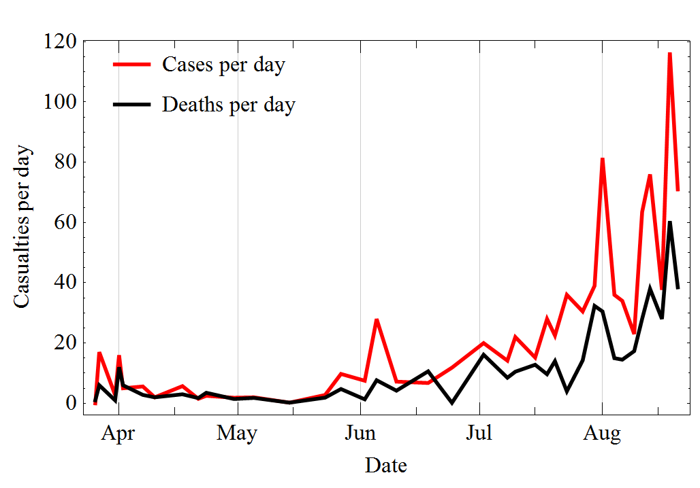
West African ebola cases two years ago.
Notes:
NOTE that b is a per-individual rate. Often it is expressed as numbers per 1000 because it is easier to think about large numbers. So, for example, the fertility rate of humans is now around 22 births per 1000 individuals. This is easier to think about than
B = 0.022

Slide 38
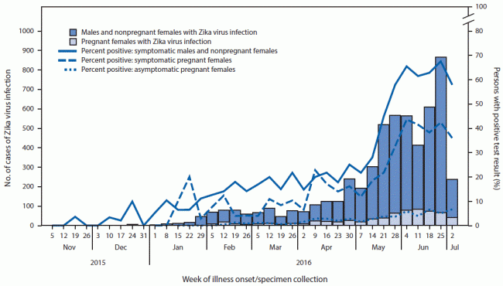
Zika cases in Puerto Rico.
Notes:
NOTE that b is a per-individual rate. Often it is expressed as numbers per 1000 because it is easier to think about large numbers. So, for example, the fertility rate of humans is now around 22 births per 1000 individuals. This is easier to think about than
B = 0.022

Slide 39
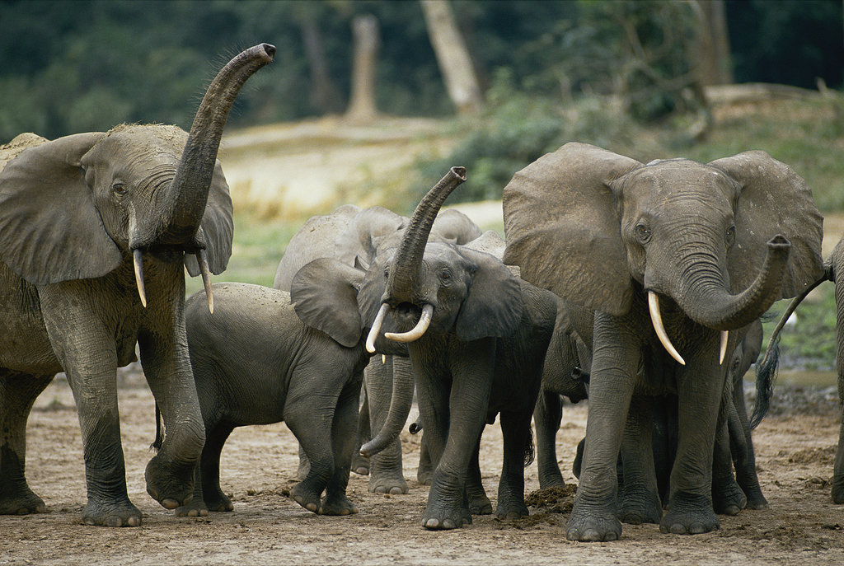
Elephant populations cannot recover quickly. You can read this article in the New York Times. They are declining at a rate of 8% per year. If all poaching stopped today, it would take 90 years for them to recover to 2002 numbers.

Slide 40
Note that an 8% rate of loss is a per-capita rate! Applying this shows that we can have exponential decline as well as growth.
Number of elephants
Year

Slide 41
Tools for Ecology
2. Demography
a. distribution, dispersion, and density
b. gender and age
c. population growth (r) – 4 processes
i. reproduction (births=b)
NOTE: b is a per-individual rate. Sometimes, it is expressed as numbers per 1000 because it is easier to think about large numbers. So, for example, the fertility rate of humans is now around 22 births per 1000 individuals. This is easier to think about than b = 0.022
Notes:
NOTE that b is a per-individual rate. Often it is expressed as numbers per 1000 because it is easier to think about large numbers. So, for example, the fertility rate of humans is now around 22 births per 1000 individuals. This is easier to think about than
B = 0.022

Slide 42
II. Tools for Ecology
2. Demography
a. distribution, dispersion, and density
b. gender and age
c. population growth – 4 processes
i. reproduction (b)
The addition of new individuals using reproduction is termed either:
-- fecundity = reproductive output under ideal conditions, limited by genetics, not the environment
-- fertility = the actual reproduction in a given environment. Note that it must be less or equal to the fecundity.
Notes:
NOTE that b is a per-individual rate. Often it is expressed as numbers per 1000 because it is easier to think about large numbers. So, for example, the fertility rate of humans is now around 22 births per 1000 individuals. This is easier to think about than
B = 0.022

Slide 43
II. Tools for Ecology
2. Demography
a. distribution, dispersion, and density
b. gender and age
c. population growth – 4 processes
i. reproduction (b)
ii. mortality (d)
d is also a rate. Think of it as the probability that an individual will die and, like b, it can be expressed per 1000 individuals. For example, in humans, d = 0.009.

Slide 44
II. Tools for Ecology
2. Demography
a. distribution, dispersion, and density
b. gender and age
c. population growth – 4 processes
i. reproduction (b)
ii. mortality (d)
Much of the ecology up until 1990 used just birth and death rates to understand population size. However, there has been a gradual emphasis on two other main factors that can affect population size.
What are they?

Slide 45
II. Tools for Ecology
2. Demography
a. distribution, dispersion, and density
b. gender and age
c. population growth – 4 processes
i. reproduction (b)
ii. mortality (d)
iii. immigration rate = number of individuals that join the population per unit time
iv. emigration rate = number of individuals that leave the population per unit time.

Slide 46
Thus, the rate of population change per individual (or per capita) is affected by all 4 of these things.
r = births – deaths + immigration – emigration
If movement between populations is negligible, then:
r = b – d

Slide 47
r = births – deaths + immigration – emigration
If there is no movement of individuals between different populations, then the numbers of individuals are determined by local processes (that is, births and deaths) and we can consider the population closed. Alternatively, if there is significant movement of individuals between populations, then the population is considered to be open.
This will come up again when we consider “metapopulations”, which are groups of local populations linked by migration. FOR NOW, LET’S ASSUME POPULATIONS ARE CLOSED.

Slide 48
II. Tools for Ecology
A. Population demography: describing populations.
1. Definitions
2. Demography
a. distribution, dispersion, and density
b. gender and age
c. population growth
So, now we have a convenient way of measuring population growth, either for the entire population:
dN/dt = rN or dN/dt = bN – dN (since r = b-d)
Or we can express this as per capita (per individual) growth by dividing by N:
1/N dN/dt = r
Notes:
Recognize that these patterns are caused by differential mortality of different age groups. Each age group can have a different rate of death and that this can be important in creating difference among populations US vs. Afghanistan). So, lets consider B-D not for entire populations, but for each age group within a population.

Slide 49
Study Guide Items from Lecture 2
Terms:
Concepts:
  Mark-recapture methods
  Assumptions of mark-recapture methods
  Population pyramids (developed and undeveloped countries)
  Open vs. closed populations
Case Studies:
  None!
Demography population growth rate fecundity fertility Immigration Emigration exponential growth | density dispersion distribution per-capita growth rate per-capita birth rate per-capita death rate r closed population open population
Notes:
49

