Slide 1
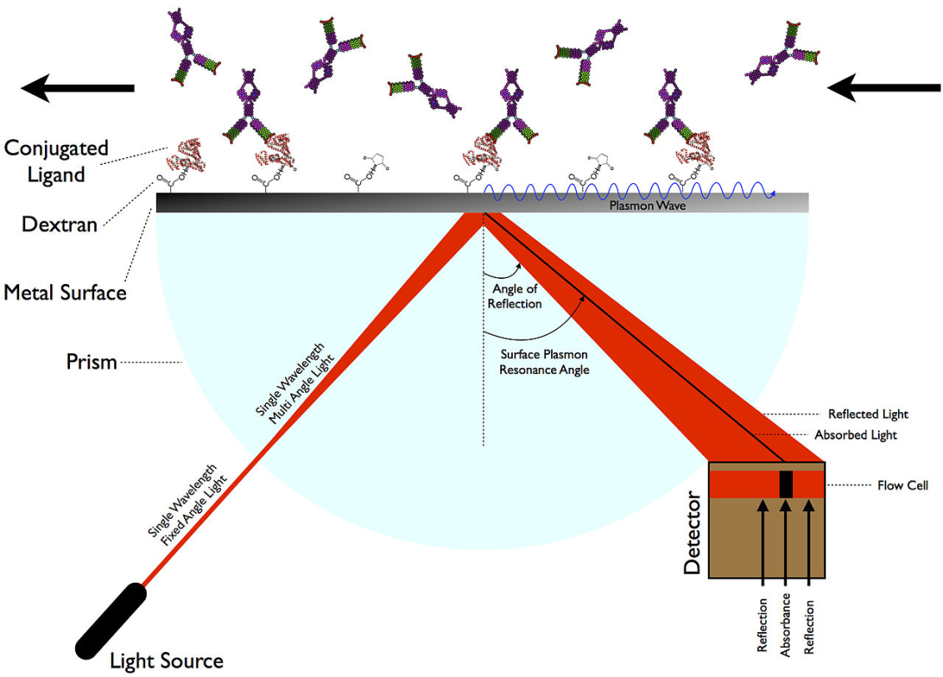
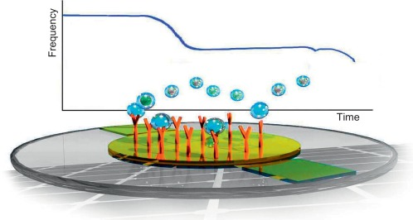
Surface Plasmon Resonance (SPR) and Quartz Crystal Microbalance (QCM)
Troy Lowry

Slide 2
The Need for Label-Free Biosensors
Label-Free Biosensors seek to:
have minimal preparation time (quick to setup)
avoid confounding effects of molecular probes
be robust and highly adaptable to a broad array of molecules
Two examples for today: Surface Plasmon Resonance and Quartz Crystal Microbalance

Slide 3
SPR is a label-free biosensing method that utilizes changes in refractive index in light caused by photon absorption by metal surface plasmons (surface electrons)
The analyte has to be no smaller than 100 g/mol

Slide 4
History of SPR
Early 1900’s R.M.Wood at Johns Hopkins University noted that dark and light banded patterns arose from polarized light was shone onto metal backed gratings
1950’s Pines and Bohm suggested energy losses due to oscillating, conducting electrons (plasmons)
1960’s Kretschmann and Otto demonstrated optical excitation of surface plasmons by total reflection
1980 – Pharmacia became interested in the technology and by 1984 developed a commercial SPR machine which would become Biacore
https://www.sprpages.nl/spr-overview/spr-history

Slide 5
Surface Plasmon Resonance – How It Works
SPR limit of detection is roughly 10 pg/mL

Slide 6
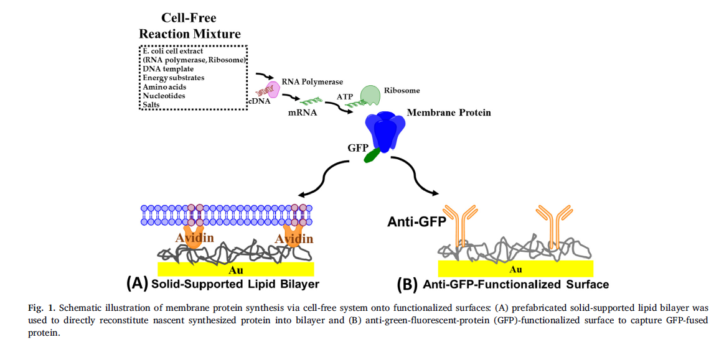
SPR Study of KcsA-Kv1.3
Vaish, A., S. B. Guo, et al. (2018). "On-chip membrane protein cell-free expression enables development
of a direct binding assay: A curious case of potassium channel KcsA-Kv1.3." Analytical Biochemistry 556: 70-77.

Slide 7
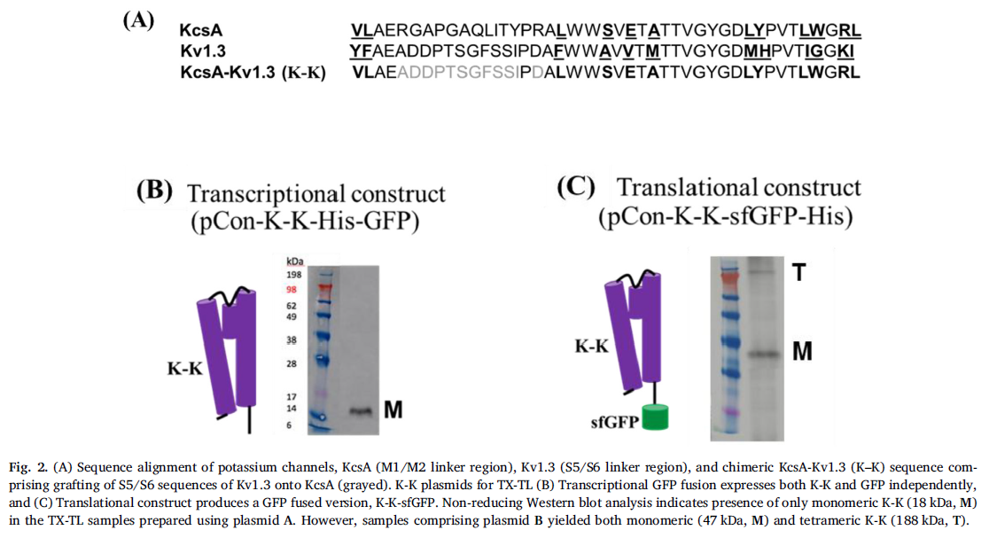
Sequencing the chimeric potassium channel
Vaish, A., S. B. Guo, et al. (2018). "On-chip membrane protein cell-free expression enables development
of a direct binding assay: A curious case of potassium channel KcsA-Kv1.3." Analytical Biochemistry 556: 70-77.

Slide 8
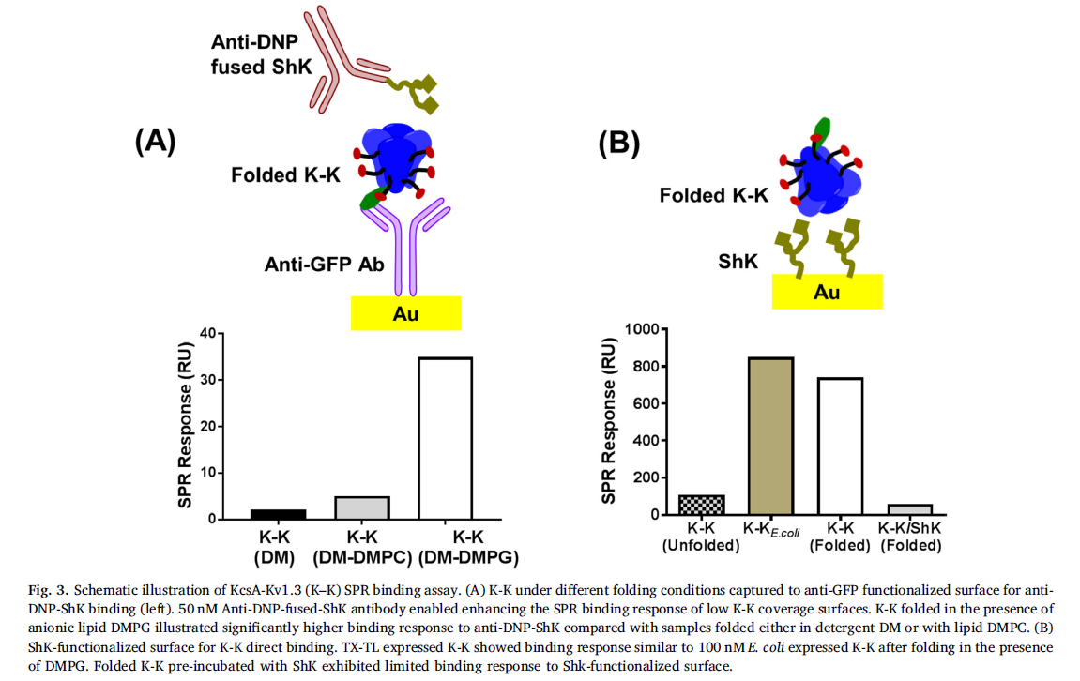
Binding of K-K in the presence of Phosphlipids
Vaish, A., S. B. Guo, et al. (2018). "On-chip membrane protein cell-free expression enables development
of a direct binding assay: A curious case of potassium channel KcsA-Kv1.3." Analytical Biochemistry 556: 70-77.

Slide 9
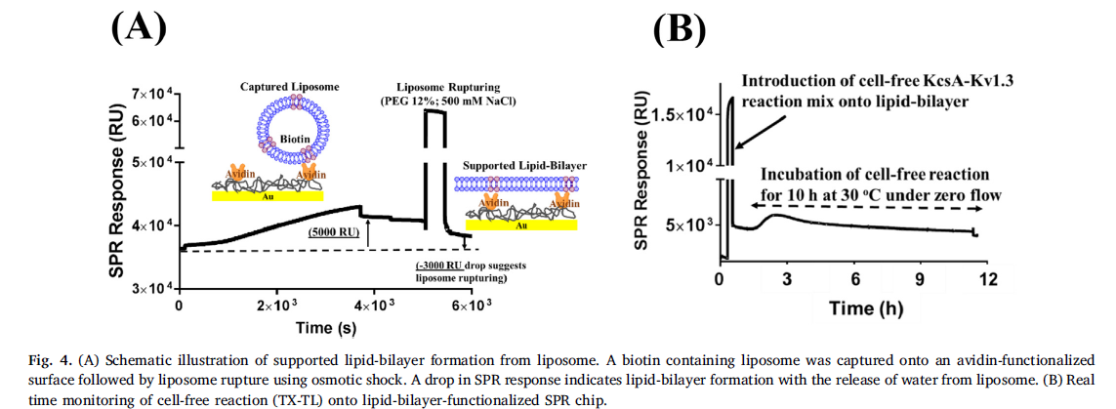
Immobilization onto SPR chip
Note: Response Unit is directly proportional to the concentration of biomolecules
on the surface
Vaish, A., S. B. Guo, et al. (2018). "On-chip membrane protein cell-free expression enables development
of a direct binding assay: A curious case of potassium channel KcsA-Kv1.3." Analytical Biochemistry 556: 70-77.

Slide 10
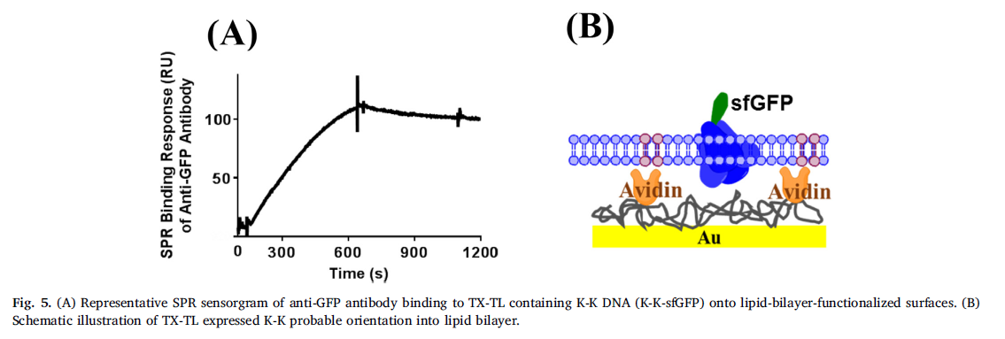
Binding of complementary antibody to K-K functionalized lipid bilayer
Vaish, A., S. B. Guo, et al. (2018). "On-chip membrane protein cell-free expression enables development
of a direct binding assay: A curious case of potassium channel KcsA-Kv1.3." Analytical Biochemistry 556: 70-77.

Slide 11
Real time monitory of K-K reaction mix onto anti GFP functionalized SPR surface
Vaish, A., S. B. Guo, et al. (2018). "On-chip membrane protein cell-free expression enables development
of a direct binding assay: A curious case of potassium channel KcsA-Kv1.3." Analytical Biochemistry 556: 70-77.

Slide 12
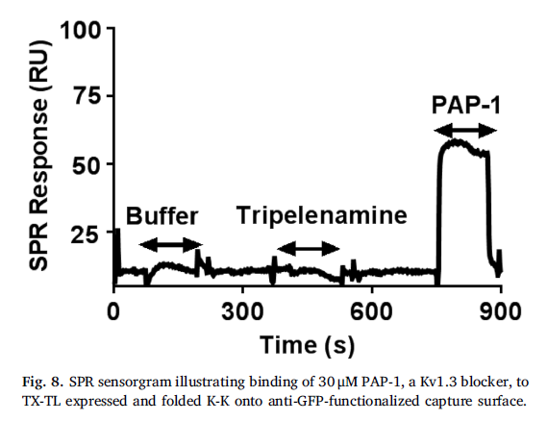
Kv1.3 blocker Pap-1 binds to K-K functional lipid extract
Vaish, A., S. B. Guo, et al. (2018). "On-chip membrane protein cell-free expression enables development
of a direct binding assay: A curious case of potassium channel KcsA-Kv1.3." Analytical Biochemistry 556: 70-77.

Slide 13
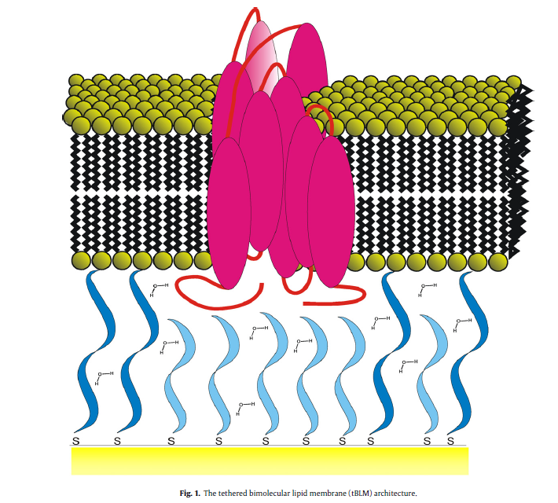
Tethered Lipid Bilayers onto SPR Chip
Knoll, W., I. Koper, et al. (2008). "Tethered bimolecular lipid membranes - A novel model membrane platform." Electrochimica Acta 53(23): 6680-6689.

Slide 14
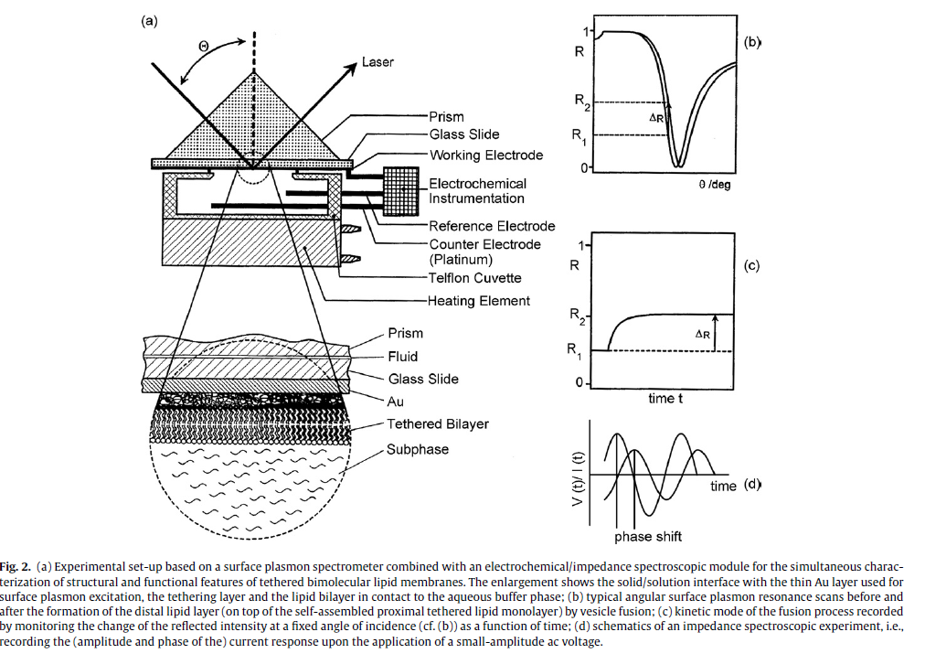
SPR + electrochemical/impedance spectroscopic module
Knoll, W., I. Koper, et al. (2008). "Tethered bimolecular lipid membranes - A novel model membrane platform." Electrochimica Acta 53(23): 6680-6689.

Slide 15
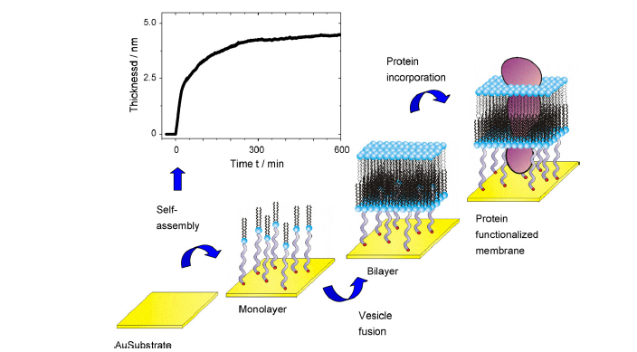
Knoll, W., I. Koper, et al. (2008). "Tethered bimolecular lipid membranes - A novel model membrane platform." Electrochimica Acta 53(23): 6680-6689.

Slide 16
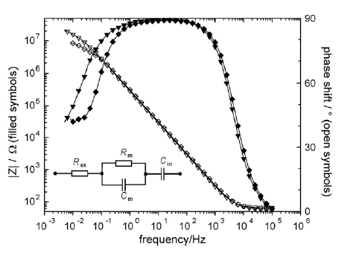
Impedance Spectroscopy
Knoll, W., I. Koper, et al. (2008). "Tethered bimolecular lipid membranes - A novel model membrane platform." Electrochimica Acta 53(23): 6680-6689.

Slide 17
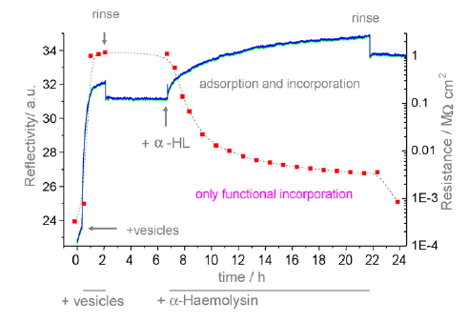
Tethered Lipid Bilayer and incorporation of alpha hemolysin
Knoll, W., I. Koper, et al. (2008). "Tethered bimolecular lipid membranes - A novel model membrane platform." Electrochimica Acta 53(23): 6680-6689.

Slide 18
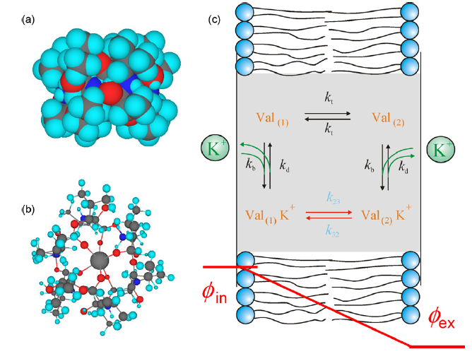
Translocation of K⁺ ions across the lipid bilayer by valinomycin
Knoll, W., I. Koper, et al. (2008). "Tethered bimolecular lipid membranes - A novel model membrane platform." Electrochimica Acta 53(23): 6680-6689.

Slide 19
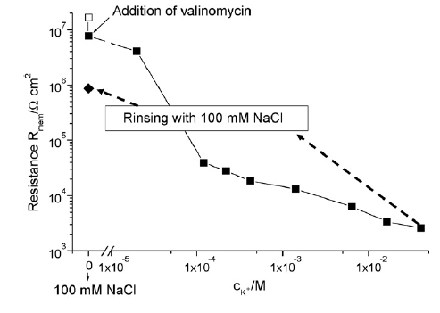
Specific Resistance of valinomycin-doped tethered bilayer lipid membrane
Knoll, W., I. Koper, et al. (2008). "Tethered bimolecular lipid membranes - A novel model membrane platform." Electrochimica Acta 53(23): 6680-6689.

Slide 20
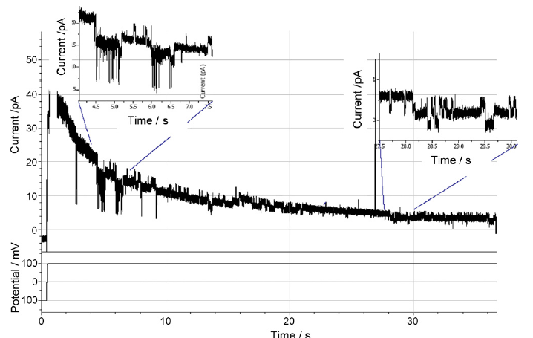
Patch clamp of tethered lipid membrane-doped with synthetic M2 (pentameric peptide
that mimics the channel part of the nicotinic acetylcholine receptor protein)
Knoll, W., I. Koper, et al. (2008). "Tethered bimolecular lipid membranes - A novel model membrane platform." Electrochimica Acta 53(23): 6680-6689.

Slide 21
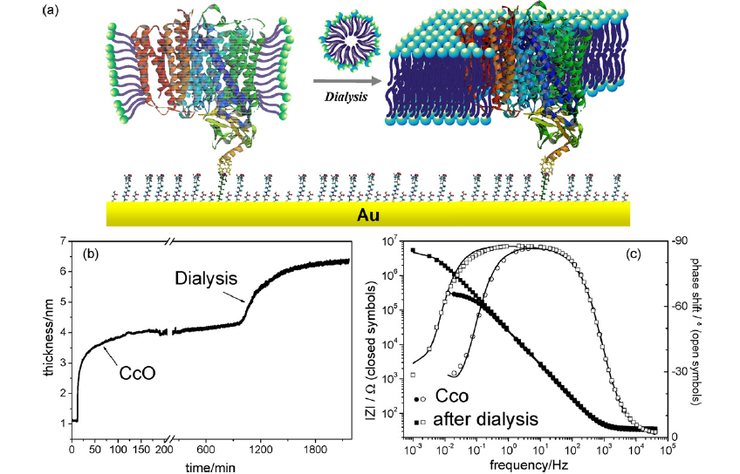
Tethered membranes via incorporated proteins!
Histidine loves NTA – this can control
the orientation
Knoll, W., I. Koper, et al. (2008). "Tethered bimolecular lipid membranes - A novel model membrane platform." Electrochimica Acta 53(23): 6680-6689.

Slide 22
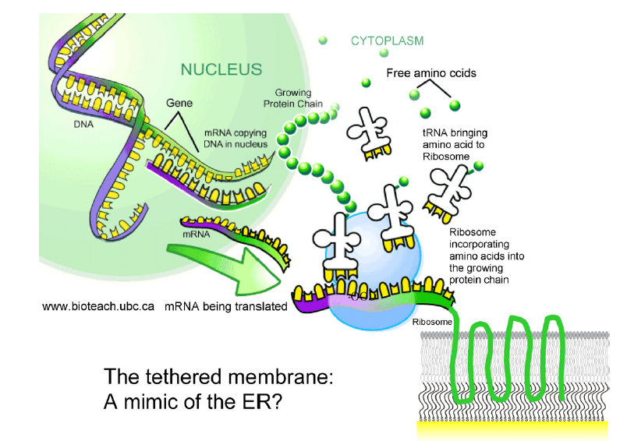
Cell-free expression of membrane proteins with immediate insertion into the tethered lipid bilayer
Knoll, W., I. Koper, et al. (2008). "Tethered bimolecular lipid membranes - A novel model membrane platform." Electrochimica Acta 53(23): 6680-6689.

Slide 23
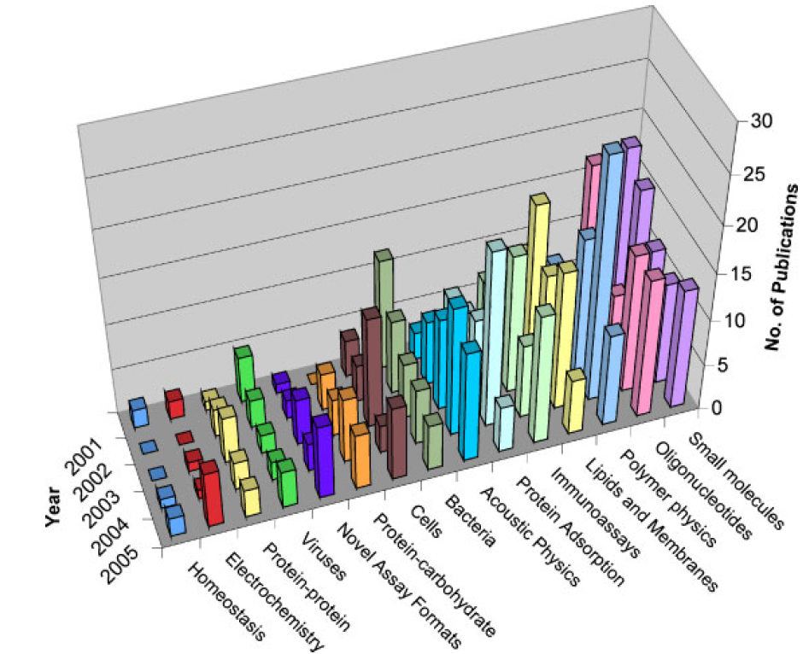
Quartz Crystal Microbalance – Types of Publications Referencing It
Cooper, M. A. and V. T. Singleton (2007). "A survey of the 2001 to 2005 quartz crystal microbalance biosensor literature: applications of acoustic physics to the analysis of biomolecular interactions." Journal of Molecular Recognition 20(3): 154-184.

Slide 24
What is QCM?
QCM is a biosensor that is based on acoustic transduction, meaning the binding
event (change in mass) is based upon changes in quartz crystal resonance.
It is label-free
Contact mechanics, interfacial dynamics, surface roughness, viscoelasticity, density
and mass monitored in real time

Slide 25
History of QCM
Sauerbrey in 1959 demonstrated a linear relationship between mass adsorbed to the surface
and the resonant frequency of the crystal in air or vacuum.
QCM was born.
Cooper, M. A. and V. T. Singleton (2007). "A survey of the 2001 to 2005 quartz crystal microbalance biosensor literature: applications of acoustic physics to the analysis of biomolecular interactions." Journal of Molecular Recognition 20(3): 154-184.

Slide 26
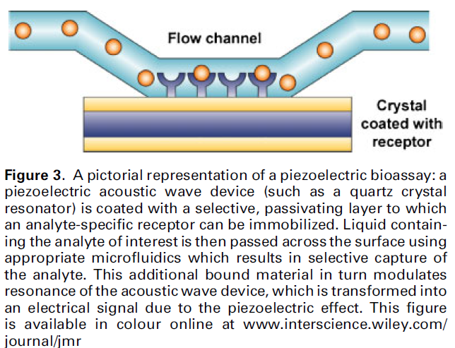
Typical Experimental Design of QCM
Cooper, M. A. and V. T. Singleton (2007). "A survey of the 2001 to 2005 quartz crystal microbalance biosensor literature: applications of acoustic physics to the analysis of biomolecular interactions." Journal of Molecular Recognition 20(3): 154-184.

Slide 27
QCM and Detection Limits for DNA Sequences
Cooper, M. A. and V. T. Singleton (2007). "A survey of the 2001 to 2005 quartz crystal microbalance biosensor literature: applications of acoustic physics to the analysis of biomolecular interactions." Journal of Molecular Recognition 20(3): 154-184.

Slide 28
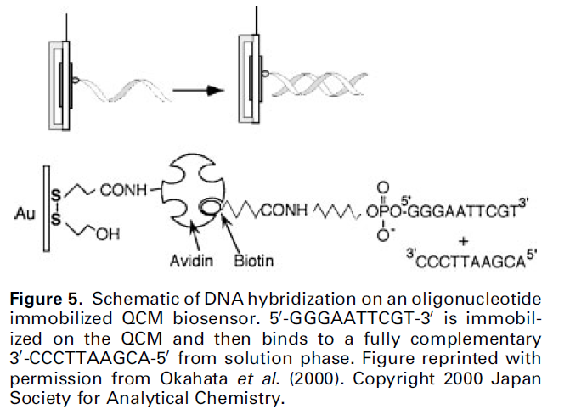
DNA hybridization on an oligonucleotide immobilized QCM biosensor
Cooper, M. A. and V. T. Singleton (2007). "A survey of the 2001 to 2005 quartz crystal microbalance biosensor literature: applications of acoustic physics to the analysis of biomolecular interactions." Journal of Molecular Recognition 20(3): 154-184.

Slide 29
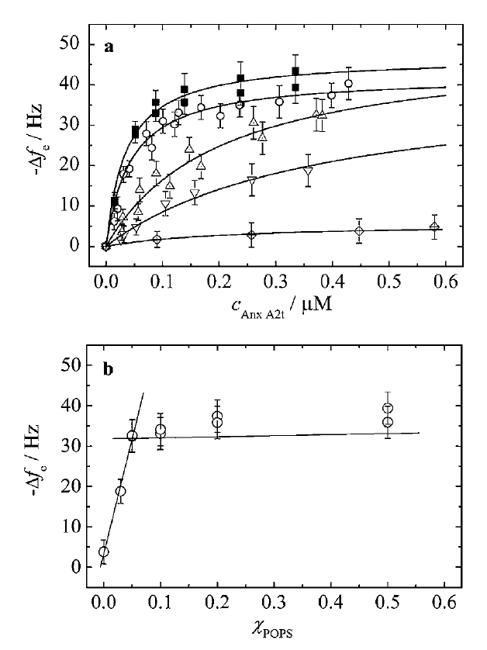
Affect of Annexin binding on POPC/POPS membranes
Cooper, M. A. and V. T. Singleton (2007). "A survey of the 2001 to 2005 quartz crystal microbalance biosensor literature: applications of acoustic physics to the analysis of biomolecular interactions." Journal of Molecular Recognition 20(3): 154-184.

Slide 30
QCM Detection Limits of Viruses and Phage
Cooper, M. A. and V. T. Singleton (2007). "A survey of the 2001 to 2005 quartz crystal microbalance biosensor literature: applications of acoustic physics to the analysis of biomolecular interactions." Journal of Molecular Recognition 20(3): 154-184.

Slide 31
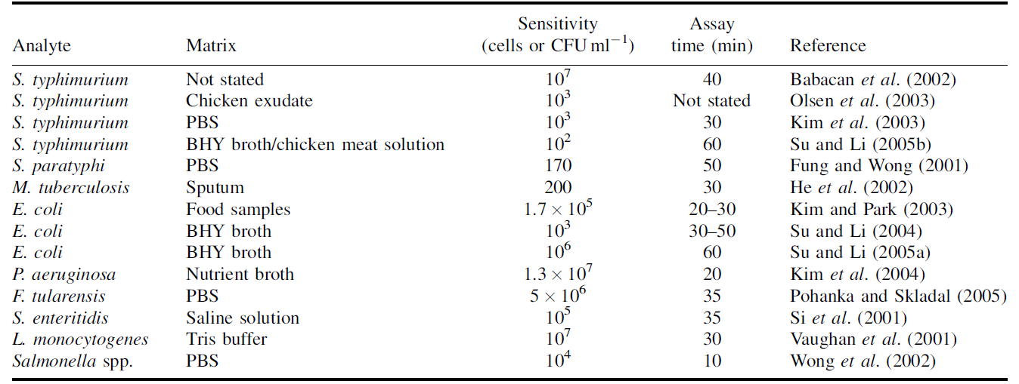
QCM can detect bacteria
Cooper, M. A. and V. T. Singleton (2007). "A survey of the 2001 to 2005 quartz crystal microbalance biosensor literature: applications of acoustic physics to the analysis of biomolecular interactions." Journal of Molecular Recognition 20(3): 154-184.

Slide 32
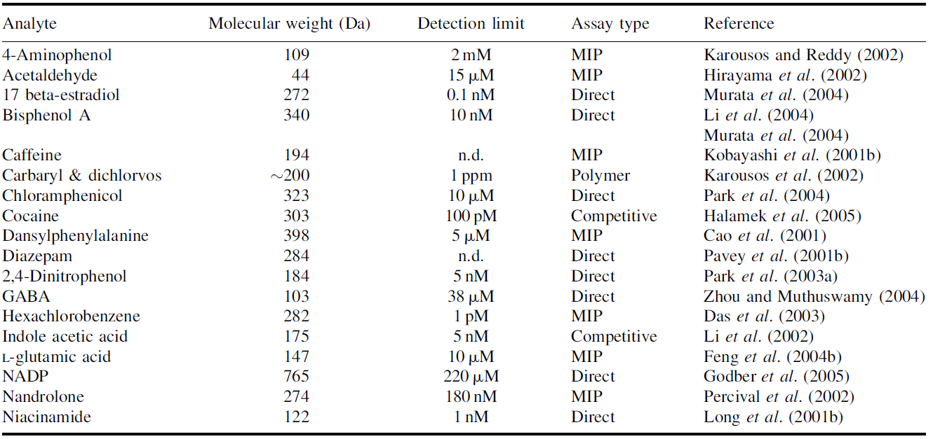
QCM Small Molecule Detection
Cooper, M. A. and V. T. Singleton (2007). "A survey of the 2001 to 2005 quartz crystal microbalance biosensor literature: applications of acoustic physics to the analysis of biomolecular interactions." Journal of Molecular Recognition 20(3): 154-184.

Slide 33
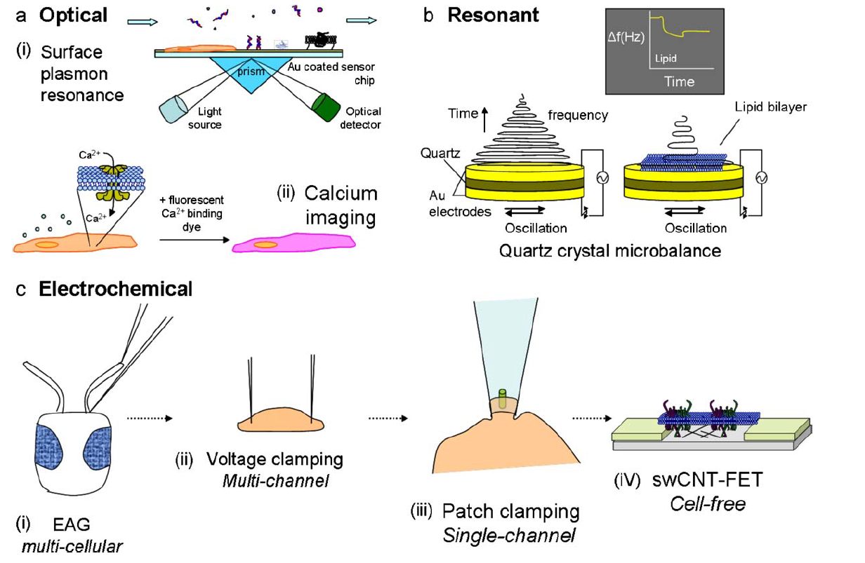
Application : Olfactory Biosensor Research
Glatz, R. and K. Bailey-Hill (2011). "Mimicking nature's noses: From receptor deorphaning to olfactory biosensing." Progress in Neurobiology 93(2): 270-296.

