Slide 1
Cl- Ion Channels
The Rodney Dangerfield of the Ion Channel Field
(They get no respect)

Slide 2
Brief history Cl⁻ Study and Interest
Cl- channels were mostly ignored until the ‘90s because it was thought that Cl− was usually in electrochemical equilibrium across cell membranes
This mis-impression occurred because many early studies on Cl−were performed on skeletal muscle and erythrocytes where resting Cl− permeability is very high so that even if there is active Cl− transport present, Cl− is in electrochemical equilibrium
In the 10-year interim between 1992 and 2001, Cl−channels had begun to acquire some respectability, largely because two Cl− channels linked to human disease, CFTR and ClC-1, were cloned

Slide 3
Brief history Cl⁻ Study and Interest
Cystic Fibrosis - Although the first indication that cystic fibrosis was an electrolyte disturbance was the discovery in 1953 that the sweat of CF patients was unusually salty, it was nearly 30 years before it was proposed that the disease was caused by a defect in Cl− transport years before it was shown to be a Cl− channelopathy (CFTR gene)

Slide 4
Brief history Cl⁻ Study and Interest
Myotonia Congenita - related to a defect in the skeletal muscle Cl− conductance by showing that myotonic muscle fibers had an increased membrane resistance and decreased Cl− conductance. In muscle, the Na+-K+ ATPase sets up transmembrane K+ gradients, and inwardly rectifying K+ channel establish the resting membrane potential (E_{m} ~ E_{K}). Because active Cl− transport is relatively small and the resting Cl− conductance is high, Cl− distributes passively across the plasma membrane (E_{Cl} = E_{m} ~ E_{K}) Because the Cl− conductance is several times larger than the K+ conductance, the Cl− battery acts as a very strong buffer of membrane potential.

Slide 6
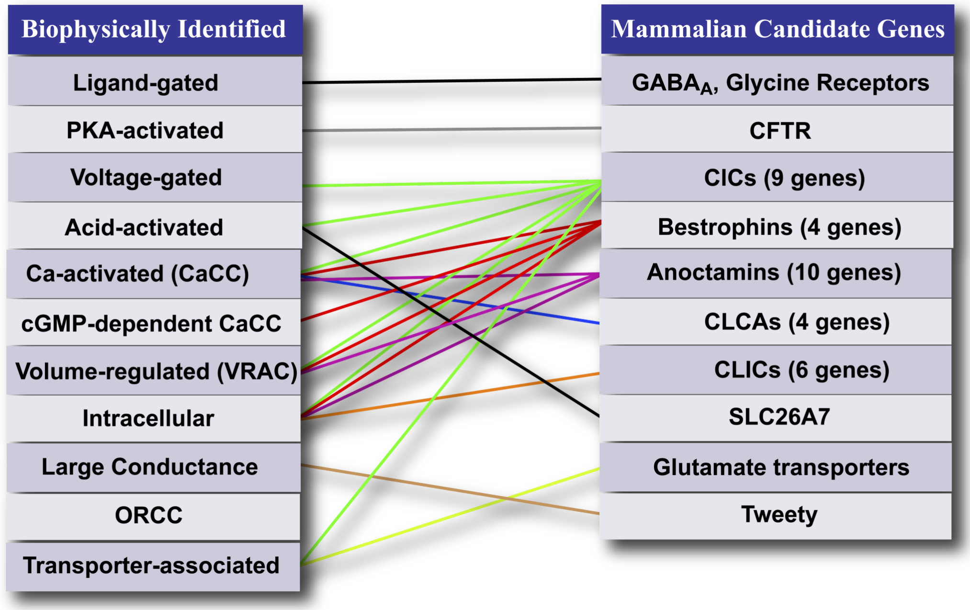
Overview of “channel” types

Slide 7
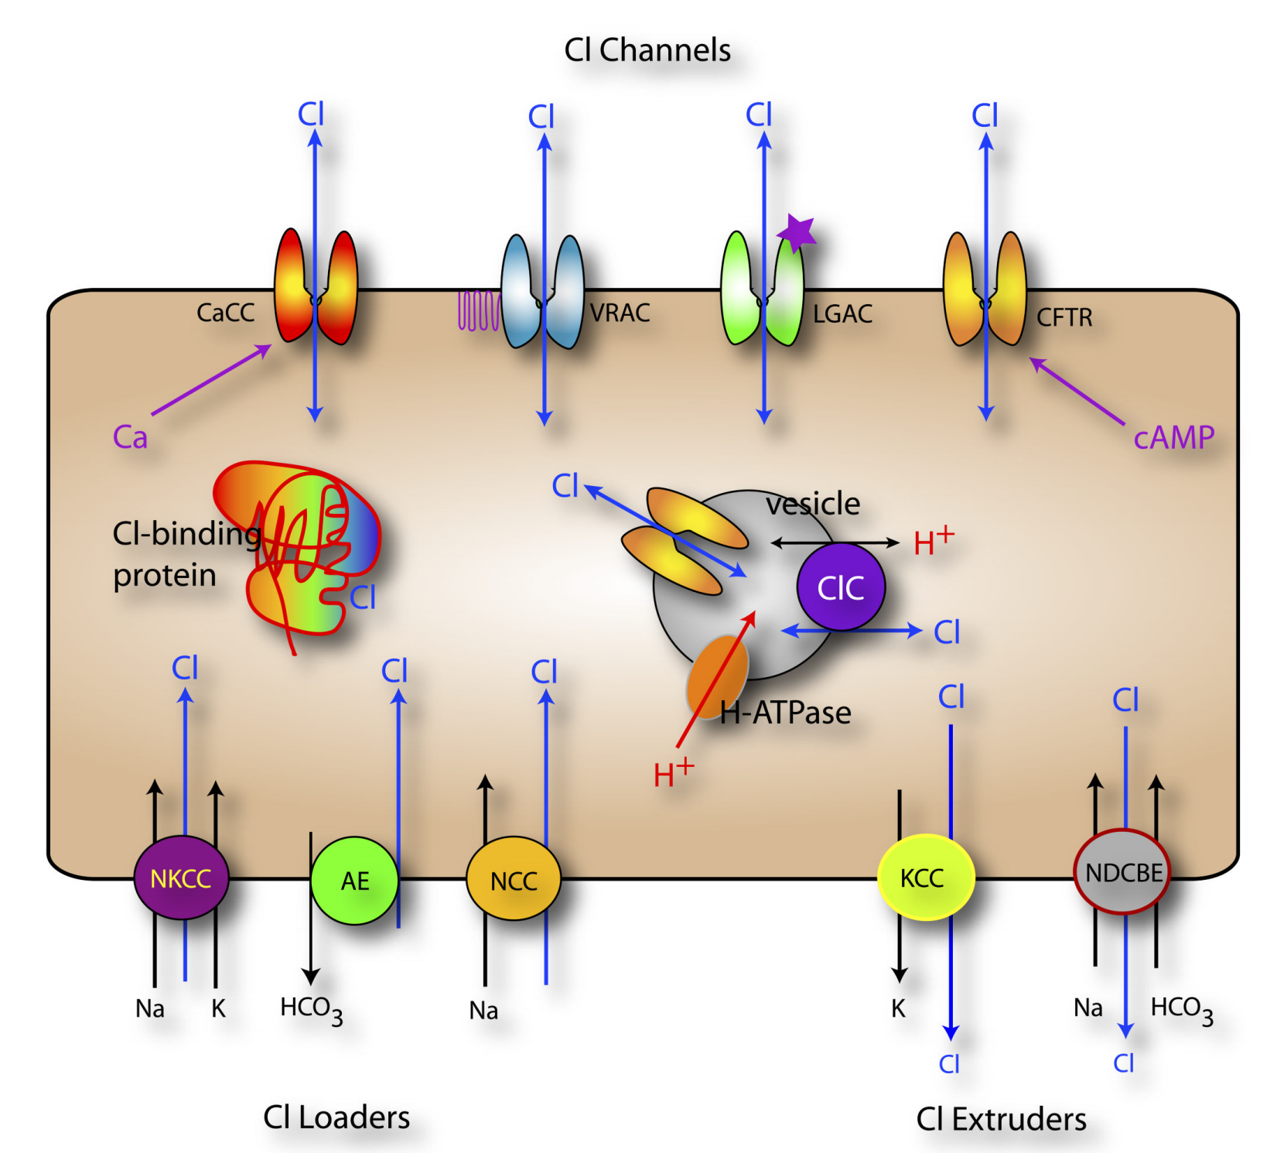

Slide 8
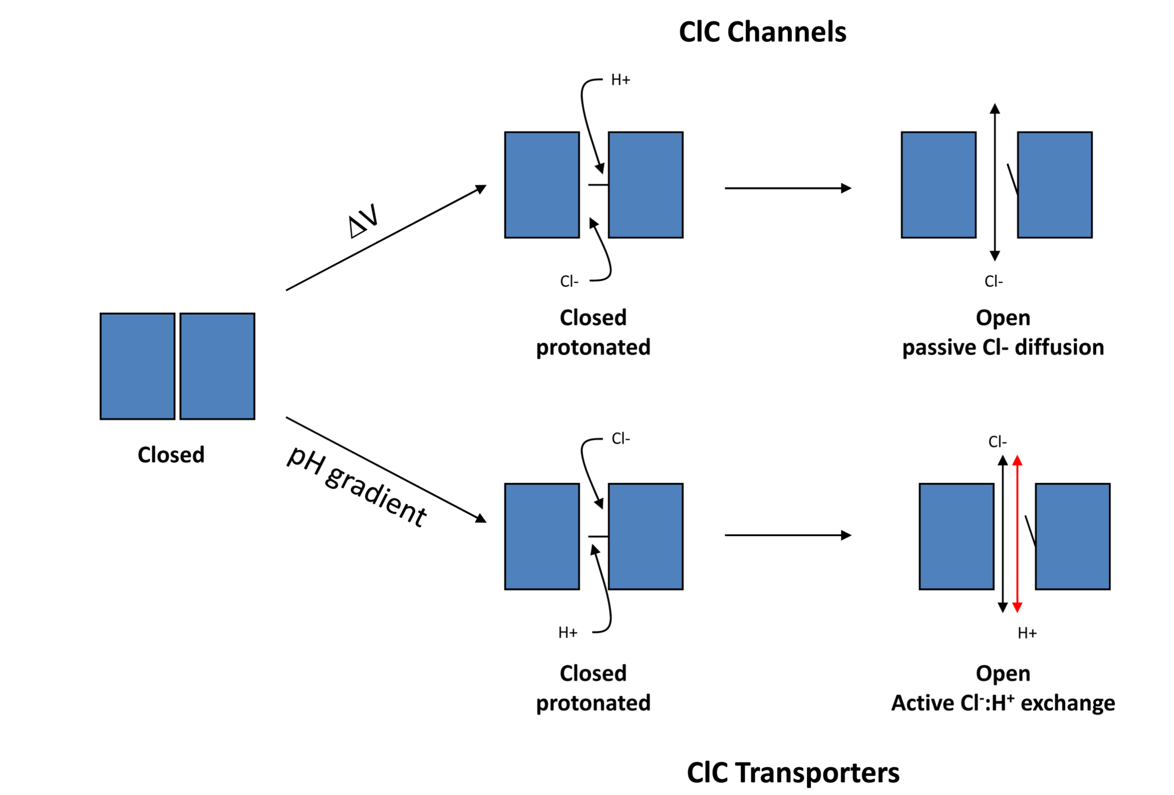

Slide 9
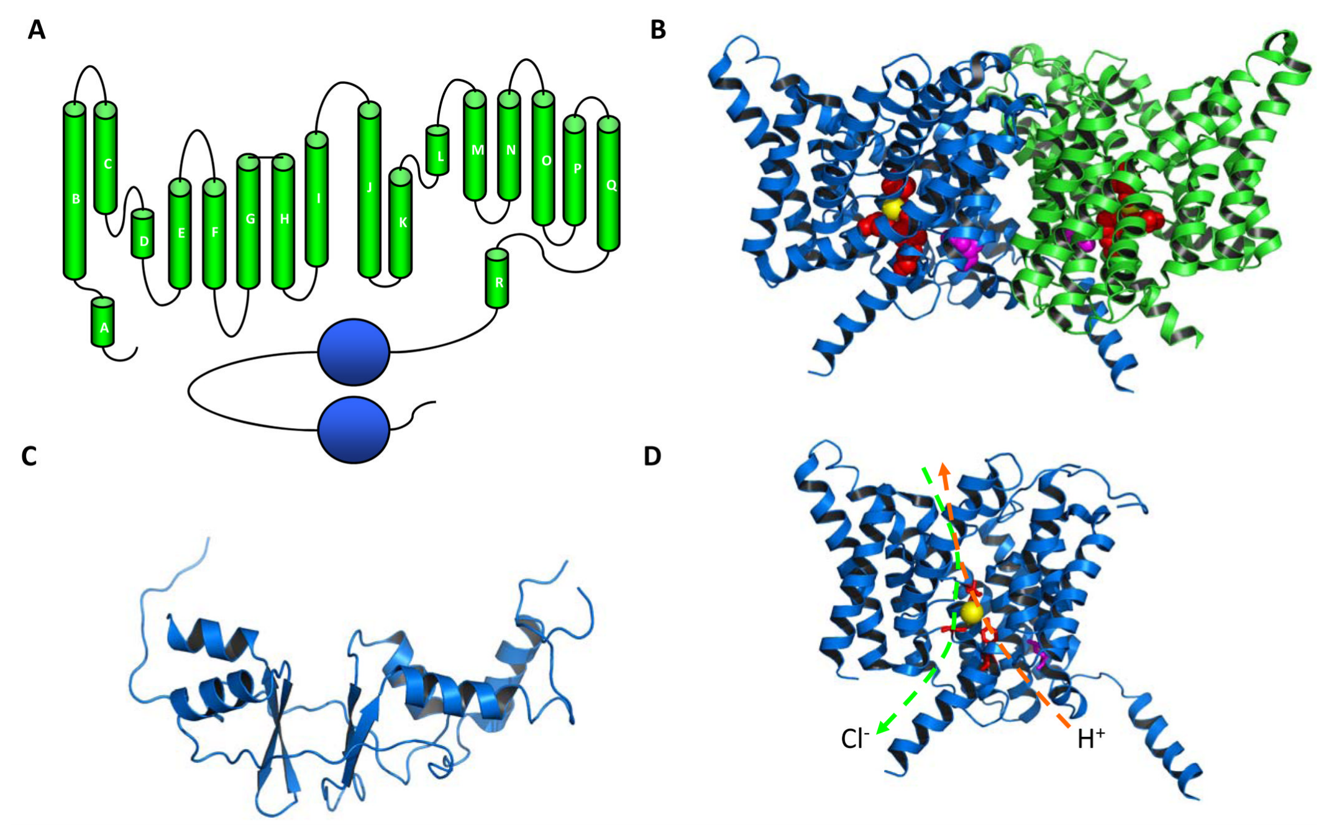
Basic structure of CLC Family

Slide 10
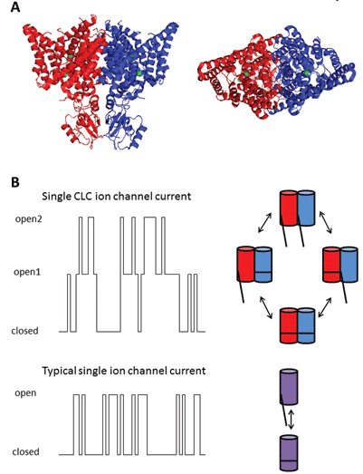
CLC Family of Chloride Ion Channels are “Double-Barrelled” with Two Open States
Notes:
This ion channel family has two major characteristics – one is anion over cation selectivity and blocking of chloride current by larger ions, such as I- or SCN-

Slide 11
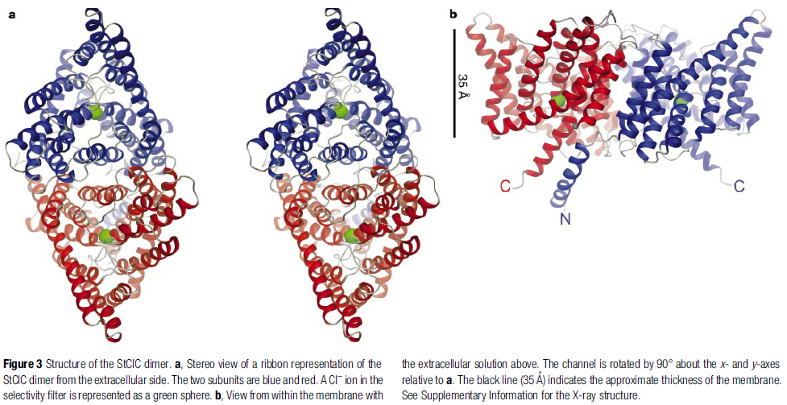
Structure of the CLC Dimer
CLC channels are like porins, aquaporins and bacteriorhodopsin in structure more
than cation channel family that K⁺ belong
Notes:
Two views of the StClC Cl- channel are shown in Fig. 3. The
channel contains two identical subunits (red and blue), which are
related by a two-fold axis of symmetry perpendicular to the
membrane plane. Viewed along the two-fold axis from outside
the cell, each subunit is triangular (Fig. 3a). The entire channel with
two subunits is shaped like a rhombus, with major and minor diagonals
of 100 and 55A Ê , respectively. In the direction perpendicular
to the membrane plane, the channel is about 65A Ê thick owing to
helical extensions that protrude into the aqueous solution (Fig. 3b).
The contact surface area between subunits is extensive, encompassing
nearly 2,300A Ê 2 within the membrane. Such a large, stable
interface is expected because ClC Cl- channels are thought to
exist and function only as dimers. The pore, or ion pathway, is
not formed at the interface between subunits. Rather, each subunit
forms its own independent pore and selectivity ®lter (green sphere).
With regard to their pore stoichiometry, ClC Cl- channels are like
the porins27, the aquaporins28,29 and bacteriorhodopsin30, not like
the cation channel family to which the K+ channels belong. The
former examples are trimers or tetramers of identical subunits in
which each individual subunit forms an independent pore or active
site. The K+ channels, however, are tetramers in which the pore is
formed by four identical subunits encircling a central ion pathway1.
The structure of the EcClC channel is essentially the same as the
StClC channel, except where deviations occur on the surface owing
to crystal contacts. Likewise, deviations from perfect two-fold
symmetry between the subunits within the dimeric channel probably
result from protein contacts within the crystal. For example, the
N terminus from only one of the subunits is visible as an a-helix
near the cytoplasmic surface, whereas in the other subunit the N
terminus is disordered (Fig. 3).

Slide 12
Helices of the CLC Channel
Blue colored helices expected to create electrostatically conducive
environment for anion binding

Slide 13
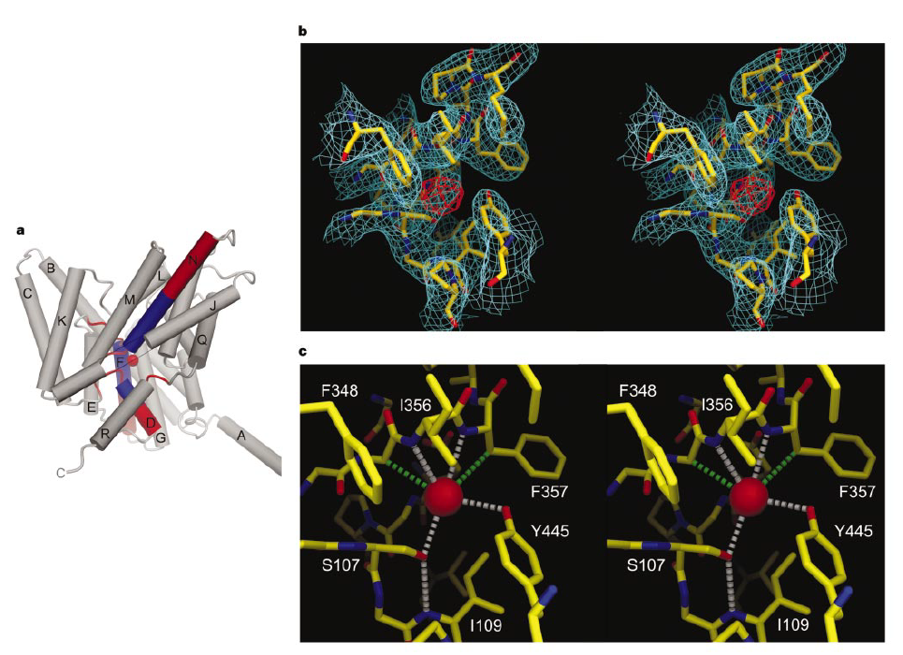
Structure of the Selectivity Filter
Notes:
Figure 5 Structure of the StClC selectivity ®lter. a, Helix dipoles (end charges) point
towards the selectivity ®lter. The a-helices are shown as cylinders with labels
corresponding to Fig. 4a. The amino (positive, blue) and carboxy (negative, red) ends of
a-helices D, F and N are shown. The selectivity ®lter residues are shown as red cords
surrounding a Cl- ion (red sphere). The view is from 208 below the membrane plane; the
dimer interface is to the right, and the extracellular solution above. Part of a-helix J has
been removed for clarity (grey line). b, Stereo view of electron density in the selectivity
®lter. A 2Fo - Fc Cl- omit map (StClC P21 crystal form, 3.0AÊ resolution, 1s contour, cyan)
is superimposed on a stick model of residues selected within a 5AÊ radius of the Cl- ion. An
FBr - FCl difference Fourier map (StClC C2 crystal form, 4.5AÊ resolution, 5s contour, red)
is shown transformed to the corresponding position in the P21 unit cell. c, Stereo view of
the Cl- ion-binding site. Distances (,3.6AÊ ) to the Cl- ion (red sphere) are shown for polar
(white dashed lines) and hydrophobic (green dashed lines) contacts. A hydrogen bond
between Ser 107 and the amide nitrogen of Ile 109 is shown (white dashed line)

Slide 14
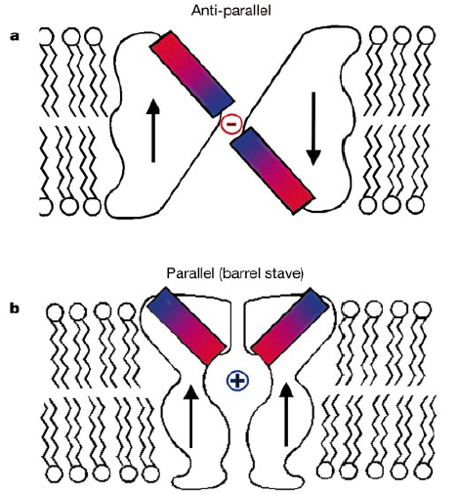
Architectures for Ion-Channel Proteins
Notes:
Two architectures for ion-channel proteins. a, The antiparallel architecture of
ClC Cl- channels contains structurally similar halves with opposite orientations in the
membrane (arrows). This architecture permits like ends (same dipole sense) of a-helices
to point at the membrane centre from opposite sides of the membrane (1808 separation).
b, The parallel or barrel stave architecture of K+ channels contains structurally similar or
identical subunits with the same membrane orientation (arrows). Helices point at the
membrane centre from the same side of the membrane. Helices are depicted as dipoles
with blue (positive) and red (negative) ends.

Slide 16
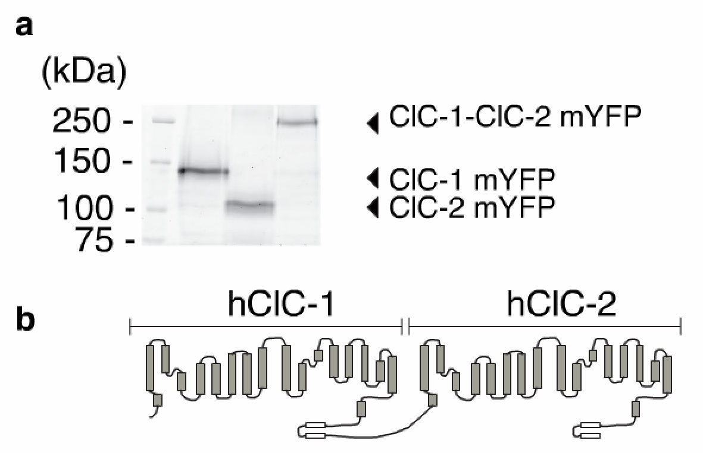

Slide 17
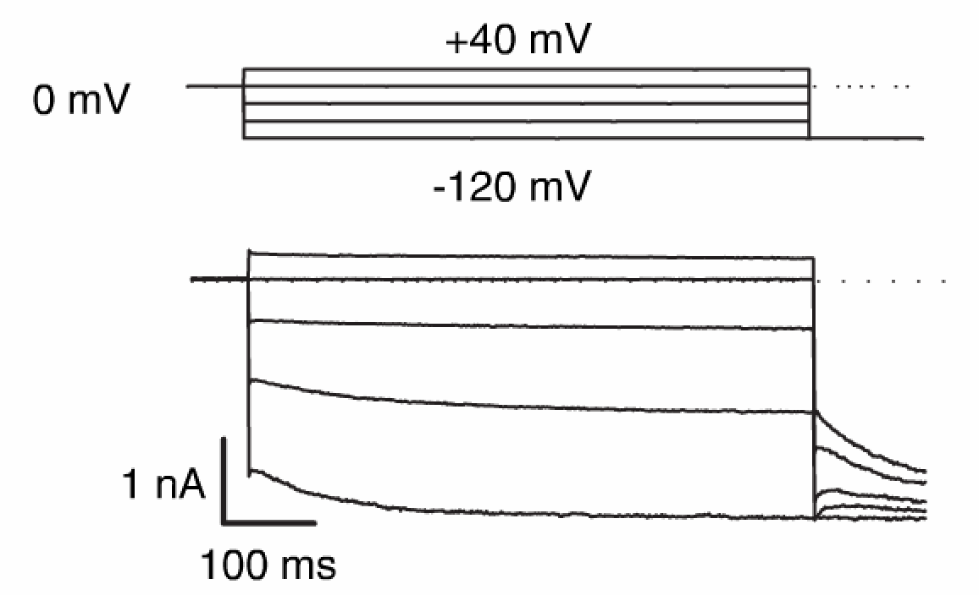
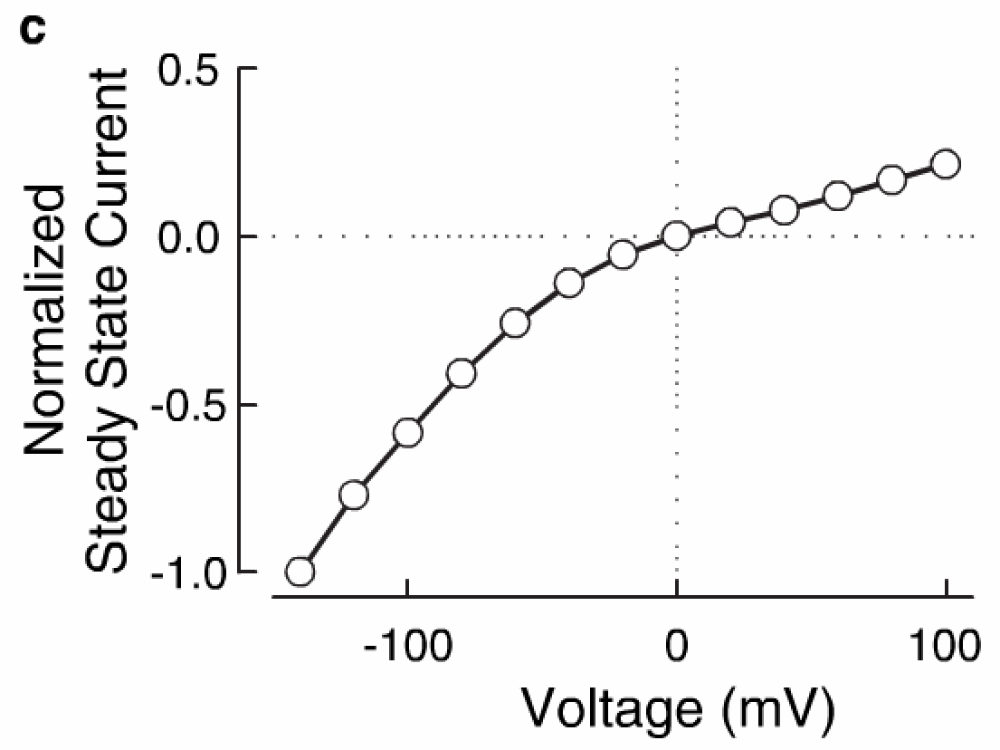
Notes:
Concatamer normalized IV
Slow activation upon hyperpolarization and maintains conductance at positive potentials
ClC1 homodimers exhibit a strongly rectifying IV relationship and ClC2 isn’t active at positive voltages

Slide 19
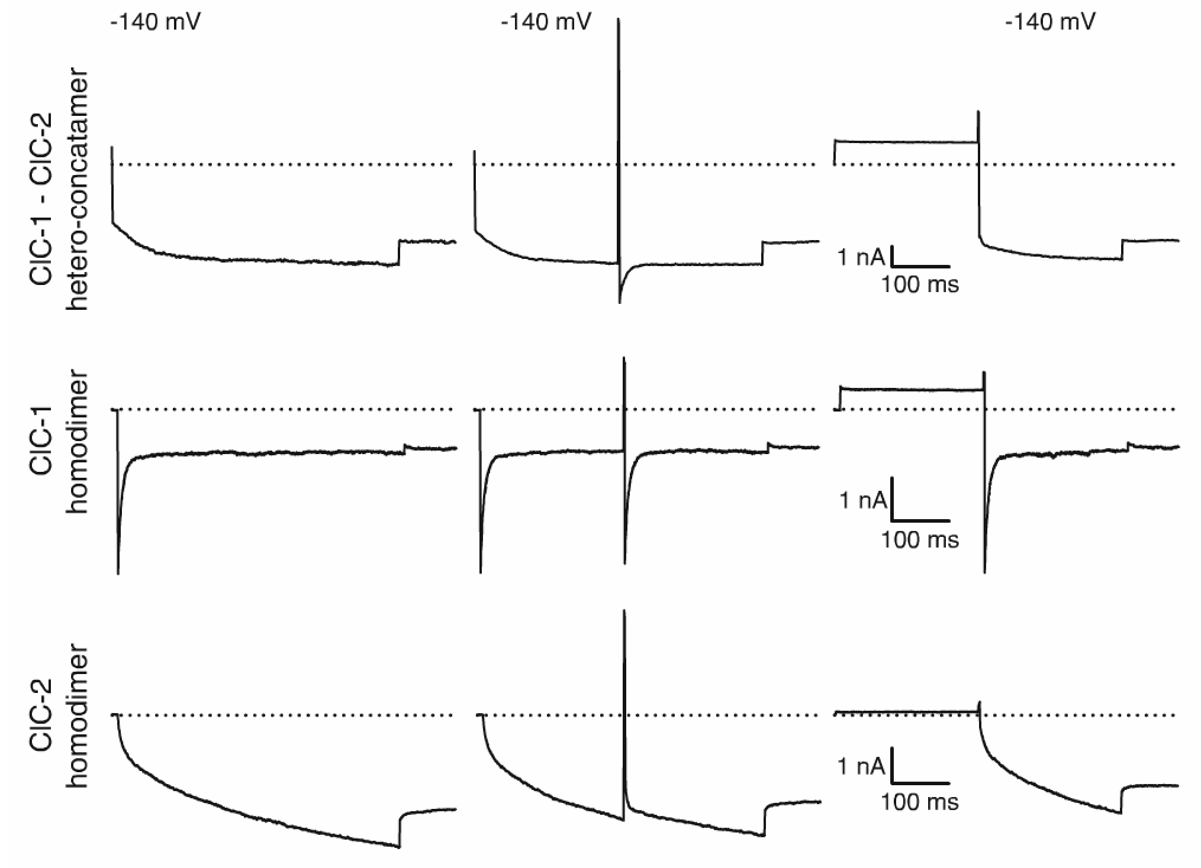

Slide 21
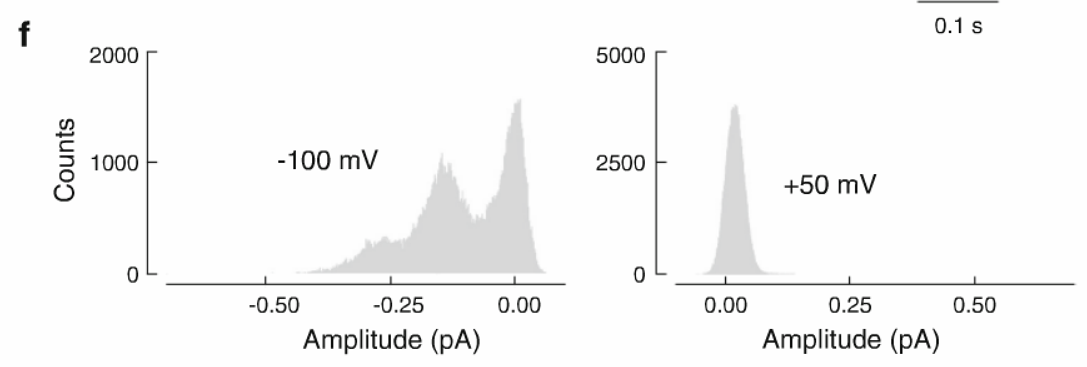

Slide 22
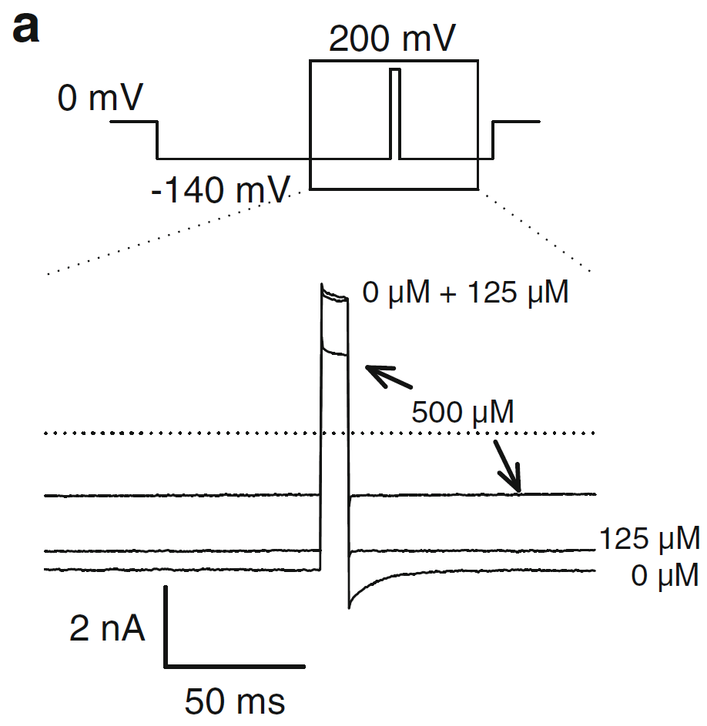
Application of 9-AC
Notes:
Remove b?

Slide 23
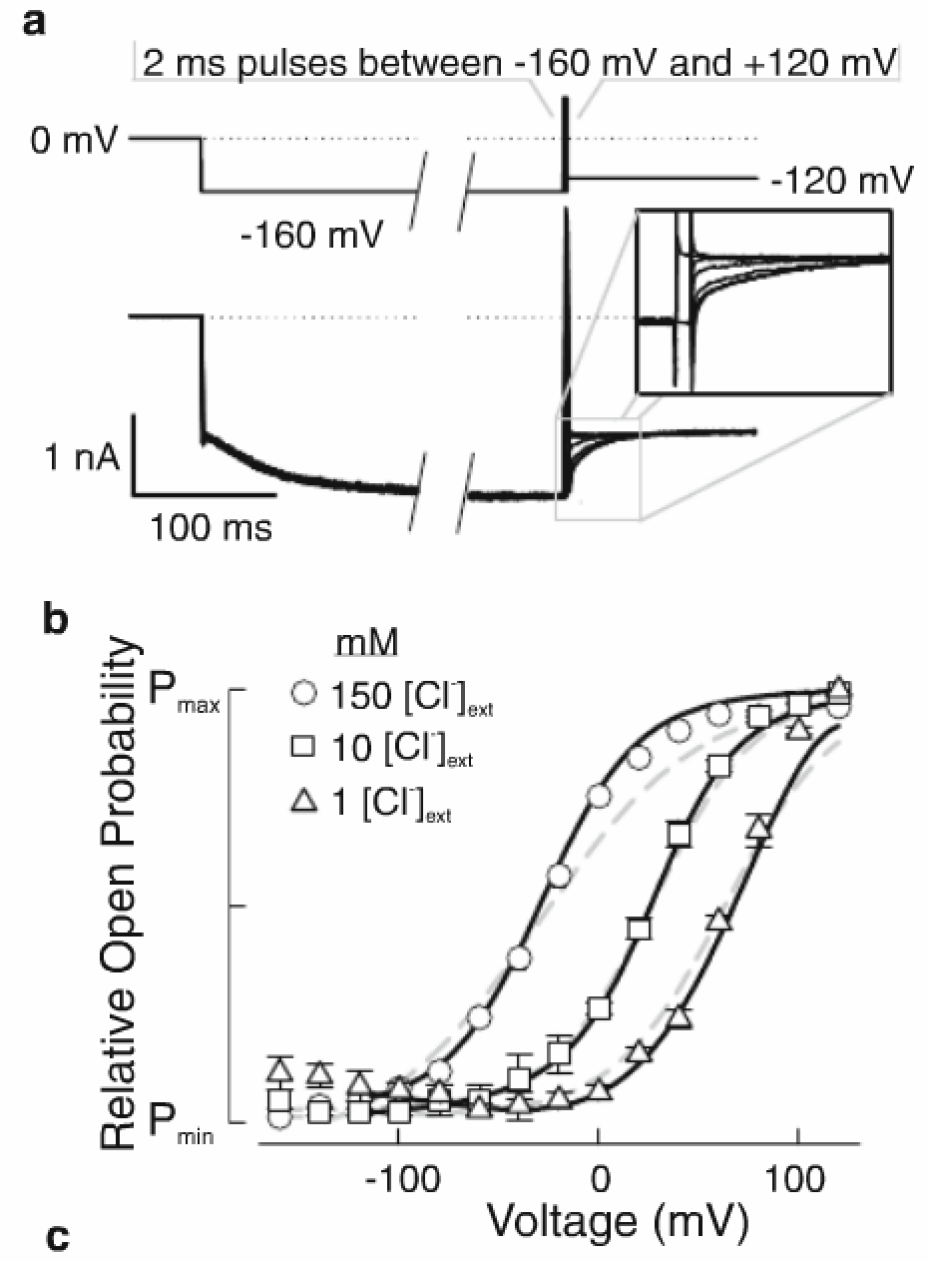
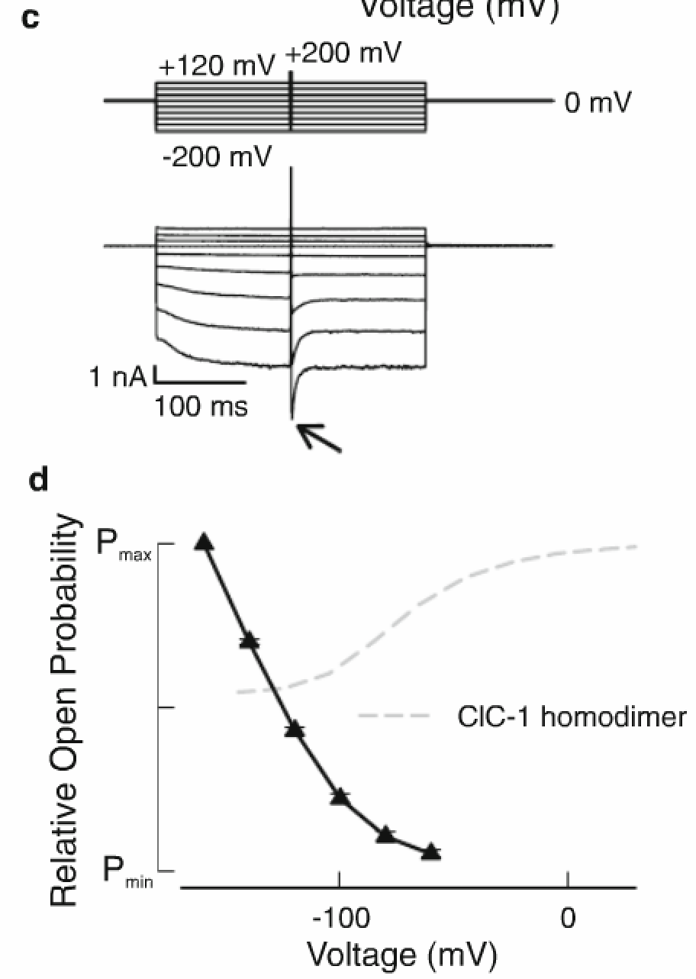
Fast gate of ClC-1
Slow gate of ClC-1
Notes:
Current traces in A are used to calculate the relative open probability of the fast gate of ClC-1
Dashed lines represent normal ClC1 homodimer
Right: protocols used to calculate open prob of the slow gate and deactivation time constants of fast gate

Slide 24
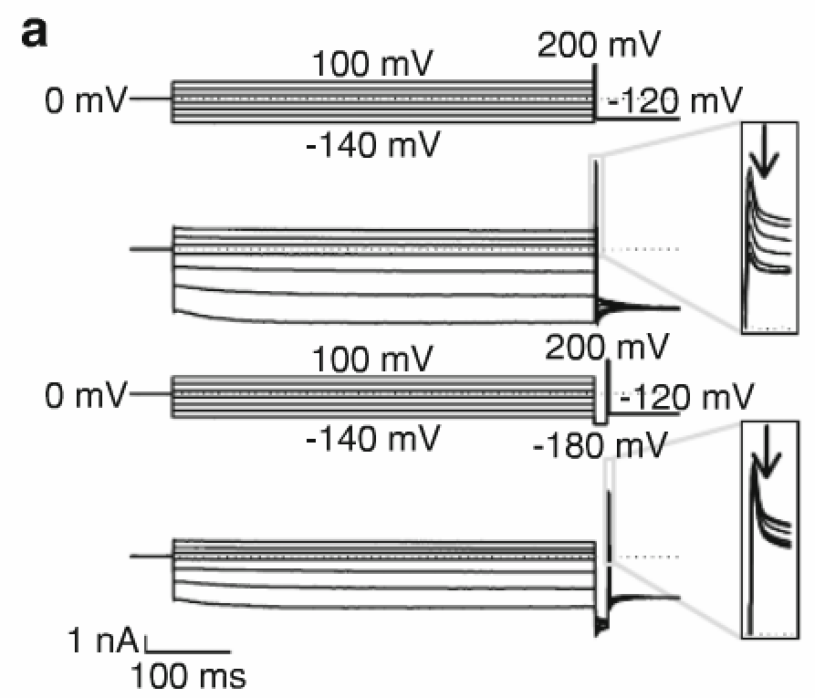
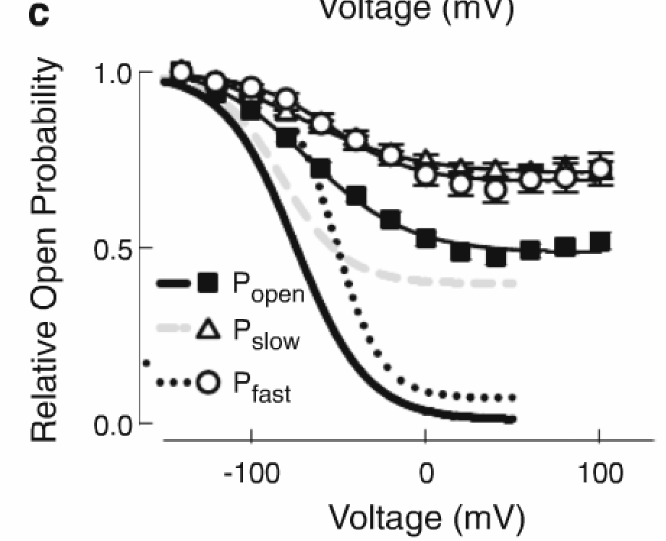
ClC-2
Fast
Slow
Notes:
Figure 6: to calculate relative open prob of the fast and slow gates
A: protocols used to calculate these (upper panel:
Remove this?

Slide 25
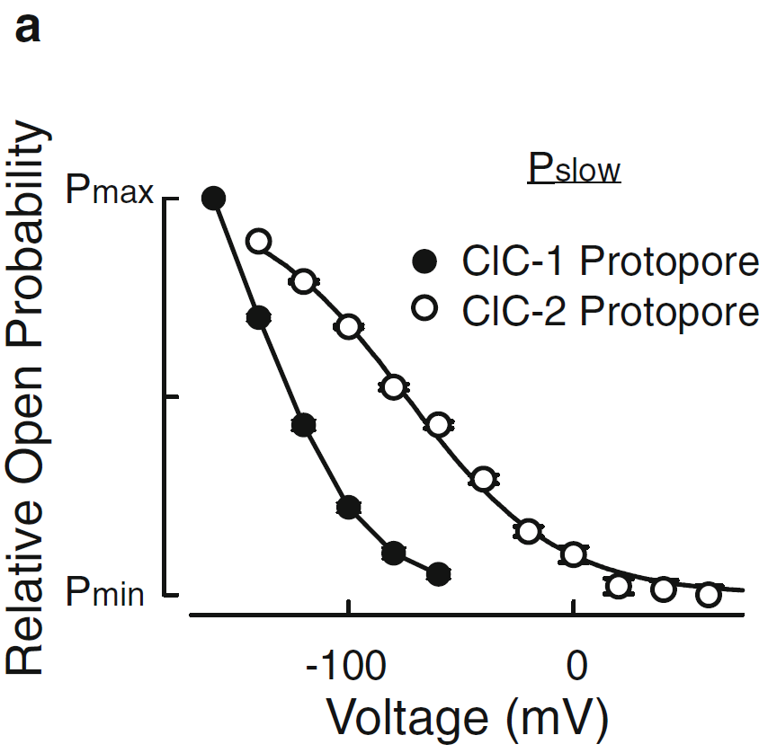
Notes:
Figure 7:

Slide 26
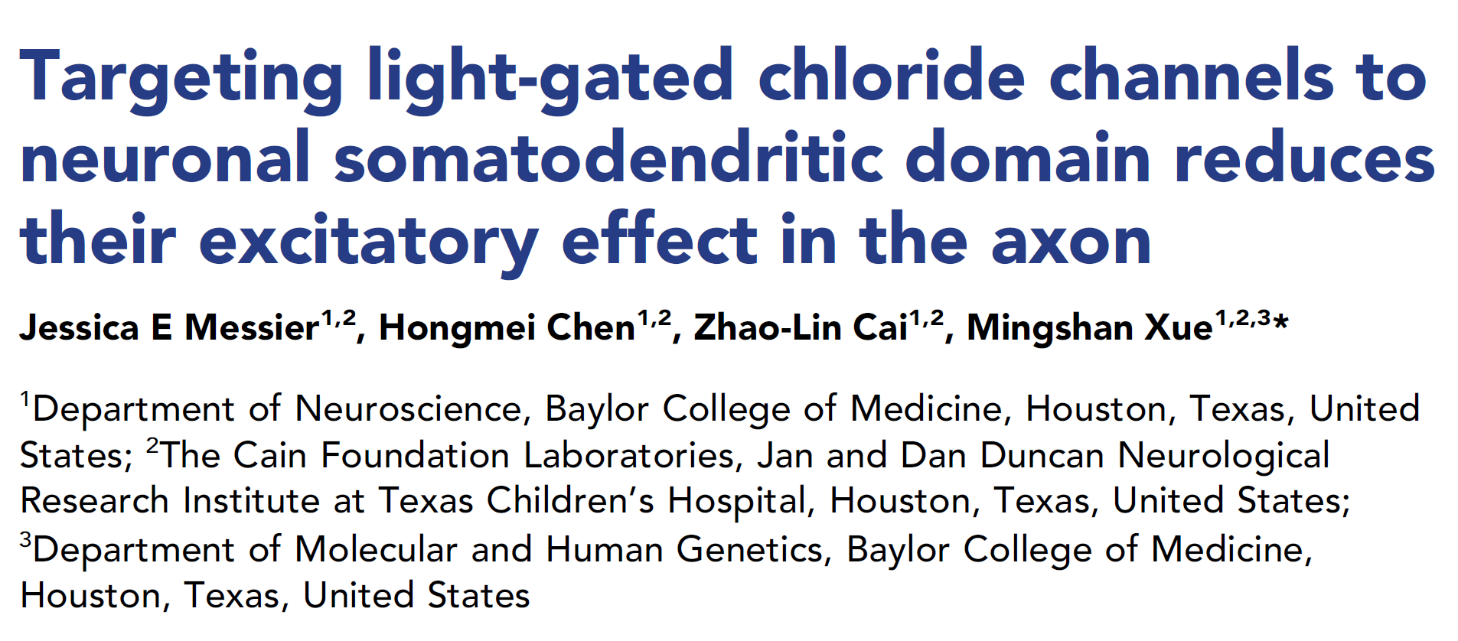

Slide 30
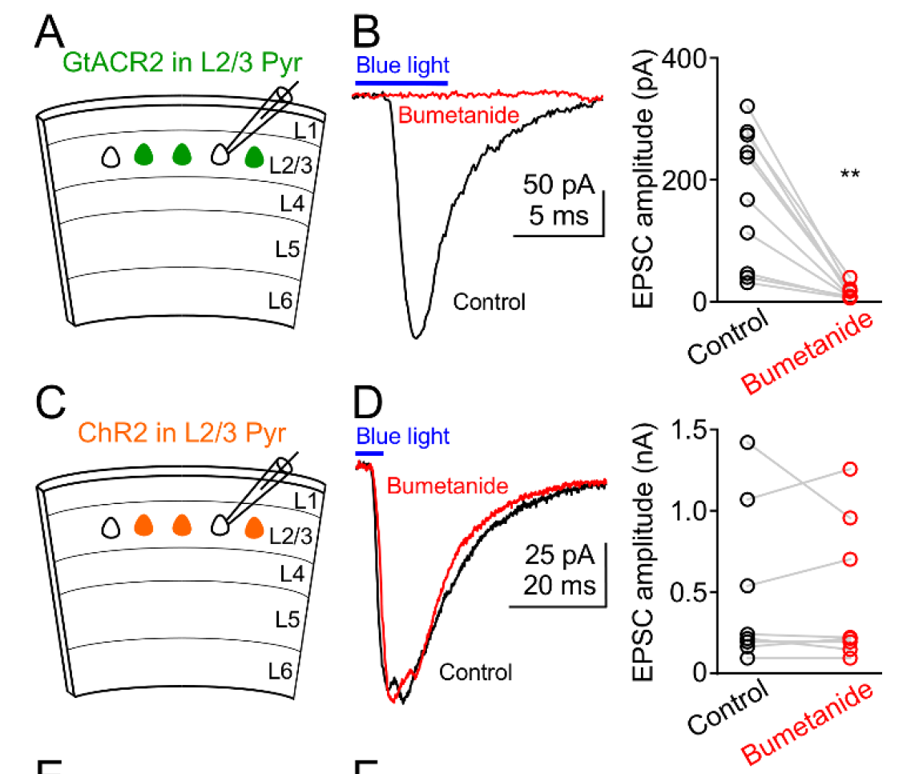

Slide 31
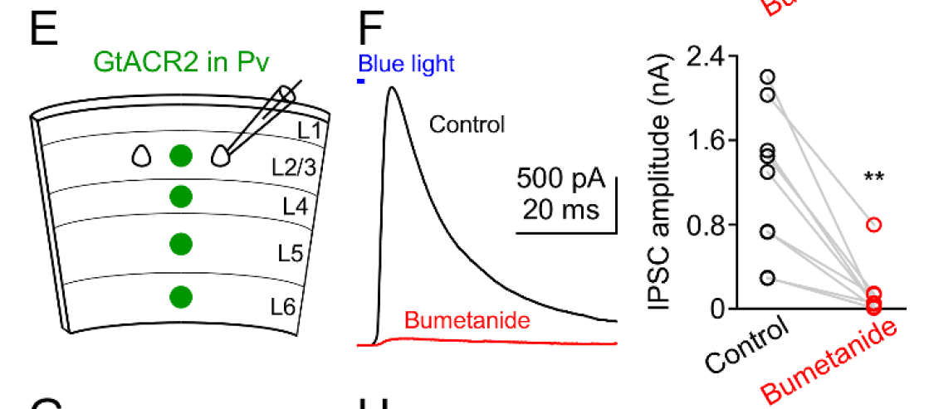

Slide 32
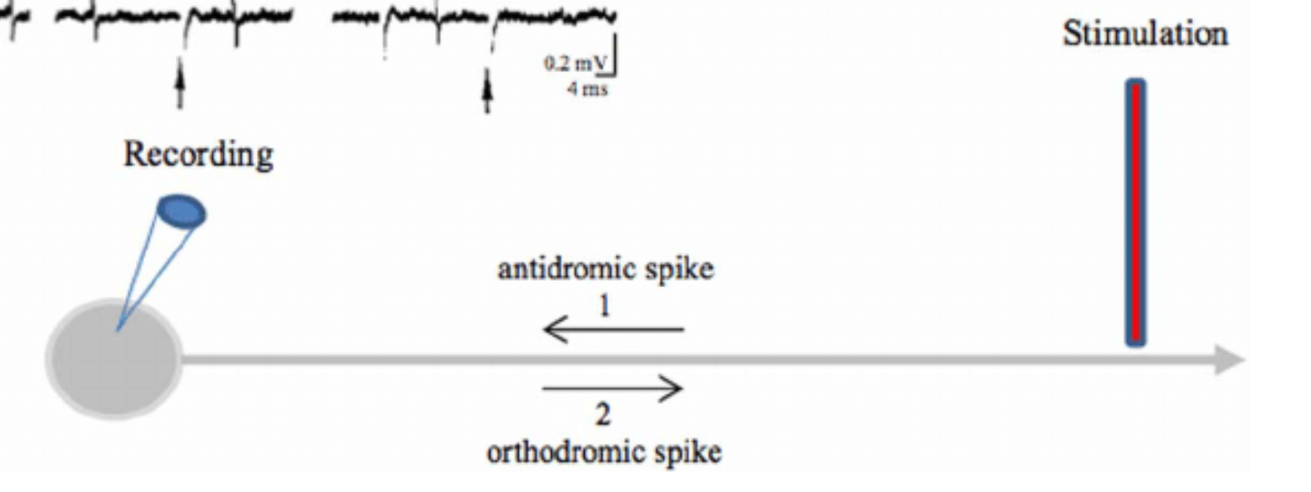

Slide 33
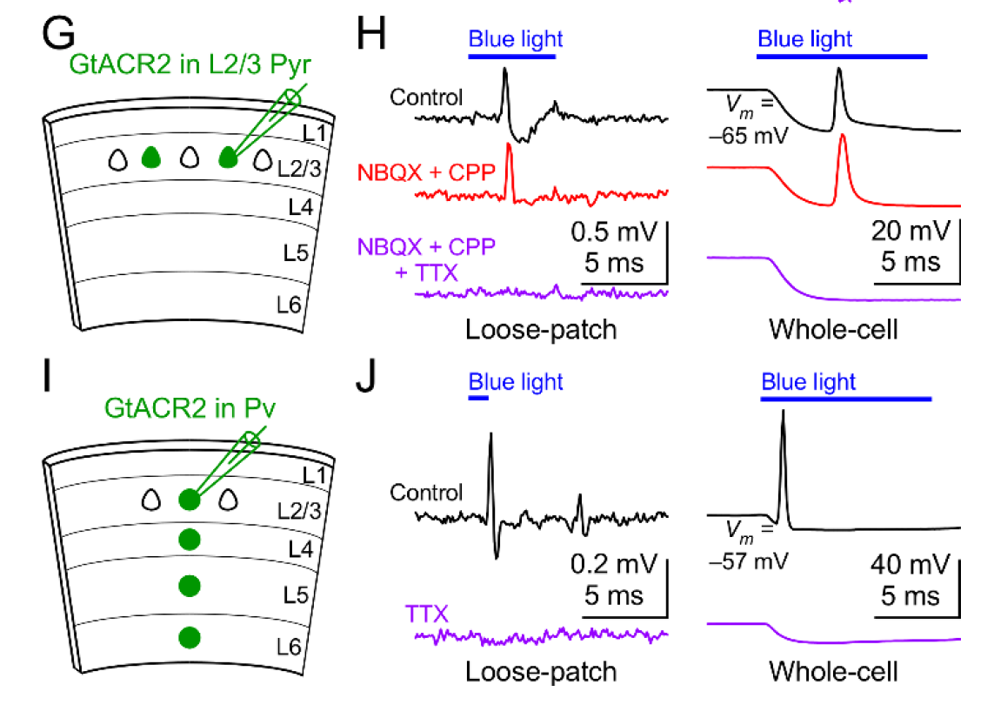

Slide 34
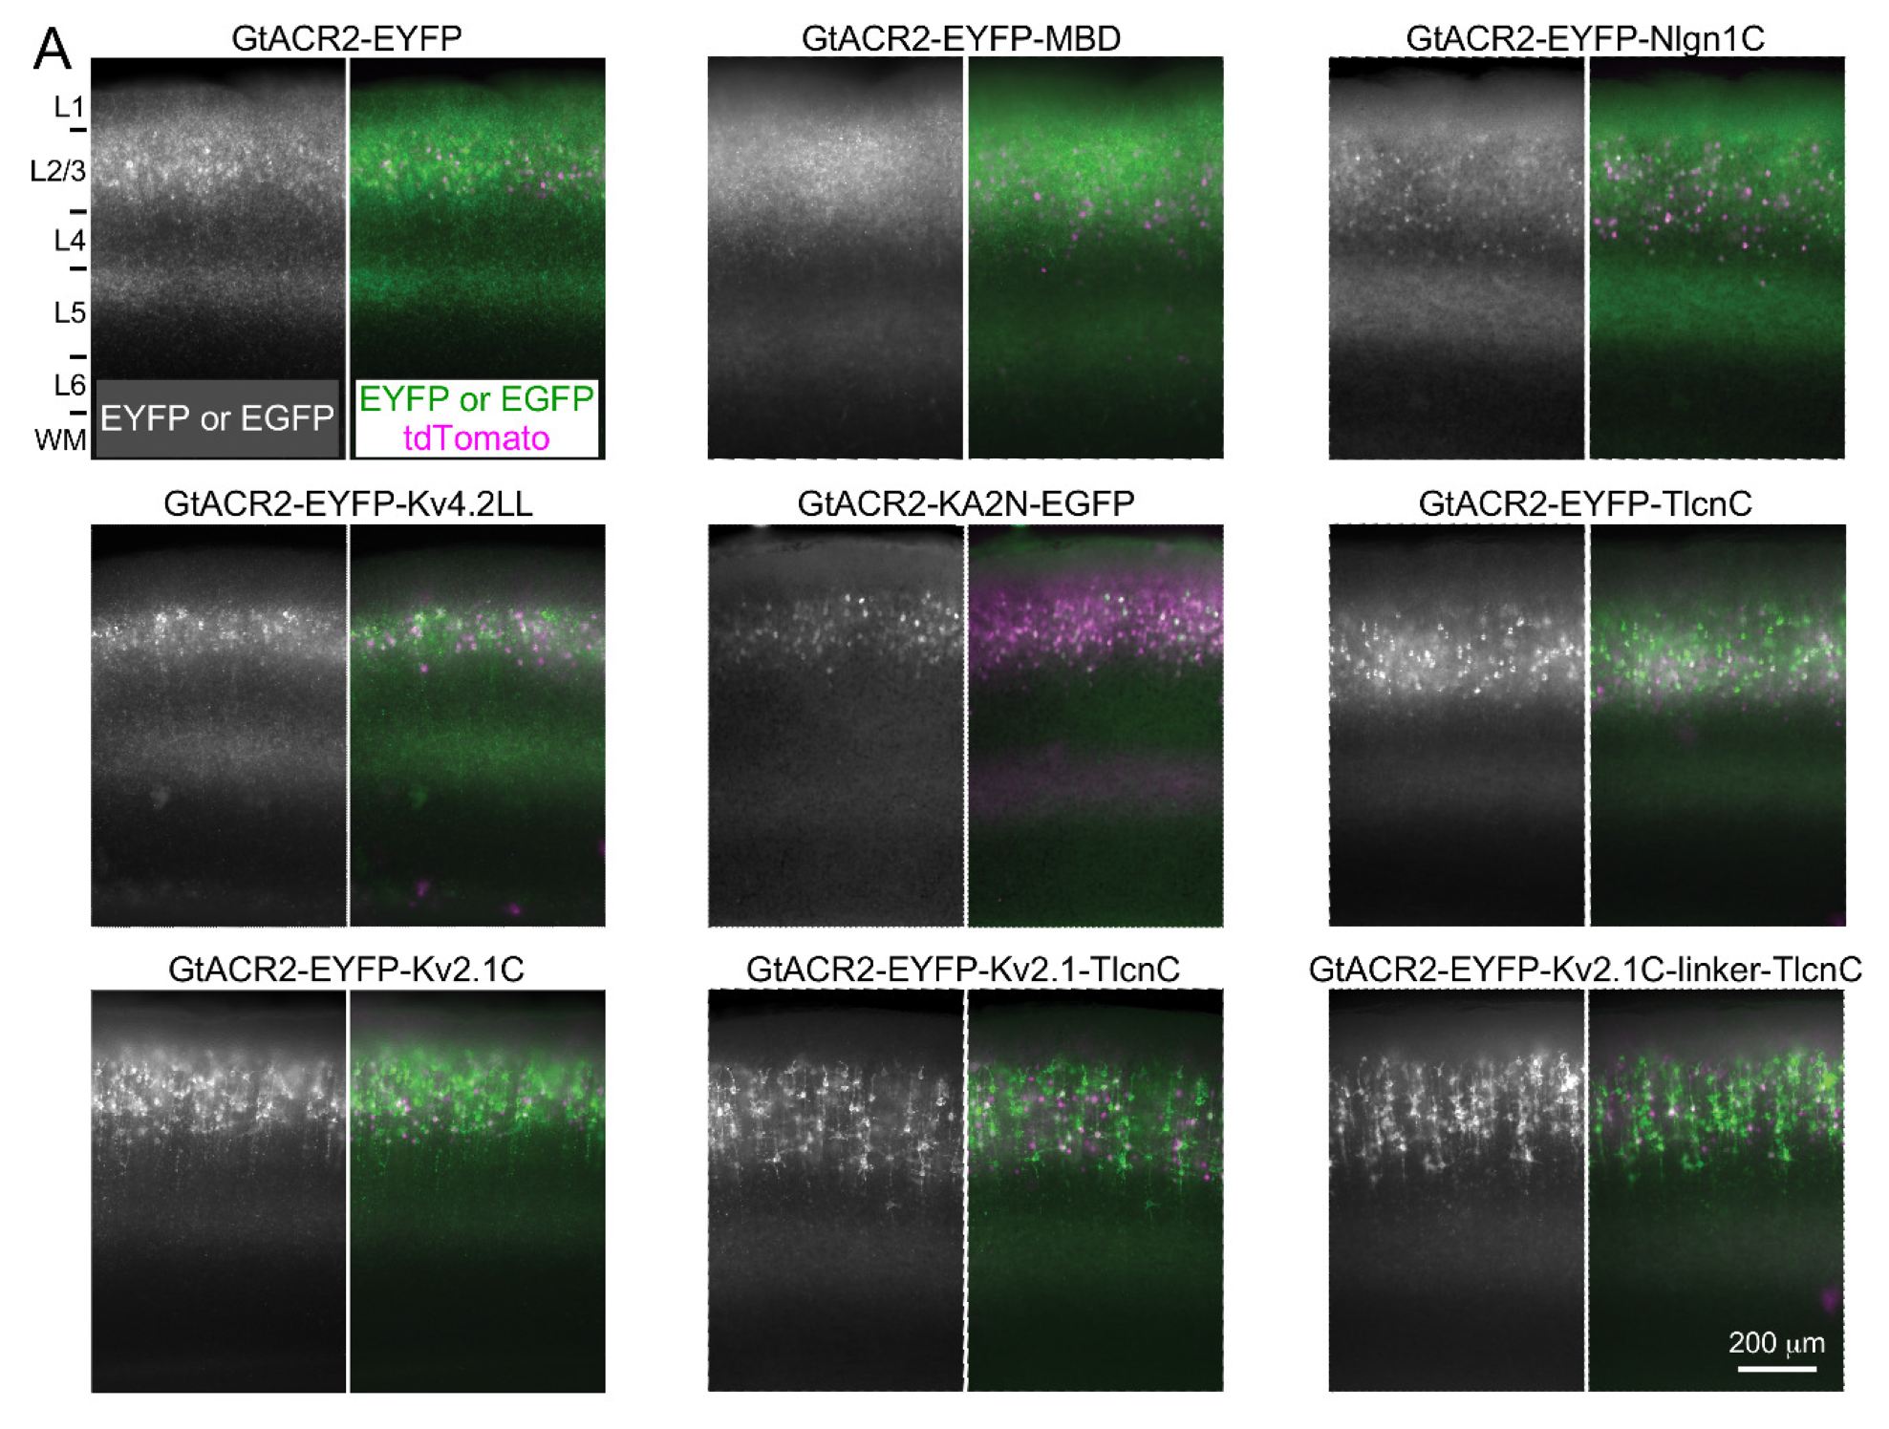

Slide 36
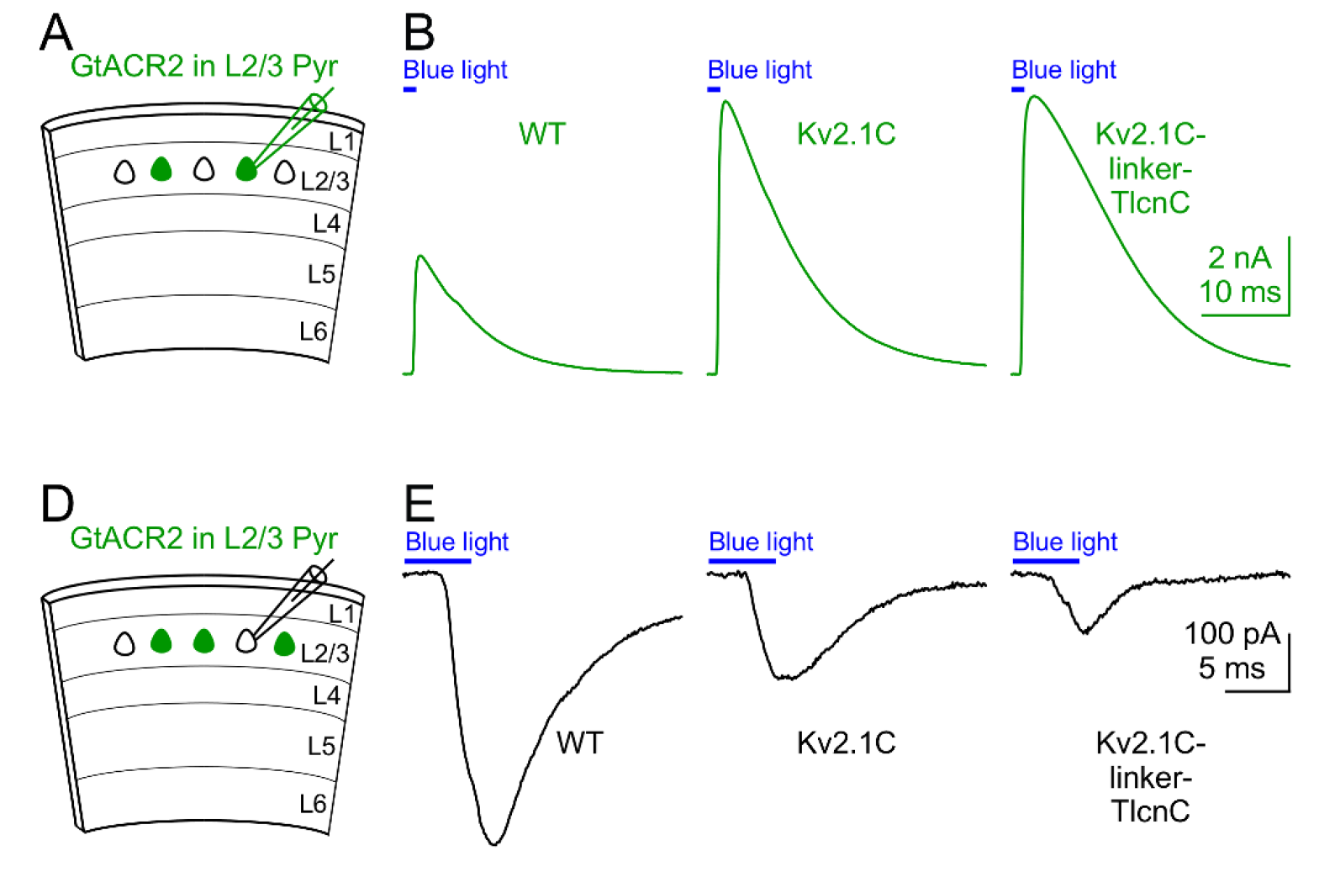

Slide 38
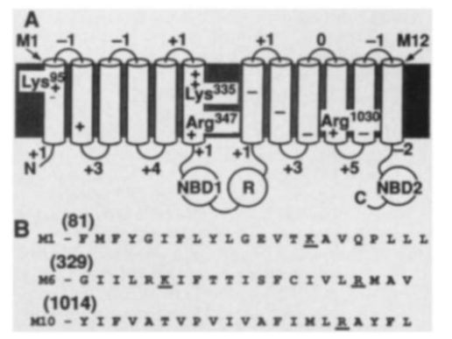
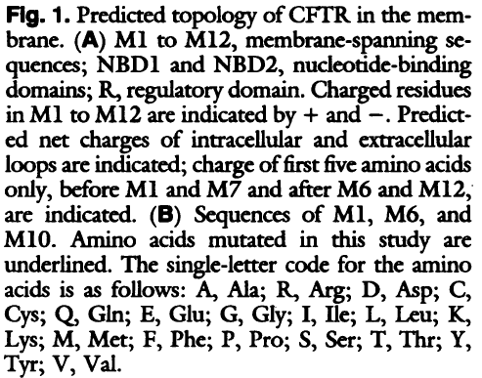
CFTR is a Chloride Ion Channel
Our data indicate that CFTR is a cAMP-regulated C1- channel. The finding that apical membrane C1- channels and C1- channels induced by recombinant CFTR share several properties is consistent with that conclusion (25). The fact that specific mutations in the membrane spanning sequences alter anion selectivity demonstrate that CFTR forms a cAMP-regulated anion pore and makes other interpretations unlikely

Slide 39
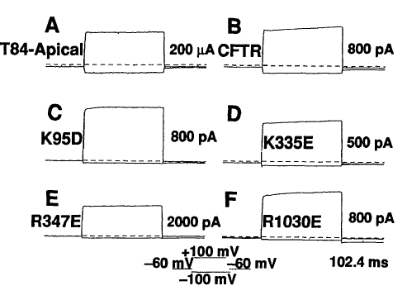
Current Response to Hyperpolarizing and Depolarizing Voltage Steps
cAMP driven current response – large voltage independent

Slide 40
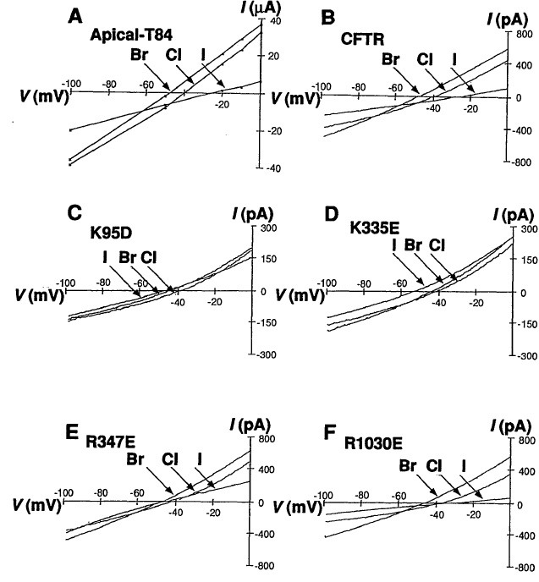
IV Relations Show Based on Site-Directed Mutagenesis that Lysine 95 or 335 altered anionic selectivity
Br- ≥ Cl- > I-
I- >Br- > Cl-
Br- > Cl- > I-
anionic selectivity depends on the hydration energy of the anion and the energy of interaction between an
anion and a positively charged site
Notes:
The anion permeability sequence of
cAMP-regulated currents in wild-type
CFIR and the apical membrane of T84 cells
was Br- > C1- > I- > F- (Fig. 3, A and B,
and Table 1) (19). Site-directed mutation
altered the anion selectivity. When Lys95 or
Lys335 were substituted with amino acids
containing acdic side chains, the amon per-
meability sequence was converted to I- >
Br- > Cl- > F- (Fig. 3, C and D, and
Table 1). When Arg347 and Argl030 were
mutated, the permeability sequence was not
different from that of wild-type CFTR, al-
though the relative permeability of I- to
Cl- increase

