Slide 1
Potassium Channels
Louis Colling

Slide 2
function
Potassium channels are channels that span cell membranes and are selective for potassium
Participate in:
  Maintain cell volume
  Dampen membrane excitability
  Programmed cell death

Slide 3
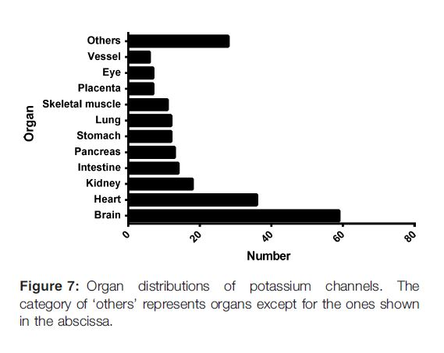

Slide 4
Diseases
Episodic Ataxia
Bartter’s Disease
Neuromytonia
Multiple Sclerosis
Rheumatoid Arthritis
Diabetes Mellitus
Short/long QT Syndrome
Glioblastoma

Slide 5
types
Calcium-activated
Inwardly rectifying
Tandem pore domain
Voltage-gated

Slide 6
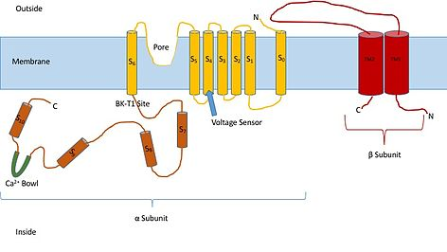
Calcium-activated Potassium channels
6T1P
Three subtypes
  BK (large conductance)
  IK (intermediate conductance)
  SK (small conductance)
Kca4/Kca5
  Na+, Cl-, pH
  NOT Ca2+
Multiple members of the family activated are both ligand AND voltage activated, and are nonselective for Rb, Cs

Slide 7
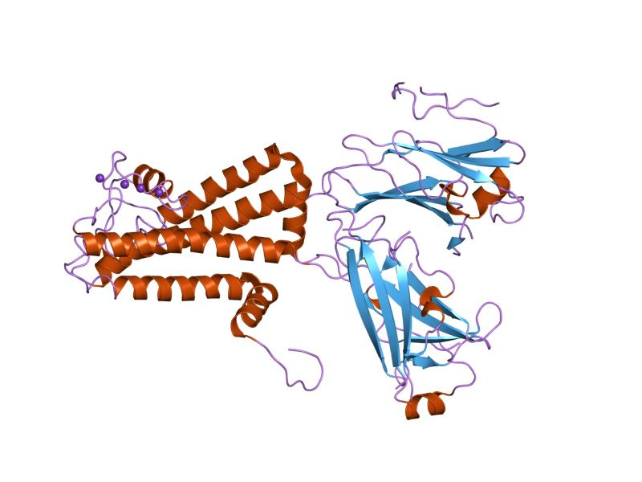
Inward-rectifier Potassium channel
2T1P
Three subtypes
  ROMK
  GPCR regulated
  ATP-sensitive
Voltage-gated, close upon depolarization

Slide 8
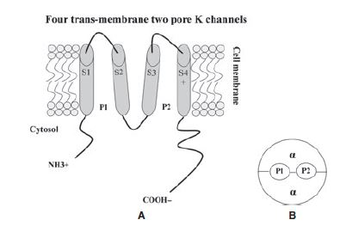
Tandem pore domain
4T2P
“leak channels”
  Rectifiers, regulated by
    Oxygen tension
    pH
    Mechanical stretch
    G proteins
  Not two-pore channels
15 known channels
Contribute to resting potential

Slide 9
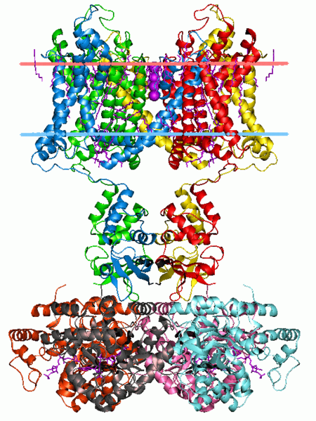
Voltage-gated potassium channels
6T1P
Six general classes
  delayed rectifier, A-type, outward-rectifying, inwardly-rectifying, slowly activating, modifier/silencer
Shaker, shab, shaw, shal, uh... Kv5, Kv6...Kv12.
Beta subunits

Slide 10
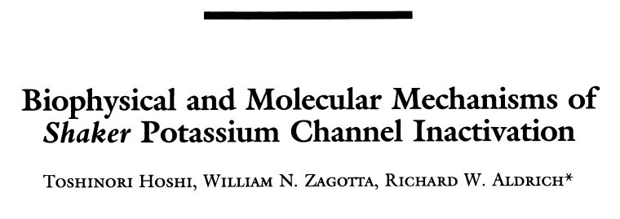

Slide 11
Background
Shaker potassium channels are delayed rectifier channels that primarily participate in action potentials
After activation, channels enter a long-lived nonconducting state called the inactivated state
These transitions are governed by physical conformational changes of the channel protein

Slide 12
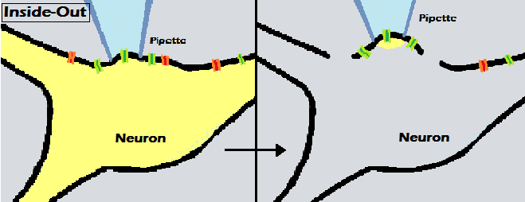
Inside-out patch clamp

Slide 13
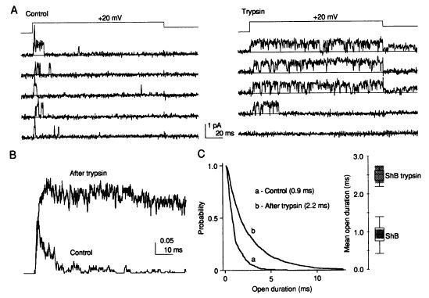
Trypsin experiments

Slide 14
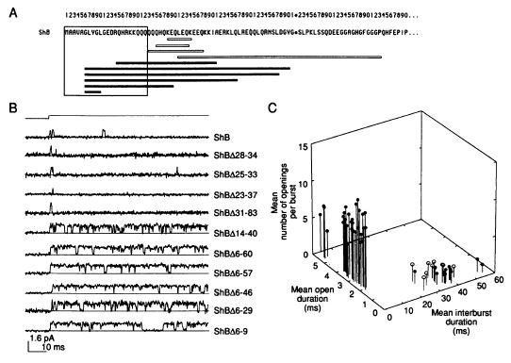
Amino-terminal mutants

Slide 15
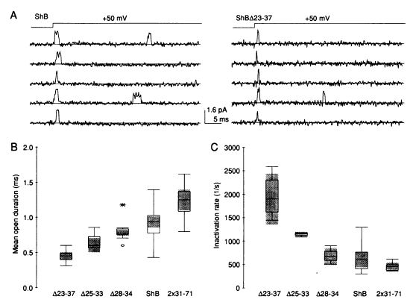
Maintenance of function mutants

Slide 16
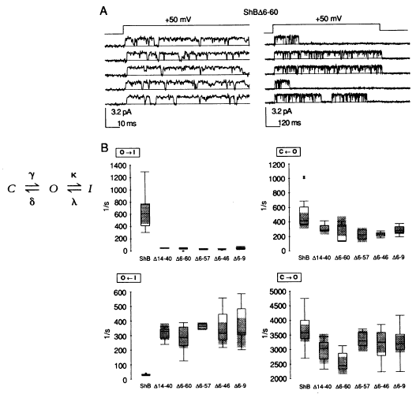
Inactivation kinetics

Slide 17
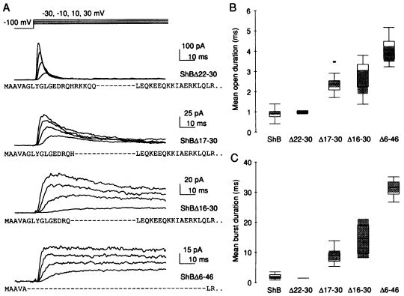
Positively charged mutants

Slide 18
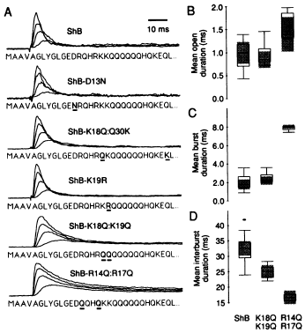
Point mutations

Slide 19
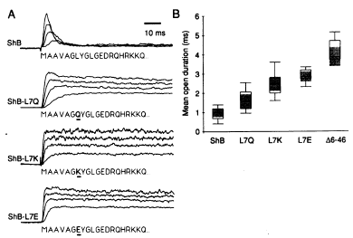
...more point mutations

Slide 20
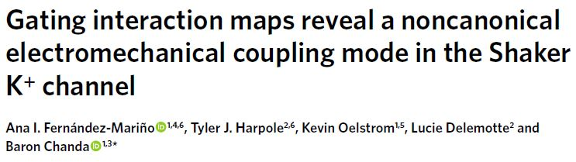

Slide 21
Background
Structural studies of membrane proteins are difficult due to the environment needed for proper assembly
The interaction between the voltage-sensing domain and the pore domain are poorly understood
Generalized Interaction-energy Analysis
  Uses molecular dynamics simulations to observe structural interactions

Slide 22
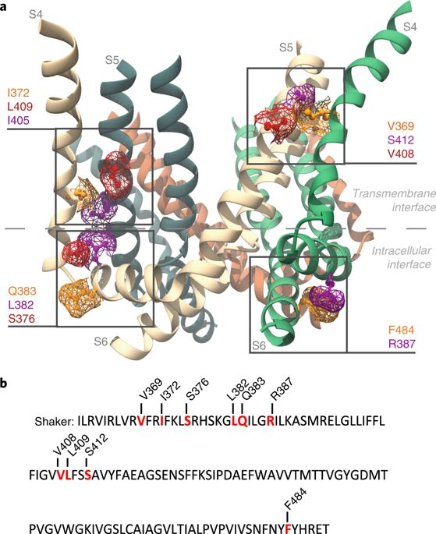
Simulated Kv1.2-2.1 chimera

Slide 23
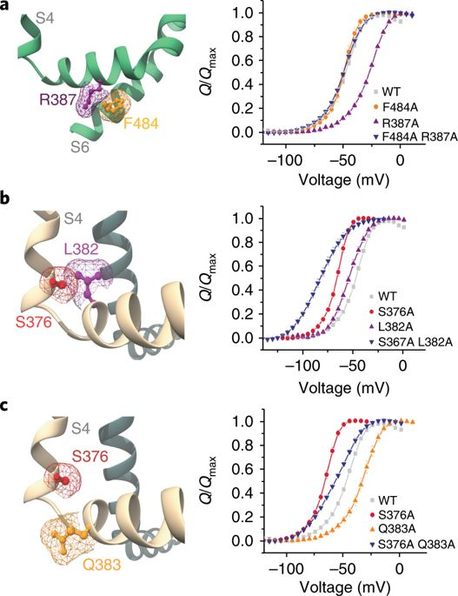
Q-V curves

Slide 24
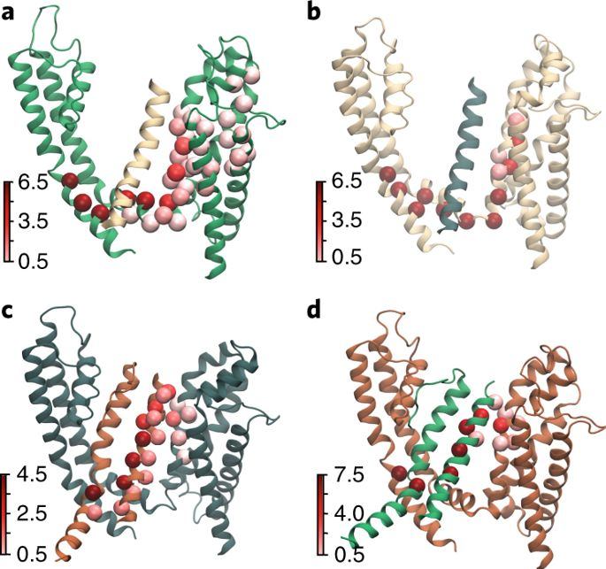
Betweenness

Slide 25
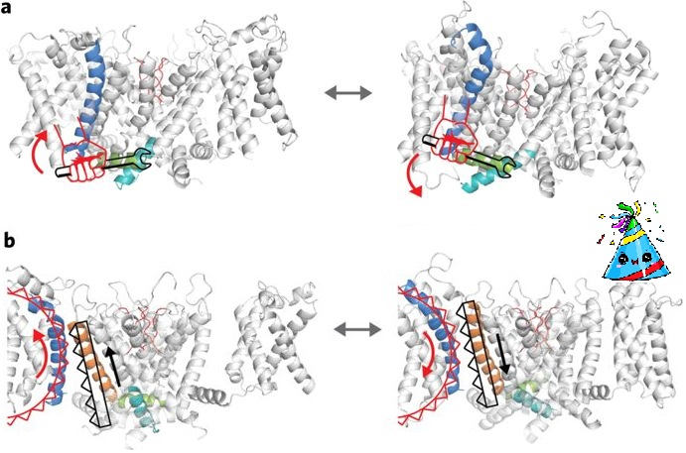
Canonical and proposed alternate pathway

Slide 26
