Slide 1
Optogenetics
Jiajing Zhang and Jordan Logue

Slide 2
The Brutal oversimplification
RATS
Notes:
https://www.youtube.com/watch?v=Ee3TDO9fEqY

Slide 3
Rats with frickin’ laser beams attached to their heads

Slide 4
The Core Concepts
Find a cell or circuit that you want to characterize
Put in a light activated channel that would theoretically change the firing pattern of the cells
See if the cells firing pattern changes or if the behavior of the animals changes

Slide 5
How did we design these channels?
Originals were directly ripped from existing biological systems
Future directions will likely incorporate more and more designer ion channels
OptoDREADD with GCPRs?

Slide 6
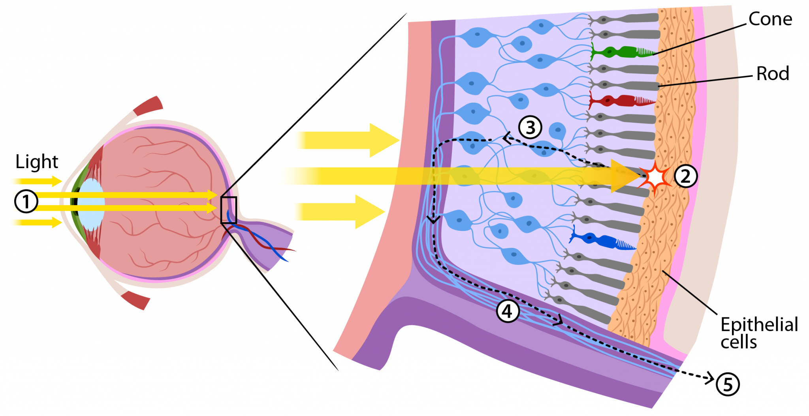
The Channels involved
There are naturally occurring light activated ion channels
Retina are the ones we’re probably most familiar with, but they also occur in some plants and microbes

Slide 7
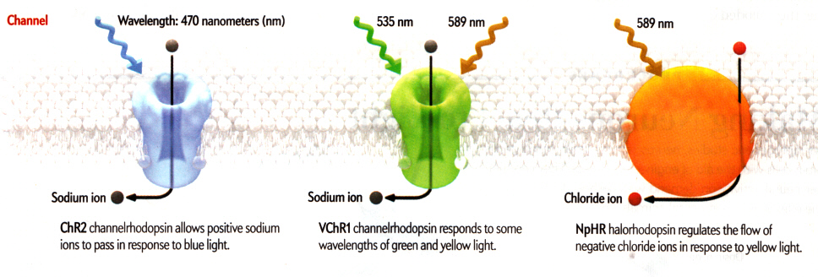
Channel dynamics
Reversible states activated by UV radiation or visible light within specific spectra.

Slide 8
How Channels respond to light
Conformational change in response to excitation from light
Channels open and close, allowing in cation or anions, which change cellular activity

Slide 9
How to Express these Channels
Transgenic animals
Insert gene for channel at select locus, then trigger the expression at a later time
Viral injections
Design virus to express the channel, introduce virus to the tissue you want it expressed in
Culture cells or living animals
Transcranial cannulations
Systemic injections
Sonication of tissue

Slide 10
The Types of Channels Created
For microbes, in the absence of complex eye structure, they have developed light-activated proteins for variety of purposes.
→7 TMD, encoded by opsin genes
2 superfamilies of opsin:
Type I = microbial opsins
Require retinal as photon-sensing cofactor, result in ion flux.
Type II = animal opsins
GPCRs, responsible mainly for vision
After binding with retinal →conformational changes →initiates the reactions that underlie the visual phototransduction 2nd messenger cascade

Slide 11
Type I: Improvements needed
They can serve as ion flow modulators and control excitability of a neuron by manipulating its membrane potential.
However, microbial proteins don’t express well in mammalian neurons
Membrane-trafficking modification: ER-export motifs
Different spiking properties needed
Chimera strategies (use hybrids of ChR1 and ChR2)
mutations

Slide 12
excitation
Non-selective Cation channels
Notes:
Toff=deactivation time constants.

Slide 13
Inhibition
eNpHR3.0 (a chloride pump used to inhibit neural activity)
eBR (a proton pump used to inhibit neural activity)
iC1C2 (a newly developed chloride channel used to inhibit neural activity)
Notes:
ChR2 (a cation channel used to stimulate neural activity), iC1C2 (a newly developed chloride channel used to inhibit neural activity), eNpHR3.0 (a chloride pump used to inhibit neural activity), eBR (a proton pump used to inhibit neural activity)

Slide 14
Type II: Under development
Use type II opsins for biochemical control/precise control of well-defined GPCR signaling pathways.
OptoXRs
Modulated by 500nm light
Goal: Allow for receptor-mediated intracellular signaling with temporal resolution suitable for modulation of behavior in freely moving mice.

Slide 15
Applications
Advantage of using optogenetics:
Cell type/circuit specific
Temporal precision
Allow activation/inactivation of neural activity in intact tissue
……
Notes:
What type of cell mediated circuits, through what kind of neural connections, send out excitatory/inhibitory output, is involved in what specific behavior?

Slide 16
How to achieve cell-type OR circuit specific manipulation?
Applications cont.

Slide 19
You can integrate optogenetic control with electrophysiology!
Applications cont.

Slide 21
Applications In living animals
Caenorhabditis elegans:
NpHR in motor neurons
Drosophila:

Slide 22
Applications In living animals
Zebrafish:
transgenic zebrafish: global activation of NpHR in the entire animal.
Mouse:
Activation of ChR2 in PBGN glutamatergic neurons elicit “escape” behavior.

Slide 24
Infect cultured rat hippocampal neurons with Lenti-YFP-ChR2
Voltage clamp
Blue light (450-490nm) for 1 sec
→ fast responding inward current
→ rapid recovery when light is OFF
Current clamp
Blue light (450-490nm) for 1 sec
→ spikes are rapidly elicit
→ however, any subsequent spikes during
steady illumination were poorly timed
Notes:
This tells them that steady illumination is not adequate for controlling the timing of ongoing spikes with ChR2, despite reliability of the first spike.

Slide 25
Steady illumination is not adequate for controlling the timing of ongoing spikes with ChR2, despite reliability of the first spike.
What if we stimulate with a series of brief light pulse? What is the best duration?
5 ms ON + 35 ms OFF
25 Hz
10 ms ON + 30 ms OFF
15 ms ON + 25 ms OFF
Notes:
Since the first spike is rapidly responsive and reliable, they want to use a train of stimuli to elicit multiple spikes. This require the light pulse to be long enough so the current reach threshold, and pulse interval shorter than the desired interspike interval.

Slide 26
Whether we can generate arbitrary spike patterns, even mimic natural neural activity?
A series of light pulses selected according to a Poisson distribution, commonly used to model natural spiking.
10ms pulses
Heterogeneous populations of neurons can be controlled in concert.
Notes:
A single hippocampal neuron response consistently across repeated deliveries of the same series of light pulses.
Different neurons response similar to the same series of light pulses.
Heterogeneous populations of neurons can be controlled in concert

Slide 27
The frequency response of light-spike coupling:
Give series of twenty 10-ms light pulses
5 Hz ~ 30Hz
ChR2 can mediate spiking across a physiologically relevant range of firing frequencies.
It was easier to evoke more spikes at lower frequencies than higher frequencies.

Slide 28
What about synaptic transmission?
ChR2+
ChR2-
Synaptic transmission was also easily controlled with ChR2.
Both excitatory and inhibitory synaptic event could be evoked in ChR2-negative neurons receiving synaptic input from ChR2-expressing neurons.

Slide 29
Since 2005…..
From PubMed

Slide 30
Optogenetic insights into striatal function and behavior
Lenz and Lobo
Behavioral Brain Research 2012

Slide 31
The striatum
Implicated in motor behavior, reward, motivation, and decision making
Huntington’s, schizophrenia, Tourette’s syndrome, depression, addiction
The dorsal striatum is more associated with repetitive behaviors
Ventral striatum (Nucleus accumbens) is more associated with reward
95% of the neurons in these areas are GABAergic medium spiny neurons (MSNs)
5% are tonically active cholinergic interneurons (TANs)

Slide 32
The Striatum

Slide 33
Receptors and connections
MSNs subdivided into 2 groups based on targets
Striatonigral and Striatopallidal
Striatonigral express D1 receptors and Striatopallidal express D2 receptors
The patch and matrix compartments of the DORSAL striatum have different receptors (expression of opioid receptors) and connectivity
Different input from cortical regions and output toward the VTA and substantia nigra
The shell and core of the Nac have different connections through the basal ganglia
Direct (D1 Striatonigral MSNs) is associated with movement initiation and reward seeking
Indirect pathways (D2 Striatopallidal MSNs) is associated with inhibition of movement and reward seeking
“Punishment pathway”

Slide 35
What have we learned from being able to manipulate these circuits?

Slide 36
What have we learned from being able to manipulate these circuits?

Slide 37
What have we learned from being able to manipulate these circuits?
Medium Spiny Neurons
Characterizations of the indirect vs indirect pathways
Interneurons
Implicated for activity in the reward pathway through their interactions with dopamine releasing neurons that feed into the striatum
Striatal afferents
Studies in trafficking signals between VTA and Nac in response to drugs where signaling is stopped or enhanced by opto stimulation
Molecular mechanisms
Downstream signaling molecules change in expression following opto stimulation (increasing or decreasing depending on pathway)
Light activated GPCRs are being generated

Slide 38
Optogenetic inhibition of medial prefrontal cortex projections to the nucleus accumbens core and methyl supplementation via L-Methionine attenuates cocaine-primed reinstatement
Wright et al 2018
Integrative Zoology

Slide 39
Cocaine addiction
High relapse rates
Epigenetic changes
Methylation of DNA and DNA methyl transferases
Dnmt3a increases in the Nac following cocaine exposure “One way to study the functional role of DNA methylation is by increasing the pool of available methyl groups with systemic administration of exogenous L-Methionine (MET) (17, 18), thereby taking advantage of the cocaine-induced upregulation of Dnmt3a and enabling the “re-methylation” of genes left transcriptionally active by cocaine”

Slide 40
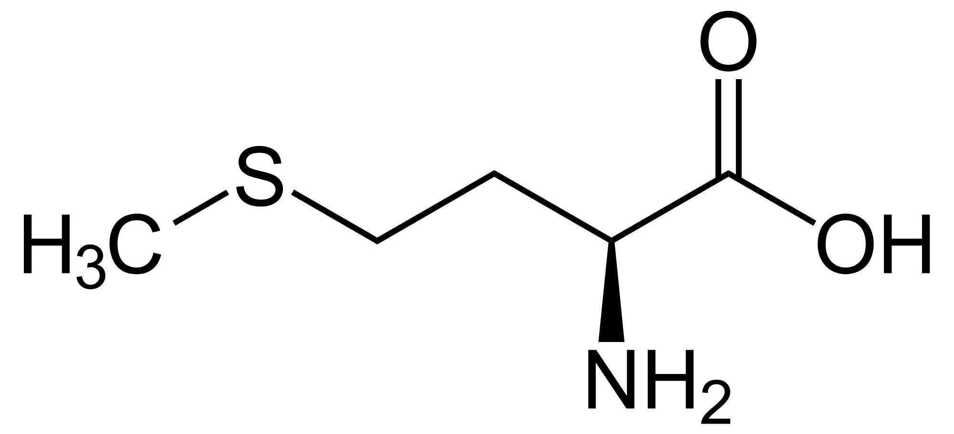
L-Methionine
“One way to study the functional role of DNA methylation is by increasing the pool of available methyl groups with systemic administration of exogenous L-Methionine (MET), thereby taking advantage of the cocaine-induced upregulation of Dnmt3a and enabling the “re-methylation” of genes left transcriptionally active by cocaine”

Slide 41
Previous studies showed that treatment with L-Methionine attenuates cocaine primed reinstatement without altering initial cocaine taking
-I.e. they still like cocaine but they are less likely to “relapse” after a period of abstinence
Causes increases in activity marker c-Fos in medial prefrontal cortex but *decreases* in the Nac
“DNA methylation may be dampening the excitability of the mPFC-to-NAc reward circuitry during cocaine-primed reinstatement”

Slide 42
Where the OPTO comes in
optogenetic inhibition of the mPFC-to-NAc projections
vs
exogenous MET treatment
Can optogenetic inhibition of these neurons accomplish the same as the pharmacological epigenetic treatment?
Notes:
using a dosing regimen that has been previously shown to block cocaine-primed reinstatement

Slide 43
Stereotaxic surgeries
Bilateral delivery of virus to mPFC (AAV-CaMKIIa-eNpHR3.0-EYFP or AAV-CaMKIIa-EYFP)
Virus was given 6-8 weeks to allow full expression
In a separate procedure, the animals also received a jugular catheter and bilateral transcranial fiber optic implants

Slide 44
Fiber Optic Line
Cocaine

Slide 45
Behavior training
Operant testing for sucrose
Nose poke
Swap out sucrose pellets for IV cocaine, continue until the animal’s use of cocaine stabilizes
Extinction training (same protocols but cues and cocaine were unavailable)
Note: one subset of rats didn’t undergo behavior training just to verify viral expression

Slide 46
Figure 1
Notes:
Cocaine use did increase with sessions
Extinction session

Slide 47
Figure 2
When the laser light is on, they do not respond to the reinstatement of the cue with training primed drug seeking behavior
Notes:
When the laser light is on, they do not respond to the reinstatement of the cue with training primed drug seeking behavior

Slide 48
Figure 3
Notes:
Presence of the virus in the terminals

Slide 49
Figure 4
Notes:
This means that c-Fos is being activated in cells where the terminals are expressing EYFP.

Slide 50
Optogenetic activation of superior colliculus neurons suppresses seizures originating in diverse brain networks
Soper et al 2016
Neurobiology of Disease

Slide 51
Seizures
Uncontrolled activity in neural and muscle tissue
About one third of patients do not receive control of these with pharmaceutical treatment
Extreme treatment options include DBS and removal of tissues
Uncontrolled firing in multiple areas of the brain can contribute and cause distinct types of seizure

Slide 52
Experimental setup
deep layers of the superior colliculus (DLSC) are thought to stop general seizure behavior
Studies using microinjections of drugs into DLSC have been done
Translationally not applicable
Optogenetics might provide some insights into circuitry without creating inherent network damage
4 models of seizures
Drug invoked seizures with PTZ
Motor seizures evoked from piriform cortex
Spike wave seizures evoked by gamma butyrolactone
Audiogenic seizures evoked in a rat line bred for epilepsy

Slide 53
Can stimulating the DLSC prevent or reduce seizure activity induced in different seizure pathways?

Slide 54
Surgeries
Injection of virus (rAAV5-hSyn-ChR2(H134R)-mCherry)
Implanting optogenetic mounting
Implanting EEG screw electrodes

Slide 57
Successfully inducing seizures and injecting the channels in the correct brain regions

Slide 58
Notes:
Left was given PTZ alone, right was given PTZ and opto stim *myoclonic jerk, dotted and solid lines are full seizures
Lower was the same treatment, PTZ only induced myoclonic jerks and opto stim stopped them entirely

Slide 59
Optostimulation decreases severity and duration

Slide 60
OptoStimulation reduces activity in Area Tempestas-evoked seizures
Notes:
Dotted lines on the bottom indicate artifact from the animal tangling the cable attached to its head

Slide 61
Reduces Seizure Activity induced by Gamma Butyrolactone
Notes:
Spectrogram showing power as a function of frequency and time after an injection of gamma butyrolactone

Slide 62
Notes:
Fig. 8. Pulsed light delivery is highly effective at suppressing spike-and-wave seizures. A. Electrographic trace of a rat after administration of gamma butyrolactone in the absence of optogenetic stimulation. B. The same animal with 100 Hz optogenetic stimulation. C. The same animal with 5 Hz optogenetic stimulation. D. Mean percentage of observation period showing spike-and-wave discharges. Dots and lines show changes in individual animals comparing baseline to 100 Hz and 5 Hz light delivery. E. Mean number of discharges observed during the test session. F. Mean duration of individual spike-wave discharges. * = P < 0.05 as compared to within-subject baseline control session; Holm-Sidak (one-tailed) corrected for multiple comparisons.

