Slide 1
Ligand gated ion channels

Slide 2
General Principles of the Channels
Extracellular domain with ligand binding sites
Conformational change following ligand binding
Transmembrane domain
Most of the time this is a pore
Internal domain
Sometimes associated with other protein complexes

Slide 3
The Family is Massive

Slide 4
Breaking it down by type
Cys-Loop
Glutamate Receptors
GABA receptors
Serotonin Type 3 receptors
ATP-gated channels
PIP2-gated channels
Indirect modulators

Slide 5
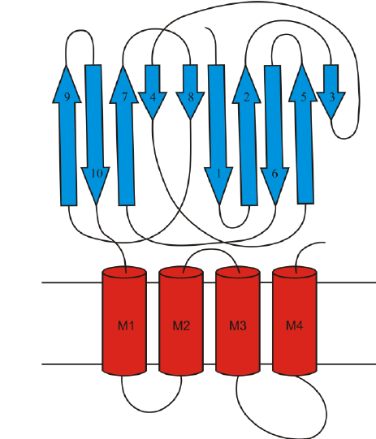
Cys-Loop
Massive extracellular domains with multiple ligands, many potential ions that are permeable
Conformational change opens pore for ion flow
The amount of area allows for multiple locations of non-competitive modulators to bind

Slide 6
Most Well Known Receptor in the Family Nicotinic Acetylcholine Receptor

Slide 7
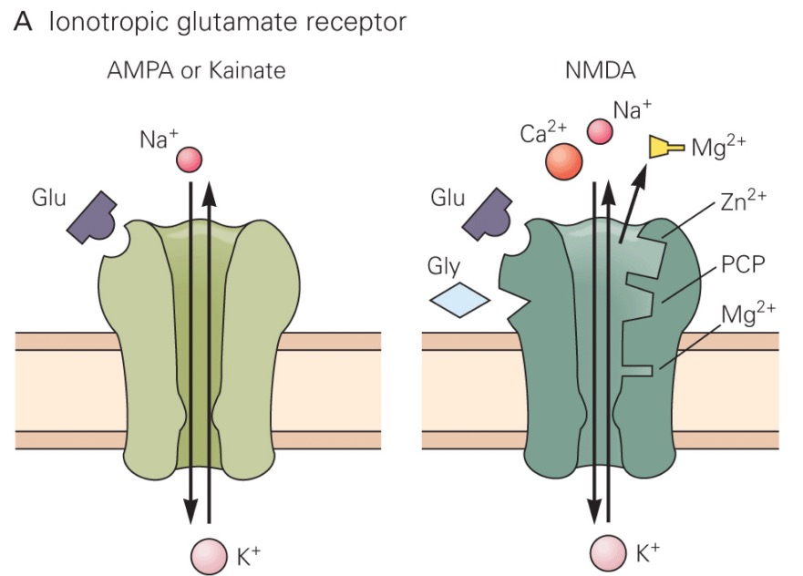
Glutamate Receptors
Ionotropic vs Metabotropic
AMPA
NMDA
Kainate
toxin derived from seaweed
Agonist of AMPA receptors used to study excitotoxicity

Slide 8
Notes:
http://pittmedneuro.com/glutamate.html

Slide 9
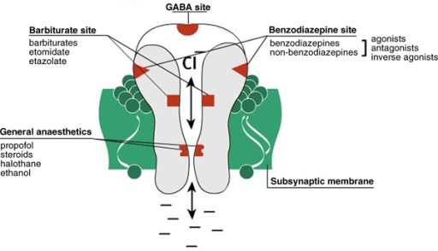
GABA receptors
Mediated by gamma aminobutyric acid (GABA)
Controls Cl- flow into the cell
Causes hyperpolarization
Phylogenetically ancient
Important for prevention of hyperactivity
Lack of regulation leads to seizure-like activity

Slide 10
ATP Gated
3 ATP molecules bind to 3 different subunits
Depolarize the cell by allowing cations to enter
Will either be open for a set period of time (P2X1) OR will stay open as long as the ATP is still bound (P2X2)
The difference between these and ion pumps like the Na-K pump is whether the ions are moving against or with their gradient.

Slide 11
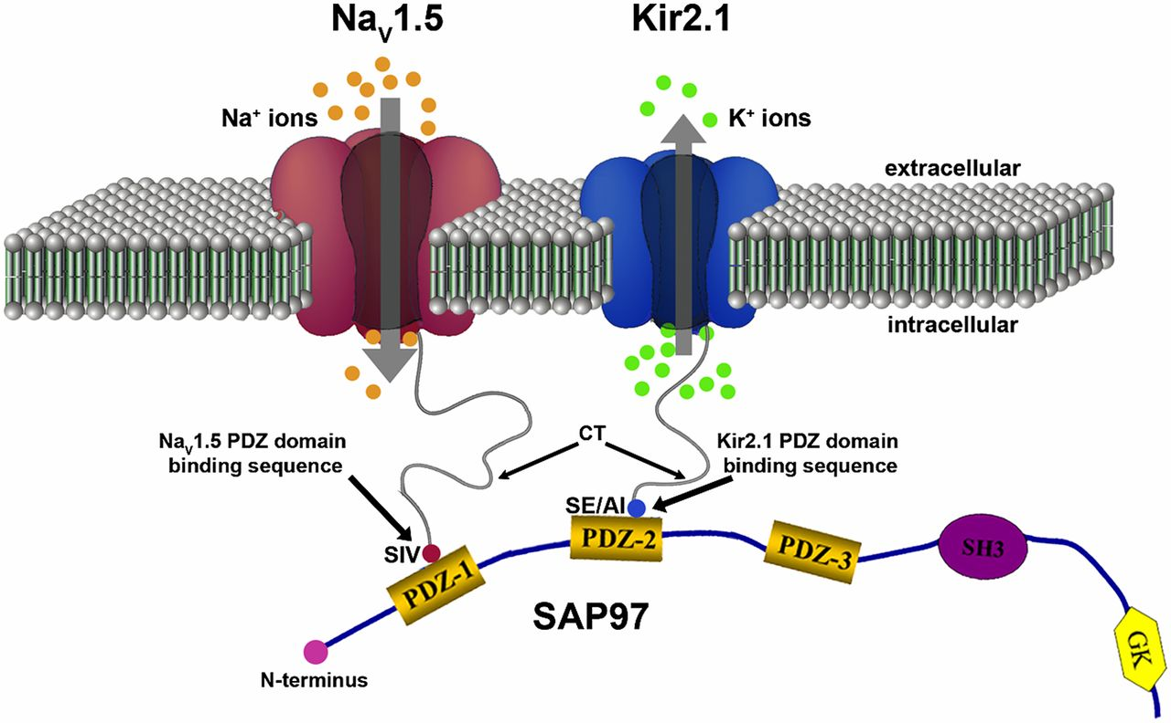
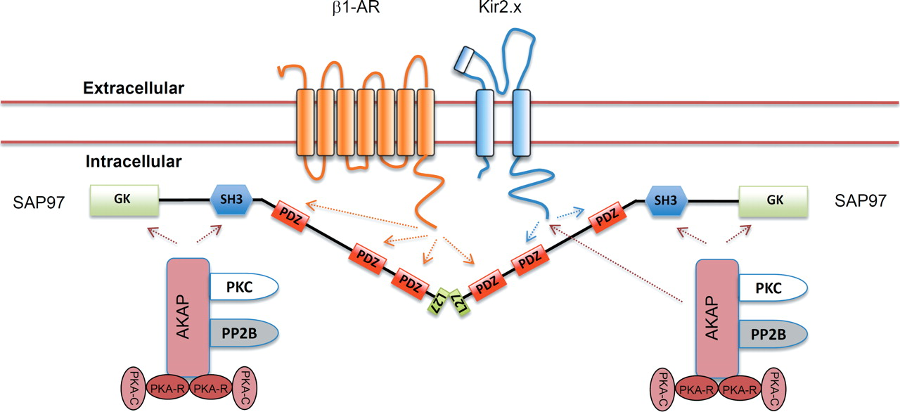
PIP2 Gated
Connected to inward rectifying K+ channels
Involved in cardiac muscle constriction and relaxation

Slide 12
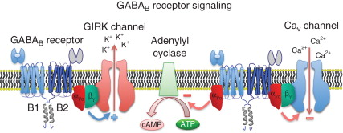
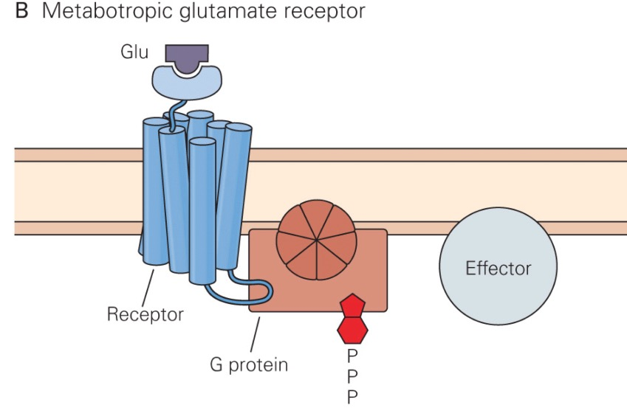
Indirect Modulators
G-protein coupled receptors
Second messenger systems open ion channels
Also alter cellular activity like protein transcription
GABA-B receptors
Hyperpolarize using K+ channels instead of Cl-
Metabotropic Glutamate Receptors

Slide 13
Serotonin type 3 receptors

Slide 14
Serotonin
Serotonin receptors
=5-hydroxytryptamine (5-HT)

Slide 15
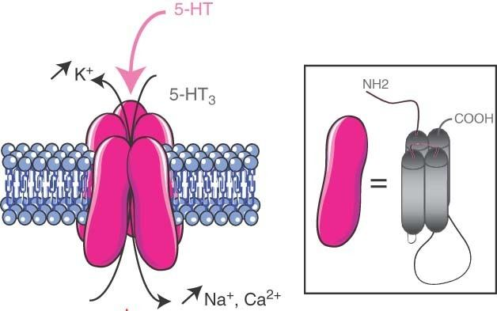
5-Hydroxytryptamine type 3 (5-HT₃) receptors
Cys-loop receptor family
(5 subunits+1 pore)
Cation-selective ion channel
(permeable to Na, K, Ca)
Mediate fast excitatory neurotransmission in the CNS and PNS
Five 5-HT₃ receptor subunits (5-HT₃A~ 5-HT₃E) have been identified in human, while rodent only possess two (5-HT₃A and 5-HT₃B).

Slide 16
Distribution and function of the 5-HT₃ receptors
Central Nervous System (CNS):
highest levels in the brainstem, especially areas involved in the vomiting reflex such as the area postrema and nucleus tractus solitarius.
Pre- and postsynaptically expressed, modulate the release of a range of neurotransmitters (dopamine, GABA, substance P, acetylcholine).
Peripheral Nervous System (PNS):
enteric nervous system
regulate gut motility, secretion, and peristalsis, and are involved in information transfer in the gastrointestinal tract.

Slide 17
Mouse homopentameric 5-HT₃A receptor
Hassaine et al. 2014

Slide 18
5-HT3 Receptor Binding Pocket
Binding pocket:
Lies at the interface of two adjacent subunits in the extracellular N-terminal domain.
Formed by three loops (A-C) from one subunit and three β-strands (D-F) from the adjacent subunits.
Other residues
Maintain the structure of the pocket
Contribute to the conformational changes for channel opening

Slide 19
Ion permeation pathway
First constriction
Hydrophobic constriction
(channel gate)
electronegative surface
Charge selectively

Slide 20
Therapeutic Use and Potential
Treatment for chemotherapy-induced and post-operative nausea and vomiting;
Treatment for Irritable bowel syndrome (IBS);
Treatment for psychiatric disorders;
Limitation
Lack of understanding of the heteromeric 5-HT₃ receptors;
Lack of understanding of the C-E subunits.

Slide 22
Activation-----desensitization (resensitization)-----deactivation
Notes:
Activation of the channel occur when agonist presents. On removal of agonist, currents decay in a process called deactivation.
Currents also decay during continuous agonist exposure and this is because of desensitization. This reflect receptor isomerization to one or more ion-impermeable desensitized states that cannot be activated even by high concentrations of agonist. This desensitization is reversible because 5-HT3 receptors resensitize after the removal of agonist.

Slide 23
Activation of human 5-HT₃ receptors
Whole-cell configuration
Record agonist-evoked current
DA is a partial agonist of 5-HT_{3A} receptors
Receptor activation was rate limited by channel gating
Receptor activation was rate limited by agonist binding kinetics
Receptor activation by DA was rate limited by channel gating

Slide 24
Desensitization of 5-HT₃ receptors
Apply long pulses of agonist as different concentration
Measure rate of desensitization

Slide 25
Resensitization of 5-HT₃ receptors
Apply long pulse (15s) 100uM 5-HT to desensitize receptors
After a variable recovery time (1-30s)
Apply 100uM 5-HT for 1s
Double agonist pulse protocol
DA-induced: Fast recovery
5-HT-induced:
Multistep recovery mechanism

Slide 26
Deactivation of 5-HT₃ receptors
Apply short pulses of agonist at different concentration (to achieve a sufficient peak current response while minimizing desensitiztion.
Measure rate of deactivation.

Slide 27
5-HT₃ receptors recovery after deactivation
Apply short pulse (5-10ms) 100uM 5-HT to desensitize receptors
After a variable recovery time (1-30s)
Apply 100uM 5-HT for 1s
Double agonist pulse protocol*

Slide 28
Cyclic allosteric model
R=resting O=open D=desensitized A=agonist

Slide 29
5-HT₃A receptor activation, deactivation, and resensitization by 5-HT and DA

Slide 30
Structure, Function, and Pharmacology of NMDA Receptor Channels
Physiological Research 2014
The 4 types of Ionotropic Glutamate Receptors
GluA (AMPA)
GluK (Kainate)
GluN (N-Methyl-D-Aspartic Acid)
GluD (δ)

Slide 31
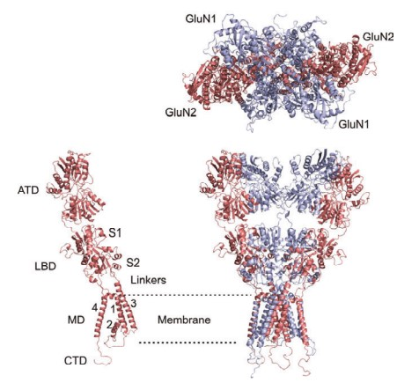
The Structure
Heterotetramers
2 GluN1 and some combination of GluN2 and GluN3 subunits
Conserved domain organization
S1 domains rigid while S2 domains are more mobile
S2 domain being mobile allows for modulation by agonists/antagonists
Ligand binding here changes ion channel forming helices

Slide 32
Proposed 3 Step Mechanism for Opening
Ligand Binds in Ligand Binding Domain (aka the pocket)
-shaped like a clamshell
Conformational change leads to closing of the ligand binding site
This conformational change propagates throughout the protein complex, causing channel opening

Slide 33
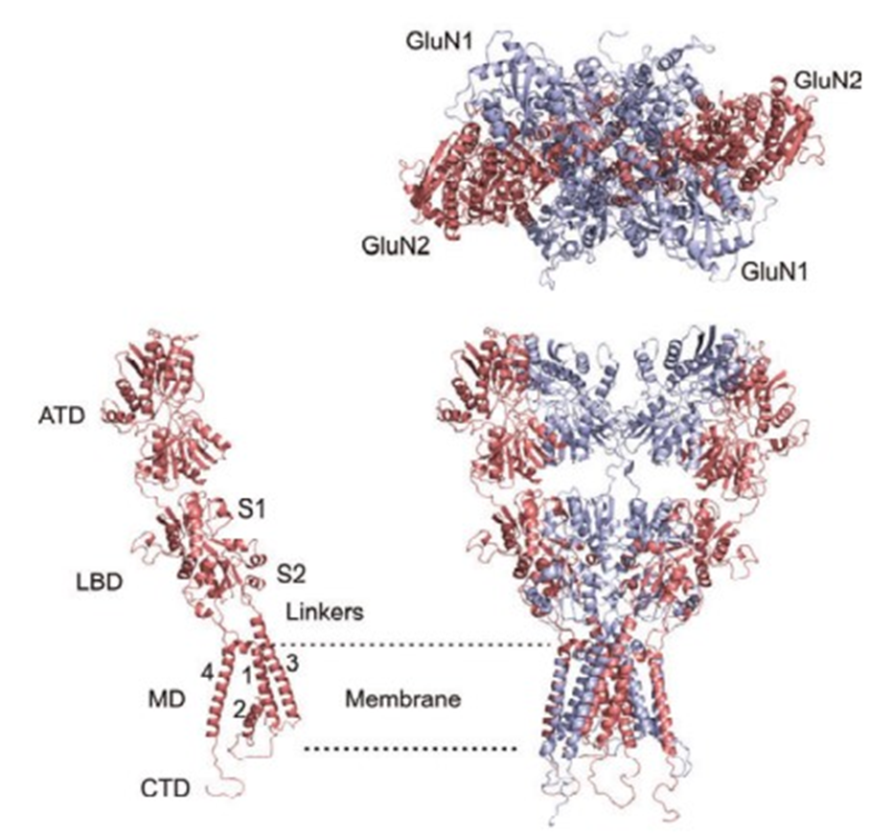
In the Membrane
Domains M1, 3, and 4 are all part of the pore
M3 specifically opens to the central cavity

Slide 34
Activation
Different Subunits change the requirements of the type and amounts of neurotransmitter delivered
Coagonist Glycine required in varying amounts to activate the channels
Found in sufficient concentration in CSF
L-serine, D-serine, D-alanine, L-alanine also serve as coagonists
Glutamate activates the channel by binding to two of the active sites on two of the GluN2 subunits
Cleared from synapse extremely quickly (avoiding cytotoxicity)

Slide 35
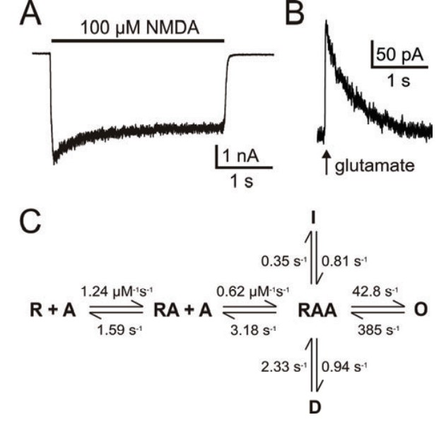
Opening the channel
Cation selective
10x more permeable to Ca2+ than to Na+
Significant amounts of calcium enter the neuron, leading to cellular metabolic activity beyond just action potentials
Cytotoxicity
A single kinetic scheme of channel opening has yet to be identified
Notes:
Fig. 2. Figure 2A illustrates tonic NMDA receptor activation by NMDA applied for 3 s. After a fast onset, this response exhibits desensitization which typically has a double-exponential time course. Deactivation occurs after NMDA is washed off and its time course also has a fast and a slow component. Figure 2B illustrates phasic NMDA receptor activation by synaptically released glutamate. Following a rapid onset, the NMDA receptor response deactivates with double-exponential kinetics (Korinek et al. 2010). Figure 2C presents a basic kinetic scheme of NMDA receptor activation (Lester and Jahr 1992). The rate constants shown were determined for HEK cells expressing recombinant GluN1-1a/GluN2B receptors activated by glutamate at 25 °C with 0.5 mM extracellular calcium (Cais et al. 2008). Their values are different for other agonists, temperatures, Ca2+ concentrations and subunit compositions of NMDA receptors.

Slide 36
How does binding of agonist ligands control intrinsic molecular dynamics in human NMDA receptors?
PLoS One 2018
Notes:
This paper had 29 subfigures so you’re only getting the highlights

Slide 39
Rotation of subunits allows opening of pore

Slide 40
When ligands bind, the binding domains close and rotates which causes the conformational change in the rest of the tetramer and opens the ion channel.

Slide 41
The Transmembrane Domain

Slide 42
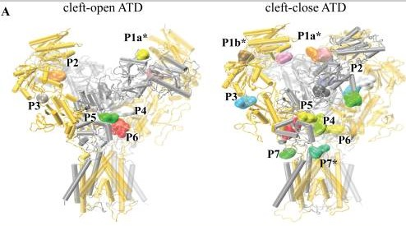
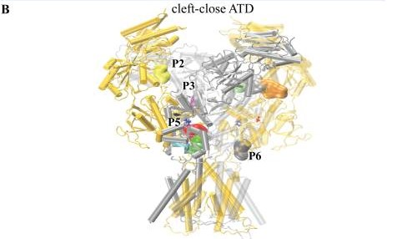
More Area, More Pockets, More Room to Interact
Binding sites for agonists and antagonists allow for a larger diversity of potential responses

Slide 43
NMDA receptors and BAX are essential for Aβ impairment of LTP
Scientific Reports 2012
So in practical and clinical application, what does all this information about the ion channel actually do for us?

Slide 44
Alzheimer’s Disease
Build up of amyloid-β (AB) is a telltale marker
NMDA receptor and AB interaction is believed to lead to degradation and loss of synapses but the mechanism isn’t fully understood
Excitotoxicity from AB acting as an agonist
Looking at GluN2 subunits (GluN2A and GluN2B)
Ro25-6981, GluN2B selective antagonist
D-AP5, broader NMDA antagonist

Slide 45
Quick Background on Hippocampal Recordings

Slide 46
Comparisons of Synaptic Transmission
AB exposure didn’t change fiber volley input/output curver

Slide 47
Comparisons of Synaptic Transmission
Treatment didn’t change Paired Pulse ratio
Both of these indicate that there is no presynaptic transmitter release

Slide 48
Post-synaptic changes
Notes:
C. No significant differences in Long term depression induced
D. LTD induced in AB treated slices but not untreated slices
E. AB treated slices were found to be deficit in LTP

Slide 49
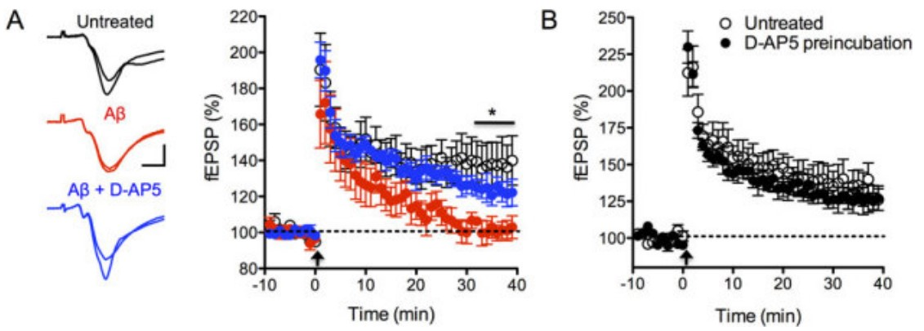
So we know that AB is causing some kind of post-synaptic impairment at the CA1 synapse…
Can we show that it’s from the NMDA channels?
Notes:
Using AP5 to block the channels actually increases LTP, meaning that blocking the channels exposed to AB protects from synaptic degradation

Slide 50
Using a more specific NMDA subunit blocker to try to figure out the exact location
Ro25-6981 attenuates inhibition of LTP
“rescue” of LTP compared to AB, but only partially
Notes:
Remember, Ro25 blocks GluN2B

Slide 51
Does a GluN2B antagonist help rescue LTP?
Notes:
B 2 hour preincubation does not yield changes to LTP, but putting the two together yields no rescue. This indicates that GluN2B is not the subunit activation site that causes the cytotoxicity enduced by AB

Slide 52
Seems a little backwards, right?
It appears that the GluN2B are not involved in the induction of LTP.
Suppression of LTP still happens when combined with AB
How exactly is it possible that a cation change will lead to lower cellular firing activity?
Activation of mitochondrial apoptosis pathway induces LTD
Cytotoxicity
Test that by knocking out pieces of the mitochondrial apoptosis pathway

Slide 53
BAX Knockout Mice
Required for Long Term Depression in hippocampal neurons
Classically known for its pro-apoptotic mitochondrial pathway
Recently discovered to be involved with synaptic plasticity

Slide 54
BAX’s role in enabling the reduction of LTP

Slide 55
That’s important because…
Proteins in the mitochondrial apoptotic pathway appear to have major non-apoptotic functions in living tissue
We still don’t have an exact mechanism, but applying the information gained can help figure it out.
Also help with new treatments for Alzheimer’s

