Slide 1
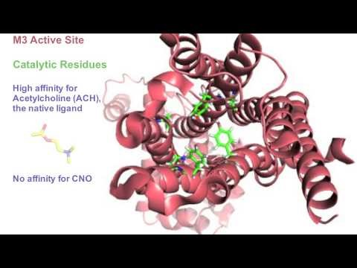
DREADDS
https://www.youtube.com/watch?v=X68yFPwNL2U

Slide 2
Proc Natl Acad Sci U S A. 2007 Mar 20;104(12):5163-8. Epub 2007 Mar 2.
Evolving the lock to fit the key to create a family of G protein-coupled receptors potently activated by an inert ligand.
Armbruster BN¹, Li X, Pausch MH, Herlitze S, Roth BL.

Slide 3
Molecular evolution approach to discover CNO
Followed by point mutation and down-stream
signaling confirmation

Slide 4
A = HEK 293 cells, transfected with G-protein inward
Rectifying K Channel (GIRK) plus either hM4 (control
mACh receptor) or hM4D (designer mACh receptor).
Stimulated with Carbachol (CCh) – a AC analog – or CNO.
C = Cultured hippocampal neurons transiently infected
with hM4 or hM4D. Note that natural ligand activates
both natural and designer receptor. Note that designer
Ligand only activates designer receptor.
E = Current clamp. Activation of hM4D by CNO induces
Hyperpolarization and silencing of neurons. Note without
activation (application of ligand and only presence of receptor
there is no change in resting potential (F).

Slide 5
The DREADD virus is called FLEX switch because it is flanked
by two repeating Lox P site and is backwards.
When infects cells that have cre recombinase, then both
Lox P sites are cleaved and it is flipped in forwards orientation (on).
This achieves cell specific DREADD expression based upon
the specificity of the promoter driving Cre expression.

Slide 6
Selective cell expression of
hM3Dq (excitatory)
mM4Di (inhibitory)
ChR2 (light activated)

Slide 7
Use fiber optic stimulation
of ChR in selective neurons
to cause excitation and
enhance food intake.
Can inject CNO peripherally,
therefore without surgery,
and elicit the same thing in
hM3Dq mice.
Can inject CNO peripherally
In hM4Di mice and cause
opposite behavior by suppressing
activity in this same class of
neurons.

Slide 8
A lot of tools are now available for large classes of cell
types not only cre drivers.

Slide 9
You can probe to see projections
of a circuit with DREADDS
Inect CAV-cre at presumed
Project site and AAV-flex
At presumed soma.
Cav-Cre viral particles are
retrogradely transported back
along the axon to the soma. The
Cre recombinase will cleave the
Double Lox P and flip the DREADD
That can then express mCherry
Along the length of the projection.

Slide 10
Is CNO really activating DREADDS???....Does not
enter the BBB, so may be metabolites are stimulating
these pws with unknown off-target effects.

Slide 11
A, B = HEK cells
C, D = mouse striatum
E, F = mouse whole brain

Slide 12
Radioactive IV/ IP
I, J = DREADD Dq
K,L = DREADD Di
M, N = AAV intracranial
Injection

Slide 13
Still Clinical Therapeutic for DREADDS?
Clozapine is approved for human consumption by the FDAA
Low doses will activate DREADD receptor selectively in vivo
Implications for interpretations for the popular technology
and 100s of papers already published demonstrating in vivo
behavioral effect of CNO.

