Slide 1
Sodium Channels
Membrane Biophysics
Charles Holcombe – Fall 2018

Slide 2
Coming soon…. Nuclear Magnetic Resonance
Membrane BioPhysics
Charles Holcombe – Fall 2018

Slide 3
Na Channels
History
Overview
Review Papers

Slide 4
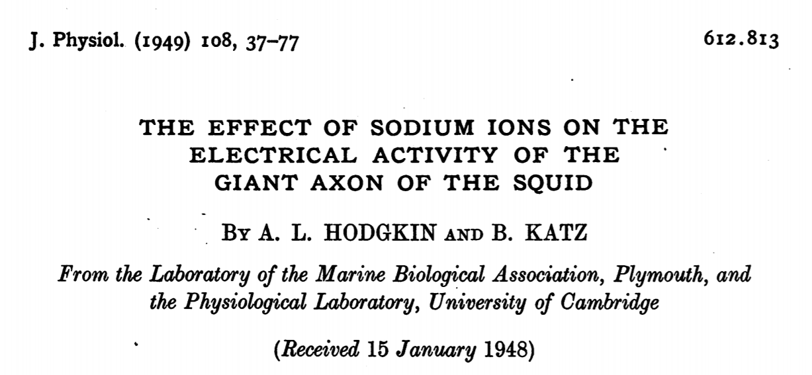
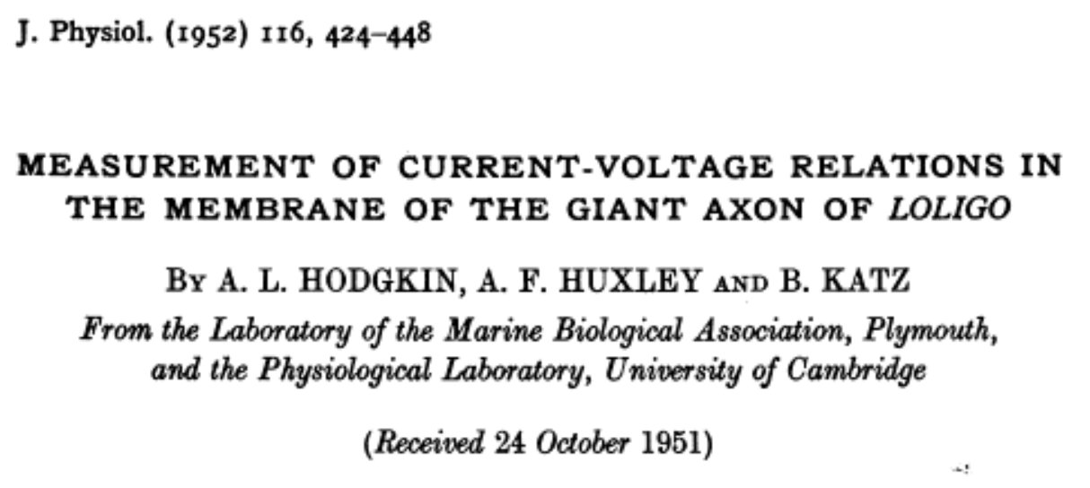
Na Channels
Notes:
Na channels 1st members of ion channel superfamily (also include voltage gated K⁺ and Ca⁺ ) to be discovered.
Hodgkin and Huxley defined the three key features of sodium channels: voltage-dependent activation, rapid inactivation, and selective ion conductance
Electrical signals in nerves were initiated by voltage dependent activation of sodium current that carries Na inward and depolarizes the cell. The sodium current then inactivates within 1-2 ms and electrical signaling is terminated by activation of the voltage gated potassium current which carries K outward and re-established the original balance of electrical charges across the membrane (Catterall, 2014)

Slide 5
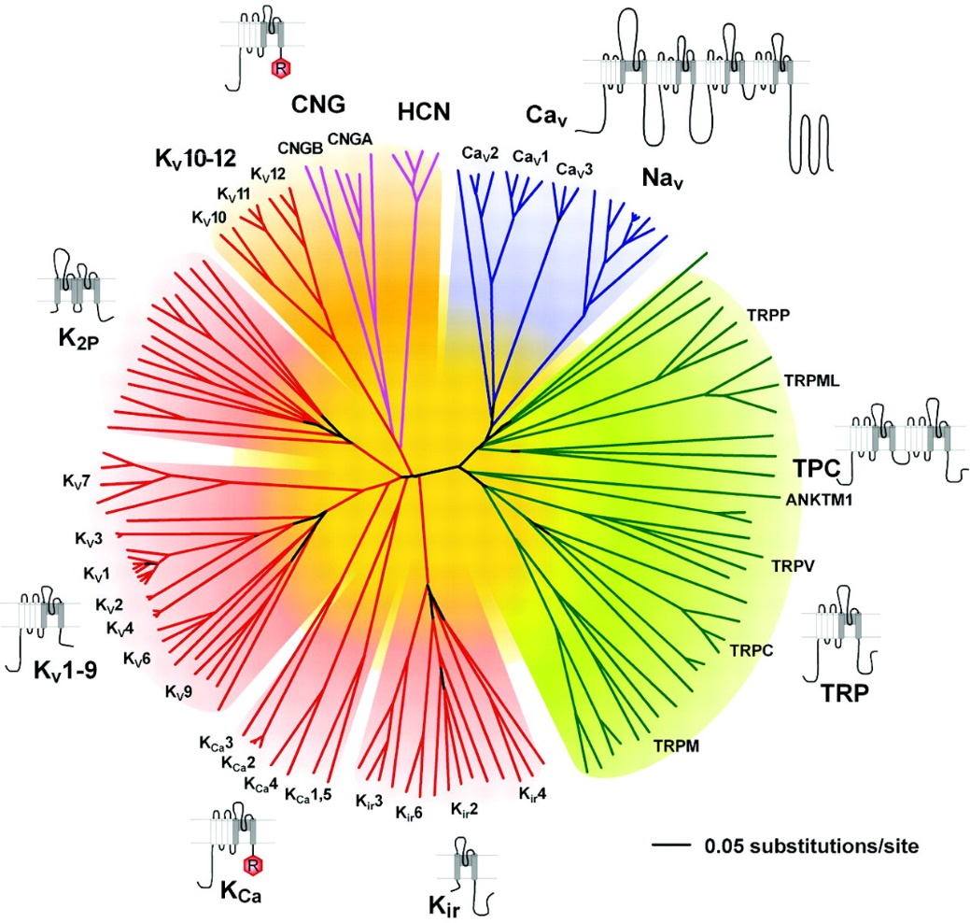
Na Channels
Representation of the amino acid relationships of the minimal pore regions of the voltage-gated ion channel superfamily.
Frank H. Yu et al. Pharmacol Rev 2005;57:387-395
The American Society for Pharmacology and Experimental Therapeutics
Notes:
Representation of the amino acid relationships of the minimal pore regions of the voltage-gated ion channel superfamily. This global view of the 143 members of the structurally related ion channel genes highlights seven groups of ion channel families and their membrane topologies. Four-domain channels (Ca_{V} and Na_{V}) are shown as blue branches, potassium-selective channels are shown as red branches, cyclic nucleotide-gated channels are shown as magenta branches, and TRP and related channels are shown as green branches. Background colors separate the ion channel proteins into related groups: light blue, Ca_{V} and Na_{V}; light green, TRP channels; light red, potassium channels, except K_{V}10-12, which have a cyclic nucleotide binding domain and are more closely related to CNG and HCN channels; light orange, K_{V}10-12 channels and cyclic nucleotide-modulated CNG and HCN channels. Minimal pore regions bounded by the transmembrane segments M1/S5 and M2/S6 were aligned by ClustalX (Thompson et al., 1997) and refined manually. The pore regions of the fourth homologous domain of Na_{V} and Ca_{V} channels, the second domain of the two-pore channels (TPC), and the first pore regions of the K_{2P} channels were used to assemble the alignment, and an unrooted consensus tree was built by minimum evolution analysis using PAUP version 4.0b10 software (Swofford, 2003). To confirm the significance of the relationship among the families that comprise the VGL ion channel superfamily, we tested the significance of the amino acid sequence relationships using the HMM searching procedure. HMM searches of the complete RefSeq database revealed that each ion channel family profile identified another family of voltage-gated-like ion channels as the nearest relative in amino acid sequence of its pore. For example, for the K_{V} channel profile, the nearest neighbor was CNGA1 (HMM e-value of 2.6 × 10⁻³); for the cyclic nucleotide-modulated channel profile, K_{V}11.2 (HMM e-value of 1.5 × 10⁻⁶); for the TRP channel profile, Ca_{V}3.1 (HMM e-value of 1.8 × 10⁻³); and for the Na_{V}/Ca_{V} profile, CatSper (HMM e-value of 9.4 × 10⁻⁶). The e-value is a measure of the number of hits from HMM searches that would be expected by chance; values less than 1.0 indicate a highly significant amino acid sequence relationship to the probe profile (Yu and Catterall, 2004).

Slide 6
Na Channels
Voltage Gated (Na_{v})
Epithelial sodium channels (ENaCs)
Structurally unrelated to voltage-gated sodium channels
members of the ENaC/Deg (epithelial amiloride-sensitive Na+ channel and degenerin) family of ion channels.
Notes:
ENaCs - They are highly selective Na+ channels that are localized to polarized epithelial cells. ENaC - assembled from homologous α-, β-, and γ-subunits. Each member has two transmembrane helices (TM1 and TM2), relatively short amino and carboxyl termini, and a large extracellular region that encompasses several domains.
The epithelial sodium channels (ENaC) are located on the apical membrane of epithelial cells in the distal kidney tubules, lung, respiratory tract, male and female reproductive tracts, sweat and salivary glands, placenta, colon and some other organs [6,10,19]. In these epithelia, ENaC allows flow of Na+ ions from the extracellular fluid in the lumen into the epithelial cell. Na+ ions are then pumped out of the cytoplasm into the interstitial fluid by the Na+/K+ ATPase located on the basolateral membrane [34].
34. Vinciguerra M, Mordasini D, Vandewalle A, Feraille E. (2005) Hormonal and nonhormonal mechanisms of regulation of the NA,K-pump in collecting duct principal cells. Semin. Nephrol., 25 (5): 312-21. [PMID:16139686]

Slide 7
Papers Reviewed
Catterall, W. 2014. Structure and function of voltage-gated sodium channels at atomic resolution. Exp. Physiol. 99.1: 35-51.
Waxmann et al., 1999. Sodium channels and pain. PNAS 96: 7635-7639.
Dab-Hajj et al., 2015. Nav1.9: A sodium channel linked to human pain. Nature 16: 511-519.
Patel, R.R. et al., 2016. Aberrant sodium channel activity can be targeted with cannabidiol. Brain. 139(8):2164-2181.

Slide 8
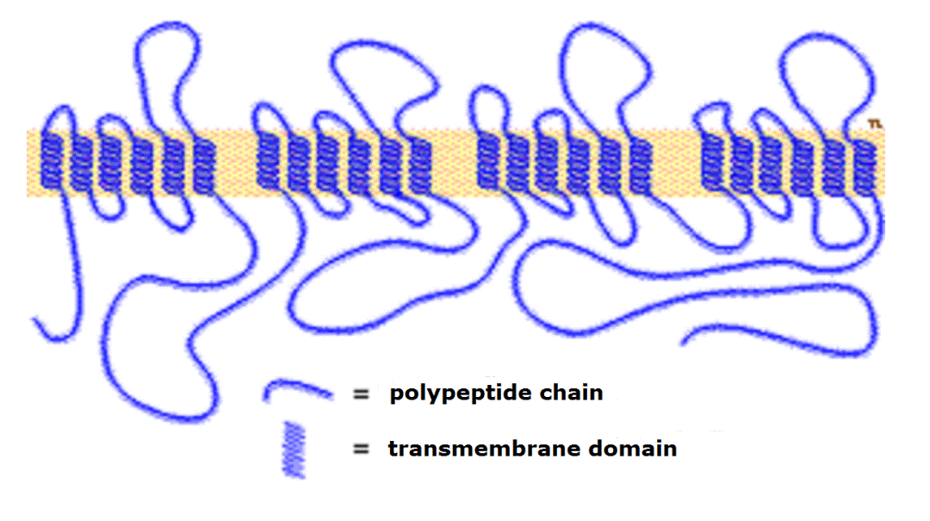
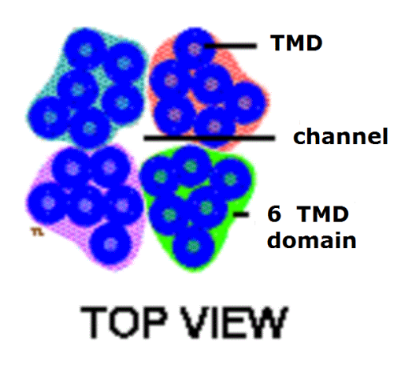
Overview of Na_{v} Channel
Notes:
Simple Na channel topography diagram showing 24 TM domains - the alpha-helices are shown spread out and in a row and divided into four groups. Each of these is an homologous domain with a similar sequence of amino acids – Top view shows more realistic configuration

Slide 9
Overview Na_{v} Channels
Large multimeric complex composed of an α (260 kDa) subunit and one or more auxiliary β (33-36 kDa) subunits
Nine α subunits (Na_{v1.1} – Na_{v1.9}) functionally characterized
Four homologous domains containing 6 TM segments
Voltage sensor in S4 segments
Outer pore re-entrant loops between S5-S6
Notes:
According to the convention of the International Union of Pharmacologists, the nomenclature of sodium channels (for example, Nav1.1) consists of the chemical symbol of the principal permeating ion (Na) and the principal physiological regulator (voltage, subscript) followed by a number indicating the gene subfamily and a decimal that separates the number assigned to specific channel isoforms
Voltage sensor – S4

Slide 10
Overview Na_{v} Channels

Slide 11
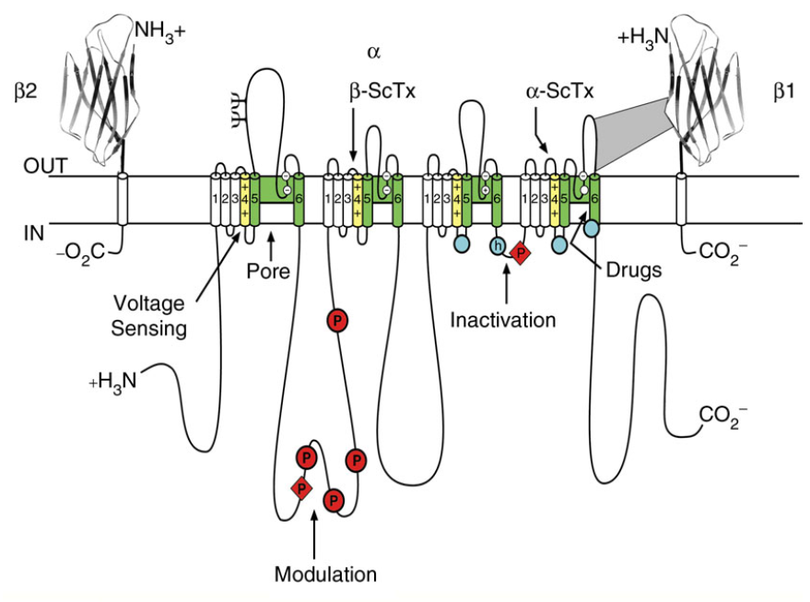
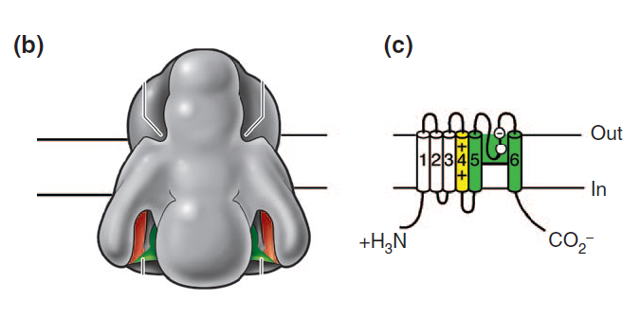
Overview Na_{v} Channels
Notes:
Structure of voltage-gated sodium channels. (a) Schematic representation of the sodium-channel subunits. The subunit of the Nav1.2 channel is illustrated together with the 1 and 2 subunits; the extracellular domains of the subunits are shown as immunoglobulin-like folds, which interact with the loops in the subunits as shown. Roman numerals indicate the domains of the subunit; segments 5 and 6 (shown in green) are the porelining segments and the S4 helices (yellow) make up the voltage sensors.
Blue circles in the intracellular loops of domains III and IV indicate the inactivation gate IFM motif and its receptor (h, inactivation gate); P, phosphorylation sites (in red circles, sites for protein kinase A; in red diamonds, sites for protein kinase C); Capital Psi, probable N-linked glycosylation site. The circles in the re-entrant loops in each domain represent the amino acids that form the ion selectivity filter (the outer rings have the sequence EEDD and inner rings DEKA). (b) The three-dimensional structure of the Nav channel -subunit at 20 Å resolution, compiled from electron micrograph reconstructions
B The three-dimensional structure of the Nav channel -subunit at 20 Å resolution, compiled from electron micrograph reconstructions
(c) Schematic representation of NaChBac, the bacterial voltage-gated sodium channel. – crystallized in pre-open state

Slide 12
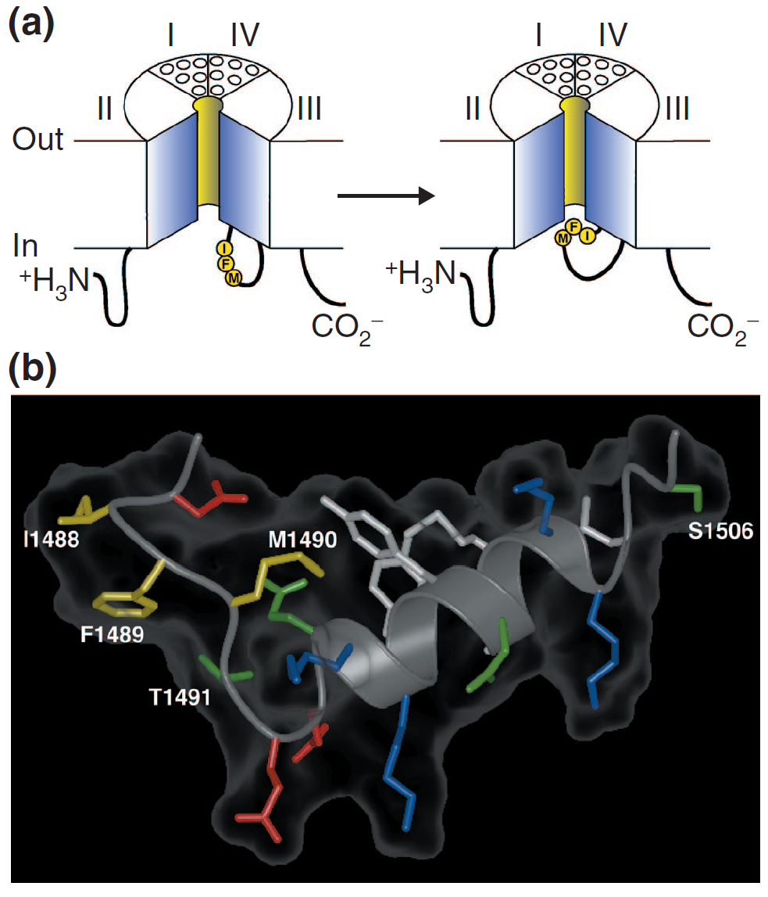
Overview Na_{v} Channels
Notes:
Mechanism of inactivation of sodium channels. (a) The hinged-lid mechanism. The intracellular loop connecting domains III and IV of the
sodium channel is depicted as forming a hinged lid with the critical phenylalanine (F1489) within the IFM motif shown occluding the mouth of
the pore during the inactivation process. The circles represent the transmembrane helices. (b) Three-dimensional structure of the central
segment of the inactivation gate, as determined by multidimensional NMR. Side chains of the critical IFM motif residues (I1488, F1489 and M1490)
are shown in yellow, and those of T1491, which is important for inactivation, and S1506, which is a protein-kinase-C-dependent
phosphorylation site, are also indicated. Adapted from [4].

Slide 13
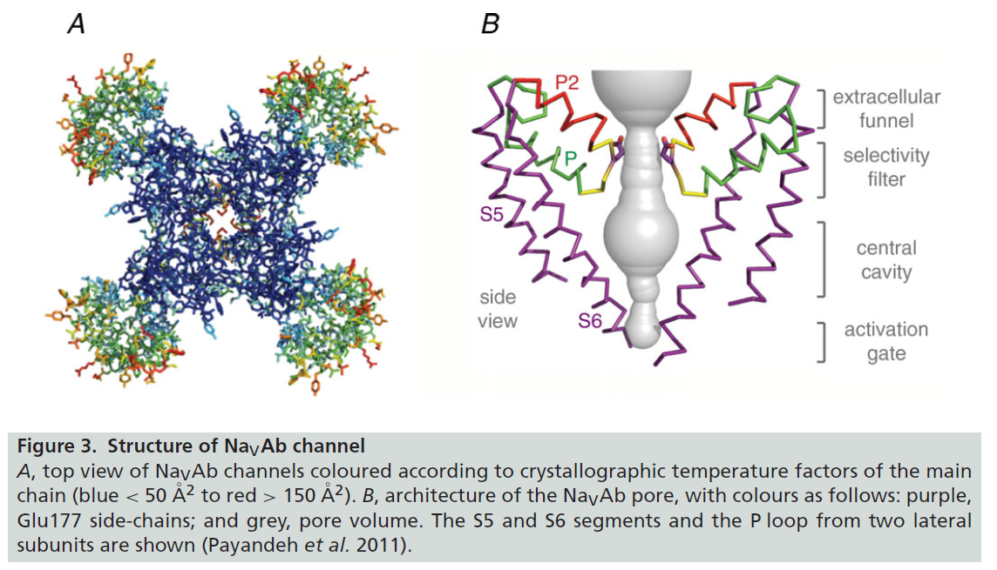
Overview Na_{v} Channels
Notes:
Sodium channel architecture has recently been revealed in three dimensions by determination of the crystal structure
of the bacterial sodium channel NaVAb at high resolution (2.7 A° ; Fig. 3; Payandeh et al. 2011).
This structure has revealed a wealth of new information about the structural basis for voltage-dependent activation, pore opening, sodium selectivity and conductance, the mechanism of block of the channel by therapeutically important drugs and the mechanism of inactivation
Although the structure of the activated voltage sensor is now well known, understanding the mechanism of voltage-dependent gating requires knowledge of the
structure of the voltage sensor in its resting state at high resolution. This structure has proved difficult to define by X-ray crystallography because the resting
state is only present in cells at the resting membrane potential of approximately −80 mV, and there is no membrane potential in protein crystals.
So use modelling...

Slide 14
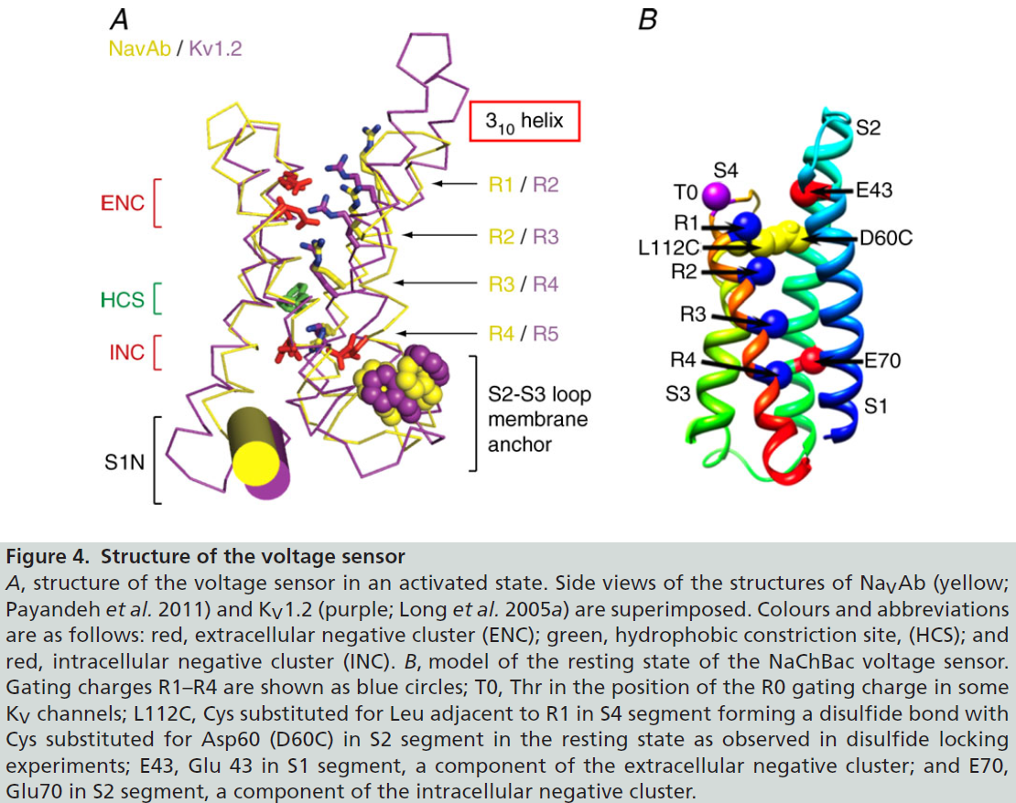
Overview Na_{v} Channels
Notes:
Used similarities for Kv1.2 to create and test model – more

Slide 15
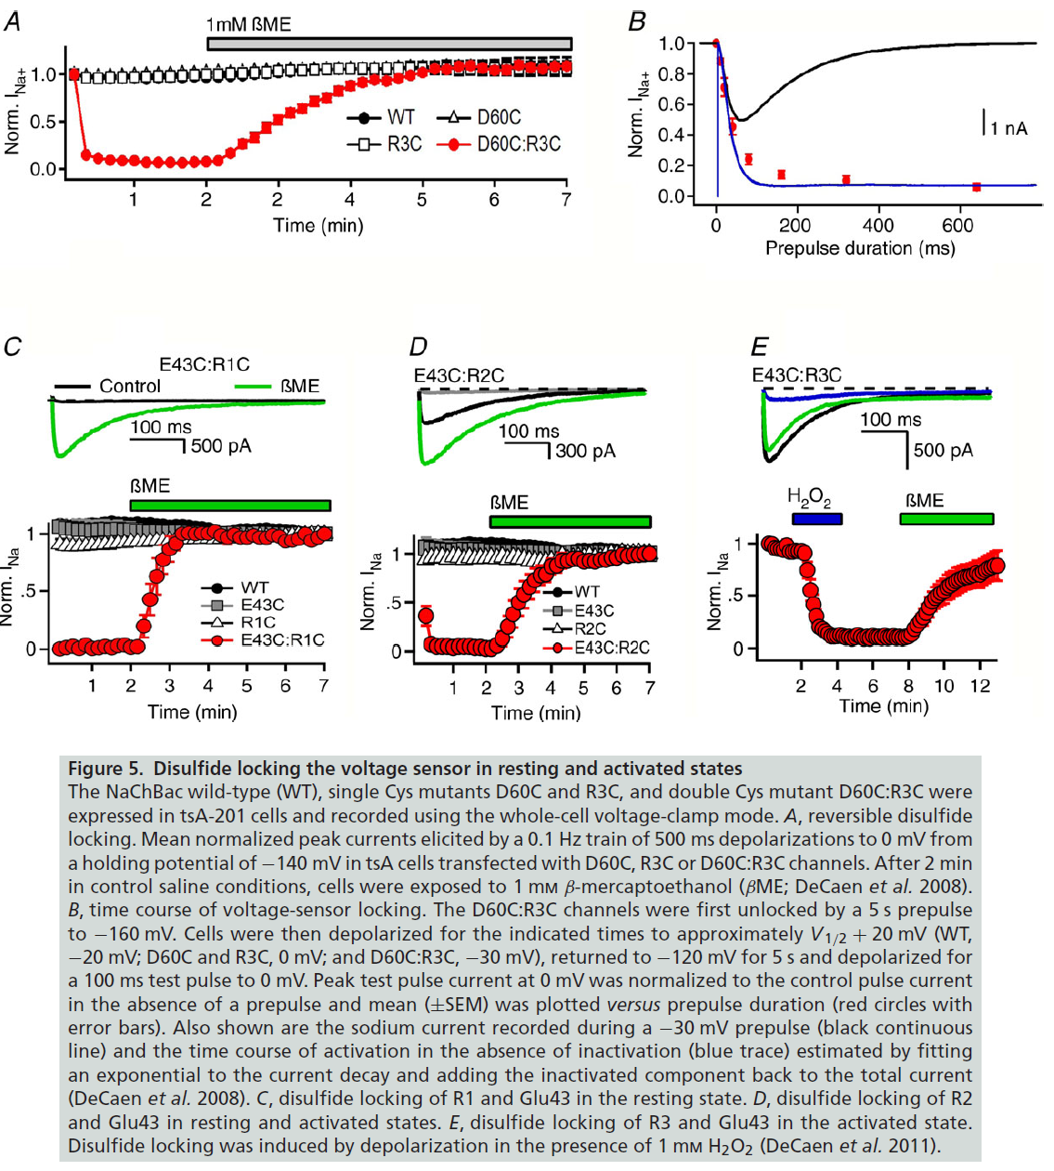
Overview Na_{v} Channels
Justified (ROSETTA) structural model based on extensive disulfide-locking studies of the ion-pair interactions in sodium channels predicted from sliding helix model

Slide 16
Overview Na_{v} Channels
Side View
Extracellular View
Intracellular View
Notes:
1. View of the conformational changes between the Resting State 1 and Activated State 3 of NaChBac from the side of the membrane. Only a single voltage-sensing domain is shown attached to the tetramer of pore domain for clarity. The models represented are as in Fig. 5B. Movies S1, S2, and S3 were generated using the University of California at San Francisco Chimera package (1)
2. View of the conformational changes between the Resting State 1 and Activated State 3 of NaChBac shown in Movie S1 from the extracellular side of the membrane.
3. View of the conformational changes between the Resting State 1 and Activated State 3 of NaChBac shown in Movie S1 from the intracellular side of the membrane.
completeworking model of a mammalian sodium channel
with a complete pore domain, a single voltage sensor (for
clarity) and an inactivation gate (SupplementalMovie S4).
Running the Movie shows the outward movement of the
S4 gating charges, the exchange of ion-pair partners that
takes place as they move, the rolling motion of the S1–S3
segments around the S4 segment, the consequent rolling
motion of the voltage sensor around the lateral surface
of the pore domain, the torque on the S4–S5 segment as
it move along the plane of the inner membrane surface
to pull on the S5 and S6 segments, the subtle bending
and twisting motion of the S6 segments and the opening
of the pore. As the pore opens, sodium ions enter from
outside the cell, and the fast inactivation gate closes to
terminate sodium conductance Amazingly, this series of
conformational transitions takes place within 2 ms and
generates the electrical signals that are responsible for
information encoding and transmission in the brain,
action potential conduction in nerves, contraction of
muscles and many other physiological processes

Slide 17
Overview Na_{v} Channels

Slide 18
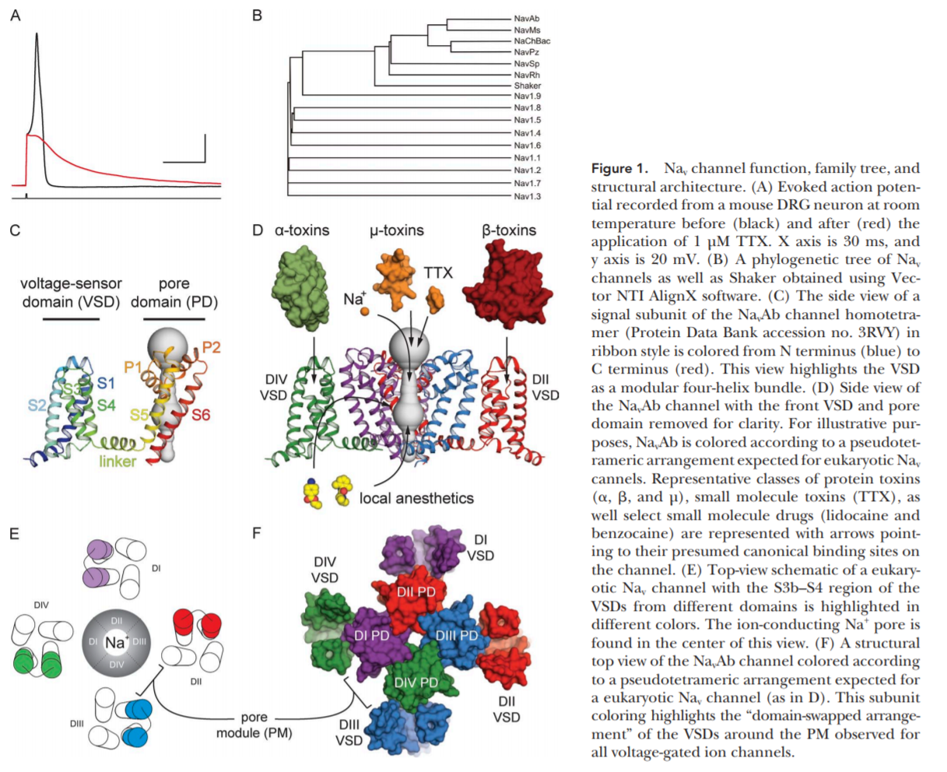
Overview Na_{v} Channels
Notes:
Hitchhiker’s guide to voltage gated sodium channel galaxy – Ahern et all, 2015

Slide 19
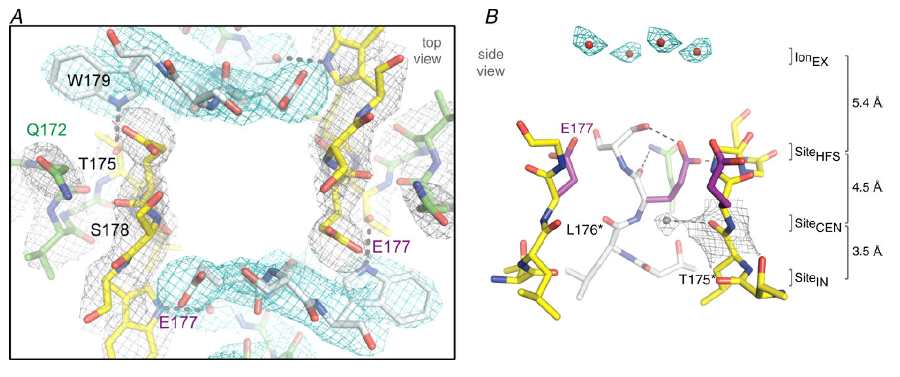
Overview Na_{v} Channels
Permeability
~6 x 10⁶ ions s-1
Selectivity Filter:
^{Selectivity Filter:}
Notes:
Figure 7 in Catterall article

Slide 20
Overview Na_{v} Channels
Fast inactivation
Within 1-2 ms (as seen by Hodgkin and Huxley)
Intracellular loop connecting domains III and IV
A hydrophobic motif containing the amino acid sequence isoleucine, phenylalanine, and methionine (IFM) is required for the inactivation process
Notes:
Fast inactivation required for repetitive firing of AP in neural circuits and for control of excitability in nerve and muscle cells; short intracellular loop connecting homologous domains 3 and 4 of the Na channel α subunit is responsible for fast inactivation (cutting this loop greatly slowed inactivation)
-Hinged lid model
- Fast inactivation get not present in homotetrameric bacterial sodium channels

Slide 21
Overview Na_{v} Channels
Slow inactivation
100s ms (also seen in squid giant axon ~1970s)
Less known, but suspect conformational changes in the selectivity filter and the S6 segment

Slide 22
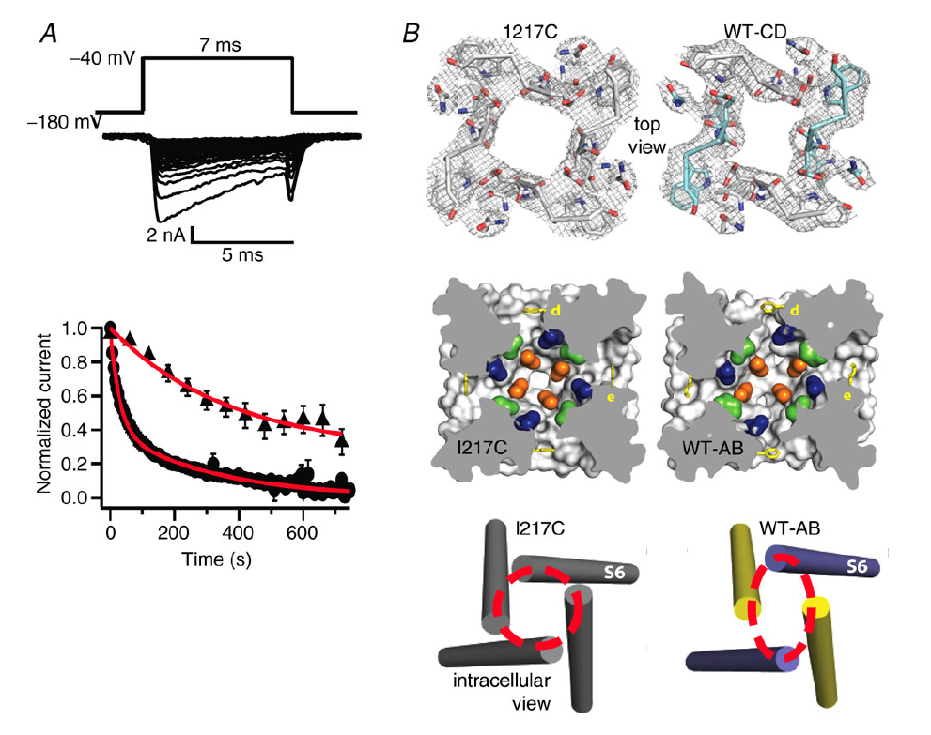
Overview Na_{v} Channels
Structure of slow the inactivated state in Na_{V}Ab
Notes:
A, use-dependent development of slow inactivation. Depolarizations from a holding potential of
−180 mV to −40 mV, 7 ms in duration, were applied at 0.2 Hz (filled circles) or once per minute (filled
triangles), and the peak current elicited by each pulse was measured. Currents were normalized to
the peak inward current during the first pulse. B, top diagrams shown the selectivity filter as stick
representations with a 2Fo–Fc map calculated at 3.2 °A resolution (grey mesh) contoured at 1.5 σ for
NaVAb -I217C and 1.0 σ for NaVAb -CD. Symmetry-related subunits in WT-CD are coloured white (chains
A and D) and cyan (chains B and C), respectively. Middle diagrams illustrate the central cavity. A view
through the pore module sectioned below the selectivity filter illustrates the lateral pore fenestrations,
hydrophobic access to the central cavity, and structural asymmetry in the NaVAb-AB pore domain. Phe203
side-chains are yellow sticks. NaVAb residues implicated in drug binding in vertebrate NaV channels are
coloured as follows: blue, Thr206; green, Met209; and orange, Val213. Bottom diagrams illustrate the
activation gate. Red dashed lines indicate the Cα location of D219 (the last S6 residue modelled in WTAB),
where the S6 helices are shown as cylinders. Colurs are as follows: purple, WT chain A; and yellow,
WTchain B (Payandeh et al. 2012).
C

Slide 23
Overview Na_{v} Channels
Mammalian model with complete pore domain, single voltage sensor and an inactivation gate
Notes:
Movie shows the outward movement of the S4 gating charges, the exchange of ion-pair partners that takes place as they move, the rolling motion of the S1–S3
segments around the S4 segment, the consequent rolling motion of the voltage sensor around the lateral surface of the pore domain, the torque on the S4–S5 segment as it move along the plane of the inner membrane surface to pull on the S5 and S6 segments, the subtle bending and twisting motion of the S6 segments and the opening of the pore. As the pore opens, sodium ions enter from outside the cell, and the fast inactivation gate closes to terminate sodium conductance Amazingly, this series of conformational transitions takes place within 2 ms and generates the electrical signals that are responsible for information encoding and transmission in the brain, action potential conduction in nerves, contraction of muscles and many other physiological processes

Slide 24
Overview Na_{v} Channels
Catterall, W. 2014. Structure and function of voltage-gated sodium channels at atomic resolution. Exp. Physiol. 99.1: 35-51.
He reviews his own paper and it’s so much better:

Slide 25
Na Channels and Pain
Pain pathways begin with primary sensory neurons
Dorsal root ganglion (DRG)
Trigeminal neurons
Changes in excitability and baseline sensitivity leads to abnormal AP that can produce chronic pain

Slide 26
Na Channels and Pain
DRG neurons express a complex repertoire of multiple distinct sodium channels, encoded by different genes
Some of these sodium channels are sensory neuron specific
Sodium channel expression in DRG neurons is highly dynamic, changing substantially not only during development, but also in various disease states, including some that are accompanied by pain.
Notes:
First paper (1998- Waxman)

Slide 27
Na Channels and Pain
Hyperexcitability in DRC Cells after injury
Injury to axons leads to changes in excitability
Abnormal Na channel accumulation at tips of injured axons
Increased density of Na channels
Link between Na channel activity and sensory neuron hyperexcitability producing pain

Slide 28
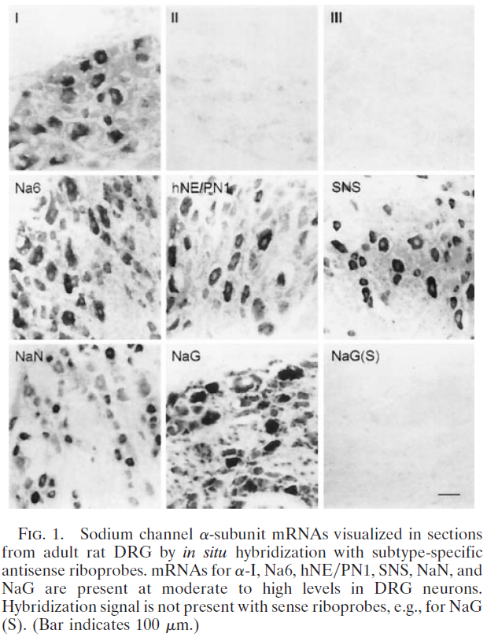
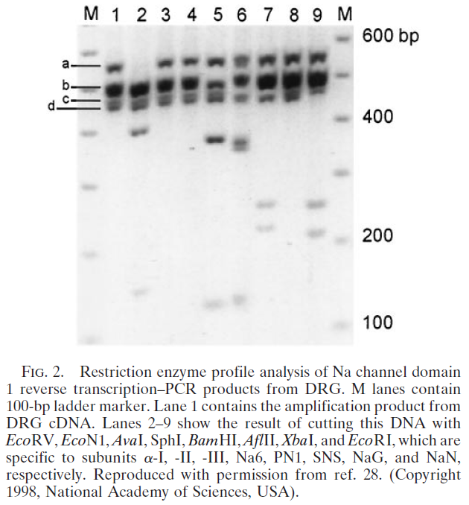
Na Channels and Pain
Multiple Sodium Channels in Primary Sensory Neurons
Notes:
DRG neurons, which had been known to display multiple, distinct sodium currents (19–22), express at least six sodium channel transcripts (23), as illustrated by the in situ hybridizations and reverse transcription–PCR shown in Figs. 1 and 2.

Slide 29
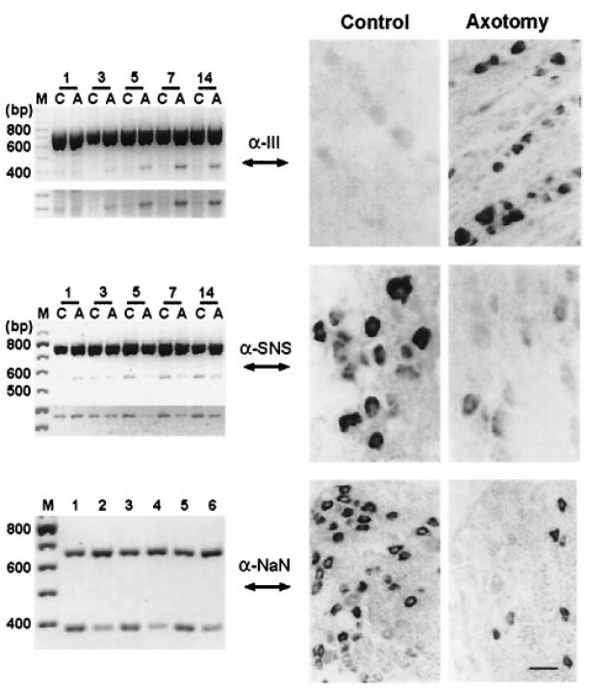
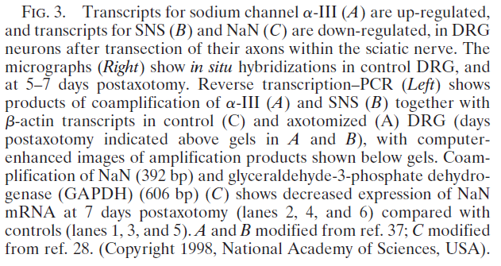
Na Channels and Pain
Sodium Channel Gene Expression Is Altered After Injury to DRG Neurons

Slide 30
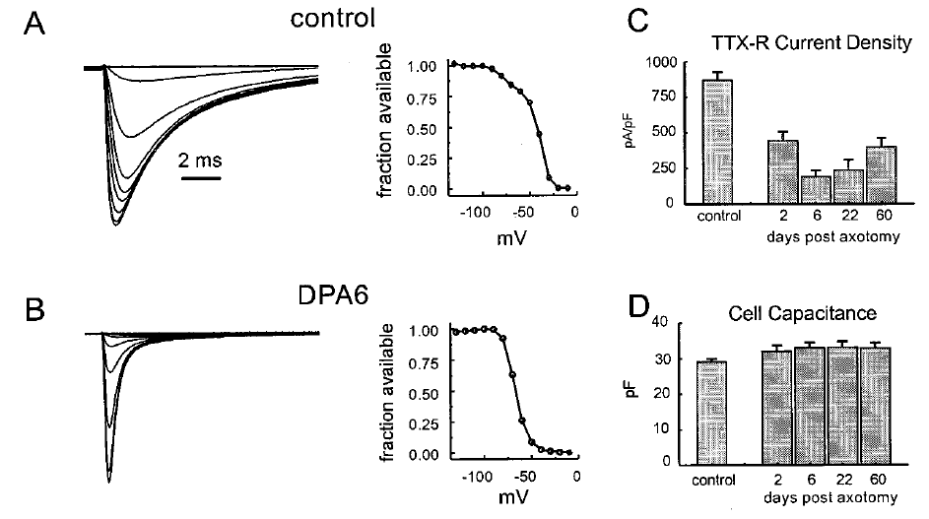
Na Channels and Pain
Physiologic Changes Accompany Altered Sodium Gene Expression After DRG Neuron Injury
TTX-resistant Na currents in small DRG neurons are down regulated after axotomy – persists at least 60 days
Notes:
(A and B, Left) Whole-cell patch-clamp
recordings from representative control (A) and axotomized (B, 6 days postaxotomy) DRG neurons. Note the loss of the TTX-resistant slowly
inactivating component of sodium current after axotomy. Steady-state inactivation curves (A and B, Right) show loss of a component characteristic
of TTX-resistant currents. (C) Attenuation of TTX-resistant current persists for at least 60 days postaxotomy. (D) Cell capacitance, which provides
a measure of cell size, does not change significantly after axotomy (modified from ref. 39).

Slide 31
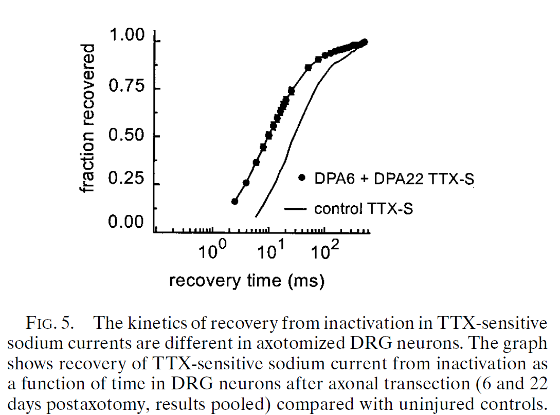
Na Channels and Pain
Physiologic Changes Accompany Altered Sodium Gene Expression After DRG Neuron Injury
Notes:
Indicates faster recovery from inactivation after injury, can fire more quickly now = hyperexcitability

Slide 32
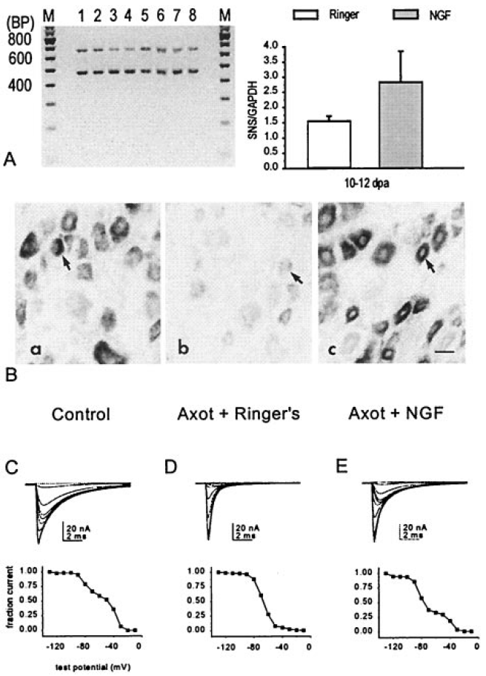
Na Channels and Pain
Neurotrophins Modulate Sodium Channel Expression in DRG Neurons
Notes:
small DRG neurons were studied in vivo after axotomy and it was demonstrated that administration of exogenous nerve growth factor (NGF) to the proximal nerve stump results in an up-regulation of TTX-resistant sodium current and of SNSyPN3 mRNA levels in small DRG neurons
-

Slide 33
Na_{v}1.9 and Human Pain
Na_{V}1.9 plays an important part both in regulating sensory neuron excitability and in pain signaling
Potential therapeutic target for pain

Slide 34
Na_{v}1.9 and Human Pain
Nine genes (SCN1A–SCN5A and SCN8A–SCN11A) in mammals encode the pore-forming α‑subunits of sodium channels, Na_{V}1.1–Na_{V}1.9
Na_{V}1.7 - Na_{V}1.9 are preferentially expressed in peripheral neurons and play an important role in normal and pathological pain

Slide 35
Na_{v}1.9 and Human Pain
Each of these channels has a conserved motif of 24 transmembrane segments that are organized into four homologous domains (DI–DIV), each with six transmembrane segments (S1–S6) that are linked by cytoplasmic loops, and cytoplasmic amino and carboxyl termini. The S1–S4 segments of each domain form the voltage-sensing domain, whereas S5 and S6, and the extracellular linker that joins these two segments, form the pore domain. The S5–S6 linker in each domain contains two membrane re‑entrant segments (SS1 and SS2) that contribute to the sodium-selectivity filter, and the DI–SS2 carries a residue that determines susceptibility to blockade by tetrodotoxin (TTX). Whereas the presence of an aromatic residue confers sensitivity to nanomolar concentrations of TTX, a serine or cysteine in this position confers resistance to micromolar concentrations of TTX1.

Slide 36
Na_{v}1.9 and Human Pain
Na_{V}1.9 Expression
First identified in DRG and trigeminal Ganglia from rats
SCN11A1 (encoding gene) mapped to human chromosome 3 (3p21-24)
Preferentially expressed in small diameter (<30 μm diameter) neurons

Slide 37
Na_{v}1.9 and Human Pain
Physiology of Na_{V}1.9 Channels
Na_{V}1.9 mediates TTX-resistant sodium ion current
Presence of a serine residue in DI-SS2 pore region
Na_{v}1.6/7 – tyrosine ( TTX sensitive)
Inactivation is unusually ultra-slow
Results in persistence of Na current activation
Large overlap between activation and inactivation (i.e., large window current)
Notes:
NaV1.9 mediates a TTX-resistant (TTX‑R) sodium ion current, which is consistent with the presence of a serine residue at the TTX-susceptibility-determining site in the
DI–SS2 pore region of the channel; amino acid residues with an aromatic ring (for example, tyrosine in NaV1.6 and NaV1.7) at this position in TTX‑S channels engage TTX
in a cation–π interaction that increases the affinity of the toxin for the binding pocket within the outer vestibule of the channel. By contrast, the presence of serine (as in NaV1.8 and NaV1.9) or cysteine (as in NaV1.5) markedly reduces the affinity of the TTX–channel interaction by several orders of magnitude

Slide 38
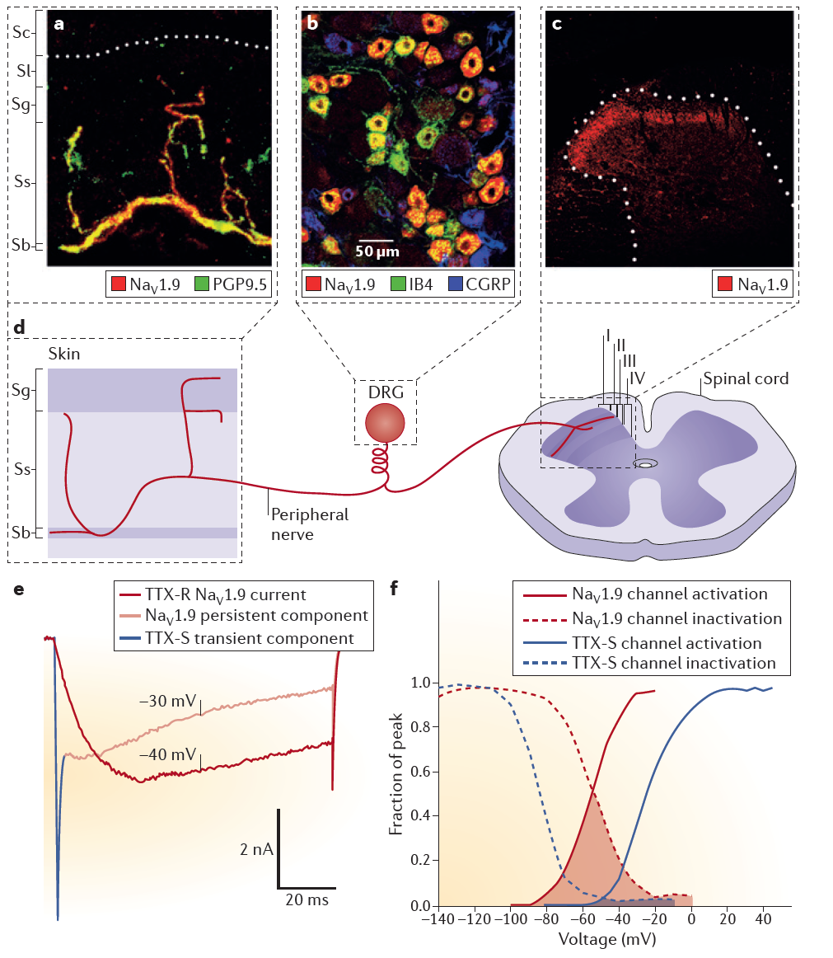
Na_{v}1.9 and Human Pain
Notes:
E -The persistent tetrodotoxin-resistant
(TTX‑R) sodium currents mediated by NaV1.9 channels and, for comparison, fast-inactivating TTXsensitive
(TTX‑S) currents mediated by NaV1.6 and/or NaV1.7 channels recorded from a small-diameter
NaV1.8‑null mouse DRG neuron that lacks the slow TTX‑R current mediated by NaV1.8 channels.
Current traces that result from 100 ms depolarizing pulses from a holding potential of −120 mV (to
ensure that all NaV channels are available to open) to the membrane voltages indicated on the traces
show that NaV1.9 channels activate at more hyperpolarized potentials than do the fast TTX‑S channels.
Depolarization to −40 mV activates only NaV1.9 channels (red trace), whereas a depolarizing
stimulus at −30 mV shows a compound trace consistent with activation of both a fast-inactivating
TTX‑S component (blue trace) and the NaV1.9‑mediated persistent component (pale red trace). Note
the rapid activation and inactivation of the TTX‑S current compared with the slow activation and very
slow inactivation of NaV1.9. F | Fitting the activation data of NaV1.9 currents (solid red curve) and TTX‑S
currents (solid blue curve) to a Boltzmann function shows that NaV1.9 channels activate at more hyperpolarized
potentials (that is, they open more easily at hyperpolarized potentials) than do the fastactivating
and fast-inactivating TTX‑S sodium channels. The steady-state inactivation curves for
TTX‑R, NaV1.9‑mediated persistent channels (dashed red line) and fast-inactivating TTX‑S sodium
channels (dashed blue line) show that NaV1.9 channels remain available at more depolarized potentials
than do the TTX‑S channels. The voltage domain delineated by the overlap between the activation
and inactivation curves corresponds to the ‘window current’ that is produced by the different channels,
and is substantially larger for NaV1.9 (red) than for the TTX‑S channels (blue). The increased
window currents of NaV1.9‑expressing DRG neurons are predicted to promote the depolarization
of resting membrane potential and thus contribute to boosting weak stimuli. Parts e,f courtesy of
J. Huang, Yale University School of Medicine, Connecticut, USA

Slide 39
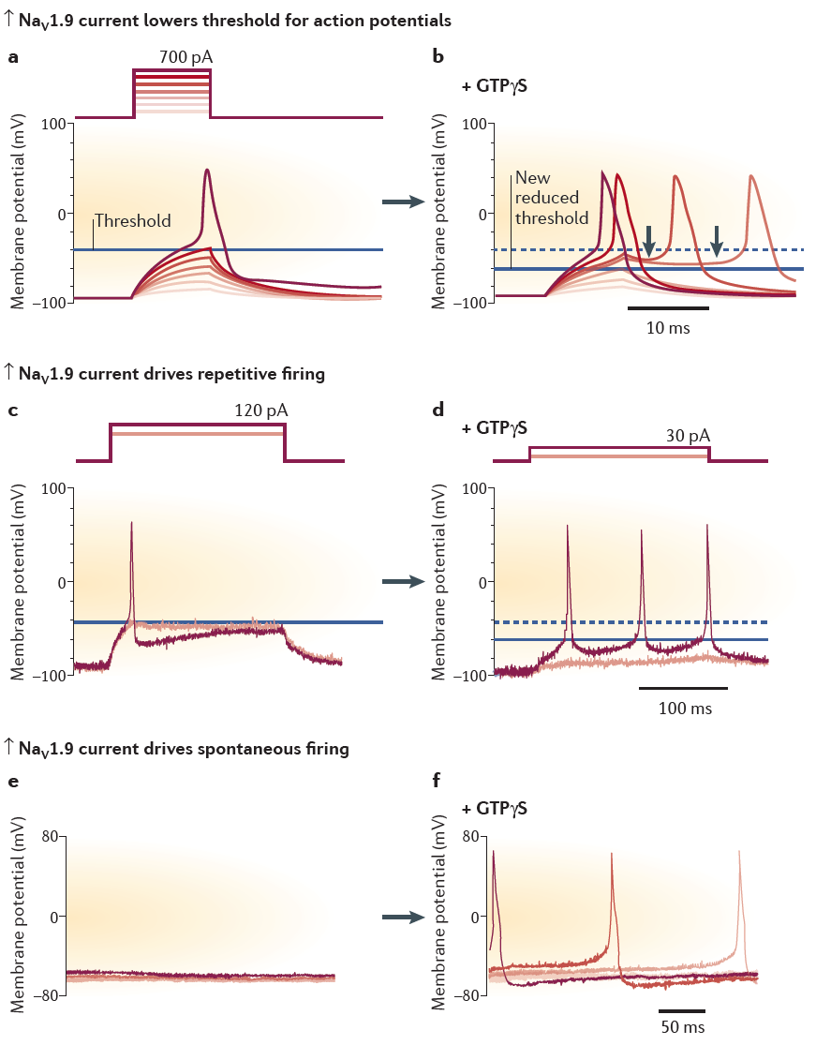
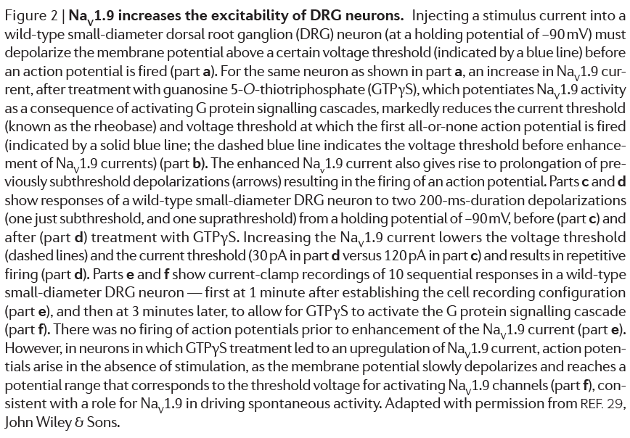
Na_{v}1.9 and Human Pain
Na_{v}1.9 acts as a threshold channel and increases the excitability to DRG neurons
Notes:
A, b: Guanosine-5-O-thiotriphosphate (GTPγS) potentiates Na_{v}1.9 activity – upregulation of channel current lowers threshold current

Slide 40
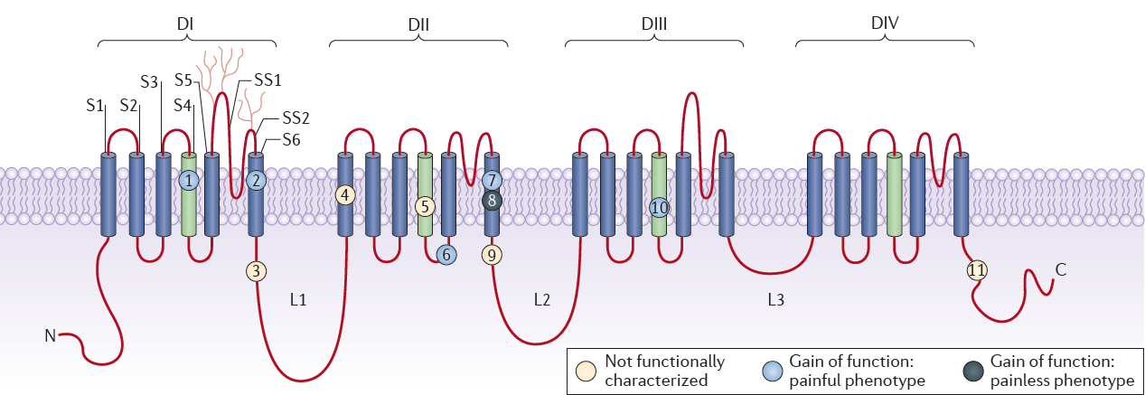
Na_{v}1.9 and Human Pain
Schematic diagram of Na_{V}1.9 channel and locations of substitutions identified in individuals with pain disorders
Notes:
Mutations 1 (R225C) and 7 (A808G) were each identified in Chinese families with familial episodic pain8. Mutations 2 (I381T), 3 (K419N), 4 (A582T), 5 (A681D), 6 (G699R), 9 (A842P), 10 (L1158P) and 11 (F1689L) were identified in individuals with painful peripheral neuropathy (predominantly with small-fibre neuropathy) who had no mutations in the genes encoding the two other peripheral sodium channels NaV1.7 and NaV1.8 (REFS 6,9). The mutation L811P (mutation 8; black) was identified
in two individuals with a complex syndrome involving an inability to experience pain and self-mutilation7. Thus, unlike mutations 1, 2, 6, 7 and 10 (all blue), which were associated with a gain of function and a painful phenotype, mutation 8 was associated with a painless phenotype despite the gain of channel function.

Slide 41
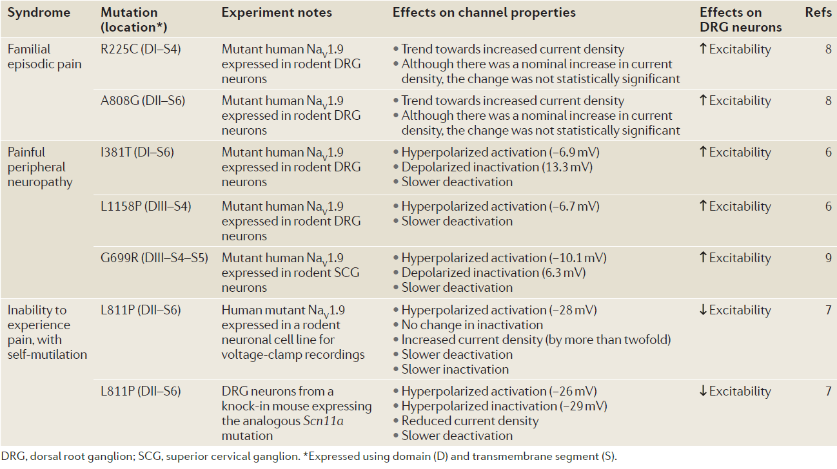
Na_{v}1.9 and Human Pain
Functionally characterized SCN11A mutations in human in syndromes

Slide 42
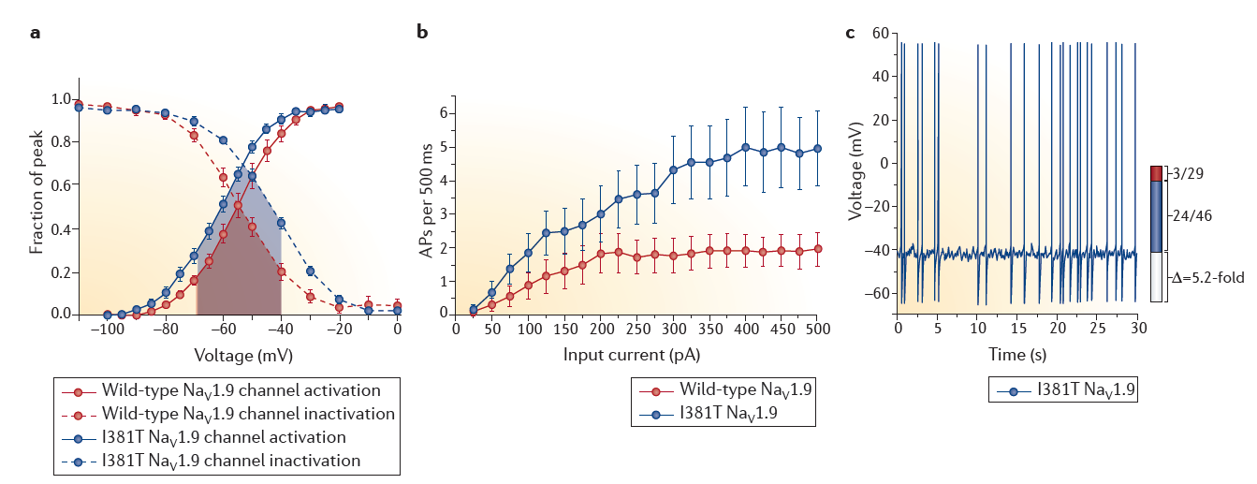
Na_{v}1.9 and Human Pain
Voltage-clamp and current-clamp analyses of Na_{V}1.9 I138T mutant channels
Notes:
Functional assessment of two of these mutations (I381T in DI–S6 and L1158P in DIII–S4) with whole-cell voltage-clamp recordings in DRG neurons from Scn11a‑knockout mice showed that these mutations confer gain‑of‑function attributes on NaV1.9 channels6. Current-clamp recordings of rat DRG neurons that expressed the full complement of endogenous sodium channels demonstrated that each of the two mutant channels confers hyperexcitability compared with wild-type NaV1.9 channels, as indicated by a depolarized resting membrane potential, an increased number of neurons firing spontaneously and an increased number of action potentials evoked by a depolarizing current (FIG. 4).
a | The effect of the I381T mutation on the gating properties of the voltage-gated sodium channel NaV1.9 was studied in NaV1.9‑null mouse dorsal root ganglion (DRG) neurons that were transfected with wild-type or mutant channel constructs. The curves for the voltage dependence of activation (solid line) and steady-state, fast inactivation (dashed line) for wild-type NaV1.9 (red) and I381T channels (blue) show that the mutation hyperpolarizes activation (thus making the channel easier to open) and depolarizes inactivation (thus increasing the availability of the channel) of the mutant NaV1.9, markedly increasing the window current (shaded area) around the physiological range of the resting potential of DRG neurons. b | The effects of the I381T Nav1.9 channels on the firing properties of primary afferents were studied in rat DRG neurons transfected with wild-type or mutant channel constructs. The average total number of action potentials (APs) elicited by injection of a depolarizing stimulus for 500 ms was higher in DRG neurons that expressed the I381T‑mutant channels than in DRG neurons that expressed wild-type NaV1.9 channels. c | Representative recording of spontaneous firing in a DRG neuron expressing I381T mutant channels. A trace was recorded for 30 s without current injection. The bar graph shows that the proportion of I381T‑NaV1.9‑expressing DRG neurons that fire spontaneously (blue) is increased by over fivefold (difference shown in white) compared with the proportion of wild-type-NaV1.9‑expressing DRG neurons that spontaneously fire (red); proportion values are shown on the right-hand side. Thus, in contrast to the I381T‑mutant-expressing neuron (from which the recording was taken), wild-type-NaV1.9‑expressing DRG neurons are much less likely to fire spontaneously.

Slide 43
Na_{v}1.6 and Epilepsy
Over 700 mutations in brain isoforms of VGSCs in patients with epilepsy
Majority in SCN1A – Na_{v}1.1
Generalized epilepsy
~30% patients with epilepsy do not respond to treatment
Cannabinoids have been shown to target peak transient currents in VGSCs
Notes:
Resurgent currents – atypical current predicted to enhance neuron excitability. Mechanistically, these currents arise from channel re-opening during the repolarization phase of the action potential due to unbinding of an open-channel blocker. Targeting these currents has a potential therapeutic value

Slide 44
Na_{v}1.6 and Epilepsy
Target Na_{v}1.1 and Na_{v}1.6
Severity of phenotype associated with mutation
Do mutations in these channels alter resurgent Na current generation?
Can we inhibit it?
Notes:
Can we preferentially inhibit resurgent sodium current over peak transient current generated by these two channel isoforms?
They found that found that epilepsy-associated mutations in Nav1.6 dramatically enhanced resurgent current generation while mutations in Nav1.1 did not, suggesting that mutations in these channel isoforms are acting by distinct mechanisms to induce epileptogenesis. Moreover, cannabidiol can selectively inhibit resurgent current over peak transient current generated by wild-type Nav1.6 as well as aberrant resurgent and persistent current generated by Nav1.6 mutant channels. Validated findings using sodium currents from striatal neurons.

Slide 45
Na_{v}1.6 and Epilepsy
Whole-cell patch clamps recordings on human wild-type and mutant Na_{v1}1.6 cells mouse striatal neurons with and without cannabidiol in the patch clamp solution
Optimized human constructs for Nav1.1 and Nav1.6 (hNav1.1 and hNav1.6) were designed in-house and purchased from Genscript. cDNA constructs for wild-type Nav1.1 and Nav1.6 channels encode for amino acid sequences corresponding to the accession numbers BAC21102.1 and NP_055006.1 in the NCBI database, respectively. Mutations were introduced into wild-type cDNA constructs (hNav1.1 R1648H, hNav1.1 N1788K, hNav1.1 N1788D, hNav1.6 L1331V, hNav1.6 N1768D, and hNav1.6 N1768K)
Human embryonic kidney 293T (HEK293T) cell cultures
Striatal neuron cultures: individual striata of postnatal Day 1 wild-type FVB/NJ mice
Notes:
To induce resurgent currents in HEK293T cells, 200 mM Na_{v}β4 peptide (KKLITFILKKTREK-OH) (Biopeptide Co), a peptide that corresponds to the sequence of part of the C-terminal tail of the full-length Na_{v}β4 subunit, was included in the pipette solution. For striatal neurons, pipette solution had only CSF solution

Slide 46
Na_{v}1.6 and Epilepsy
Arginine to histidine mutation at position 1648 in Na_{v}1.1 (S4 segment of DIV) identified in generalized epilepsy patients
Asparagine to lysine mutation at position 1788 in Na_{v}1.1 (end of S6 segment of DIV) identified in patients with Dravetsyndrome

Slide 47
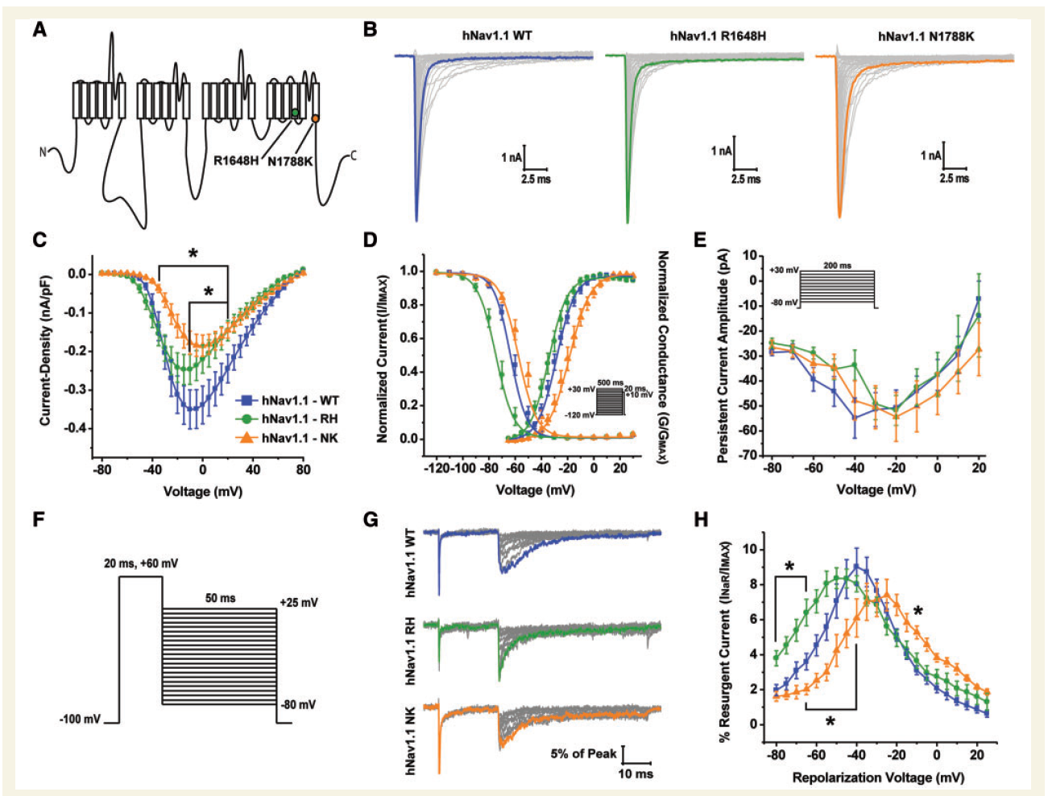
Na_{v}1.6 and Epilepsy
Biophysical characterization of hNa_{v}1.1 wild-type, R1648H and N1788K mutant channels
(A) Linear schematic of the structure of the VGSC -subunit depicting the locations of the hNav1.1 R1648H (green circle) and hNav1.1 N1788K (orange circle) mutations. (B)
Representative family of current traces generated by hNav1.1 wild-type (WT), R1648H and N1788K expressing HEK293T cells. Currents were elicited with step depolarizations ranging from 80mV to + 80mV for 50 ms from a holding potential of 100mV. Peak current traces are in bold. (C) Current density–voltage curve for hNav1.1 wild-type (blue squares), R1648H (green circles) and N1788K (orange triangles). Current
density values were calculated by normalizing the peak sodium current at each voltage to the cell capacitance and subsequently averaged across cells. (D) Voltage dependence of steady-state activation and inactivation curves fit with a Boltzmann function. Steady-state inactivation was
measured using a protocol in which cells were held at a series of voltages ranging from 120mV to + 30mV for 500 ms followed by a 20-ms step pulse to + 10mV to measure channel availability (inset). (E) Persistent current amplitude plotted as a function of voltage. Persistent current was measured at 180 ms into current traces elicited by 200-ms step depolarizations ranging from 80mV to + 30mV from a holding potential of 100mV (inset). (F) Resurgent currents were elicited with a step depolarization from 100mV to + 60mV for 20 ms to open channels allowing
them to undergo open-channel block and subsequently repolarizing to a series of potentials ranging from + 25mV to 80mV for 50 ms to allow the blocker to unbind. (G) Representative family of resurgent current traces generated by hNav1.1 wild-type (top), R1648H (middle) and N1788K
(bottom). Peak resurgent current traces are bolded. (H) Per cent resurgent current plotted as a function of the repolarization voltage for hNav1.1 wild-type (blue squares; n = 29), R1648H (green circles; n = 17) and N1788K (orange triangles; n = 11). Per cent resurgent current was calculated by normalizing peak resurgent current at each voltage to peak transient current measured with a single step pulse from 120mV to + 10mV.*P50.05; two-way ANOVA.
Notes:
Neither mutation significantly alters persistent current (1.E). And F – no significant effects of steady-state slow inactivation or development of slow inactivation –
Summary: concluded these mutants are loss-of-function mutations
No difference in peak resurgence I in mutants either (H)

Slide 48
Na_{v}1.6 and Epilepsy
Leucine to valine mutation at position 1331 in Na_{v}1.6 (S4-S5 linker of DIII) identified in early infantile epileptic encephalopathy patient
Asparagine to aspartic acid mutation at position 1768 in Na_{v}1.6 (end of S6 segment of DIV) identified in a patients with severe epileptic encephalopathy

Slide 49
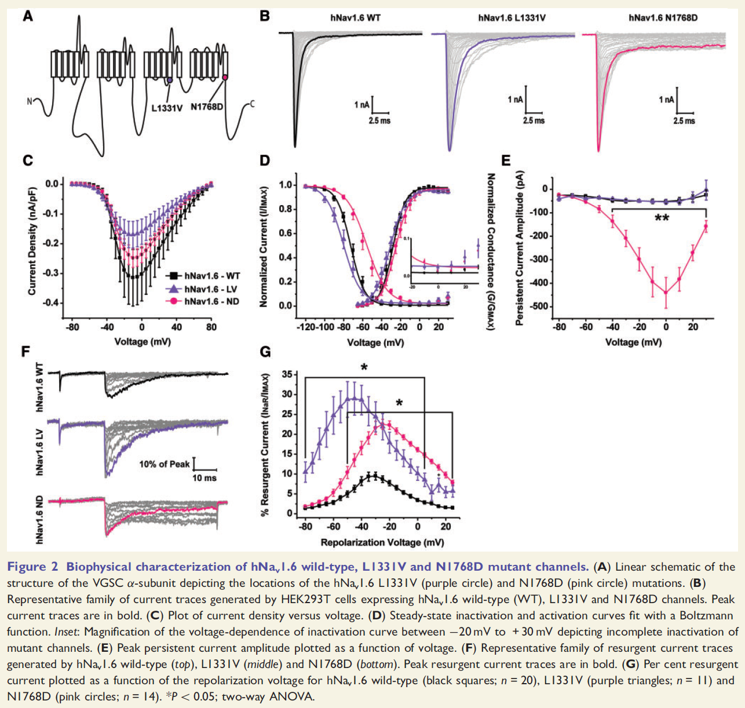
Na_{v}1.6 and Epilepsy
Notes:
Both mutations in hNav1.6 impaired fast inactivation as evidenced by incomplete inactivation in the steady-state inactivation curve (Fig. 2D, inset). We next examined persistent current and found that hNav1.6 N1768D produces a very large persistent current while hNav1.6 L1331V has similar persistent current amplitudes as wild-type (Fig. 2E). hNav1.6 mutant channels had opposing effects on slow inactivation
Both mutants generate resurgent Na current. – findings indicate Gain of function mutations

Slide 50
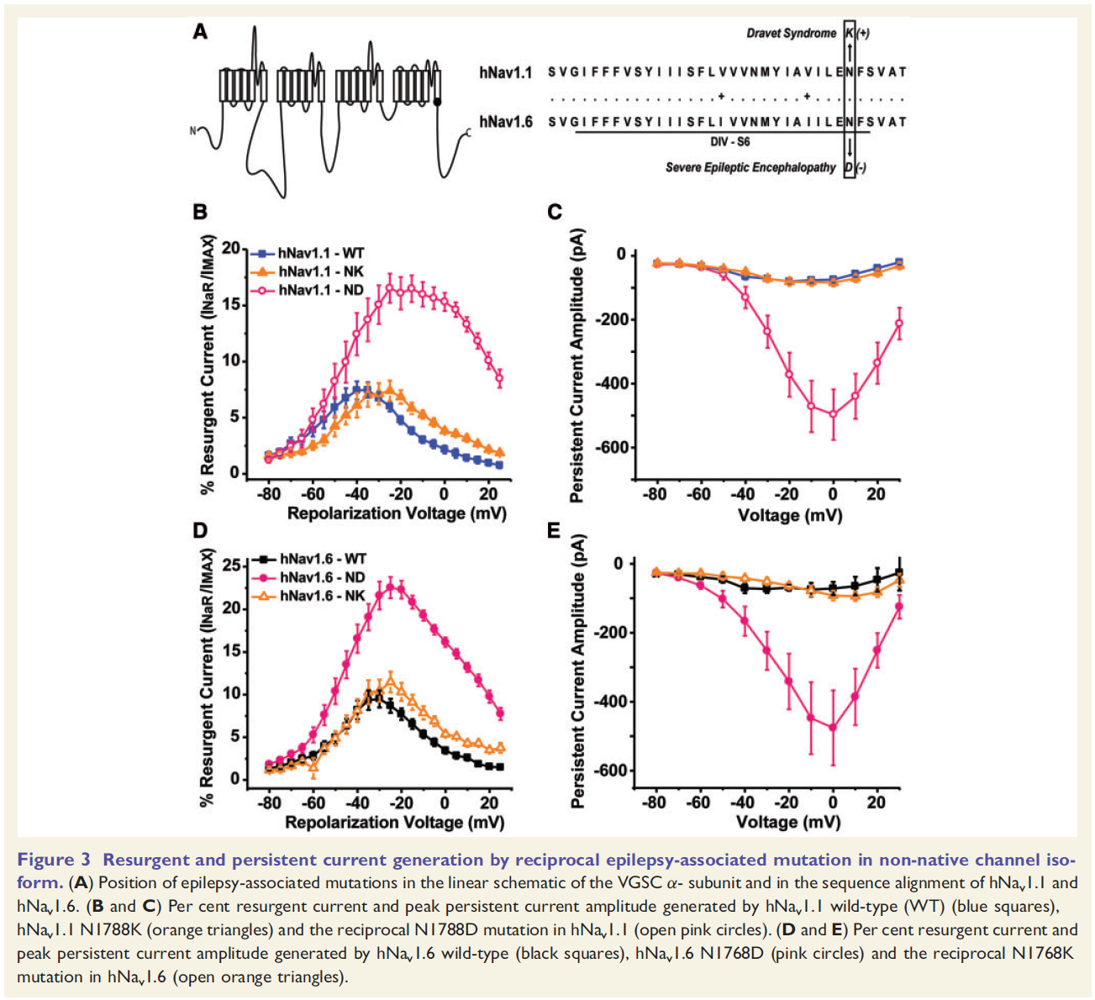
Na_{v}1.6 and Epilepsy*
Notes:
Nav1.6 N1768D was the first human epilepsy-associated mutation to be reported in the Nav1.6 isoform and coincidentally occurs at the same position as a previously identified Dravet syndrome-associated mutation in Nav1.1 (Nav1.1 N1788K) (Fig. 3A) (Depienne et al., 2009; Veeramah et al., 2012). This gave us a unique opportunity
to ask whether disease mutations confer the same biophysical consequences to different channel isoforms. To address this we created the reciprocal mutations in the non-native channel isoform (hNav1.1 N1788D and hNav1.6 N1768K). We measured resurgent and persistent sodium current generation by these mutant channels since we observed dramatic changes in these properties with the epilepsy associated mutant channels…..
This suggests that distinct phenotypes likely arise from not only differences in the expression pattern and regulation of the channel isoform in which the mutation occurs but is also dependent on the amino acid residue itself.

Slide 51
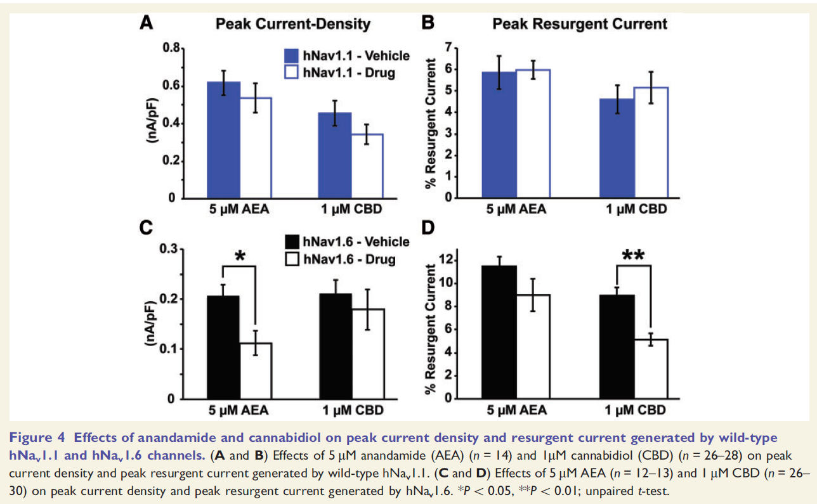
Na_{v}1.6 and Epilepsy
Notes:
We found that neither 5 mM anandamide nor 1 mM cannabidiol had any significant effect on peak current density or peak resurgent current generated by hNav1.1 (Fig. 4A and B)
1mM cannabidiol significantly (P50.01; unpaired test) inhibited the peak resurgent current generated by hNav1.6 (measured as a percentage of the peak transient
current in each cell) while having no significant effect on peak current density (Fig. 4C and D).
This finding identifies a novel target (i.e. resurgent sodium current) and mechanism underlying the anti-convulsant properties of cannabidiol

Slide 52
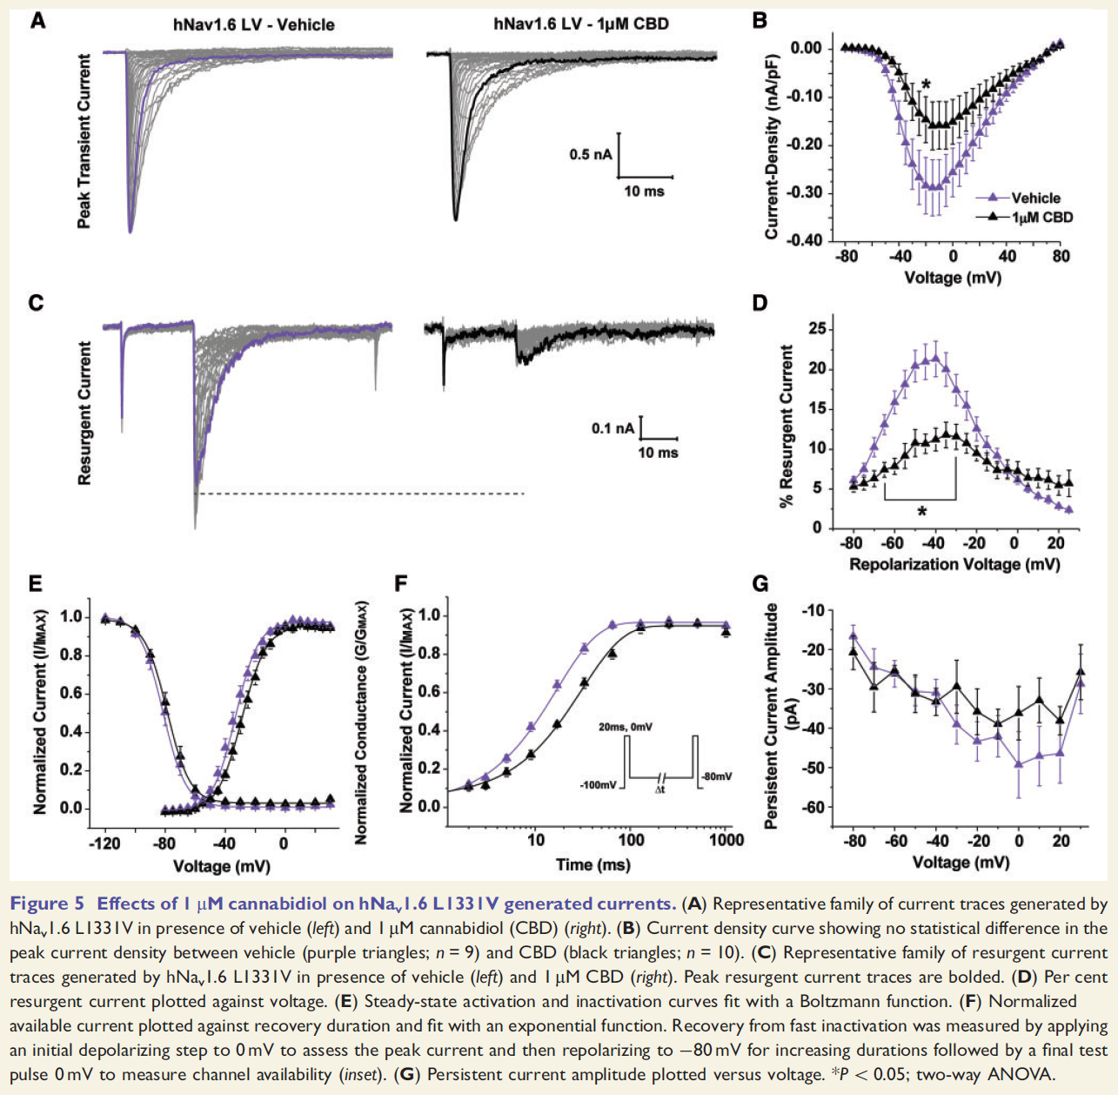
Na_{v}1.6 and Epilepsy

Slide 53
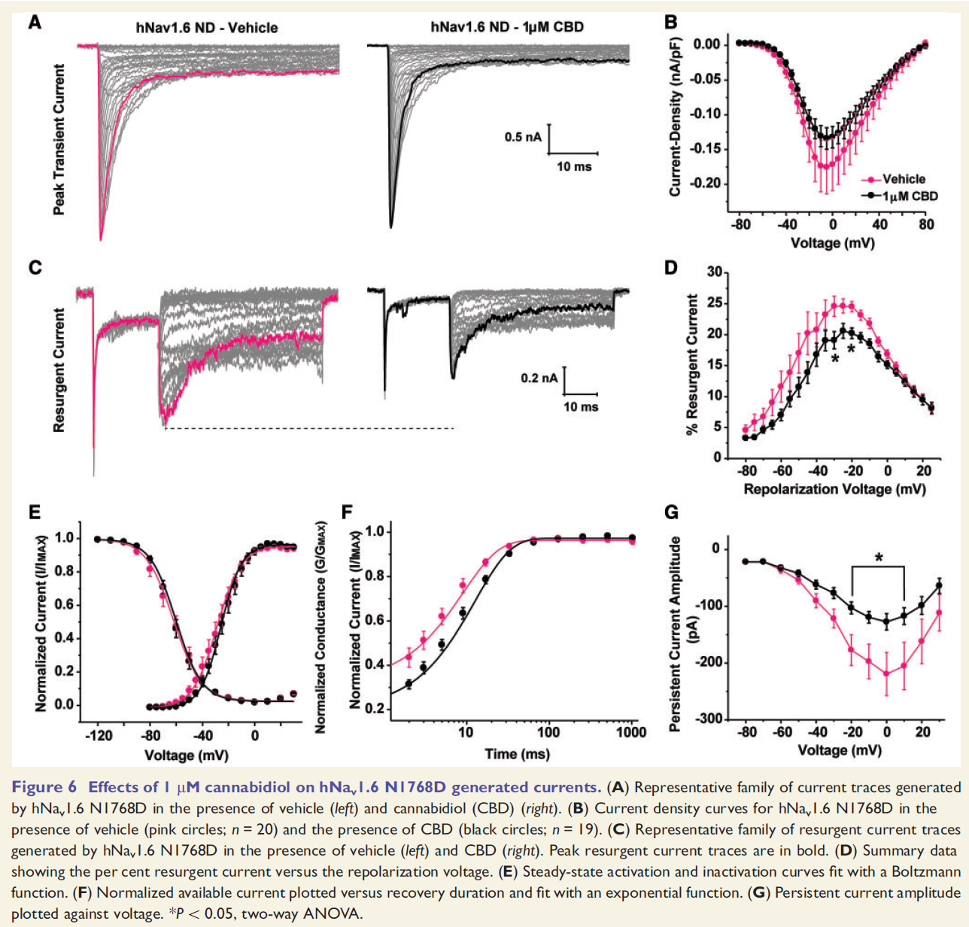
Na_{v}1.6 and Epilepsy

Slide 54
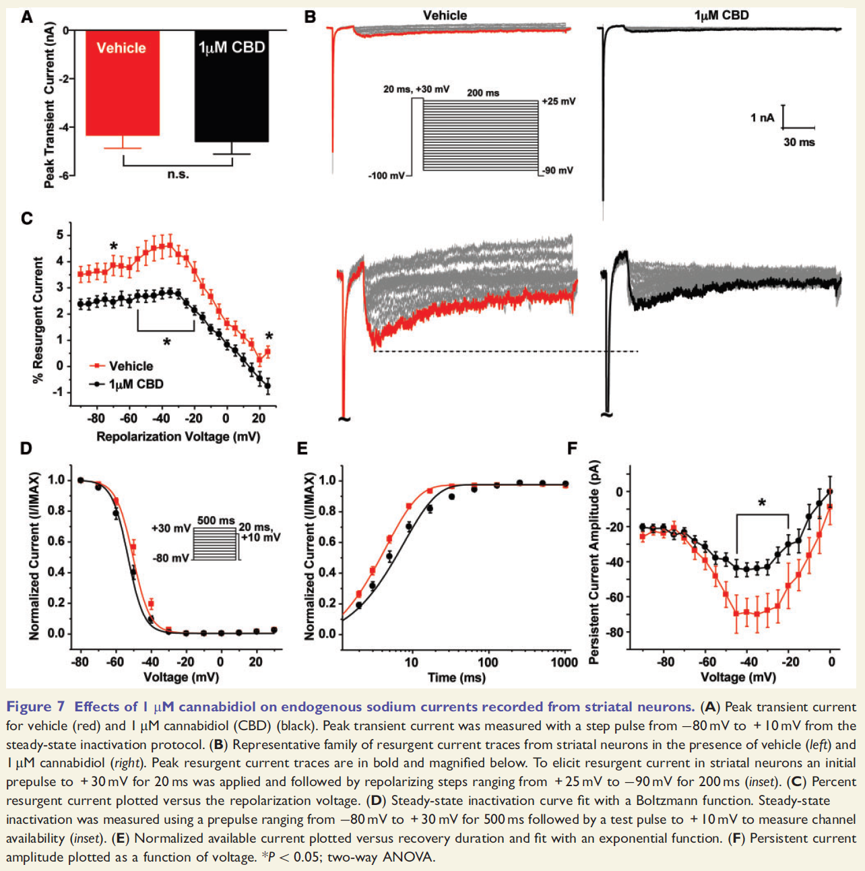
Na_{v}1.6 and Epilepsy

Slide 55
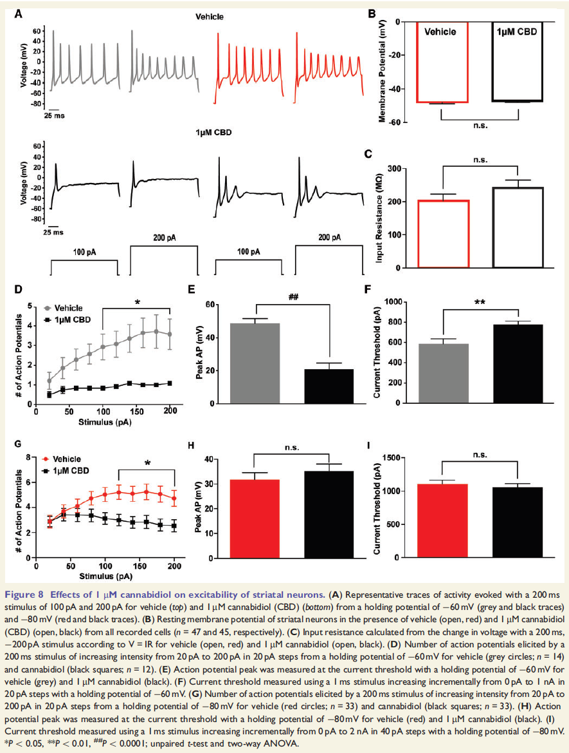
Na_{v}1.6 and Epilepsy

Slide 56
Na_{v}1.6 and Epilepsy
Epilepsy associated mutations in Na_{v}1.1 are predominantly loss-of-function while mutations in Nav1.6 are primarily gain-of-function.
Cannabidiol can preferentially inhibit Na_{v}1.6 generated resurgent current over peak transient current.
Low concentration of cannabidiol can reduce mutant channel activity by shifting the voltage-dependence of activation to more depolarizing potentials, slowing channel recovery from fast inactivation and inhibiting resurgent and persistent current.
Confirmed our findings using endogenous sodium currents from striatal neurons, again demonstrating that cannabidiol can inhibit endogenous resurgent and persistent current.
Overall, cannabidiol inhibits voltage-gated sodium channel activity contributing to a decrease in neuronal excitability.

Slide 57
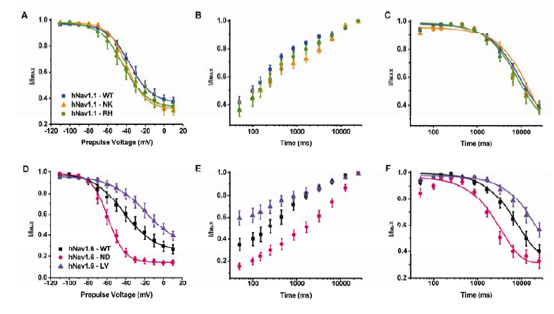
Na_{v}1.6 and Epilepsy
Steady-state, recovery, and development of slow inactivation of wildtype and mutant channels in HEK293T cells Steady-state, recovery, and development of slow inactivation of wildtype and mutant channels in HEK293T cells
Notes:
A, Steady-state slow inactivation curve for hNav1.1 wildtype (blue squares; n = 12), hNav1.1 N1788K (orange triangles; n = 9), and hNav1.1 R1648H (green circles; n = 12) fit with a Boltzmann function. Slow inactivation was examined with a 10 second conditioning pulse increasing incrementally from −110mV to +10mV followed by a step to −120mV for 100ms to recover channels from fast inactivation and a test pulse to +10mV to assess available channels. B, Normalized available current plotted versus recovery duration. Recovery from slow inactivation was measured by holding cells at −20mV for 10 seconds and subsequently hyperpolarizing to −120mV for increasing durations to recover channels and assessing channel availability with a final test pulse to +10mV. C, Development of slow inactivation curve fit with a single exponential function. To examine the development of slow inactivation cells were held at −20mV for increasing durations and then stepped to −120mV for 100ms to recover channels from fast inactivation after which a test pulse to +10mV was applied to assess channel availability. D, Steady-state slow inactivation curves for hNav1.6 wildtype (black squares; n = 12), hNav1.6 N1768D (pink circles; n = 12), and hNav1.6 L1331V (purple triangles; n = 13). E, Recovery from slow inactivation. F, Development of slow inactivation.

