Slide 1
Voltage-Gated Calcium Channels
Angie Davenport
Membrane Biophysics Fall ‘18

Slide 3
Introduction
${Ca}_{v}$ are key transducers of membrane potential changes ([Ca]i begins physiological events)
10 Members of voltage-gated family in mammals
Cav1, Cav2 and Cav3 subfamilies
Physiological Roles:
Activate on membrane depolarization
Mediate Ca influx
Current Types
L,T,N,P,Q and R (N,P,Q,R most prominent in neurons)
Notes:
Cav1: initiates contraction, secretion, regulation of gene expression, integration of synaptic input in neurons, and synaptic transmission at ribbon synapses in specialized sensory cells.
Cav2: initiates synaptic transmission at fast synapses
Cav3: important for repetitive firing of action potentials in rhythmically firing cells such as cardiac myocytes and thalamic neurons
In cardiac and smooth muscle cells, activation of Ca channels initiates contraction directly by increasing cytosolic Ca concentration and indirectly by activating calcium-dependent calcium release
In skeletal muscle cells, Cav channels interact directly with ryanodine-sensitive Ca release channels to initiate rapid contraction
In neurons, Cav channels initiate synaptic transmission
Cav channels are the KEY signal transducers of electrical excitability, converting the electrical signal of the action potential in the cell surface membrane to an intracellular Ca transient

Slide 4
Current Types Defined
L-type:
Slow voltage-dependent inactivation and long lasting when Barium is current carrier
No Ca-dependent inactivation
P-type:
First recorded in Purkinje neurons
High sensitivity to spider toxin
Q-type:
First recorded in cerebellar granule neurons
Blocked by w-agatoxin IVA with lower affinity
R-type:
Cerebellar granule neurons – resistant to most subtype-specific organic/peptide Ca channel blockers
Notes:
L-type:
- In endocrine cells they initiate release of hormones
- In neurons they regulate gene expression, integrate synaptic input and initiate neurotransmitter release at specialized ribbon synapses in sensory cells
Subject to regulation by second messenger-activated protein phosphorylation in several cell types

Slide 5
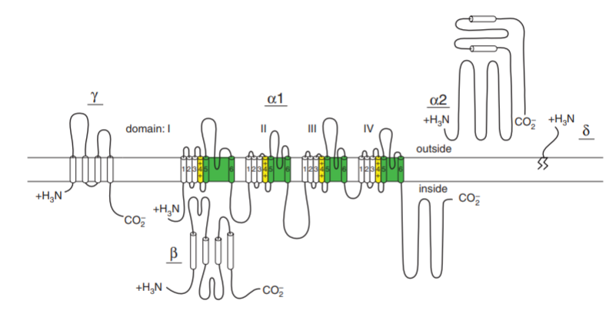
Subunit Structure
Notes:
Alpha1 subunit is a protein of about 2000 amino acid residues in length with an amino acid sequence and predicted transmembrane structure like the previously characterized pore-forming alpha subunit of voltage gated sodium channels.
The aa sequence is organized in four repeated domains, with each containing 6 transmembrane segments and a membrane-associated loop between transmembrane segments S5 and S6.
The intracellular Beta subunit has predicted alpha helices but not transmembrane segments, whereas the gamma subunit is a glycoprotein with four transmembrane segments
The cloned alpha 2 subunit has many glycosylation sites and several hydrophobic sequences- but it is an extracellular, extrinsic membrane glycoprotein, attached to the membrane through disulfide linkage to the delta subunit

Slide 6
Calcium Channel Diversity
Different Ca currents → Different α1 subunits
3 subfamilies (Cav1, Cav2, Cav3)
Cav1:
Mediate L-type currents
Serve to couple depolarization of membrane to wide range of cellular responses
S4 segments = voltage sensors
S5/S6 membrane = pore loop
Notes:
S4 segments of each homologous domain serve as the voltage sensors for activation, moving outward and rotating under the influence of the electric field and initiating a conformational change that opens the pore
S5 and S6 segments and the membrane-associated pore loop between them form the pore lining of the voltage-gated ion channels. The narrow external end of the pore is lined by the pore loop, which contains a pair of glutamate residues in each domain that are required for Ca selectivity (unique feature of Ca channels).
Only 3 glutamate residues in the pore loops btwn S5 and S6 in domains II, III, IV of sodium channels are sufficient to confer Ca selectivity. Inner pore is lined by S6 segments, which form receptor sites for the pore-blocking Ca antagonist drugs specific for L-type Ca channels

Slide 7
Cav1 Channels (Excitation-Transcription Coupling)
Privileged role in gene transcription
Preferential localization, interaction with binding partners, nuclear targeting of subunit or domain
Localized in higher density in the cell bodies and proximal dendrites of neurons
Only local increase required for up-regulation of transcription
Calmodulin a regulator?
Calcineurin a regulator?
Notes:
Might arise from preferential localization (which could provide Ca in the vicinity of transcriptional regulators), preferential interaction with binding partners (which could be activated by local Ca entry and carry the regulatory signal to the nucleus) or nuclear targeting of a subunit or domain of the Cav1 channel itself (would serve to regulate transcription directly). Likely all 3 are involved.
Cav1 channels are localized in higher density in the cell bodies and proximal dendrites of neurons compared to Cav2 and Cav3 (more prevalent in nerve terminals and dendrites). This preferential localization would favor Ca entry through these channels in control of transcription in the nucleus
Only a local increase in Ca is required for up-regulation of transcription in neurons. Suggests that specifically bound Ca dependent regulatory proteins may respond to local Ca entering via Cav1 channels and regulate transcription.
Calmodulin binding to the proximal carboxy-terminal domain of Cav1.2 channels is required for regulation of transcription in neurons (thus calmodulin itself may serve as a regulator by binding local Ca, changing conformation to the active form and moving to the nucleus). However there are large pools of free and Ca-bound calmodulin throughout the cell, so additional mechanisms must be engaged to specifically move Ca/calmodulin complexes from the Cav1 channels to the nucleus in the context of this mode of regulation
Calcineurin bound to the distal carboxy-terminal domain of Cav1 channels also is a potential transcriptional regulator through de-phosphorylation of the nuclear factor of activated T cells (NFAT) by calcineurin bound to Cav1.2 channels induces its dissociation, movement to the nucleus and regulation of transcription. This seems to have all of the right elements for selective regulation of gene transcription by Ca entering neurons via Cav1.2

Slide 8
Cav3 Channels and Frequency Modulation
Conduct T-type currents
Activated at negative membrane potentials
Same range as Na currents in most cells
Fast voltage-dependent inactivation
Important in repetitively firing tissues
Notes:
Fast v-dep inactivation → well suited for rhythmic firing of action potentials, well suited for generation of large Ca transients because they’re activated at negative membrane potentials where driving force for calcium is large
Firing tissues:
In the sino-atrial node of the heart, they conduct an important component of the pacemaker current that generates the heartbeat
In relay neurons of thalamus, they’re crucial for generation of the rhythmic bursts of action potentials that drive sleep spindles and control sleep
mutations cause absence epilepsy, where individuals transiently enter sleep-like state that interrupts their normal activites
In the adrenal cortex, they’re important in regulation of synthesis and secretion of aldosterone
Regulation:
-In neurons, dopamine/other neurotransmitters inhibit T-type Ca currents
-

Slide 9
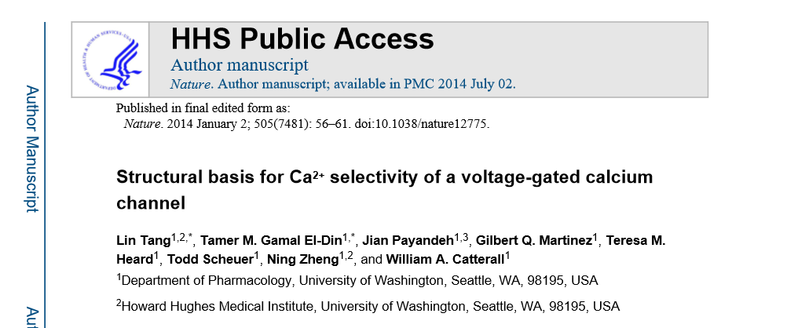
Structural Basis for ${Ca}^{2+}$Selectivity of a Voltage-Gated Calcium Channel

Slide 10
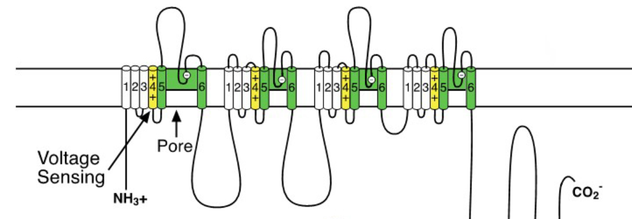
Why Do We Care?
Extracellular [Na] > Extracellular [Ca]
Ca channels need high selectivity (contraction, secretion, neurotransmission, gene expression)
High affinity binding of Ca?
Fast flux, ‘Knock-Off’ – electrostatic repulsion between Ca ions overcomes tight binding of single Ca ion
Notes:
SN: Cav channels are closely related to Nav channels
- 3 structures of homotetrameric bacterial Nav channels open the way to elucidating the structural basis for ion selectivity and conductance of vertebrate Nav and Cav channels, which probably evolved from the bacterial NaChBac family and retained similar structures and functions
- Mutations of 3 aa residues in the selectivity filter of NaChBac is sufficient to confer Ca selectivity

Slide 11
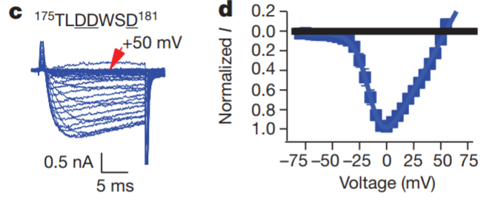
Structure and Function of ${Ca}_{v}Ab$
${Na}_{v}Ab$ channels have 4 identical pore motifs for ion selectivity
${Na}_{v}Ab$ don’t allow Ca in but allow Na out
Notes:
Voltage dependent conductance of inward Ca current by CavAb under with 10 mM [Ca]o and 140 mM [Na]I, holding potential -100 mV. 20-ms 5-mV step depolarizations
Concluded that reversal potential for Ca current under bi-ionic conditions closely follows the expectation for a highly Ca-selective conductance

Slide 12
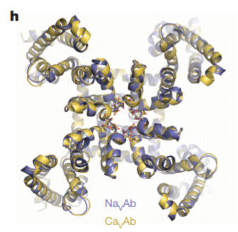
Structure and Function Cont.
Notes:
They also crystallized and determined the structure of CavAb and its derivatives by molecular replacement. The overall structure of CavAb is very similar to that of NavAb and the Ca selectivity of CavAb is mainly determined by the side chains of the aa at the selectivity filter

Slide 13
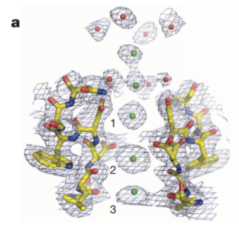
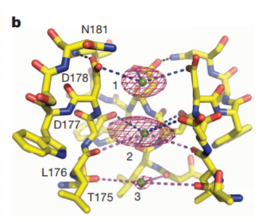
Structure and Function Cont.
Notes:
Two strong peaks followed by a weaker peak on the intracellular side were found in the selectivity filter along the ion-conduction pathway, verifying three binding sites for Ca (Site 1, Site 2 and Site 3 from the extracellular to the intracellular side)
Site 1 is predominantly coordinated by the carboxyl groups of D178 which define a plane at the selectivity filter entrance on the extracellular side of the bound Ca ion
The chemical environment of Site 3 hints at a lower affinity, consistent with its role in exit of Ca from the selectivity filter into the central cavity
Block of NavAb and CavAb by divalent bonds
Cd, Mn and other inorganic cations are effective blockers of Cav channels
Both bind in the selectivity filter of Site 2 (central site) and inhibit the Ca current by competitively binding to the high-affinity site required for Ca permeation

Slide 14
Ion Permeation Mechanism
Site 2 (central) has highest affinity, then Site 1 and Site 3
Why?
Independent binding of Ca to Sites 1, 2 and 3
Increasing [Ca] saturate Site 2 → reduced binding for Site 1, 3
Two flanking sites have lower affinity than central site

Slide 15
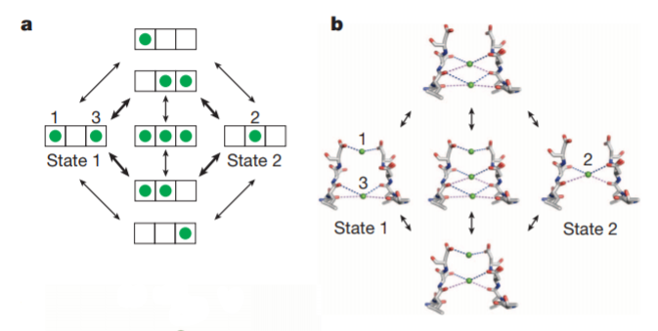
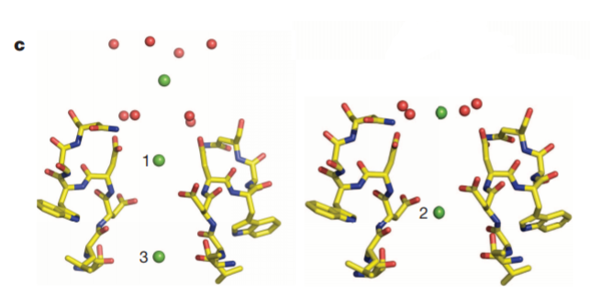
Ion Permeation Mechanism
Notes:
It is energetically unfavorable for Ca ions to occupy adjacent sites simultaneously
Hypothesis: two interchangeable functional states of the selectivity filter in the crystal structure
Bc of high concentration of Ca in the extracellular solution, Ca will prefer to enter site 1 and the weak binding of site 3 will force loss of Ca into the low Ca concentration in the cytosol
Gives unidirectional flux of Ca into the cell
3 ion occupied state would manifest only when the external Ca concentration is increased enough that the flux reaches a limiting value

Slide 16
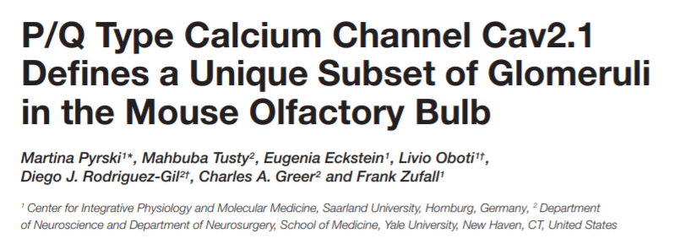

Slide 17
Introduction – Mammalian Olfactory System
Comprised of anatomically segregated chemoreceptive organs:
Main Olfactory Epithelium (MOE)
Vomeronasal Organ (VNO)
Grueneberg ganglion (GGN)
Each have distinct olfactory subsystems (sensory neurons)
Signal transduction mechanisms
Chemosensory cues they detect
Axonal connections they target
Notes:
Cav channels are a prereq for signal transmission at the first olfactory sensory neuron (OSN) synapse w/in the glomeruli of the main olfactory bulb (MOB)
In this paper they identify a distinct subset of glomeruli in the MOB of adult mice that is characterized by expression of the P/Q-type channel subunit Cav2.1.
Immunolocalization shows that Cav2.1+ glomeruli reside predominantly in the medial and dorsal MOB and in the vicinity of the necklace glomerular region close to the accessory olfactory bulb
Cav2.1 labeling of glomeruli colocalizes with the presynaptic marker vGlut2 in the axon terminals of Osns
Electron microscopy shos that Cav2.1+ glomeruli receive axonal input from OSNs that express molecules of canonical OSNs: olfactory marker proten, the ion channel Cnga2 and the phosphodiesterase Pde4a
In the main olfactory epithelium, Cav2.1 labels a distinct subpopulation of OSNs whose distribution mirrors the topography of the MOB glomeruli, that shows the same molecular signature, and is already present at birth. Together, these experiments identify a unique Cav2.1+ multiglomerular domain in the MOB that may form a previously unrecognized olfactory subsystem distinct from other groups of necklace glomeruli that rely on cGMP signaling mechanisms.
The mammalian olfactory system exhibits a highly complex organization that comprises several anatomically segregated chemoreceptive organs: MOE, VNO, GGN
MOE & GGN
Project their axons to the main olfactory bulb (MOB)
Vomeronasal sensory neurons (VSNs)
Project to a specific nucleus located posterior to the dorsal MOB known as the accessory olfactory bulb (AOB)
Understanding olfactory subsystems is key in understanding the processing of chemosensory information and the role each subsystem plays in odor-guided behaviors
Here they present evidence for the existence of a novel multi-glomerular domain in the mouse MOB that may represent a previously unrecognized olfactory subsystem.
This subsystem is differentiated by the expression of the Cav channel subunit Cav2.1. P/Q (Cav2.1) and N (Cav2.2) have been identified to conduct Ca currents that initiate synaptic transmission. Neurotransmitter release at central synapses is primarily mediated by high-voltage activated Ca channels (Cav2.1 and Cav2.2)
In olfactory system both subunits have been identified in the olfactory mucosa using RNA techniques and Western blot analyses
Presynaptic Cav2.2 protein is present in vast majority of glomeruli MOB and AOB and plays a role in neurotransmitter release
Here they show Cav2.1 represents a second candidate for olfactory signal transmission within a distinct subset of MOB glomeruli

Slide 18
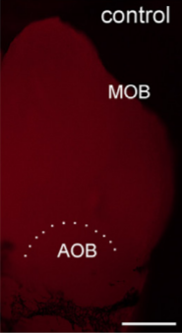
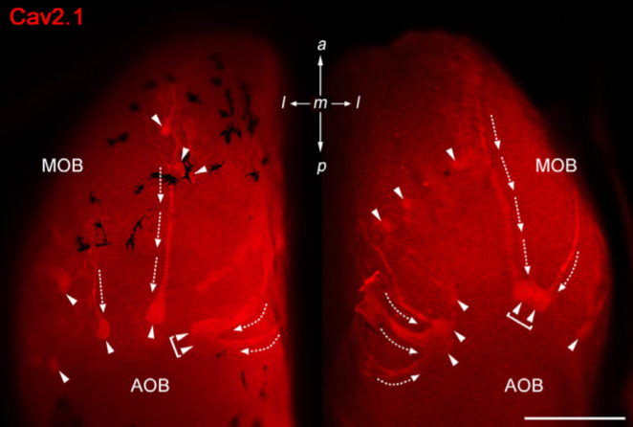
${Ca}_{v}2.1$ Immunostaining Identifies Multiglomerular Domain
Notes:
To assess if P/Q-type channel subunit Cav2.1 represents a second calcium channel involved in synaptic transmission at the first olfactory synapse they conducted a systematic immunohistochemical analysis of the olfactory bulb of an adult mouse
Analyzed whole-mount preparations (N=9) and tissue sections anterior-to-posterior and medial-to-lateral axes of MOB (N=13)
Whole-mount staining of olfactory bulbs revelaed robust Cav2.1 immunoreactivity in small set of glomeruli and their afferent axon bundles (1)
Negative control reactions using Cav2.1 antibody that was blocked with its cognate peptide lacked immunoreactivity
Most prominent is the semicircular arrangement- this part of MOB contains necklace glomerular region innervated by OSNs and GGNs which both employ non-canonical second messenger pathways
Also larger
N-type Ca channel Cav2.2 was found in anterior MOB but Cav2.1 was NOT found

Slide 19
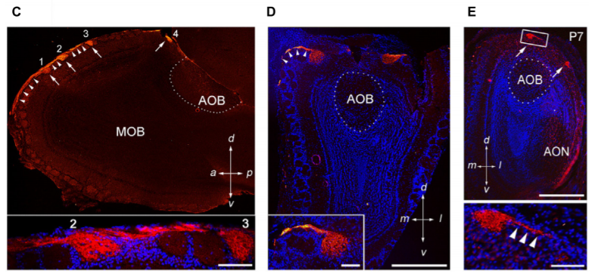
Immunostaining Cont.
Notes:
c) Saggital section at MOB midline depicting four individual Cav2.1+glomeruli and their axonal fibers. Bottom inset is a magnified version.
d) Coronal section of the posterior MOB showing two large Cav2.1+glomeruli medial and lateral to the AOB. The inset is zoomed
e)Cav2.1+glomeruli are evident at postnatal day 7 including many axons (clusters that travel 500 microns across dorsal MOB surface terminating in posterior glomeruli)

Slide 20
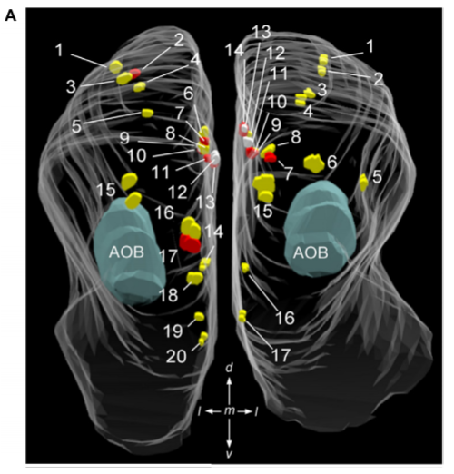
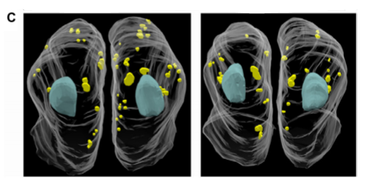
Quantitative 3D Reconstruction
Notes:
Created maps to analyze Cav2.1 expression in the MOB in more detail they created glomerular maps using 3D reconstruction
A) reconstruction from a 4 month old mouse with 20 glomeruli on left and 17 on right
C) Two other reconstructions (18 \pm 1 in left hemi and 21 \pm 4 bulbs in right hemi)
This labeling shows that Cav2.1 immuno-labeling reveals a subset of olfactory glomeruli in the MOB that defines a specific domain

Slide 21
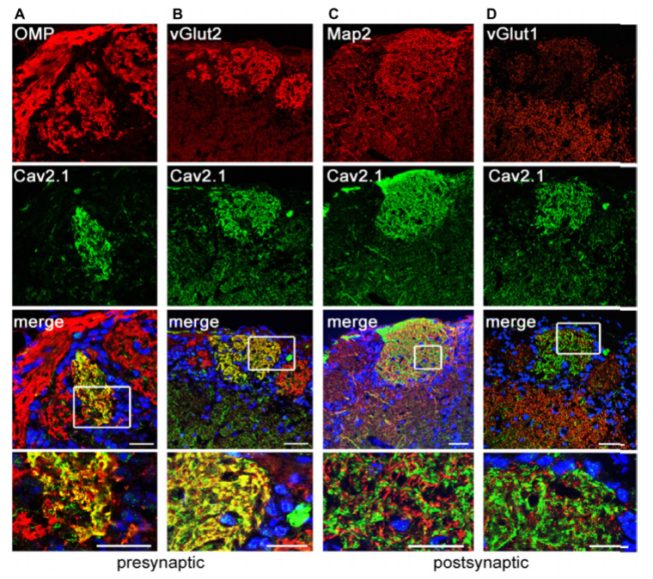
Notes:
Want to know whether glomerular Cav2.1 staining solely originates from the OSN presynaptic boutons or also from post-synaptic membranes of mitral and tufted cells that form synapses with OSN axon terminals in glomerular neuropil
Top panels: looking for immunoreactivity (red)
Second panels: looking for Cav2.1
(A,B) merge, presynaptic markers OMP and vGlut2 colocalize with Cav2.1 yielding the yellow fluorescence signal
(C,D) merge, post-synaptic dendritic markers Map2 and vGlut1 do not colocalize with Cav2.1 (separate red and green signals, no yellow)

Slide 22
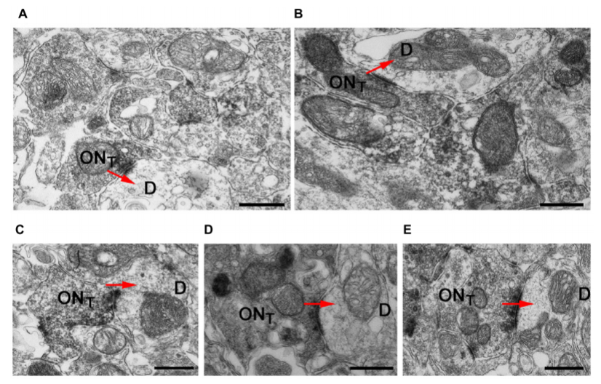
Notes:
-OSN axon terminals show robust immunoreactivity and formed typical asymmetrical synapses with post-synaptic mitral cell dendrites that were devoid of any staining
W/in a glomerulus there was no evidence of unlabeled OSN terminals proximal to labeled OSN terminals suggesting Cav2.1 is homogeneously expressed by the axons innervating these glomeruli
Ultrastructural features of Cav2.1-labeled and unlabeled OSN terminals in neighboring glomeruli were undistinguishable
Vesicle density, organization of pre- and post-synaptic membrane specializations and the distribution of mitochondria were remarkable
THUS, localization of Cav2.1 in the signal transmission and transmitter release at the first olfactory synapse of these glomeruli
Examples of Cav2.1+ OSN terminals (ONT) establishing asymmetric synapses with unstained and electron lucent dendrites (D) are shown. Arrows (red) indicate the polarity of the synapses. Labeled axonal terminals were evident from the accumulation of the DAB precipitate among the presynaptic vesicles and membrane specializations. There was also a typical darkening of mitochondrial membranes in labeled terminals. In Cav2.1+ glomeruli, only ONT are visible suggesting that Cav2.1 is homogeneously expressed by the axons innervating glomeruli.

Slide 23
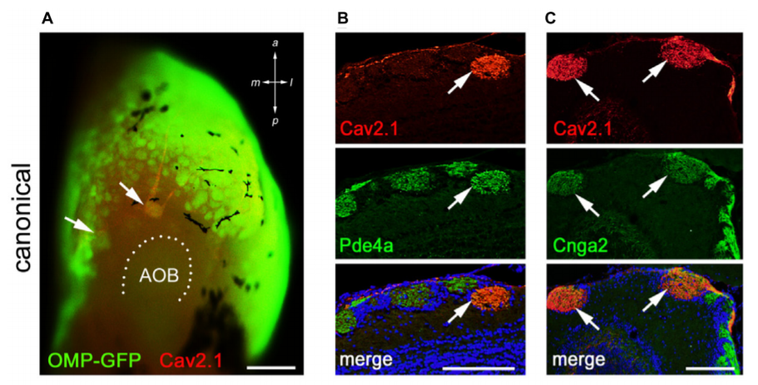
Where is the input from?
Notes:
Immunoreactivity (red), endogenous GFP fluorescence in whole mount MOB prep of an adult OMP-GFP mouse. Cav2.1 and GFP colocalize in individual glomeruli (arrows)
Coronal MOB section showing Cav2.1+glomeruli (red) colocalize with Pde4a (green) and Cnga2 (green) in C
Thus, Cav2.1 glomeruli receive axonal input from mature sensory neurons of the MOE that seem to belong to the group of canonical OSNs in that they express at least two elements of the classical cAMP-mediated signal transduction cascade.

Slide 24
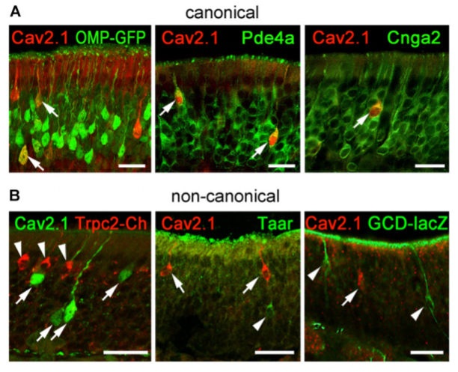
Notes:
In summary results indicate that Cav2.1+ OSNs may represent a specialized subpopulation of canonical OSNs in the MOE that project to a unique subset of Cav2.1+ glomeruli in the MOB
Cav2.1+ OSNs express the canonical markers OMP, Pde4a, and Cnga2. Coronal MOE sections (14 µm) of adult mice labeled for Cav2.1 and different canonical (A) and non-canonical (B) signal transduction molecules. (A) As shown at the left, Cav2.1 (red) and GFP (green) colocalize in mature OSNs (arrows) of OMP-GFP mice. Cav2.1+ OSNs (red) express Pde4a (green, middle, arrows) and Cnga2 (green, right, arrow). (B) Cav2.1 immunoreactivity (arrows) is absent in non-canonical OSNs such as those expressing Trpc2 (red, left, arrowheads), Taar (green, middle, arrowhead) or GC-D (green, right, arrowhead). Images are representatives of (N ≥ 2) mice with N = every 10th section along the anterior-to-posterior extent of the MOE in each mouse.

Slide 25
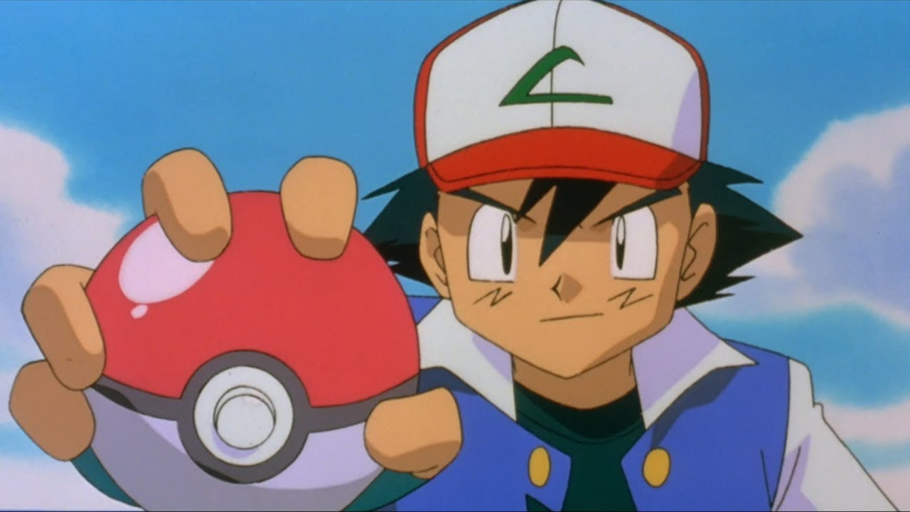
Non-selective Cation Channels

Slide 26
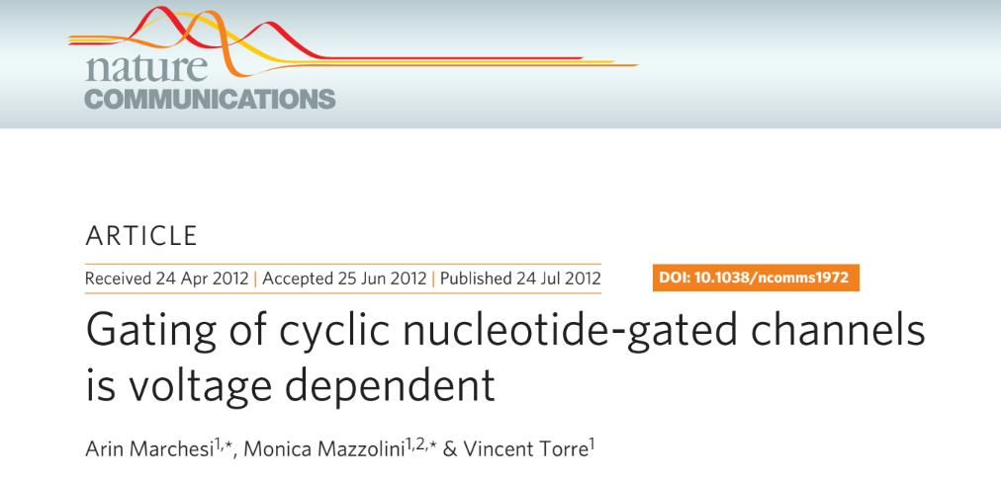

Slide 27
Introduction
CNG channels expressed in vertebrate photoreceptors and olfactory sensory neurons
Mediate sensory transduction
$K^{+},{Na}^{+}$ gating controlled by ‘bundle crossing’ at the intracellular side
This does not gate ion permeation in CNG channels
Selectivity filter acts as the gate
Largely CNG channels not thought to be voltage-gated
They are with larger permeating ions
Notes:
Cyclic nucleotide-gated channels belong to the family of voltage-gated ion channels, but pore opening requires presence of intracellular cyclic nucleotides.
Here they report that in the presence of Lithium, Sodium and potassium, the gating of wild-type cyclic nucleotide-gated A1 and native cyclic nucleotide-gated channels is voltage independent, BUT their gating is highly voltage-dependent in the presence of Rubidium, Caesium and organic cations
Mutagenesis experiments show that voltage sensing occurs through a voltage sensor composed of charged/polar residues in the pore and of the S4-type voltage sensor
During evolution, cyclic nucleotide-gated channels lose their voltage sensing ability when Na or K permeate so that the vertebrate photoreceptor cyclic nucleotide-gated channels are open at negative voltages (necessary for phototransduction)

Slide 28
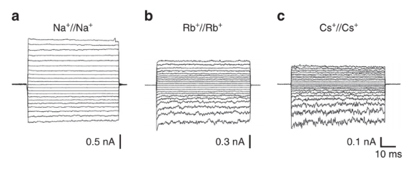
Notes:
We expressed recombinant wild-type (WT) and CNGA1 mutant channels in Xenopus laevis oocytes and recorded the ionic currents evoked by
1mM cGMP, a saturating concentration, added to the intracellular
side
The I–V relationship in the presence of 110mM Li+, Na+ or K+ on both
sides of the membrane was weakly outward rectifying (Fig. 1a;
Supplementary Fig. S1), but in the presence of Rb+ or Cs+, the
relationship was inward rectifying (Fig. 1b,c); the relationship between
the relative conductance (G/G+200) and voltage (V) depended
on the ionic species
These observations suggest that for Rb+ and Cs+, Po is significantly higher at +200mV than at −200mV. If Po (open probability) is higher at positive voltages than at negative voltages, large tail currents at −200mV are expected when they are preceded by steps at positive voltages.
Pores that are open at positive V then close after a delay and V returning to -200 mV gives rise to tail currents (It)
In presence of Na (It were small, h). But It were larger in presence of Rb and Cs

Slide 29
Enlarged Tail Currents
Notes:
The dependence of the size of It on the permeating ions is a strong evidence for coupling
between gating and permeation. These results suggest the existence
of two different voltage-dependent mechanisms operating together
in the presence of Rb+ and Cs+: an inward rectification of the open
pore that reflects asymmetries in ion permeation, and voltage- and
time-dependent gating.

Slide 30
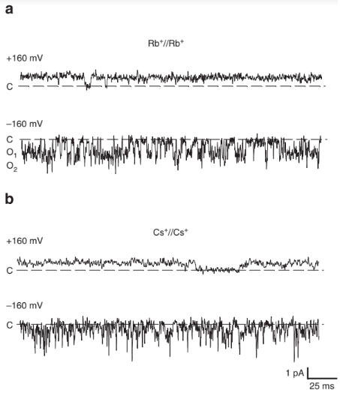
Analyzed single channel properties
in presence of Rb and Cs
Channel openings were flicker at negative voltages
Channel amplitude could not be measured as precisely as positive voltages
Channel openings → Noise analysis
Notes:
Flickering openings at negative voltages in presence of Cs are unlikely to be caused by cationic blockage because flickering blockage is associated with a decrease of single channel currents, in contrast with what is observed

Slide 31
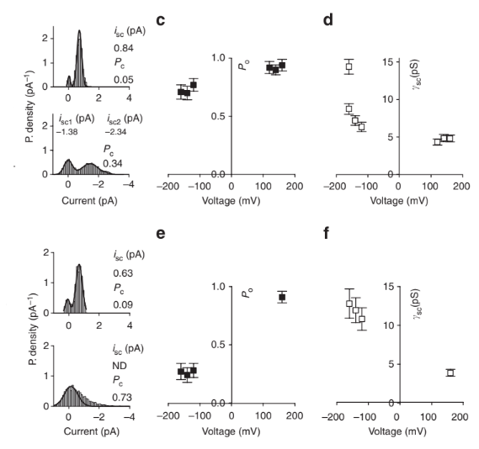
Notes:
The dependence of single channel conductance and Po on V reveals the existence of a voltage sensor in CNGA1 channels. (i.e. a molecular structure senses changes in the electric field and transducing it into a conformational change. If the sensor becomes effective when Rb and Cs are present, it could be located in the pore itself and be distinct from the S4-type voltage sensor of K channels
c) Dependence of Po on V for symmetrical Rb
d) Dependence of single channel conductance on V for symmetrical Rb
e) Same as c) but with Cs
f) Same as d) but with Cs

Slide 32
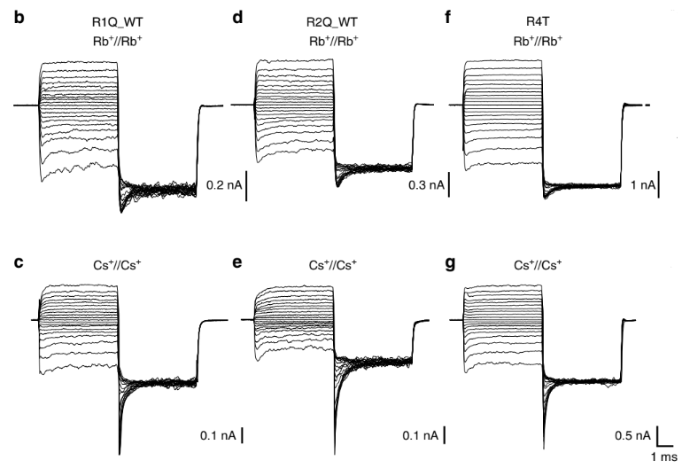
Notes:
Does S4 play a role in voltage gating the pore?
The high amino-acid conservation (30% identity and 75% similarity) in the S4 segment between CNGA1 and Kv1.2. channels (Fig. 6a) and the observation that the paddle motif (S3b-S4) from CNGA1 channels sustains voltage-dependent gating in a chimeric Shaker channel29 raise an obvious question: does the S4 segment contribute to voltage gating in the presence of Rb+ and Cs+?
B,c) tail currents at -200 mV evoked by pre-pulses at voltages from -180 to +200
D,e) same as b,c but for construct R2Q_WT
Since R2Q_Wt and R2Q+WT for Rb are similar to what observed in WT CNGA1 channels, but not Cs We can say the size of the permeating ion is important. Raising the possibility that S4 is primarily involved in the voltage gating of large ions and not small ions (Li, Na, K)
Inspection of the crystal structure of voltage-gated channels and the analysis of conformational changes in Shaker K channels could identify a possible molecular mechanism.

Slide 33
Thank you for listening!

