Slide 1
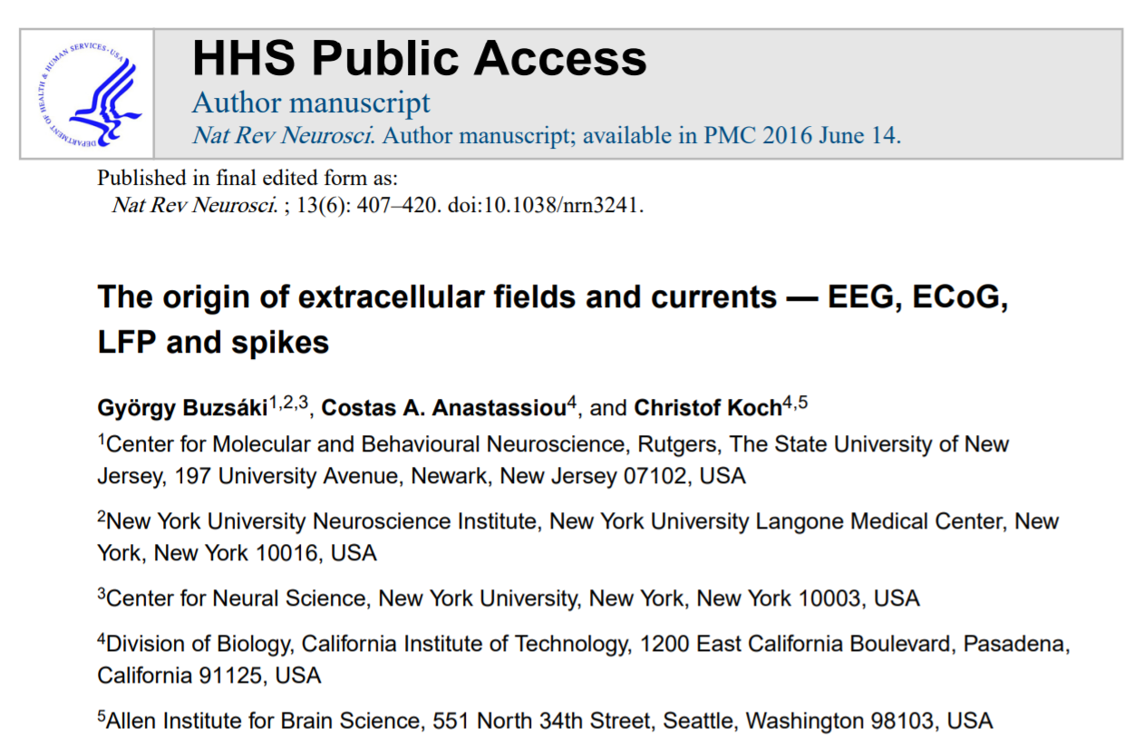

Slide 2
Recording methods of extracellular events
Notes:
Electric current contributions from all active cellular processes within a volume of brain tissue superimpose at a given location in the extracellular medium and generate a potential, Ve, with respect to a reference potential
The difference in Ve between two locations gives rise to an electric field (a vector whose amplitude is measured in Volts per distance) that is defined as the negative spatial gradient of Ve
Electric fields can be monitored by extracellularly placed electrodes that can be used to interpret many facets of neuronal communication and computation
Advantage of extracellular field recording techniques: in contrast to several other methods used for the investigation of network activity, the biophysics is well understood
This enabled the development of reliable and quantitative mathematical models to elucidate how transmembrane currents give rise to the recorded electric potential

Slide 3
Recording methods of extracellular events
Electroencephalography (EEG)
Magnetoencephalography (MEG)
Electrocorticography (ECoG)
Local field potential (LFP)
Voltage-sensitive dye imaging

Slide 4
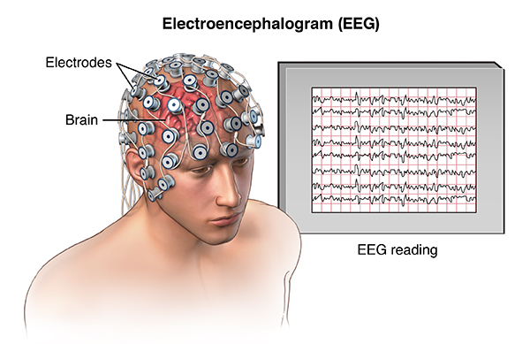
EEG
Notes:
Electroencephalography (EEG) is one of the oldest and most widely used methods for the investigation of the electric activity of the brain. The scalp electroencephalogram, recorded by a single electrode, is a spatiotemporally smoothed version of the local field potential (LFP), integrated over an area of 10 cm2 or more.
Under most conditions, it has little discernible relationship with the firing patterns of the contributing individual neurons, and this is largely due to the distorting and attenuating effects of the soft and hard tissues between the current source and the recording electrode.
The recently introduced ‘high-density’ EEG recordings, in combination with source-modelling that can account for the gyri and sulci (as inferred from structural MRI imaging) of the subject, have substantially improved the spatial resolution of EEG

Slide 5
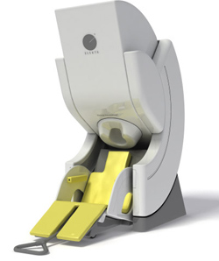
MEG
Notes:
(MEG) uses superconducting quantum interference devices (SQUIDs) to measure tiny magnetic fields outside the skull (typically in the 10–1,000 fT range) from currents generated by the neurons .
Because MEG is non-invasive and has a relatively high spatiotemporal resolution (~1 ms, and 2–3 mm in principle), it has become a popular method for monitoring neuronal activity in the human brain.
An advantage of MEG is that magnetic signals are much less dependent on the conductivity of the extracellular space than EEG. The scaling properties (that is, the frequency versus power relationship) of EEG and MEG often show differences, typically in the higher frequency bands. These differences may be partly explained by the capacitive properties of the extracellular medium (such as skin and scalp muscles) that distort the EEG signal but not the MEG signal

Slide 6
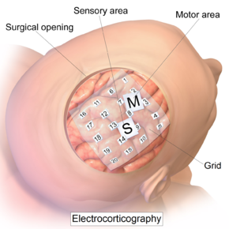
ECOG
Notes:
(ECoG) is becoming an increasingly popular tool for studying various cortical phenomena in clinical settings. It uses subdural platinum–iridium or stainless steel electrodes to record electric activity directly from the surface of the cerebral cortex, thereby bypassing the signal-distorting skull and intermediate tissue.
The spatial resolution of the recorded electric field can be substantially improved by using flexible closely spaced subdural grid or strip electrodes

Slide 7
Contributors to extracellular fields
Any type of transmembrane current or excitable membrane – spine, dendrite, soma, axon or axon terminal
Any type of transmembrane current = LFP voltage deflection
What sources shape the extracellular field?
Notes:
Here they provide an overview of their present understanding of the mechanisms that underlie the generation of extracellular currents and fields
Even though all nervous structures generate extracellular fields, their focus in the mammalian cerebral cortex, as most of their quantitative knowledge is the result of cortex studies
Any type of excitable membrane – spine, dendrite, soma, axon or axon terminal – and any type of transmembrane current contributes to the extracellular field.
Field is the superposition of all ionic processes, from fast Aps to slowest fluctuations of glia
Any transmembrane current leads to an intracellular as well as an extracellular (LFP) voltage deflection
Characteristics of LFP waveform, amplitude and frequency, depend on the proportional contribution of the multiple sources and properties of brain tissue
The larger the distance of the recording electrode from the current source, the less informative the measured LFP becomes about events
In addition to magnitude and sign of the individual current sources, and their spatial density, the temporal coordination of the respective current sources shapes the extracellular field. Thus extracellular currents can emerge from multiple sources

Slide 8
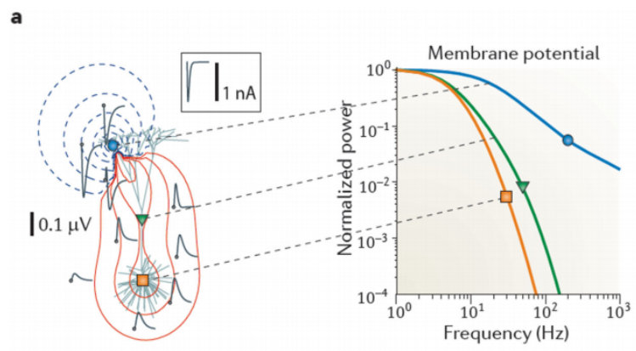
Synaptic activity
Notes:
In physiological situations: synaptic activity is often most important source of extracellular current flow
Idea that synaptic currents contribute to the LFP stems from recognition that extracellular currents from many individual compartments must overlap in time to induce a measurable signal
This overlap is most easily achieved for relatively slow events, like synaptic currents
Neurotransmitters acting on synaptic AMPA and NMDA receptors mediate excitatory currents (NA or Ca2+ ions) which flow inwardly at the synapse
This influx of cations gives rise to a local extracellular sink
To achieve electroneutrality w/in the relevant time constants for systems neuroscience, the extracellular sink needs to be ‘balanced’ by an extracellular source (an opposing ionic flux from the intracellular to extracellular space – this is called return current
Depending on the location of the sink current(s) and its distance from the source current, a dipole or higher-order n-pole is formed
A) computer-simulated LFP traces (left panel; grey) in response to an excitatory synaptic current (a sink shown by the blue circle) injected into the distal apical dendrite of a purely passive layer 5 pyramidal model neuron. Waveform of injected current shown in box. Red and blue contour lines correspond to positive and negative values for the LFP amplitude, respectively. The calculated double log power spectra of the transmembrane potential are shown in the right panel. Following injection of current into the apical dendrite near the injection site (blue), mid-apical dendrite (green) and soma (orange). High frequency activity decreases with the distance from the active synaptic site (the sink).

Slide 9
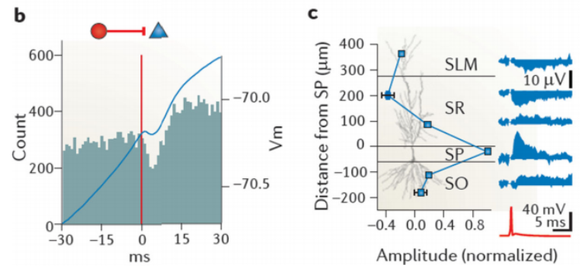
Synaptic activity
Notes:
GABA_A receptor-mediated inhibitory currents are typically assumed to add very little to the extracellular field as the Cl- equilibrium potential is close to the RMP
In actively spiking neurons the membrane is depolarized, and therefore inhibitory (often hyperpolarizing) currents can generate substantial transmembrane currents
B) A monosynaptic inhibitory connection between a putative layer 3 entorhinal cortical interneuron (red circle) and intracellularly recorded pyramidal cell (blue triangle). Below, a cross-correlogram between the spikes of the reference interneuron, with the pyramidal cell and, superimposed on it, the spike-triggered average of the membrane potential (Vm) of the pyramidal cell in blue
Note the small, short-latency hyperpolarization (the dip) superimposed on the rising phase of the intracellular theta oscillation and the corresponding decreased spike discharge of the pyramidal cell
C) inhibition induced LFPs. LFPs were generated in the vicinity of a pyramidal neuron (bottom cell) by intracellularly induced action potentials in a nearby basket cell (top cell), and were recorded extracellularly at 6 sites in multiple layers of the hippocampus
The mean LFP amplitude at each site is shown by the blue squares
Example LFP traces (blue) from 6 sites and the AP of the basket cell (red trace) are shown on right
Note: the largest positive response by inhibition-induced hyperpolarization occurs near the soma

Slide 10
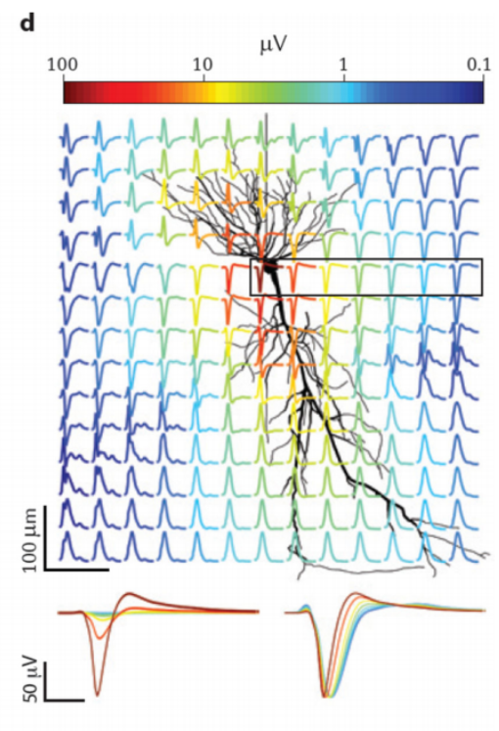
Fast action potentials
Notes:
Fast (Na) Aps generate strongest currents across neuronal membrane and can be detected as ‘unit’ or ‘spike’ activity in the extracellular medium
Although Na spikes generate large amplitude Ve deflections near the soma (Fig. 2D), until recently they were thought not to contribute substantially to traditionally considered LFP band(<100 Hz) or to the scalp-recorded EEG, bc the strongest fields they could generate are of short duration (<2ms) and nearby neurons rarely fire synchronously in such short time windows under phys conditions
However, synchronous Aps from many neurons can contribute substantially to high-frequency components of the LFP
Therefore w/ appropriate methods, valuable information can be extracted from the LFP about the temporal structure of spiking neuronal popl’ns
D) Extracellular contribution of an AP to the LFP in the vicinity of the spiking pyramidal cell. Magnitude of spike is normalized. The peak-to-peak voltage range is indicated by the color of traces.
Note: spike amplitude decreases rapidly with distance from the soma, without a change in polarity within the pyramidal layer (approximate area of which is shown by box), in contrast to the quadrupole (reversed polarity signals both above and below the pyramidal layers) formed along the somatodendritic axis
The distance-dependence of the spike amplitude within the pyramidal layer is shown (bottom left panel) with voltages drawn to scale using the same color identity as the traces in boxed area. The same traces are shown normalized to the negative peak (bottom right panel)
Note: the widening of the spike with distance from soma, owing to greater contributions from dendritic currents and intrinsic filtering of high-frequency currents by the cell membrane.

Slide 11
Calcium spikes
Long-lasting Ca-mediated spikes contribute to extracellular field
Voltage-dependent Ca spikes triggered by NMDA receptor-mediated EPSPs
Can we separate them?
Very little is known about Ca spikes in vivo!
Notes:
Other non-synaptic events that can contribute prominently to the extracellular field are the long-lasting (10-100 ms) Ca2+-mediated spikes
Since voltage-dependent regenerative Ca spikes are often triggered by NMDA receptor-mediated excitatory postsynaptic potentials (EPSPs), separating them from EPSPs in extracellular recordings is not straightforward
A potential differentiating factor is that, in contrast to EPSPs, Ca2+ spikes can actively propagate within the cell and can therefore generate fields across the laminar boundaries of afferent inputs
Ca2+ spike scan also be triggered by back-propagating somatic Aps, in which case they are independent of synaptic activity
Since dendritic Ca2+ spikes are large (10-50 mV) and long-lasting, their share in the measured extracellular events can be substantial under certain circumstances
UNFORTUNATELY VERY LITTLE IS KNOWN ABOUT Ca2+ spikes in vivo

Slide 12
Intrinsic currents and resonances
Ih vs. ICaT
Contribute to intrinsic resonance
Resonance is voltage- and frequency-dependent
Contributions to the LFP?
Notes:
Ih currents and ICaT currents are prominent examples of intrinsic, v-dependent membrane responses
These and other voltage-gated currents contribute to intrinsic resonance and oscillation of the membrane potential
Several neuron types possess resonant properties (they respond more effectively to inputs of a particular frequency range)
When the intra depolarization is sufficiently strong , the resonant property of the membrane can give way to a self-sustained oscillation of the voltage
Because resonance is both voltage- and frequency-dependent, its impact on the magnitude of the extracellular field can vary in a complex manner
To contribute substantially to the LFP, resonant membrane potential fluctuations must occur synchronously in nearby neurons, a feature that most often occurs in inhibitory interneurons

Slide 13
Spike afterhyperpolarizations (AHPs) and ‘down’ states
Elevation of ion concentration may trigger influx
Bursts of fast spikes and Ca spikes followed by hyperpolarized membrane
AHPs contribute to extracellular field
Bereitschafts potential, readiness potential or contingent negative variation
Non-rapid eye movement
Notes:
Elevation of the intracellular concentration of a certain ion may trigger influx of other ions through activation of ligand-gated channels, and this will in turn contribute to Ve
Ex: bursts of fast spikes and associated dendritic Ca spikes are often followed by hyperpolarization of the membrane, owing to activation of a Ca mediated increase of K+ conductance in the somatic region. As the amplitude and duration of such burst-induced AHPs can be as large and last as long as synaptic events
AHPs also contribute to extracellular field, particularly when bursting of nearby neurons occurs in a temporally coordinated fashion: ex, following hippocampal sharp-wave events
In the intact brain, responses to unexpected stimuli or movement intitiatino are often associated with relatively long-lasting LFP shifts, which might be mediated by synchronized AHPs
This slow LFP is referred to as Bereitschafts potential, readiness potential or contingent negative variation
During non-rapid eye movement (non-REM) sleep, the membrane potential of cortical neurons periodically shifts between a hyperpolarized ‘down’ state and a more depolarized ‘up’ state.
At least part of the cessation of spiking during the down states can be explained by AHPs of the synchronously bursting pyramidal cells in the up state
Gap junctions and neuron-glia interactions
Direct electric communication between neurons through gap junctions can enhance neuronal synchrony
Although gap junctions allow ionic movement across neurons and, therefore, do not involve any extracellular current flow, they can affect neuronal excitability and contribute indirectly to the extracellular field
Membrane potential changes in non-neuronal cells (glia) may also give rise to Ve

Slide 14
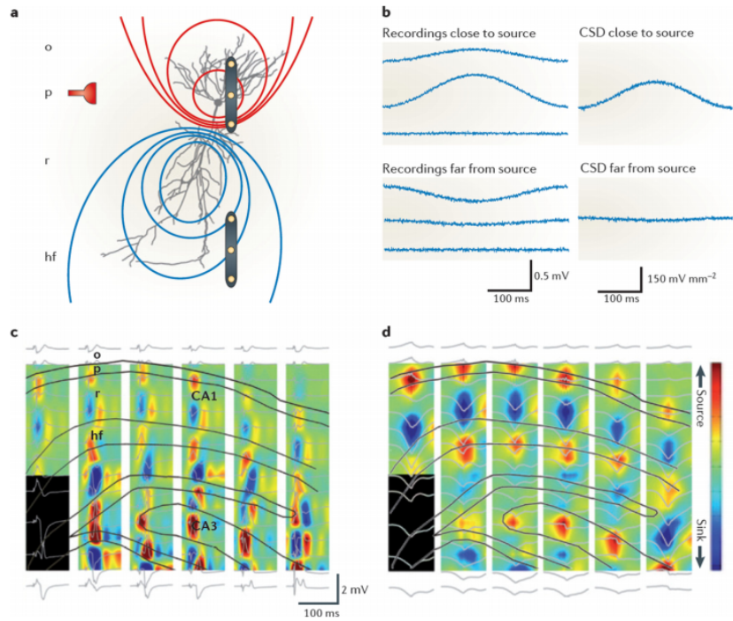
Localizing current sinks and sources: csd analysis
CSD represents volume density of the net current entering or leaving extracellular space
Notes:
In deciphering the location of the current sources (cations flowing from intra to extra) and sinks (cations flowing into cell) that give rise to the LFP, the concept of CSD is useful.
CSD is a quantity that represents the volume density of the net current entering or leaving the extracellular space
Consider a distant current source relative to three linearly and equally spaced recording sites in a homogenous volume (Fig 4). Each electrode will measure some contribution to the field from the distant source, and the voltage difference between the middle and side electrodes will be small
As a consequence, the difference between the ‘voltage differences per distance’ between the middle and side electrodes is small; an indication that the field can be attributed to a distant source
By contrast, if three electrodes span the location of the current-generating synapse or neuron group, the voltage at the three recording sites will be unequal and the difference magnitude of this derivative will be large; an indication of the local origin of the current
Using high-density recording probes to monitor the LFP, it is possible to precisely determine the maximum CSD and therefore the exact location of the current sink or source
A) a current source-sink dipole, embedded in a homogeneous and isotropic conductive medium, that is induced by barrage-like inhibitory input (shown by the red symbol) impinging on the perisomatic region. Lines show the iso-potentials (red, positive; blue, negative). A triplet of linearly and equally spaced recording electrodes (shown in yellow) is located near the soma (top), that is, close to the current source, and another is located far from the current source
B) Ve traces (left panels) measured at the three equally spaced locations relative to an ideal infinite (reference) site. The middle trace in the top panel is from the electrode positioned closest to the soma. The voltage contribution induced by the active dipole decays in the medium as the inverse square of the distance. The current source density (CSD) traces (right panels) are calculated from the voltage traces. Although dipole-induced Ve can be measured far from the source, CSD is spatially confined and can therefore help to identify the anatomical location of the dipole
C) Simultaneous recordings from 96 sites (six shanks (represented by columns in the figure) with 16 recording sites each (LFP traces shown in grey)) in a behaving rat. Simultaneously recorded evoked field responses in the CA1–dentate gyrus axis of the rat hippocampus (black lines show the outline of the layers) in response to electrical stimulation of entorhinal afferents are shown. Such trisynaptic activation of CA1 pyramidal cells is reflected as negative LFP (and sink, blue) in the apical dendritic layer (stratum radiatum, r). The black rectangle indicates missing channels
D) A CSD map of average spontaneously occurring sharp waves. Note the nearly identical distribution of sinks and sources in CA1 during the evoked responses and sharp waves, supporting the idea that sharp waves reflect CA3- induced depolarization of the apical dendrites of CA1 neurons. Selective activation of known afferents thus can be used to ‘calibrate’ the locations of sinks and sources, and relate them to the CSD distribution of spontaneously occurring LFP events

Slide 15
Your brain on… math!

Slide 16
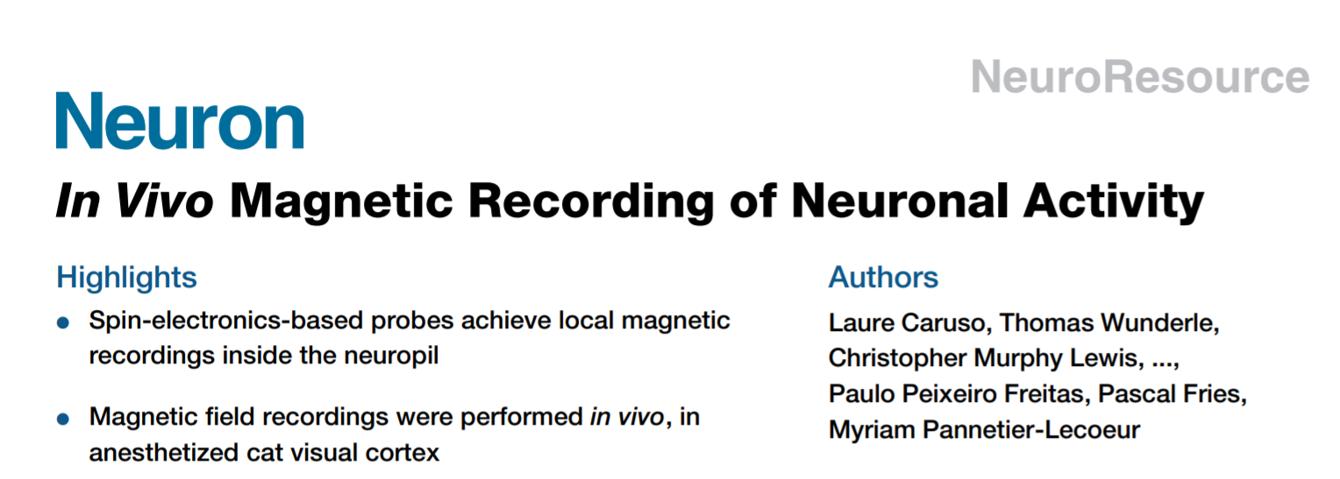

Slide 17
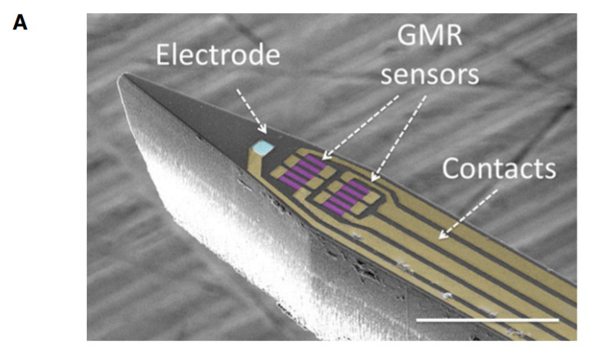

Slide 18
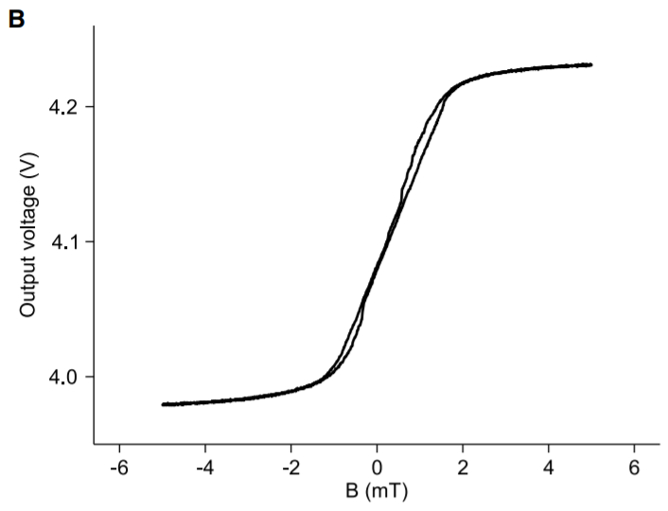

Slide 19
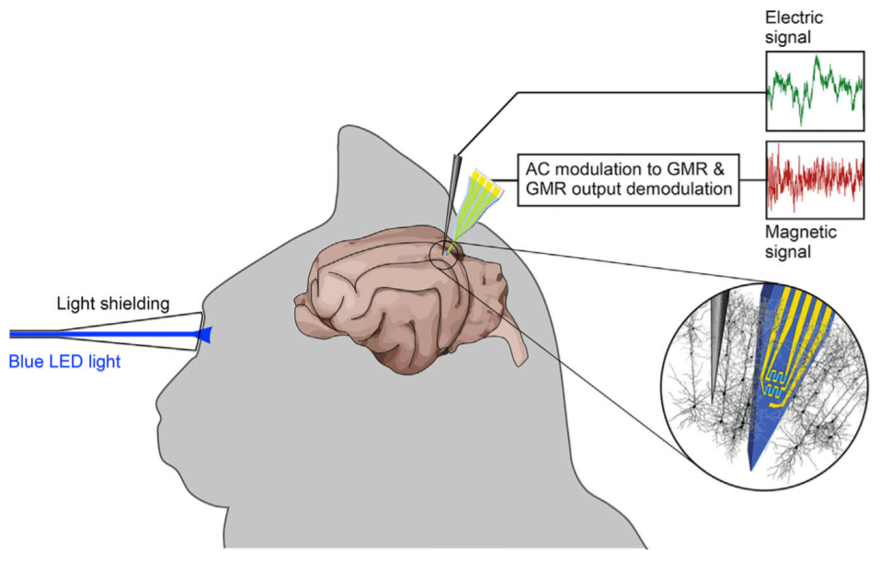

Slide 20
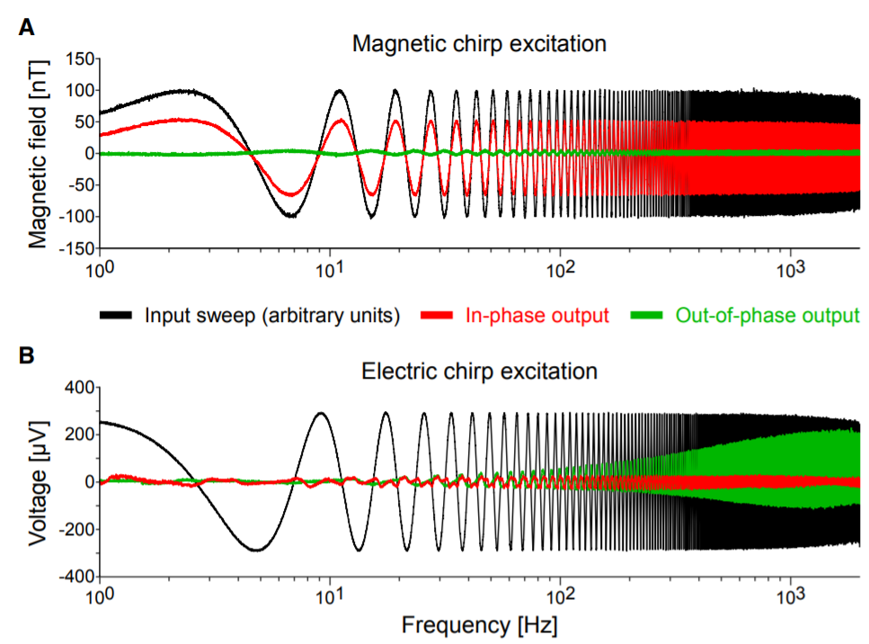

Slide 21
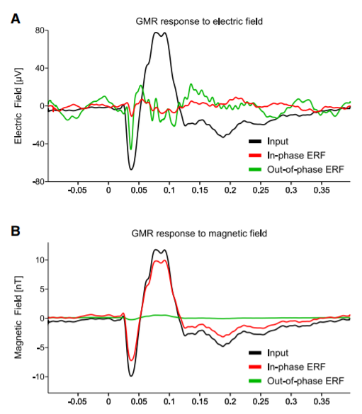

Slide 22
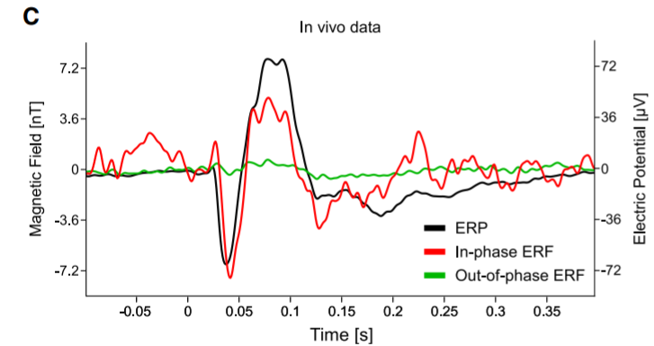

Slide 23
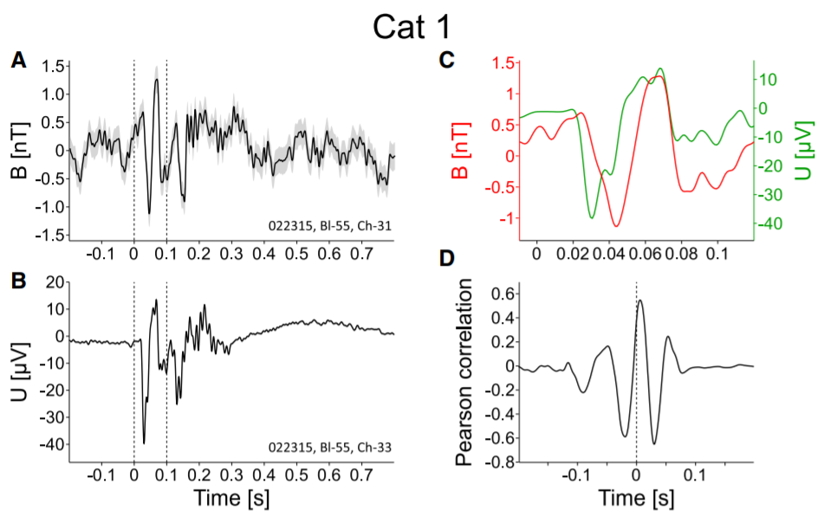

Slide 24
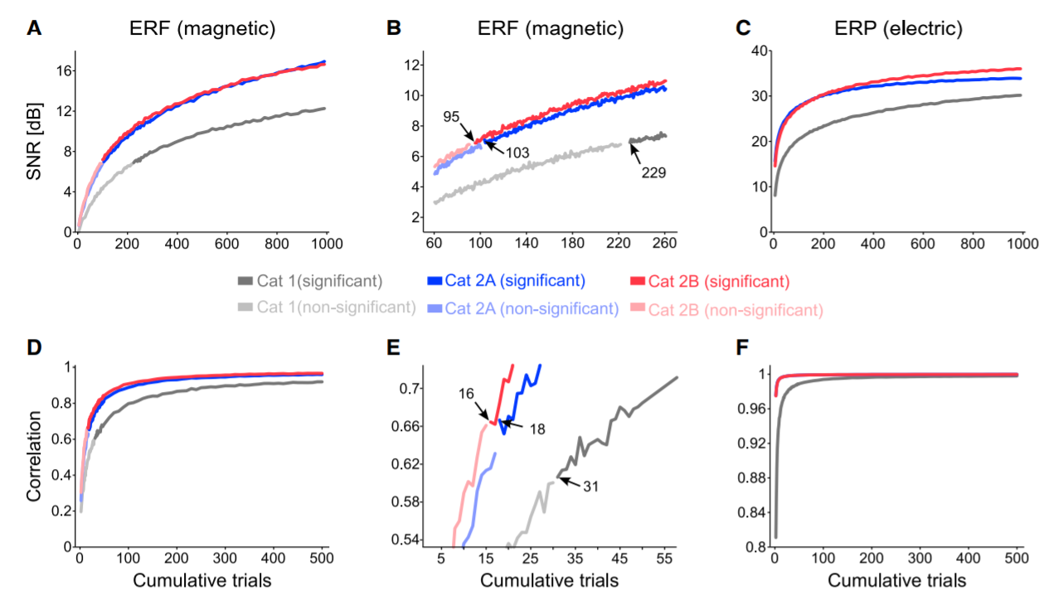

Slide 26
Viral Transduction Strategies

Slide 27
What does a virus do normally?
Viruses infect other cells in order to replicate
Differences in cargo
Lytic vs lysogenic
Transduction vs infection vs transfection vs transformation
Why do we use AAV (Adeno-Associated Virus)
rep and cap genes removed rAAV (ssDNA)
Previous Lentivirus
Notes:
They don’t have expression or replication machinery
Lysogenic cycle, integrates and chills splitting into daughter cells then goes lytic
Rna most typical
AAV needs a helper to integrate, and when it spontaneously does it’s at a set point in chromosome due to homologous recombination

Slide 28
AAV2 particle
Notes:
Talk about transduction mechanism, different coat proteins. Inside is a plasmid.

Slide 31
In Brief
“The role of dopamine in signaling rewards is well known, but here Broussard et al. show that dopamine D1-like receptor activity in the hippocampus is necessary for retention of aversive memories. The results indicate dopaminergic innervation and function within the hippocampus underlying long-term synaptic potentiation associated with aversive memory retention.”

Slide 32
Molecular approaches verified dopamine innervation of the hippocampus
Notes:
A: AAVDJ8, cre-dependent gfp-synaptophysin with EF1a promoter
B: injected into midbrain dopamine area, ventral tegmental area and substantia nigra
C: prominent labeling of projection and cell bodies in VTA, labeled terminals in the ventral striatum and medial prefrontal cortex. (major known targets for innervation by midbrain DA neurons)

Slide 33
Notes:
F/H: gfp-positive terminals found throughout CA1 region of cre-positive mice
G/I wild-type doesn’t show any green (autofluorescence
J: no cell body labeling at locus coerulus, so labeling must have projected from DA of midbrain

Slide 34
Notes:
To doubly verify this result, they did the same thing again but injected with a red. They then stained for tyrosine hydroxylase in green, and the overlap represents that they did in fact identify projections from DA to CA1.

Slide 35
Inhibitory avoidance (IA) learning induces ex vivo and in vivo LTP in the CA1
Notes:
A: gave mice a D1/D5 receptor antagonist, then mice received a footshock upon entering the dark side of a training chamber.
B. 24H after training, control mice injected with saline delayed entering the dark side where they had been shocked. Mice given the dopamine receptor antagonist during their training did not delay in exploring the dark side even though they’d been previously shocked.

Slide 36
Notes:
C: they say this isn’t from the drug impairing short-term memory because at 1 and 3 hours the drug group avoided the dark side of the room.
D: They repeated this again, but instead of an intraperitoneal injection they used cannular infusion to deliver their dopamine blocker directly to the hippocampus. This suggests that the receptors responsible for this change are in the hippocampus.
E: injecting more of the drug after testing doesn’t have additional effects
F: a D1 agonist helps the mice learn to avoid vs controls
G: beta2 adrenergic antagonists- the mice still learned to avoid the dark side so not mediated by that

Slide 37
D1-like dopamine receptor inhibition prevents IA induction of LTP
Notes:
A: Here they wanted to know if there was synaptic potientiation associated with the IA learning task in real time. Monitored synaptic transmission from the stratum radiatum of the CA1 by stimulating the contralateral Schaffer collateral axons before and after IA training.
A gives position of the electrodes. In B are those recordings, 1 is before 2 is after training. There is a difference in EPSP.
In C, significant increase in EPSP slope for trained mice, back to normal day after.

Slide 38
Notes:
So they did this whole thing again with the drugs from before. Sch is a D1 receptor antagonist and Tim is a beta adrenergic receptor antagonist. So that dopamine receptor is necessary for the increased EPSP and concomitantly for the mice to learn to hate the footshock.

Slide 39
Dopamine activation enhances and inhibition prevents long-term retention of IA
Notes:
These guys had previously demonstrated that the IA learning induced an increase in the AMPA/NMDA ratio specific to the CA3-CA1 circuit of the hippocampus. So they wanted to see if D1 was necessary for increases in that ratio.
A, B, D and E are traces of AMDA and NMDA-mediated currents after several treatments.
C and F give those ratios.
This shows that D1 receptor activation significantly influences CA1-CA3 IA-induced synaptic potentiation.

Slide 41
Cholinergic Neurons
Widespread, modulation of Ach receptors affects numerous brain processes
The casual role of these neurons remains unclear
Represent less than 1% of neurons, dominant control roles
Activated by cocaine, silencing the cocaine-activated cholinergic activity blocked cocaine conditioning

Slide 42
Notes:
So these guys want to figure out what function specific populations of cholinergic neurons has.
A-D: they’re focusing on the nucleus accumbens, injecting AAV particles that express either a cre-dependent channel rhodopsin or halorhodopsin. In red they’re staining for Choline Acetyltransferase. They’re going a long way to show colocalization.
E: membrane potential changes induced by current injection of -60,-20, 20 pA
F: membrane potential changes induced by 1s of 580nm light (halo)
G: spike train evoked by 470nm light (blue, chr2)
H: average probability of generating action potentials in chr2 chat neurons at different stimulation frequencies

Slide 43
Optogenetic photoactivation of ChAT interneurons increases frequency of inhibitory currents and suppresses MSN spiking
Notes:
A: chat interneurons with chr2 activated with blue light and nearby control cells are patch clamped
B: Left, spontaneous currents in MSN cell. Middle, currents increases when ChAT cell is stimulated. Right, currents blocked when GABA receptor antagonist is used, so considered IPSCs.
C: time course for the spikes in B
D: shows the increase in IPSCs following stimulation of the ChAT cell
E: stimulating the ChAT cell with light increased the frequency of IPSCs, but didn’t effect their amplitude.

Slide 44
Notes:
F: an optrode (optical fiber attached to a tungsten electrode) inserted into the nucleus accumbens in vivo
G: voltage trace of a unit that is inhibited by blue light stimulation, then a raster plot showing 5 repetitions of that, then average firing rate vs time of those recordings.
H: Most sites were inhibited by blue light, but nearly one fifth were excited
I: they said, “hey. Is there any way that we could get a few more panels on this figure?”

Slide 45
Optogenetic photoinhibition of ChAT interneurons enhances MSN spiking in vivo.
Notes:
A: This is like the previous panel but using the halorhodopsin that is gated with yellow light. A is a unit that was excited with yellow light, they repeat that 5 times, and average the responses vs time for us.
Skip B, they were stupid for using this type of graph instead of using a coordinate system in R3.
C: Most of these units were excited, but many of them were inhibited.
D: Same as A, but one of the inhibited units.
E: we have more raw data point crowding

Slide 46
ChAT interneurons can be activated by cocaine in slice and required for cocaine conditioning in vivo
Notes:
A: this in slice, dumped cocaine in the bath solution and firing frequency increased
B:
C: At the ten minute mark the firing rate was way higher in cells receiving cocaine vs acsf
D: double optic fiber placement in these new mice
E: training paradigm, cocaine and inhibitory light left chamber, saline injection right chamber
lame, daytime cocaine injection

Slide 47
Notes:
F: I hate that this is in a paper and not the supplemental information, but basically if the cholinergic neuron is inhibited, then the mice don’t prefer the cocaine room.
G: states the same thing but using a metric called fold change in time
H-J: So here’s what I was waiting for the entire paper, the mice that don’t show cocaine conditioning run faster, farther and move more when they’re given cocaine! Didn’t see that one coming yeah? I’m assuming that leginth is a unit of distance.

