Slide 1
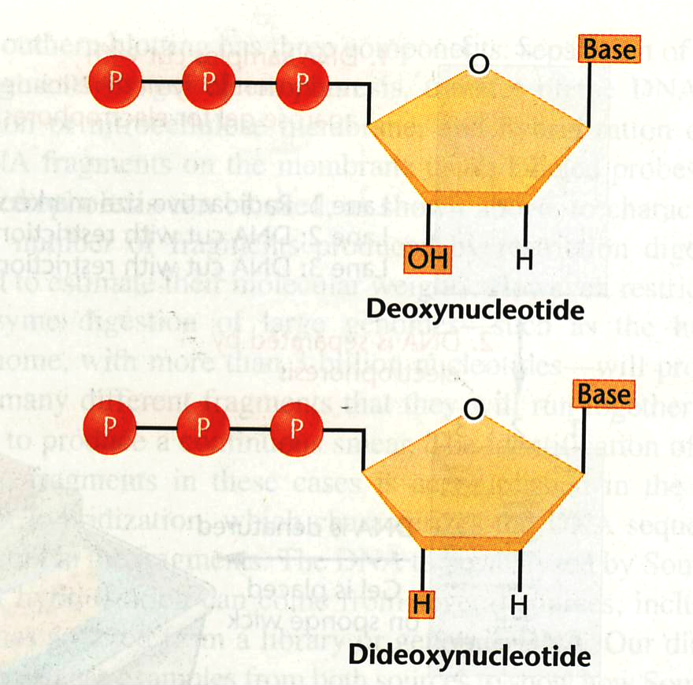
DNA Sequencing – dideoxynucleotide sequencing
or Sanger sequencing
Dideoxynucleotide
sequencing
DNA polymerase
primer
dATP, dGTP, dCTP, dTTP
small amount of a didNTP
that is labeled

Slide 2
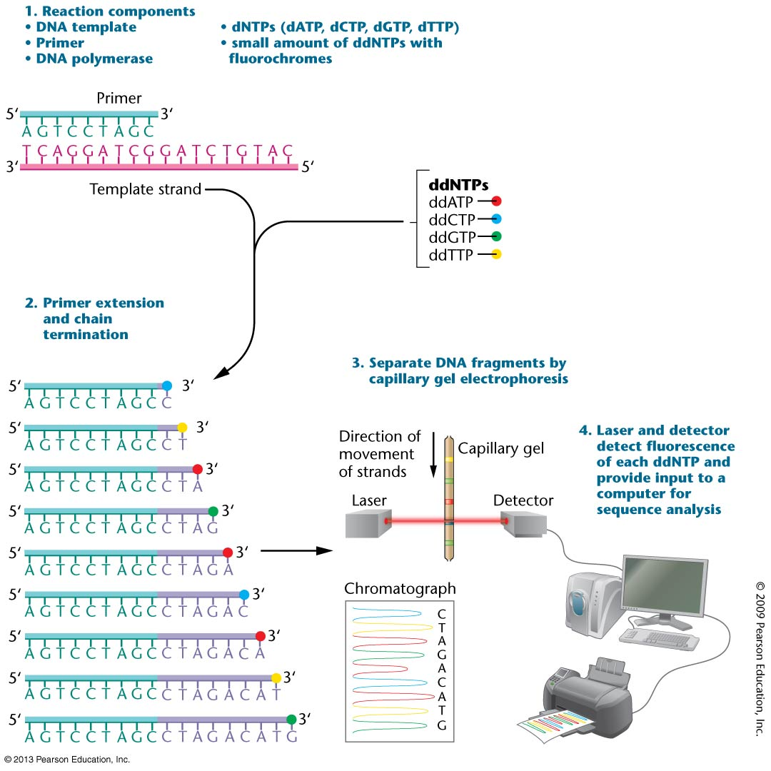

Slide 3
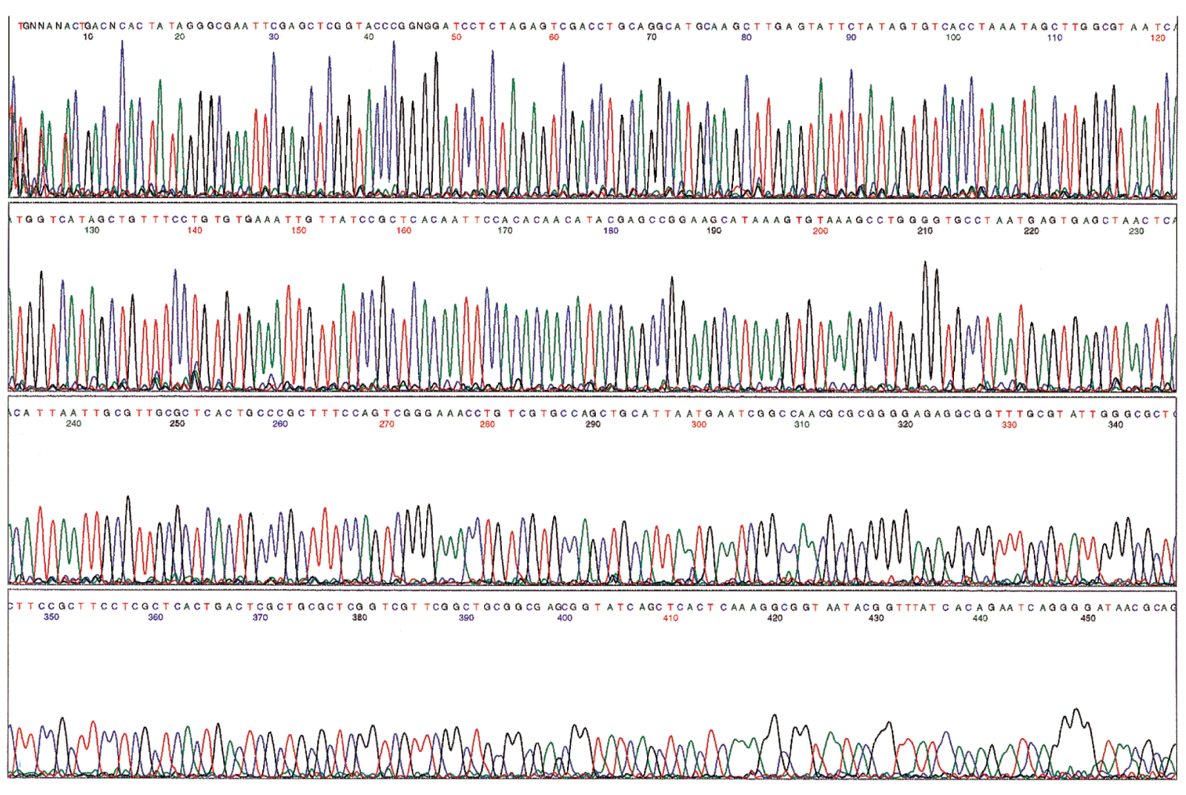
Output of a DNA sequencing reaction using fluorescently labeled bases

Slide 4
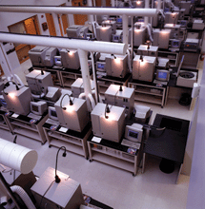
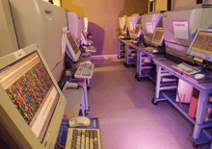
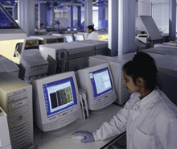
Sequencing is done
robotically and assembled
by computer

Slide 5
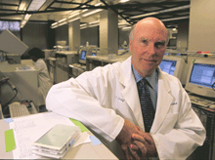
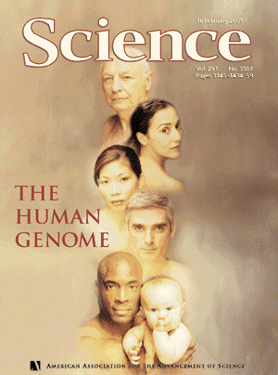


Two competing Groups Sequenced the Human
Genome
Craig Venter
Francis
Collins
International Human Genome
Consortium
Celera Inc.
“Draft” Sequence Published Feb 2001
“Finished” Sequence 2004

Slide 6
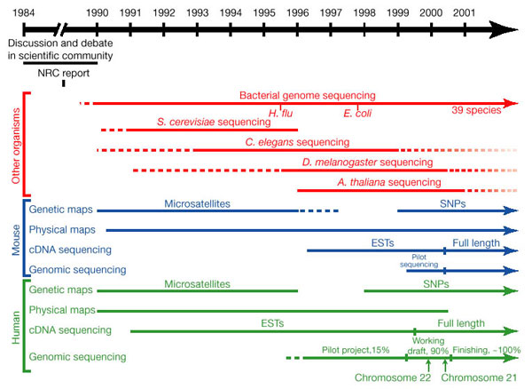
ESTs – expressed sequence tags – cloned and sequenced mRNAs

Slide 7
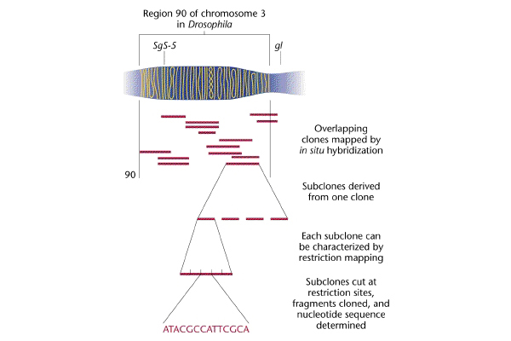
Genome sequencing
based on mapped
“contigs”
(overlapping
genomic
DNA clones)
Map-based Cloning:
1. large DNA clones
are mapped
2 .individual contigs
are restriction
mapped
subcloned and
subclones are
sequenced

Slide 8
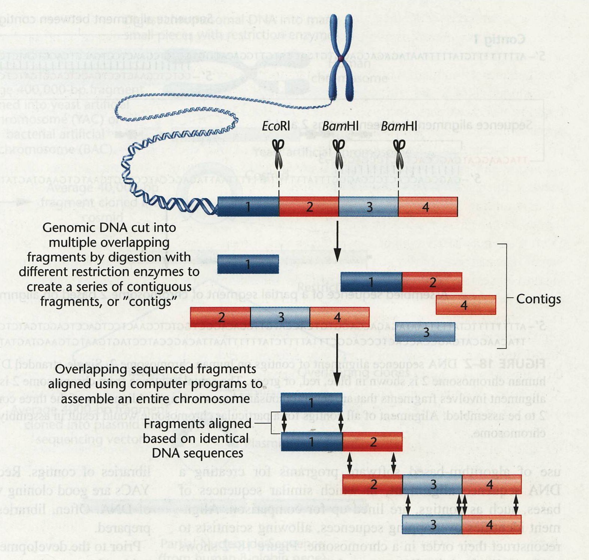
“Shotgun Cloning” approach used by Celera
genome cut into
small pieces with REs
and cloned
2. clones are
sequenced and
contigs identified
by overlapping end
sequences
3. chromosome
sequence assembled

Slide 9
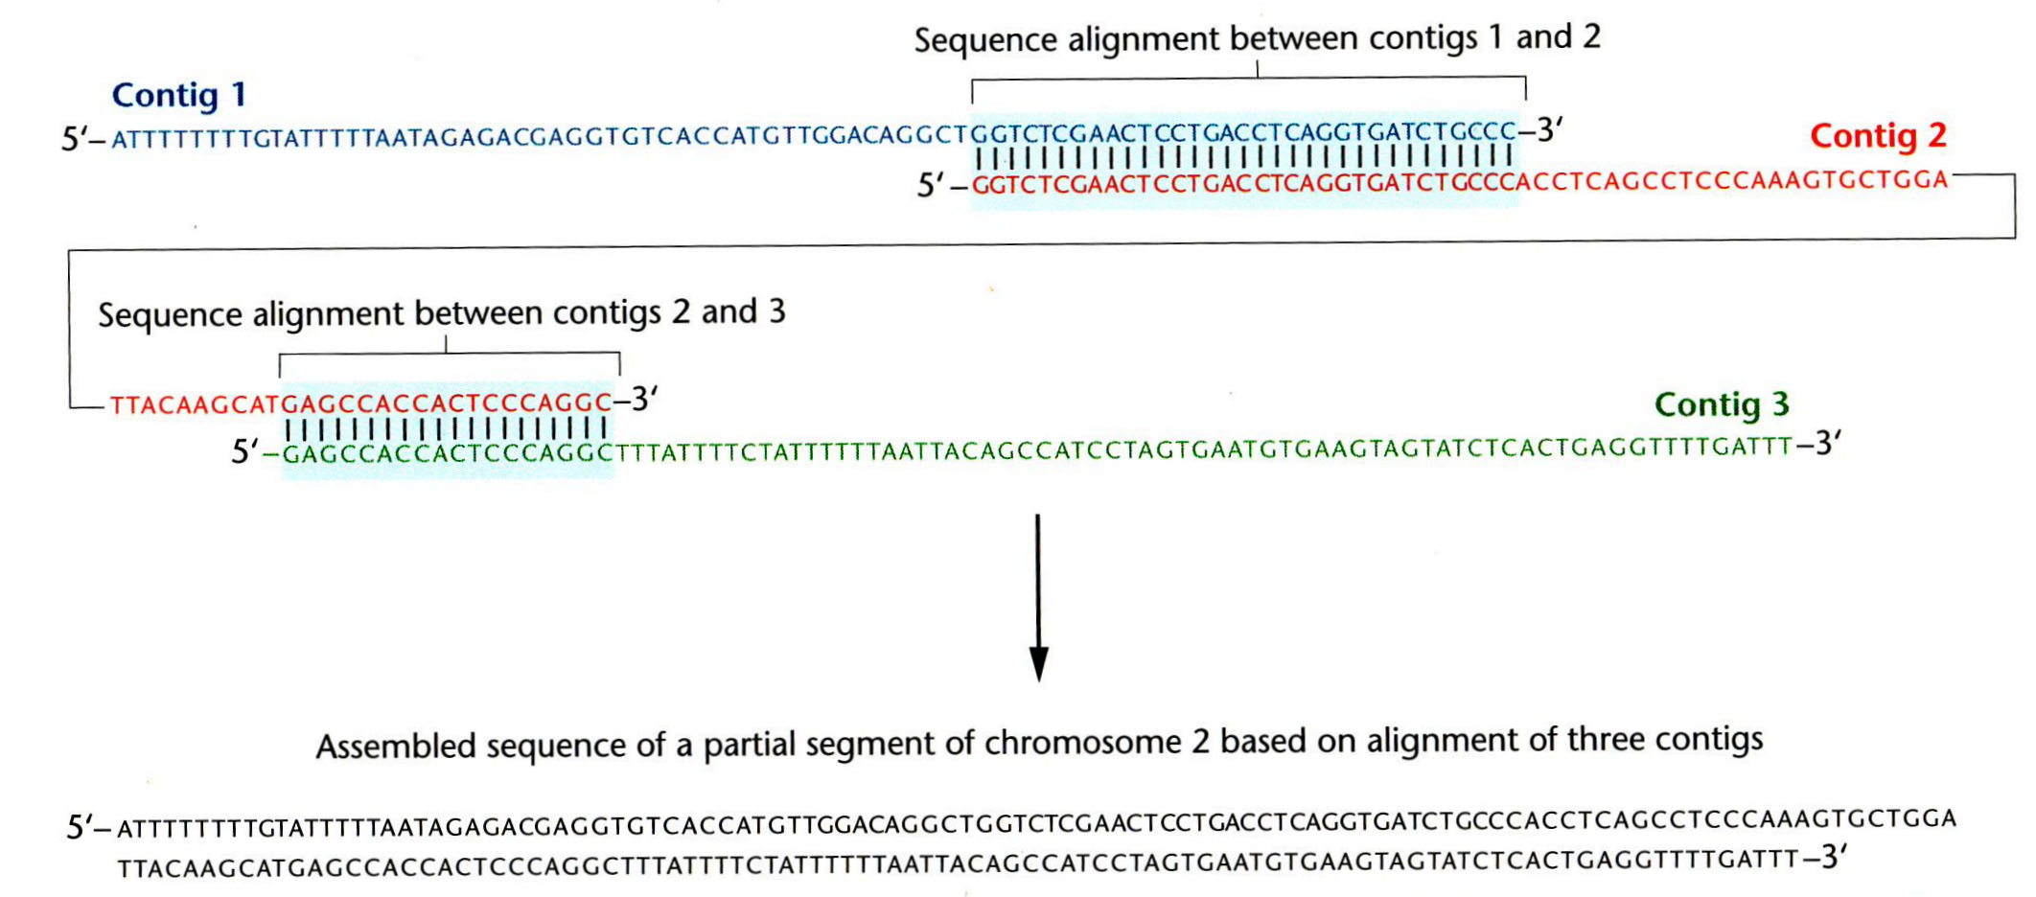
Computers assemble the sequence of individual contigs into one
continuous sequence
Map-based cloning – highly accurate and complete sequence
Difficulty with map-based cloning – mapping all the contigs takes
a LONG time
Shotgun cloning is fast (and cheap) and reveals most of the genes
Difficulty with shotgun cloning – repeated sequences cause
places to be missed (gaps) or
misassembled (put in wrong place)

Slide 10
Celera
DNA from five subjects was selected for genomic DNA sequencing:
two males and three females
one African-American, one Asian-Chinese, one Hispanic-Mexican,
and two Caucasians
(27.3 million sequence reads; 14.9 billion bp of sequence)
Hugo
DNA from 8 males was sequenced - 23.1 billion bp sequenced
Human genome size - 3.2 Gb only 2.9 Gb was sequenced
centromeres and telomeres were skipped
Gaps - about 10% of the sequence was in gaps between clones

Slide 11
Next Gen Sequencing
the quest for the $1000 genome
 | Read length (bases) | Runtime (days per gigabase) | Cost ($ per 1000 bases)
Capillary | 1000 | 500 | $0.10
454 | 450 | 2 | $0.02
Illumina | 75 | 0.5 | $0.001
SOLiD | 50 | 0.5 | $0.001
Current work focuses on sequencing different individuals to see
how we differ and how these differences correlate with health
and disease --- We are all 99.9% the same.

