Slide 1
DNA Replication
transcription translation
DNA mRNA protein
replication
Before each cell division the DNA must be replicated
so each daughter cell can get a complete genetic set

Slide 2
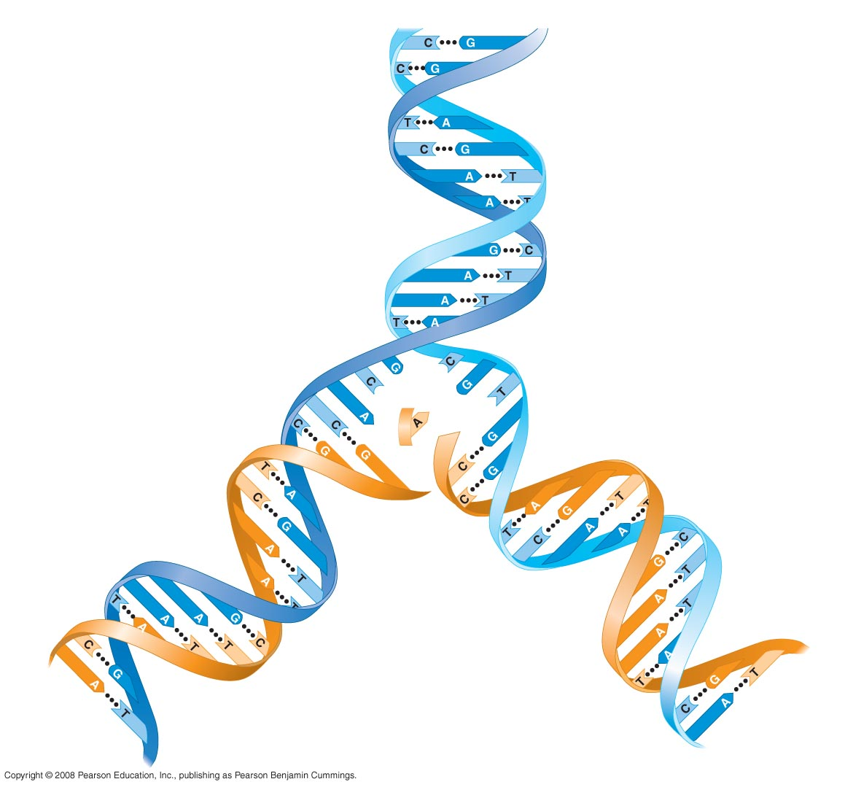
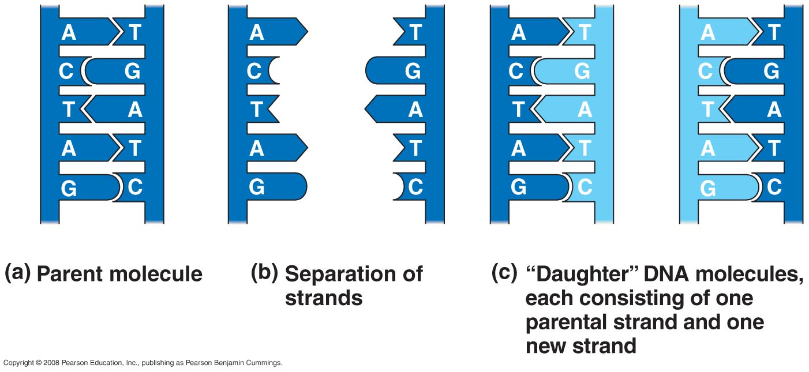
5' end
3' end
Complementary
Base Pairing
is at the Heart of DNA
Replication
3' end
5' end
New
strands
3' end
5' end
Old strands
5' end
3' end

Slide 3
DNA Replication
DNA polymerase
adds deoxyNTPs to 3’ end of DNA
5’ to 3’ synthesis
requires a DNA template
requires a primer (either DNA or RNA)
for starting DNA replication

Slide 4
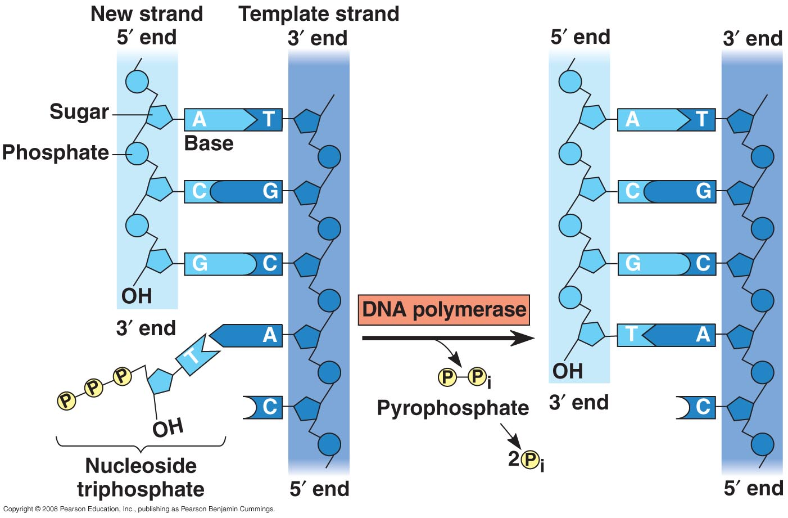
Primer

Slide 5
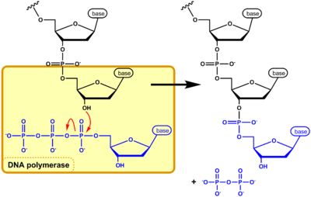
phosphodiester bond formation

Slide 6
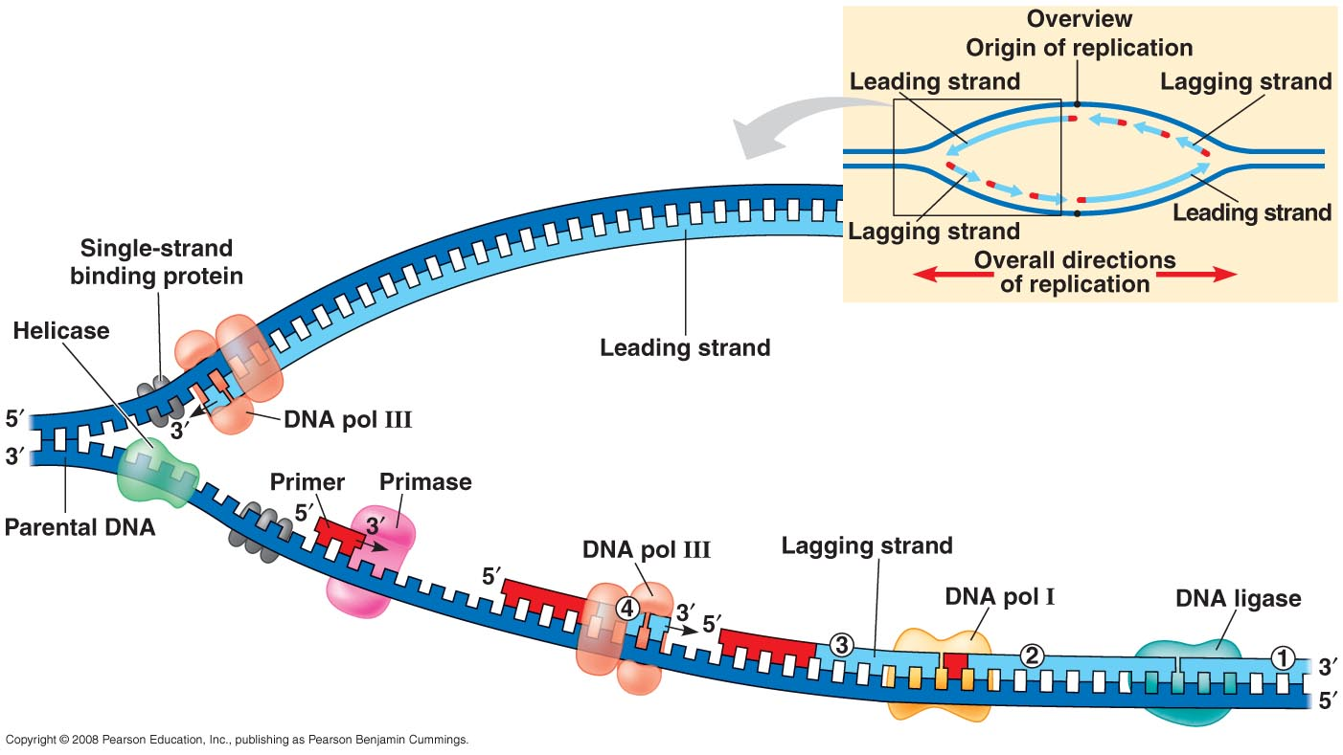
Many Primers are Required
In Lagging Strand Synthesis

Slide 7
DNA Replication in a test tube is used for
DNA sequencing and PCR

Slide 8
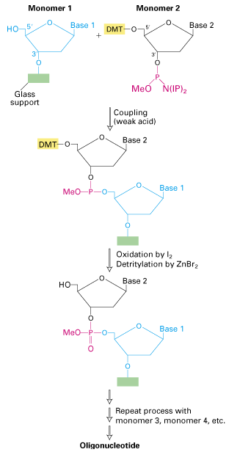

Primers – short pieces of
single stranded DNA can
be synthesized chemically

Slide 9
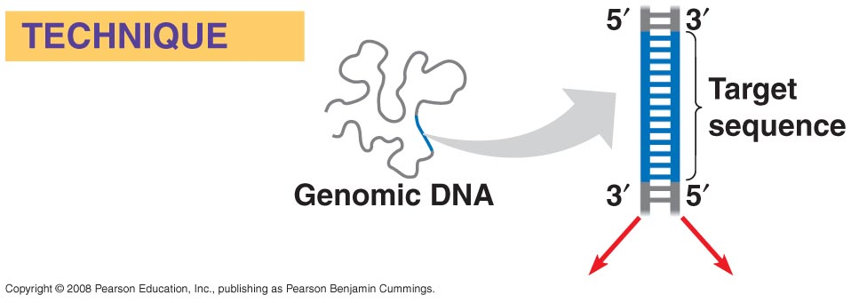
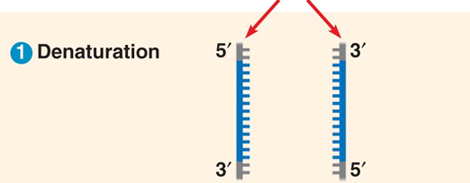
Polymerase chain reaction, PCR
makes many copies of a DNA
sequence by repeated rounds
of DNA replication
First the DNA
is denatured
(95 degrees C)
Then short single stranded DNAs (PRIMERS)
are allowed to bind - ANNEALING STEP

Slide 10
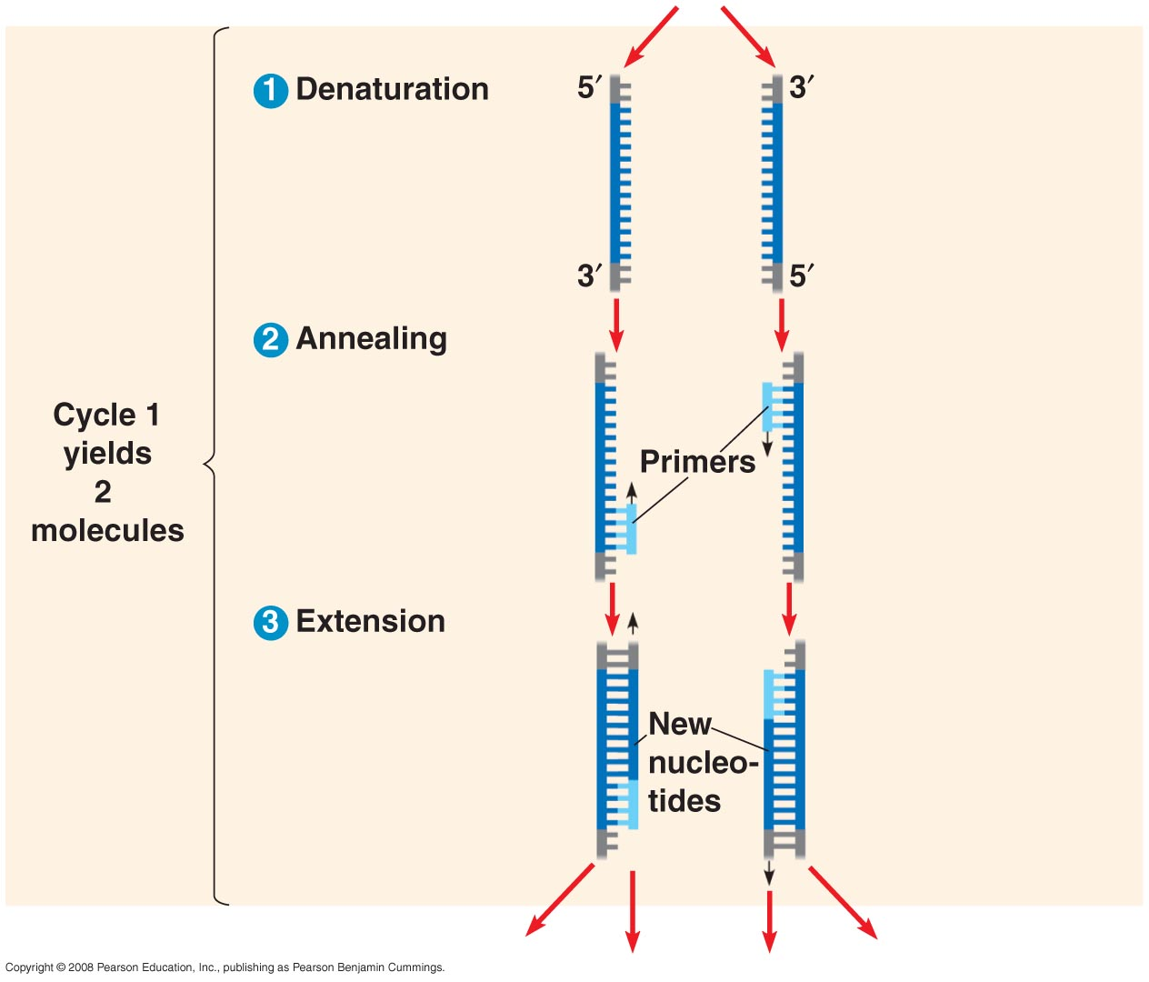
The temperature of the
annealing step is adjusted to allow the primers to just be able to bind (60 degrees C)
Each
DNA Polymerase
extends from the
primers
Each PCR cycle
doubles the number
of target molecules

Slide 11
