Slide 1
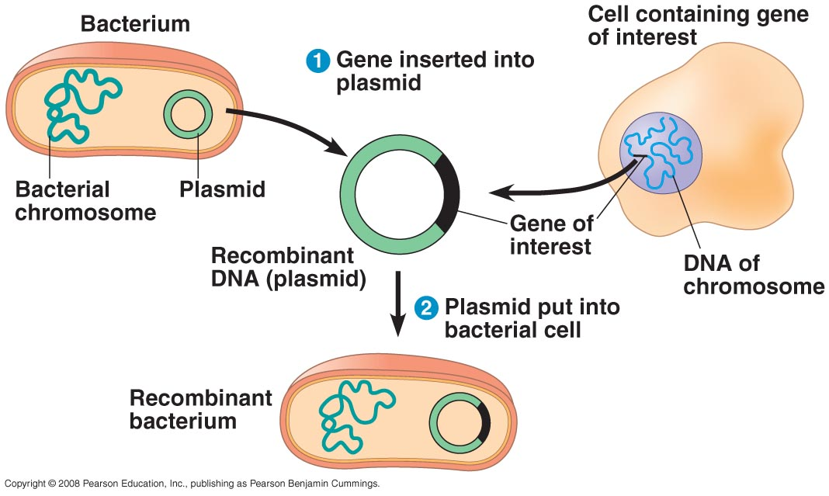
Recombinant DNA and Biotechnology
Recombinant DNA
DNA molecules that
have been joined
in a test tube
Gene cloning in bacterial plasmids
Plasmid – extrachromosomal piece of DNA
not necessary for survival
can be transferred between bacterial cells

Slide 2
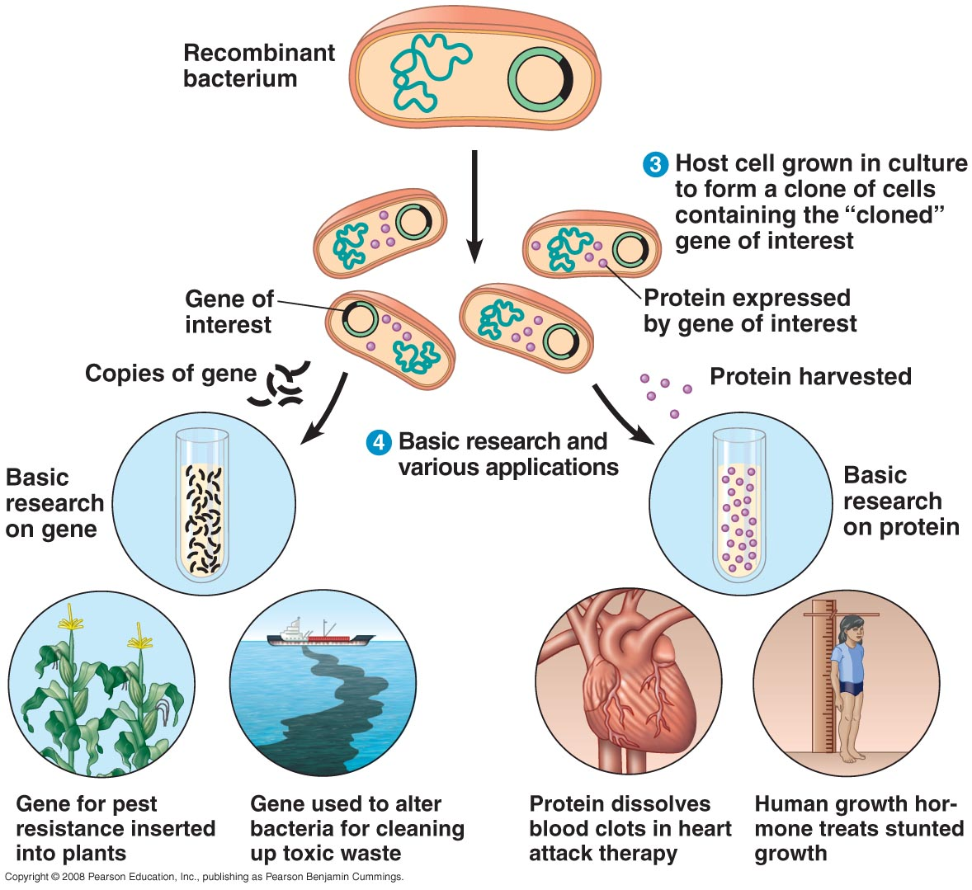

Slide 3
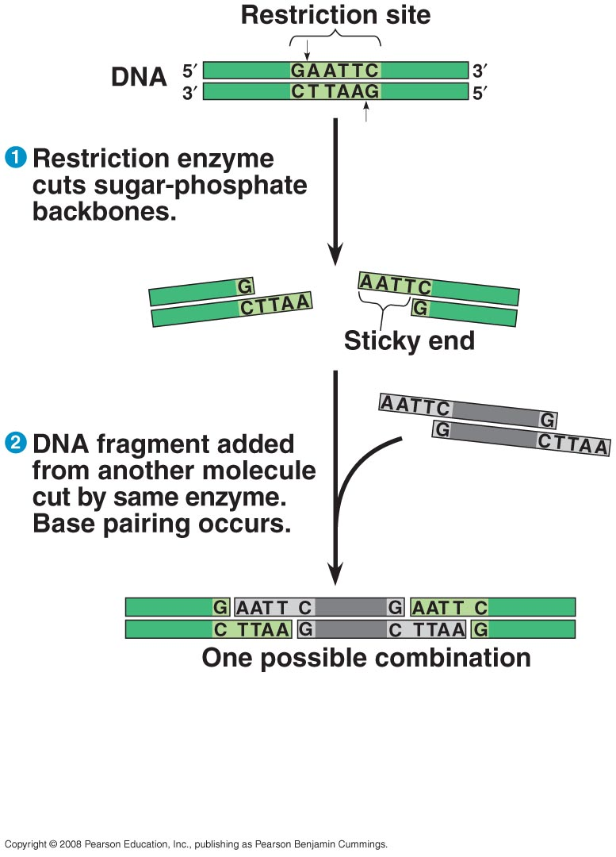
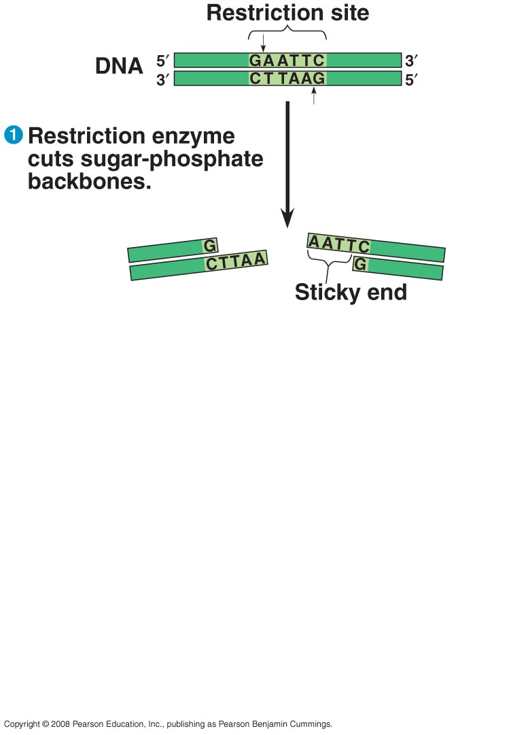
Restriction enzymes
are key to gene
gene cloning and
making recombinant
DNA
Site specific
nucleases
make double stranded cuts
in DNA at their
recognition sequence
leave overhanging
complementary ends
“sticky ends”
Two DNA molecules cut with the same restriction enzyme
can be joined together.

Slide 4
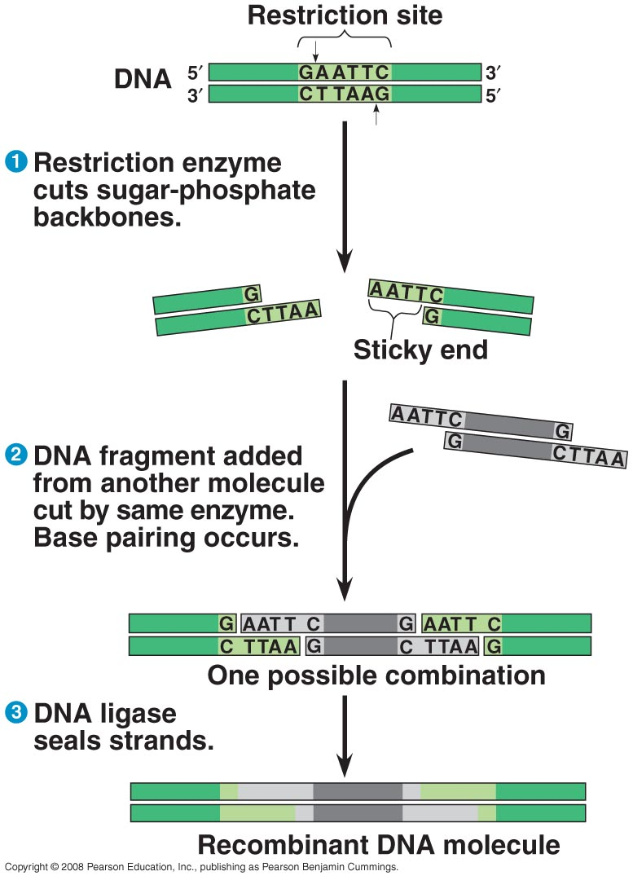
Final joining requires
DNA ligase

Slide 5
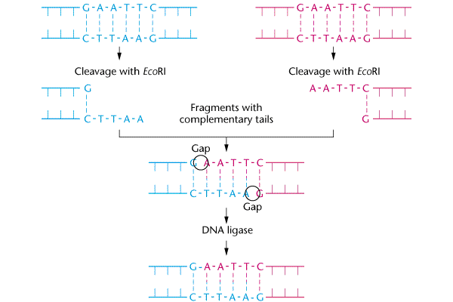
DNA from organism
Vector DNA
Recombinant DNA

Slide 6
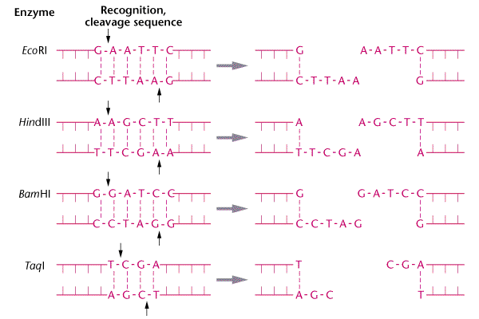
Different Restriction
Enzymes cut
different DNA
sequences

Slide 7
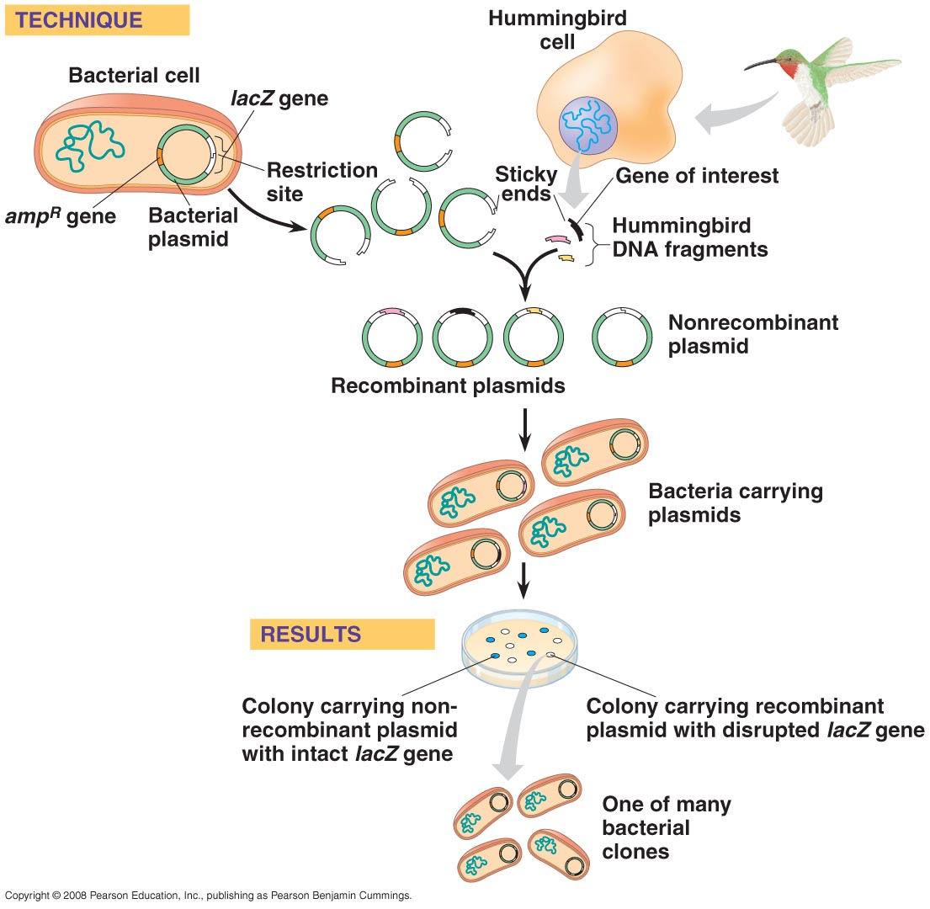
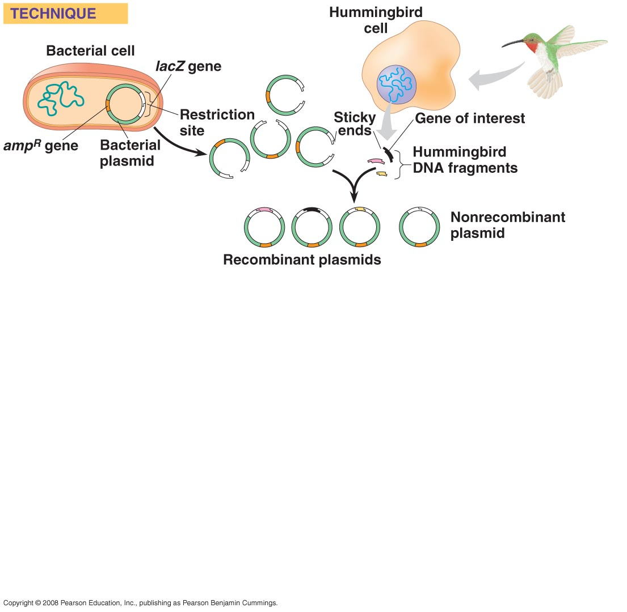
In gene cloning DNA fragments are randomly
inserted into plasmids
Recombinant
plasmids are
put into bacteria
Each bacterial
colony carries a
different piece of
cloned DNA

Slide 8
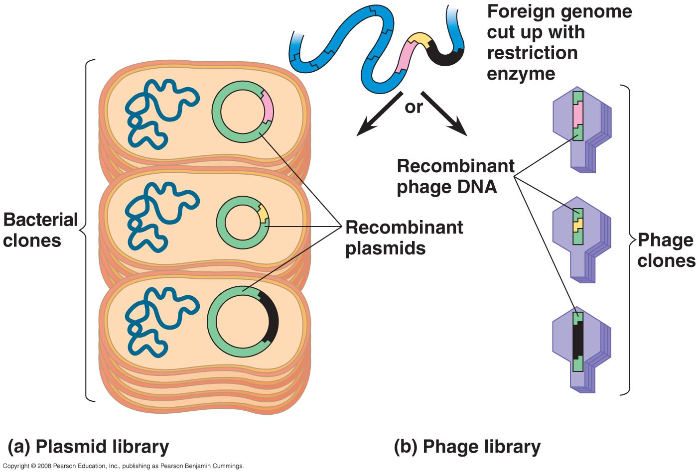
A “gene library” is a
collection of cloned
DNA fragments each
in a bacterial colony

Slide 9
Do not exceed the following setting:
Examples:
tens
ones
tenths
1
2
2
0
4
1
2
0
0
P 20
1 - 20 μl
12.2 μl
4.1 μl
20.0 μl
hundreds
tens
ones
1
3
6
0
7
5
2
0
0
P 200
20 - 200 μl
136 μl
75 μl
200 μl
thousands
hundreds
tens
0
2
5
0
5
0
1
0
0
P 1000
200 - 1000 μl
250 μl
500 μl
1000 μl = 1 ml

