Slide 1
Biology in London Program
Summer 2023
A departmental program targeted to majors during the summer in London
Two upper division classes, offered sequentially over eight weeks (May 9 – July 5)
Two classes: Genetics and Human Physiology
Open to non-majors with permission of instructors

Slide 2
Biology in London Program
Why study biology in London?
Study abroad experience
Satisfy graduation requirements
Smaller class sizes than at Tallahassee campus, with more direct instruction and greater access to teachers
Discover London with a science perspective
Learning experiences and resources not available in Florida (esp. museums)

Slide 3
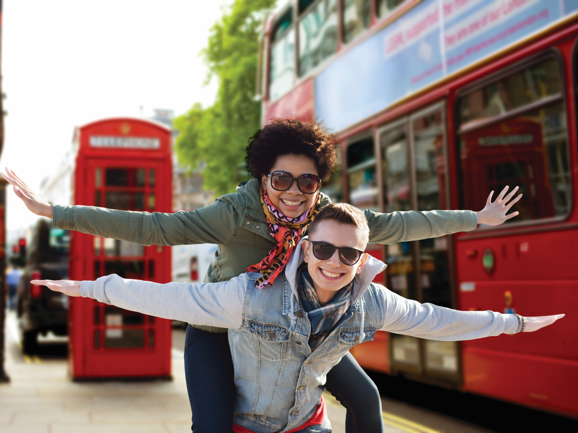

The London
Experience
Notes:
Introductions

Slide 4
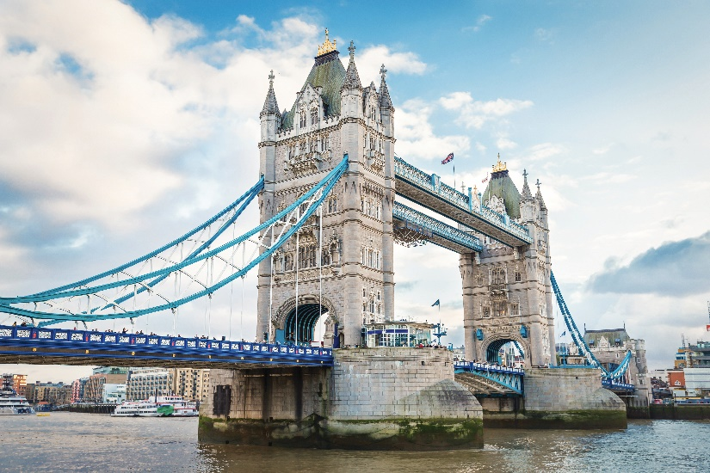
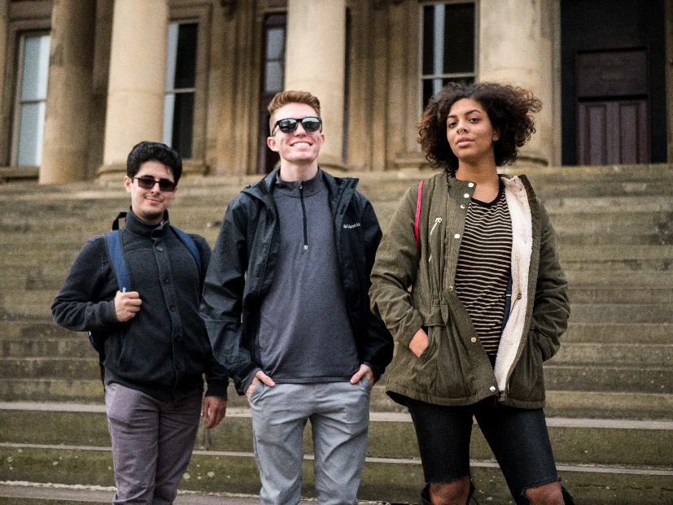
Florida State University’s International Programs is proud to celebrate more than 60 years of experience in international education (and more than 50 years in London), and is a nationally recognized leader in the field of study abroad programs.

Slide 5
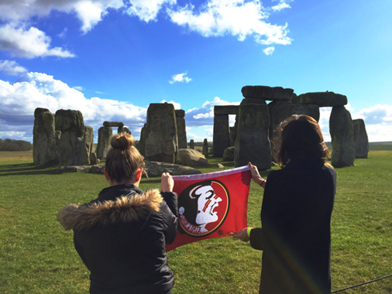
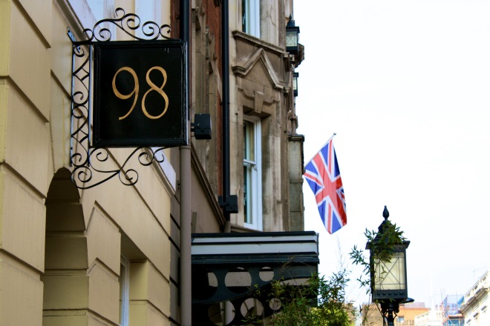
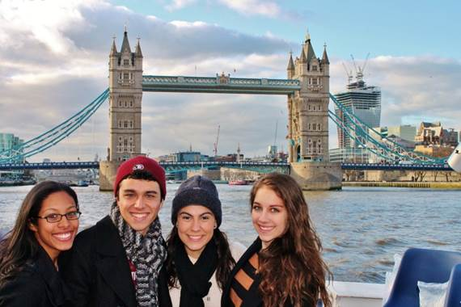
London Study Center
Centrally located, two blocks from the British Museum
Adjacent to University College, London
Walk to Covent Garden, Trafalgar Square, and Houses of Parliament
Lots of FREE cultural events, including 3-day weekend excursions to cities such as Edinburgh, Bath or York

Slide 6
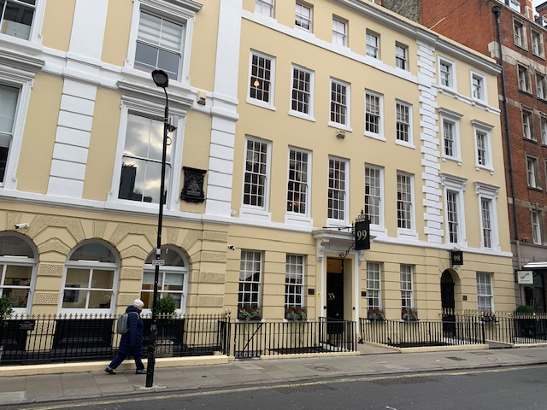
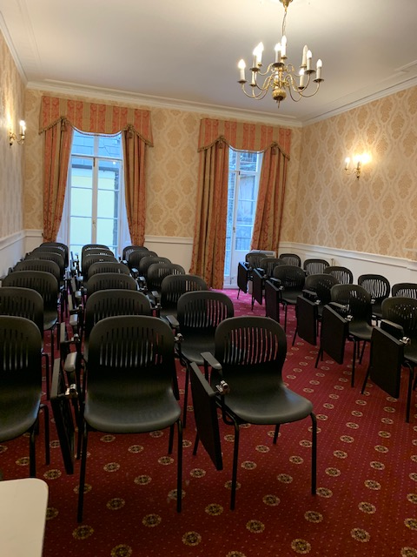
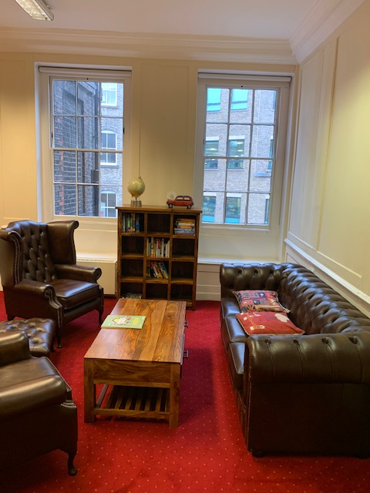
London Study Center

Slide 7
Biology in London Program
Class excursion possibilities
Anesthesia Heritage Center British Library
British Museum
Francis Crick Institute
Darwin’s home (Down House)
Florence Nightingale Museum
Garden of World Medicine in the Chelsea Physic Garden
Grant Museum of Zoology
Kew Gardens
Museum of London
National Portrait Gallery
Natural History Museum
Old Operating Anesthesia Museum
Royal College of Physicians Hunterian Museum
Royal Geographic Society
Royal London Hospital Museum
Royal Observatory
Royal Society of Surgeons of England
Science Museum
University College London Physiology Laboratory
Wellcome Collections (e.g., “Medicine Man”)

Slide 8
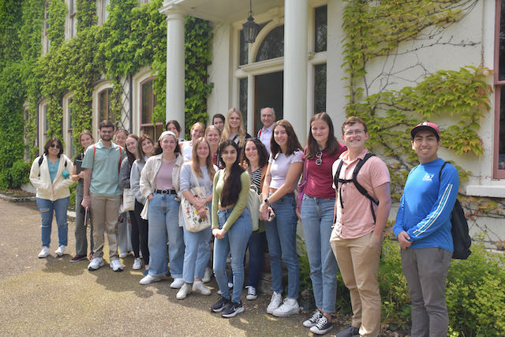
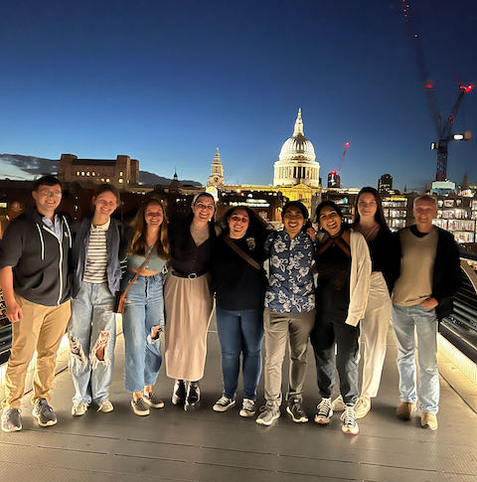
Biology in London Program
The London Experience: 2022
Biogeography at Darwin’s Home
After the farewell Shakespeare play

Slide 9
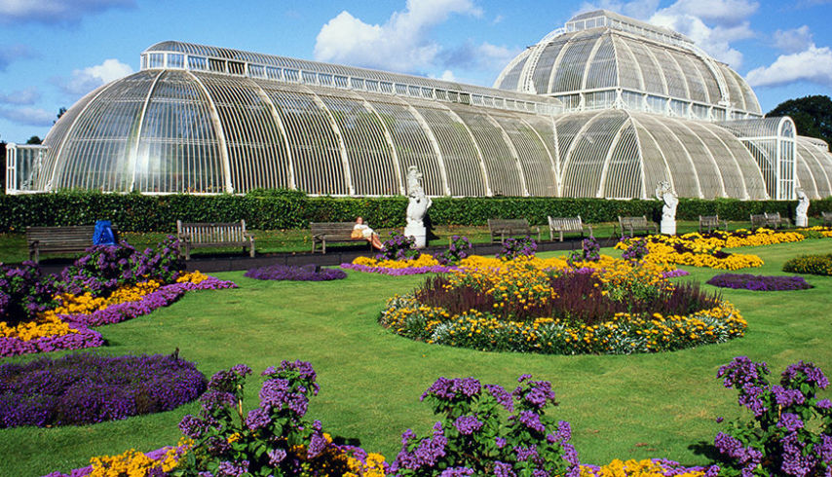
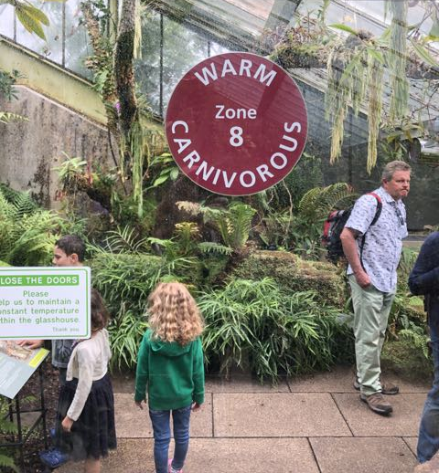
Biology in London Program
The London Experience: 2022
Royal Kew Gardens

Slide 10
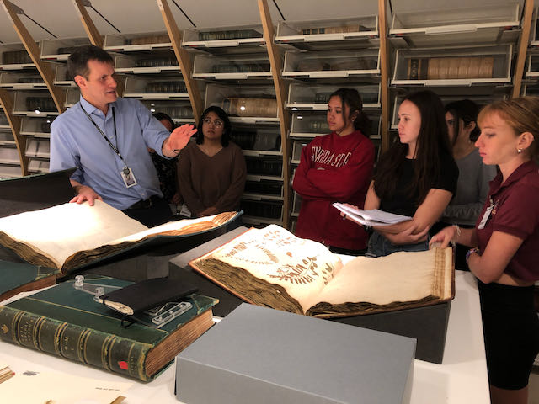
Biology in London Program
The London Experience: 2022
Private tour of the collections, Natural History Museum

Slide 11
Biology in London Program
The London Experience: 2022
An historical perspective
The cholera well
Smallpox vaccination

Slide 12
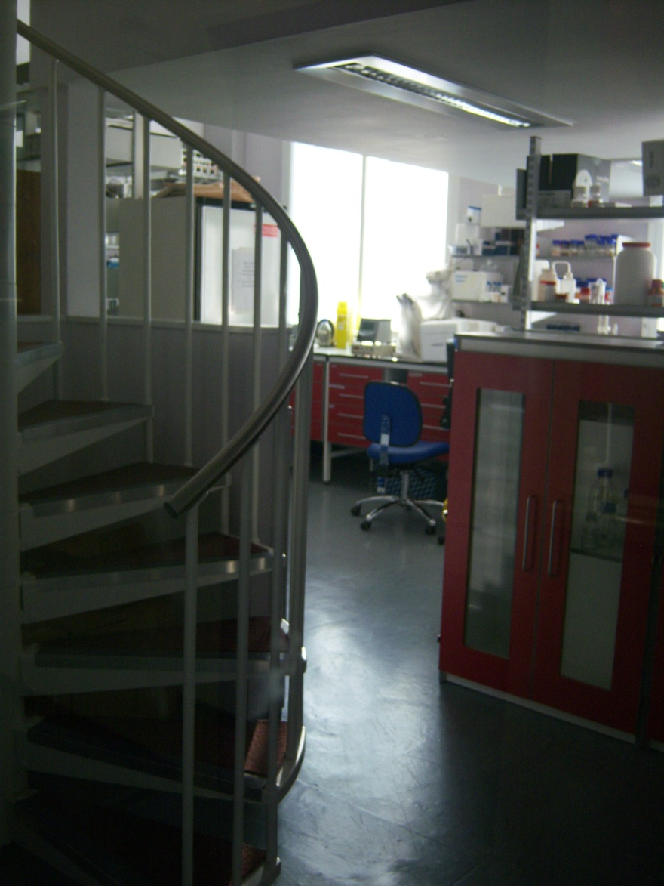
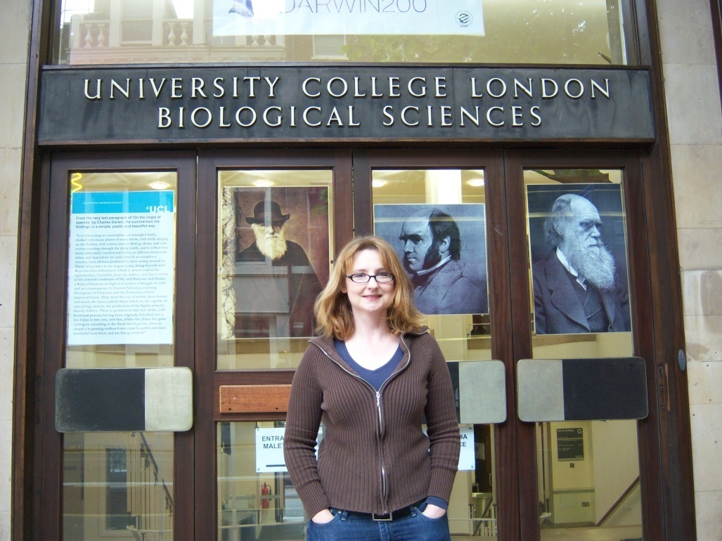
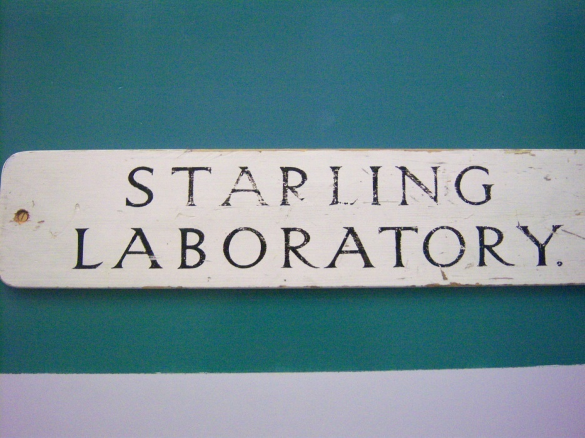
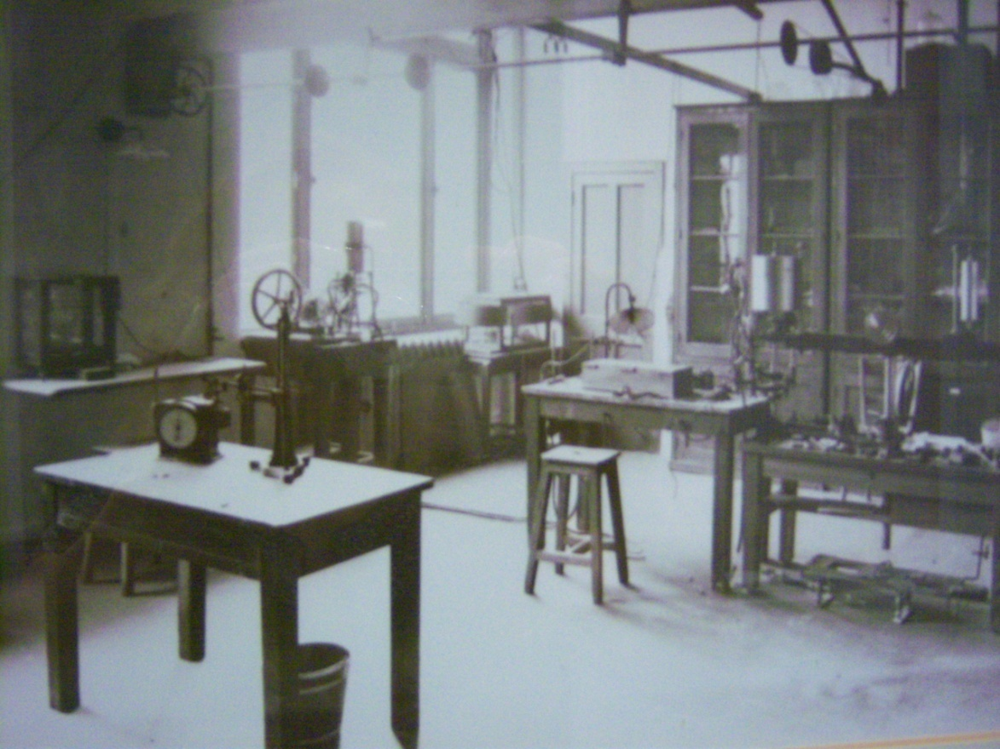
Biology in London Program
The London Experience: 2023
Visit to University College, London

Slide 13
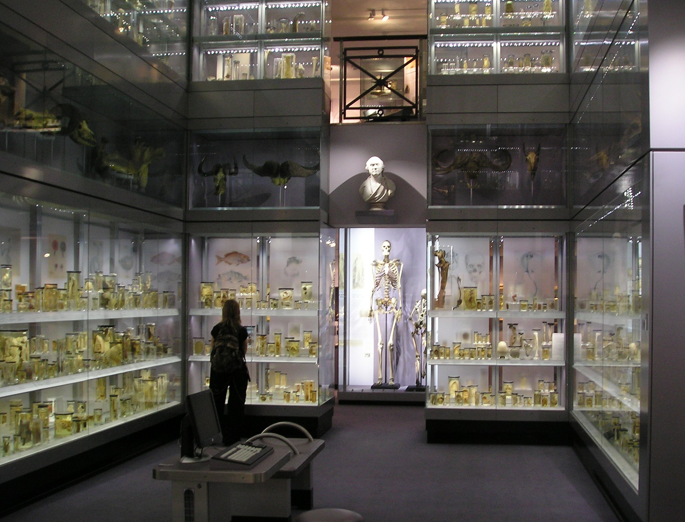
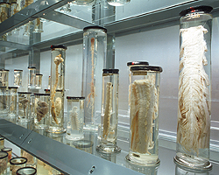
Biology in London Program
The London Experience: 2023
Hunterian Collection, Royal College of Surgeons
Notes:
Can’t photograph, these are from websites

Slide 14
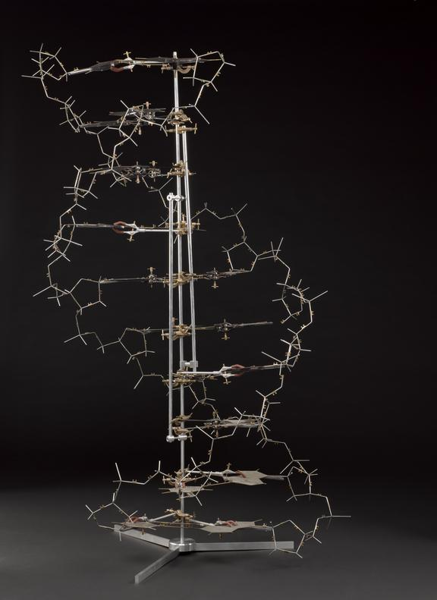
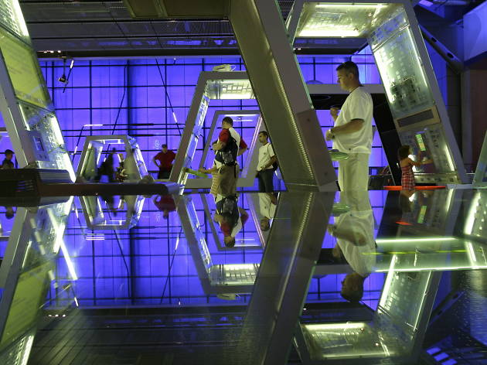
Biology in London Program
The London Experience: 2023
Science Museum

Slide 15
Biology in London Program
Classes to be offered Summer 2023
General Genetics (PCB 3063, 3 credits)
Dr. James M. Fadool
Human Physiology (PCB 4701, 3 credits)
  Dr. Debra Ann Fadool

Slide 16
General Genetics in London Program
offered Summer 2023
WEEK 1 Classical Genetics
Class Day 1 8 May Science in the 19th Century/Mendel (Grant Museum of Zoology – UCL)
Class Day 2 9 May Fast forward 100 years: The Nature of the Gene
10 May Problems in the Park: (Genetics in the Park: mastering genetics problems)
Class Day 3 11 May Beyond Mendel (Quizlet 1) – (Trip to Prof. Steve Wilson Lab, Vice Dean for Research, FLS, UCL)
WEEK 2 Human Genetics
Class Day 4 15 May Nothing Special Here (Natural History Museum – Human Evolution Collection)
Class Day 5 16 May Let’s do some Maths: Quantitative Genetics & Populations
17 May Excursion to Down House (Quizlet 2)
Class Day 6 18 May Chromosomes (Genetics in the Park: Reading Genetics Articles)
WEEK 3 Genetics in Action
Class Day 7 22 May Translating the Code
Class Day 8 23 May Gene Regulation: Why 2 sexes? (Afternoon field trip: The Francis Crick Institute)
Class Day 9 24 May Mutation: Let’s talk about Corona Virus (Quizlet 3)
Class Day 10 25 Mar Diseases of the Chromosomes: From Neuroscience to Cancer Genetics
(Visiting Lecturer: Prof. Courine Houart – Deputy Head, Center for Developmental Neuroscience, King’s College)
WEEK 4 Where Did the Time Go
Class Day 11 29 May Tools and Technology: Student Selected Topics (Quizlet 4)

Slide 17
Human Physiology in London Program
offered Summer 2023
Class Day 1 (W 8 June) – Cell Biology
Class Day 2 (Th 9 June) – Nervous System
Class Day 3 (M 13 June) – Brain (brain electrophysiology experiments at the
University of College London with Dr. Pedarzani)
Class Day 4 (T 14 June) – Skeletal Muscle (Hunterian Museum Royal College of Surgeons, \
Bone Regeneration Exhibit) EXAM on Class materials Day 1 to 3
Class Day 5 (Th 16 June) – Smooth Muscle
17-19 Liverpool and N Wales Overnight Trip (Friday to Sunday)
Class Day 6 (M 20 June) – Heart & Circulation (Royal College of Physicians, Human Veins,
Nerves, Arteries Section)
Class Day 7 (T 21 June) – Pulmonary Physiology (Old Operating Theatre Museum,
Discovery of Anesthesia) EXAM on Class materials Day 4 to 6
Class Day 8 (Th 23 June) – Renal Physiology (Garden of World Medicine in the
Chelsea Physic Garden, Discovery of Pharmaceutics)
Class Day 9 (M 27 June) – Renal Physiology
Class Day 10 (T 28 June) - Digestive Physiology (Wellcome Collection Museum –
Obesity/Metabolism Exhibit)
Class Day 11 (Th 30 June) – Endocrinology Pregnancy Lactation (Florence
Nightingale Museum – Nursing Division) EXAM on Class materials Day 8 to 10
English Cultural Activities: Great Inventors (Ben Franklin House), Evolution (Down House/Charles
Darwin), Music/Religion (John Wesley House), Literature (John Keats House),
and Society (British Museum High Tea).

Slide 18
Biology in London Program
No prerequisites beyond BIO 2010/L, BIO 2011/L; CHM 1045/L and CHM 1046/L:
Program application timeline:
Summer 2023
07 September, 2022 Applications Open* $100
09 January, 2023 Scholarship Applications Due
18 January, 2023 Commitment Fee Due $1500
15 February, 2023 Full Payment Due
9th May to 5th July 2023 – London!
*Early application is advisable as program enrollment is limited and acceptances are offered on a rolling basis.

Slide 19
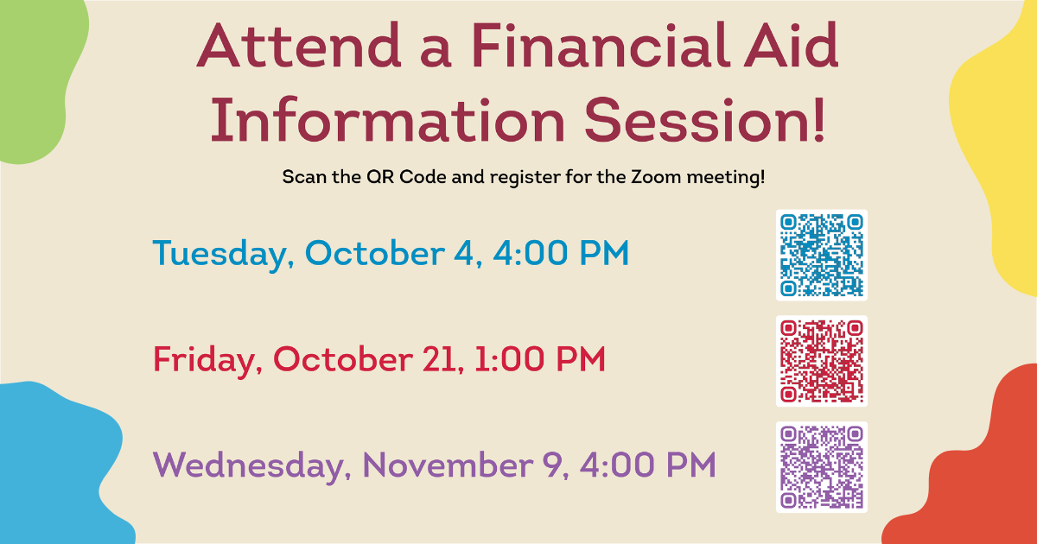

Slide 20
Biology in London Program
For more information:
Jim Fadool (jfadool@bio.fsu.edu), Debra Fadool (dfadool@bio.fsu.edu)
Scott Steppan, Bio in London Coordinator (steppan@bio.fsu.edu)
(Dept. Advising office advisor@bio.fsu.edu)
International Programs (international.fsu.edu)
Becca Piers (Program Coordinator rpiers@fsu.edu )

