Slide 1
Background of ReplicatonDomain
Original idea and conception by Dr. Dave Gilbert
Store and visualize the genomic data collected by his lab
Provide other scientists access to his data
Making data public required by some publications

Slide 2
Gathering of system requirements
Meet with end users, get their idea of what site should look like and how it will function
Look at similar sites, both suggested by end users and from own research
Look at example datasets

Slide 3
Current capabilities of ReplicationDomain
Storage of Epiginetic data sets
Dynamic visualization of multiple epigenitic datasets, with zoom and move of visualization window
Downloading of whole and partial datasets
Granular sharing of datasets between users and user groups

Slide 4
ReplicationDomain – System Architecture
Operating System: FreeBSD
Web server: Apache + PHP
Database server: MySQL
Database admin interface: PHPMyAdmin
Dynamic image creation: GraphicsMagick

Slide 5
Relational Databases
Flat Databases
One large table
Generally contain redundant data
Easier to design and implement
Invented in 1970 by Edgar Codd of IBM
Eliminates redundancy in data
Require more time and effort to design and code
Reduces chances for errors in data
Generally more efficient than a flat database

Slide 6
Example of flat database
Lname | Fname | Age | Salary | Hours | City | Avg Salary | Avg Hours
Smith | John | 38 | $280 | 40 | Tallahassee | $320 | 42
Brown | Scott | 34 | $350 | 41 | Boston | $390 | 45

Slide 7
Example of flat database
Lname | Fname | Age | Salary | Hours | City | Avg Salary | Avg Hours
Smith | John | 38 | $280 | 40 | Tallahassee | $320 | 42
Doe | Jane | 29 | $320 | 43 | Tallahassee | $320 | 42
Brown | Scott | 34 | $350 | 41 | Boston | $390 | 45
Taylor | Tom | 45 | $390 | 42 | Boston | $390 | 45
Shemp | Howard | 43 | $380 | 41 | Boston | $390 | 45
Select Lname, Fname, Salary, AvgSalary from People where Lname=Smith and Fname=John

Slide 8
Example of Relational Database
Lname | Fname | Age | Salary | Hours | City
Smith | John | 38 | $280 | 40 | 1
Doe | Jane | 29 | $320 | 43 | 1
Brown | Scott | 34 | $350 | 41 | 2
Taylor | Tom | 45 | $390 | 42 | 2
Shemp | Howard | 43 | $380 | 41 | 2
CityNumber | CityName | AvgSalary | AvgHours
1 | Tallahassee | $320 | 42
2 | Boston | $390 | 45
Select Peole.Lname, People.Fname, People.Salary, City.AvgSalary from People, City where People.Lname=Smith and People.Fname=John and People.City = City.CityNumber

Slide 9
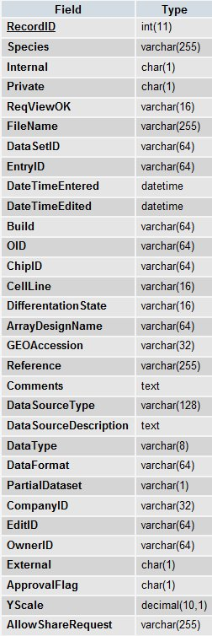
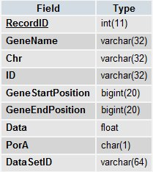
ReplDB Tables – table structure
Datasets table
Data table

Slide 10
Groups
- User capabilities on ReplicationDomain website controlled by groups.
- Every function on the website has a corresponding group.
- Groups are implemented via the People, Groups and groupsXuserid tables.
- Allows granular access to website functions.

Slide 11
Data upload and input scripts
- Check to make sure user is logged in and that the user is in the data upload group
- Use PHP file upload library and functions to upload data file to the server
- Does extensive data validation before inserting the data into the database
- Originally all data points were stored in one table. Now the datapoints from each dataset are stored in separate tables.

Slide 12
Example data file (Replication Timing)
GeneID GeneName CHR Start End Data
1 NA chr1 32108 32168 0.38345398166424
2 NA chr1 36566 36626 0.364192185307867
3 NA chr1 37196 37256 0.361495417337534
4 NA chr1 38109 38169 0.357598361745252
5 NA chr1 39532 39592 0.351550655778936
6 NA chr1 49283 49343 0.310969710092480
7 NA chr1 52308 52368 0.298685934100916
8 NA chr1 55650 55710 0.285281234664487
9 NA chr1 59489 59549 0.270095756722014
10 NA chr1 60884 60944 0.264633874328716
11 NA chr1 72260 72320 0.221203716120895
12 NA chr1 241735 241795 -0.207085578195046
13 NA chr1 357503 357563 -0.291335217941659
14 NA chr1 389471 389531 -0.288986772899941
15 NA chr1 403676 403736 -0.283373882928247
16 NA chr1 443361 443421 -0.246078544630576

Slide 13
Example data file (Transcription)
Gene ID Gene Name CHR Start End Data
NM_009834 Ccrn4l chr3 51312375 51339502 8517
NM_023502 Elf2 chr3 51343599 51413916 11284
BC022740 4930583H14Rik chr3 51476344 51484438 1927
NM_025523 Ndufc1 chr3 51493407 51496884 5071
NM_053089 Narg1 chr3 51504070 51561953 22257
BC065076 Rab33b chr3 51571894 51584141 737
BC050190 Setd7 chr3 51603246 51648752 11948
NM_174995 Mgst2 chr3 51749121 51770604 105
BC049812 Maml3 chr3 51777363 51944212 1163
NM_019739 Foxo1 chr3 52356302 52437467 7700
NM_026225 Cog6 chr3 53070094 53105122 6398
NM_175386 Lhfp chr3 53129475 53349607 1307
We have data files with over 2 million lines of data

Slide 14
Dataset security levels
- Public: Dataset is publicly viewable.
- Private: Only registered users can view the dataset.
Uber Private: Only you can view the dataset unless specific users are chosen.
Uberprivate datasets can be shared with registered users or user groups. Registered users can create user groups.

