Slide 1

Mechanosensitive channels
Or a (very) short summary on the works of Dr. Boris Martinac
Daniel Landi Conde & Jason Cote
Membrane Biophysics – Fall 2018

Slide 2



Slide 3
Research Areas
Structure and function of mechanosensitive ion channels
Lipid - mechanosensitive channel interactions
Mechano-electric feedback in the heart
Mechanosensory transduction in chondrocytes
Membrane mechanics

Slide 4
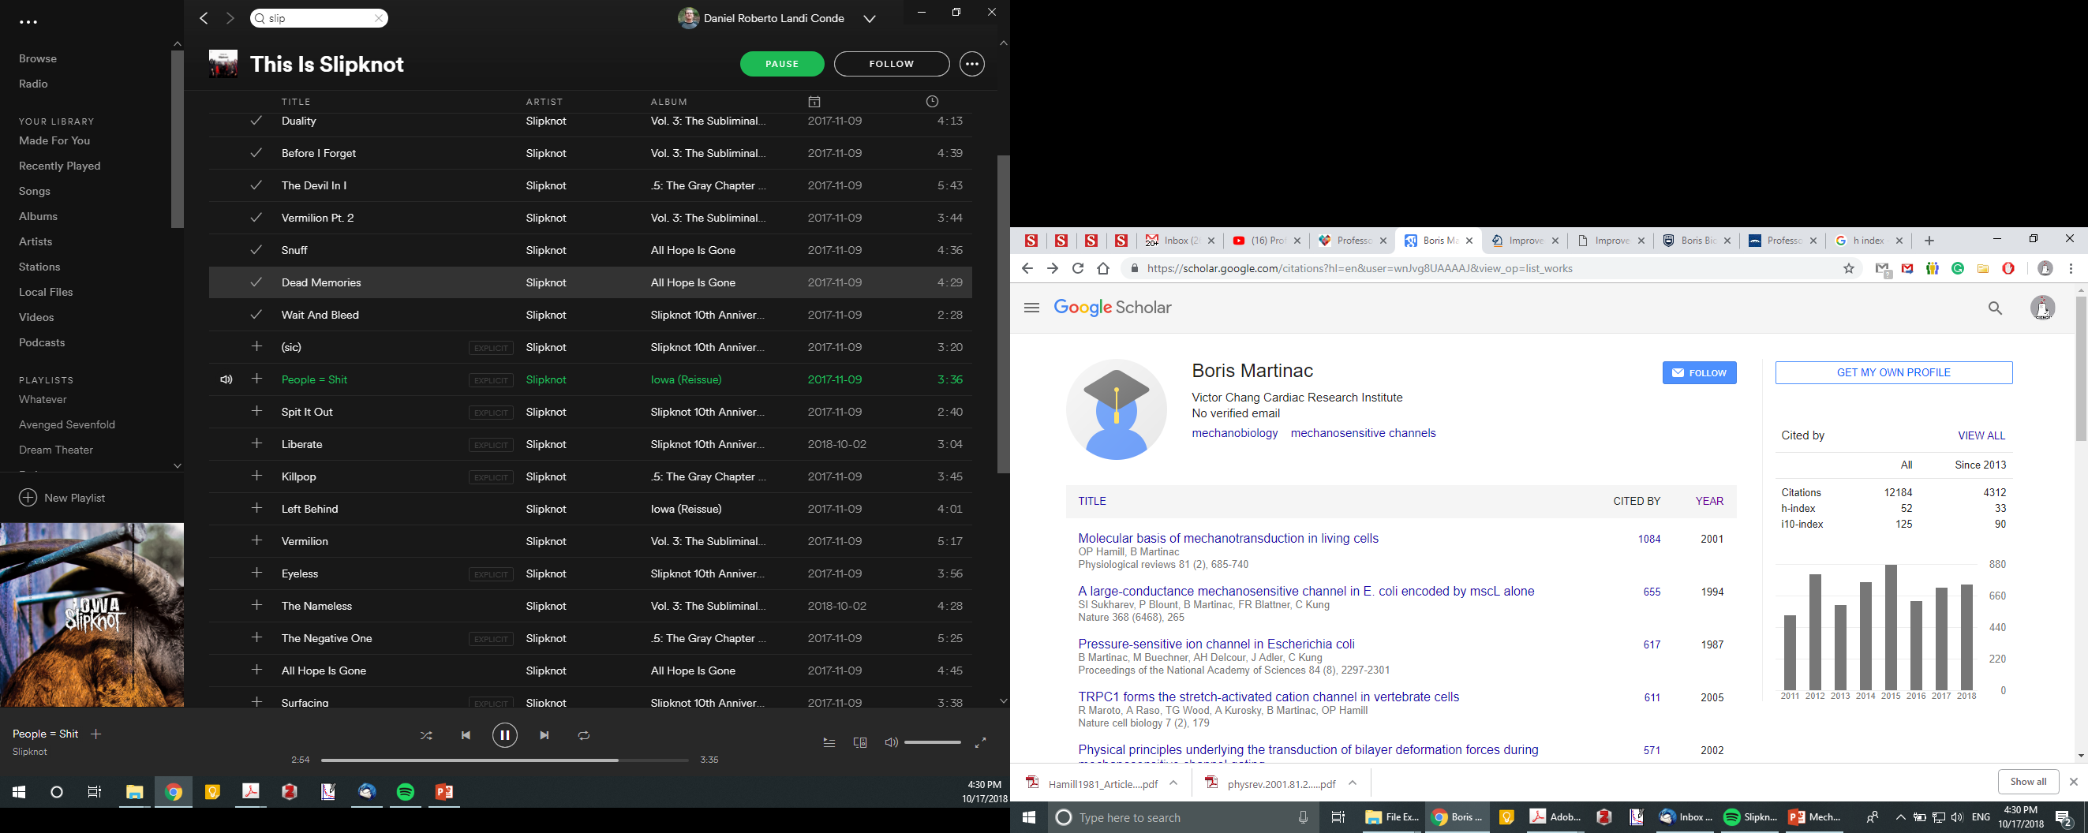
“Hirsch reckons that after 20 years of research, an h index of 20 is good, 40 is outstanding, and 60 is truly exceptional.”
Notes:
MacKinnon’s h-index is about 90.

Slide 5
What are mechanosensitive channels?
Mechanosensitive (MS) ion channels are the fastest primary mechano-electrical transducers, which couple mechanical stimuli to intracellular signaling pathways on a submillisecond time scale.

Slide 6
Why should we care?
Implicated in numerous mechanosensory transduction processes ranging from cellular osmoregulation in bacteria to the senses of touch and hearing in animals and humans.

Slide 8
~75 kDa
~210 kDa
Chang et al., 1998
Bass et al., 2002

Slide 9
Notes:
-Interestingly, not only does the N-terminus drive the tilting of the pore-lining helix, but it seems to also drive radial pore expansion.
-Lipids protrude into intersubunit cavities and essentially wrap around the upper portions of the N-termini.

Slide 10
Notes:
-MD simulation shows that while lipids do move from these cavities, they still strongly interact with a number of the N-terminal residues.
-Hydrophilic substitution of these amino acids results in loss of mechanosensitivity.

Slide 11
Hydrophilic substitutions of these residues (i.e. F68S) results in a loss of mechanosensitivity.

Slide 12

Lipid-filled protein pockets are also found in the structures of many non-mechanosensitive membrane-embedded proteins.
Kv1.2

Slide 14
~75 kDa
~210 kDa
Chang et al., 1998
Bass et al., 2002

Slide 15
Bilayer reconstitution

Slide 19
“Force from lipids”
The force-from-lipids principle is a fundamental physicochemical
principle based on the large and anisotropic forces defined by
the transbilayer pressure profile inherent to biological membranes.

Slide 20
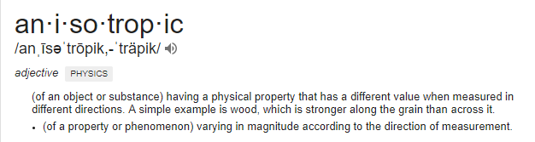

Slide 21
Transbilayer pressure profile

Slide 22
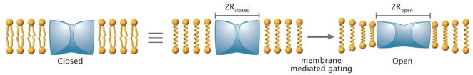

Slide 24
Hydrophobic mismatch

Slide 25
Hydrophobic mismatch
Effects of the mismatch between the hydrophobic length d, of transmembrane alpha helices of integral proteins and the hydrophobic thickness, Dh , of the membranes they span are studied theoretically utilizing a microscopic model of lipids.
Plasma membranes of living cells are intrinsically asymmetric.

Slide 26
Cox et al., 2017
Also affected by lipid saturation (Ridone et al., 2018)

Slide 27
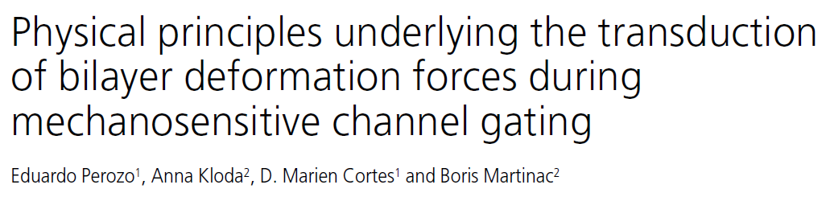
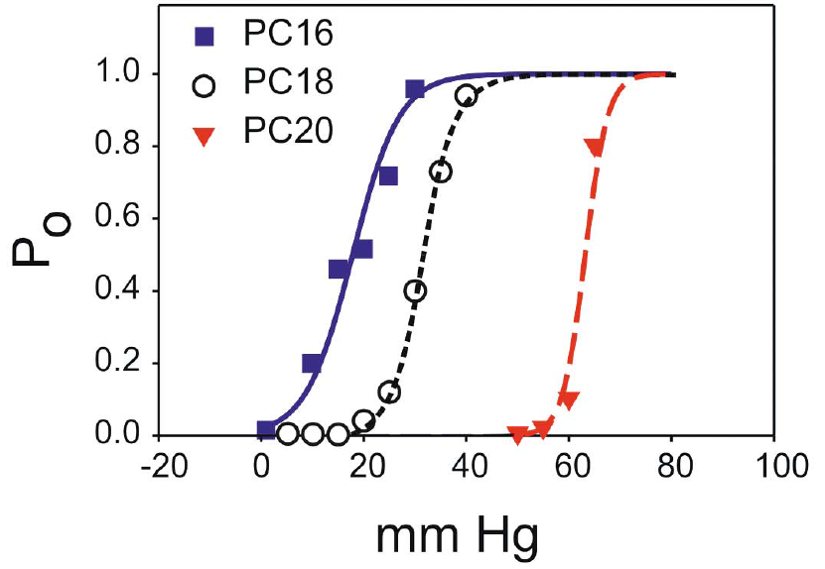

Slide 28

https://www.youtube.com/watch?v=9TJ6PP36QCo

Slide 32
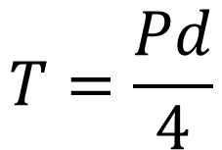
4.3μm
3.3μm
$$T=\frac{Pd}{4}$$
5.7μm

Slide 34
Whole-cell recordings
Adaptation is voltage dependent.

Slide 35
Assessed system | Mean lytic tension (mN/m)
Phospholipid vesicles | 3-4
Erythrocytes | 6-12
Yeast spheroplasts | 6-11
There probably is a parallel elastic element stabilizing the yeast membrane.
High internal concentrations of Cl⁻ or Ca²⁺ halved the lytic tension. Adaptation in yeast was rarely observed under high Ca²⁺ conditions.

Slide 36
Piezo channels
Piezo proteins are a family of functionally diverse mechanosensititive non-selective cation channels.
Piezo1 (isolated from Neuro2A cells) ~2500 amino acids long with 38 transmembrane regions assembling into a trimer (Patapoutian group, 2016).
Notes:
Piezo proteins were first identified as potential channels in the cell line Neuro2A (a glial tumor line) by the Patapoutian group.¹³ In whole cell mode, Coste et al. mechanically stimulated many cell types looking for a cell line with a strong and reproducible mechanical response and they found it in Neuro2A. The currents evoked by pressing on the cells with a glass probe increased with the depth of penetration, the reversal potential was near zero, and the currents rapidly inactivated.
Using cryo-electron microscopy (cryo-EM) we determined a structure of mPiezo1 to an overall resolution of 3.7 Å (Figure 2 and Figure 2—figure supplement 1). Viewed down its 3-fold axis, the trimeric Piezo channel is a triskelion with extended arms (Figure 2a,c); from the side, it is curved as shown (Figure 2b,d)
First shown to exist in Neuro2A cells, and the gene was identified through siRNAs that diminish the mechanical response by knocking out individual transcripts: gene Fam38A found to be essential and the protein named Piezo1

Slide 37
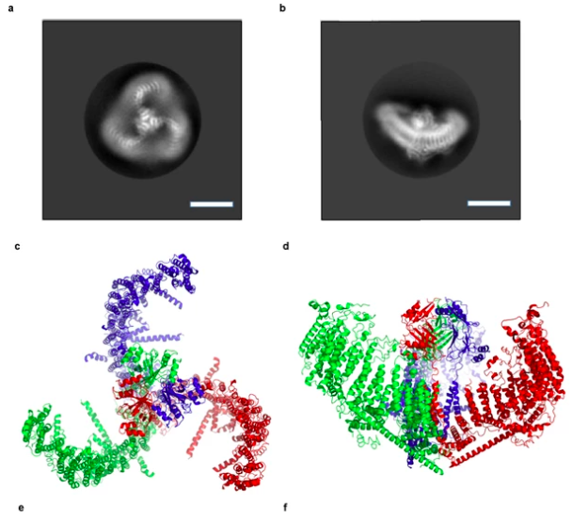
(Guo & MacKinnon, 2017)

Slide 38
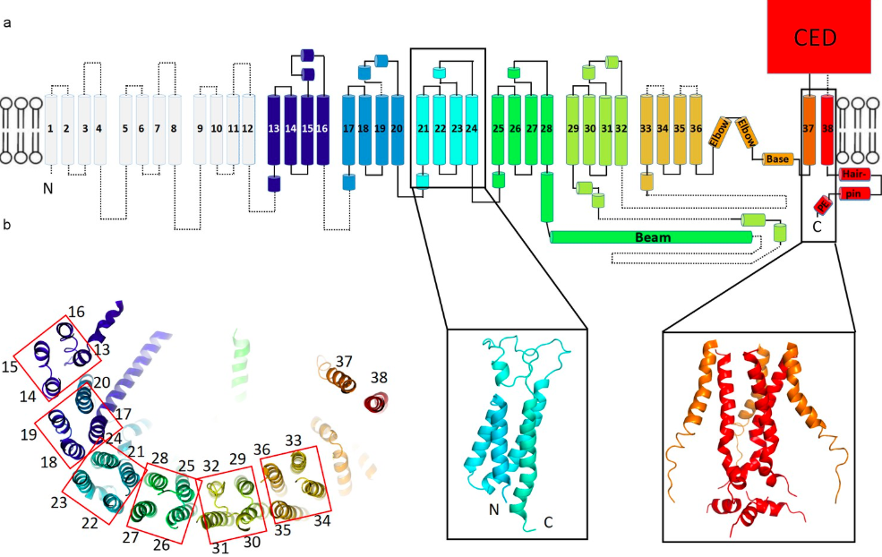
Piezo1 Topology
(Guo & MacKinnon, 2017)
Notes:
cartoon representation of a monomer, rainbow-colored with C-terminus in red and N-terminus in blue, except for the first 12 TMs that are not visible in our structure. Helices within a single 4-TM unit are colored uniquely. Helices are shown as cylinders, loops as solid lines, and unresolved regions as dotted lines. C-terminal extracellular domain (CED) is simplified as a box. A ribbon diagram of 4-TM unit 6, consisting of TM 21 to 24, is shown in the left inset panel with N- and C- termini labeled. The right inset panel shows a ribbon diagram of the pore region, formed by TM37, TM38 and the PE helix from all three subunits. (b) A ribbon diagram of a monomer rainbow-colored as in A, viewed from top. Each 4-TM unit is highlighted in a red box with TM number labeled.

Slide 39
Biophysical properties of Piezo channels

Slide 40
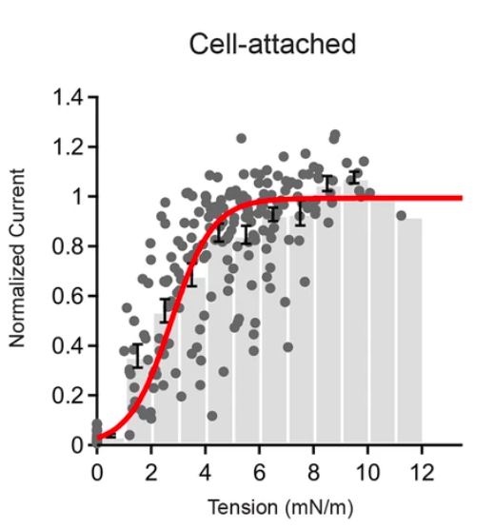
Activation
(Lewis & Grandl, 2015)

Slide 41
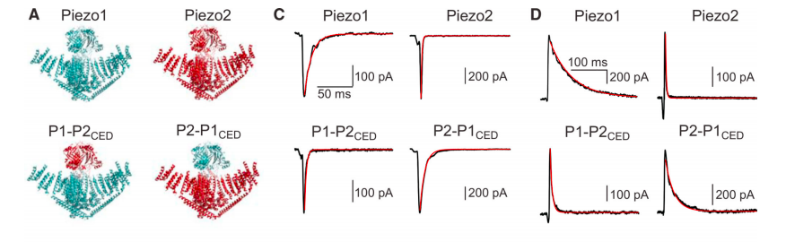
Inactivation
(Wu et al., 2017)

Slide 42
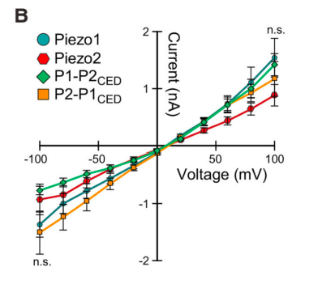
Inactivation
(Wu et al., 2017)

Slide 43
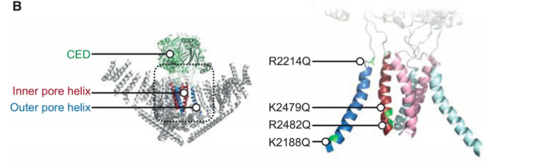
Single Charged Residue Confers Voltage Sensitivity
(Wu et al., 2017)

Slide 44
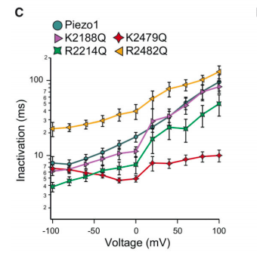
(Wu et al., 2017)

Slide 45
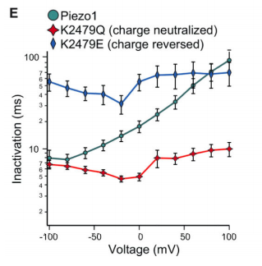
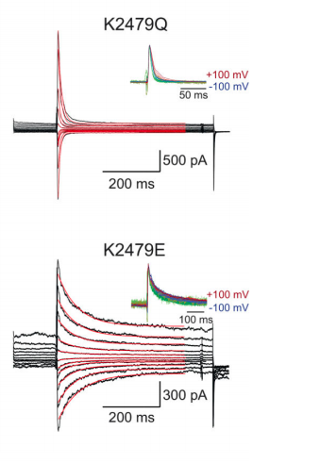
(Wu et al., 2017)

Slide 46
Permeable to monovalent ions (K⁺, Na⁺, Cs⁺, Li⁺), with Li⁺ having the lowest permeability, and most divalent ions (Ba²⁺, Ca²⁺ and Mg²⁺), but not to Mn²⁺.
Weakly permeable to organic cations TEA and TMA, suggesting pore size of ̴8 Å.

Slide 47
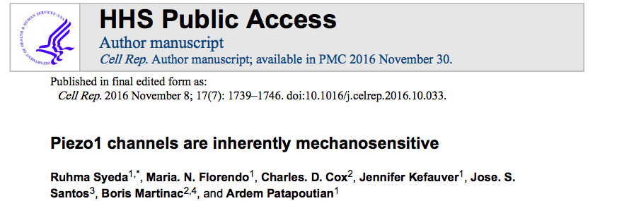

Slide 48
Criteria of a mechanosensitive ion channel
  The gene encoding the mechanosensitive protein must be expressed in mechanosensitive cells.
  Deletion of the gene should abolish mechanosensitivity without loss of other cellular functions.
  The candidate mechanosensitive protein should contain a pore forming subunit.
  Mutations in critical domains should alter pore properties of the mechanical currents.

Slide 49
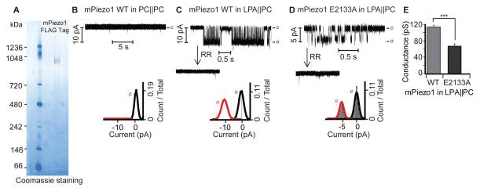
Confirmation of Piezo1 Current

Slide 50
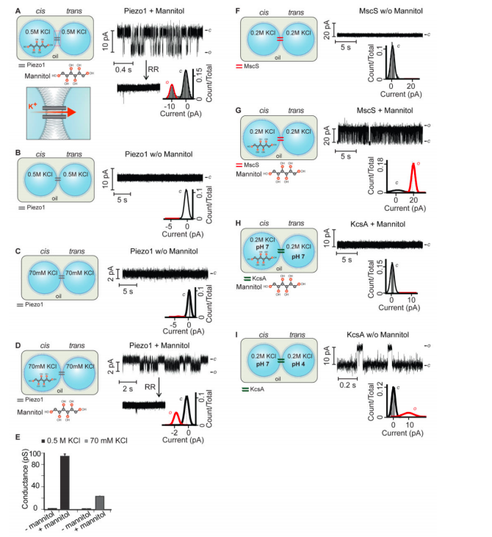
Osmotic Gradient Stimulation

Slide 51
Osmotic Gradient Stimulation

Slide 52
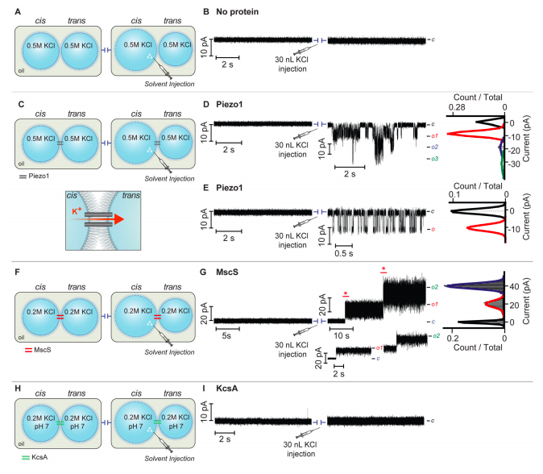
Activation by solvent injection

Slide 53
Activation by solvent injection

Slide 54
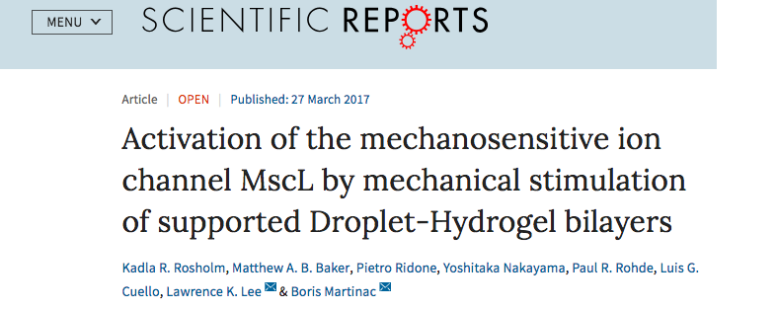

Slide 55
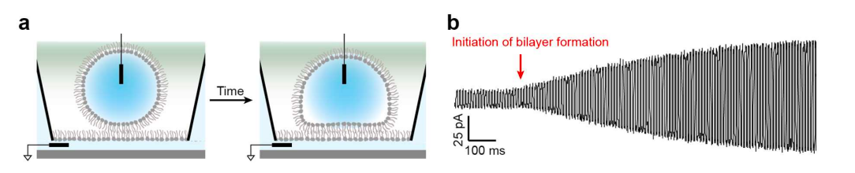
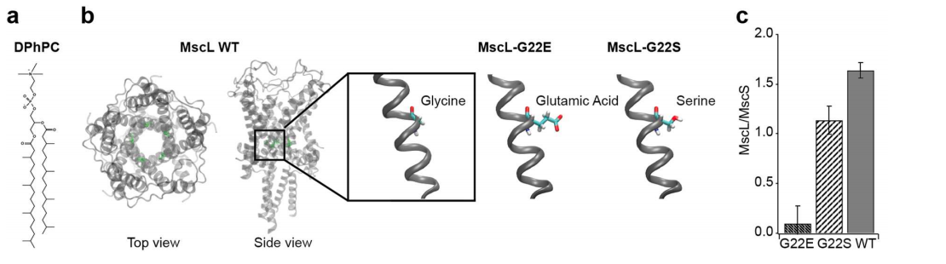
Construction of DHBs

Slide 56
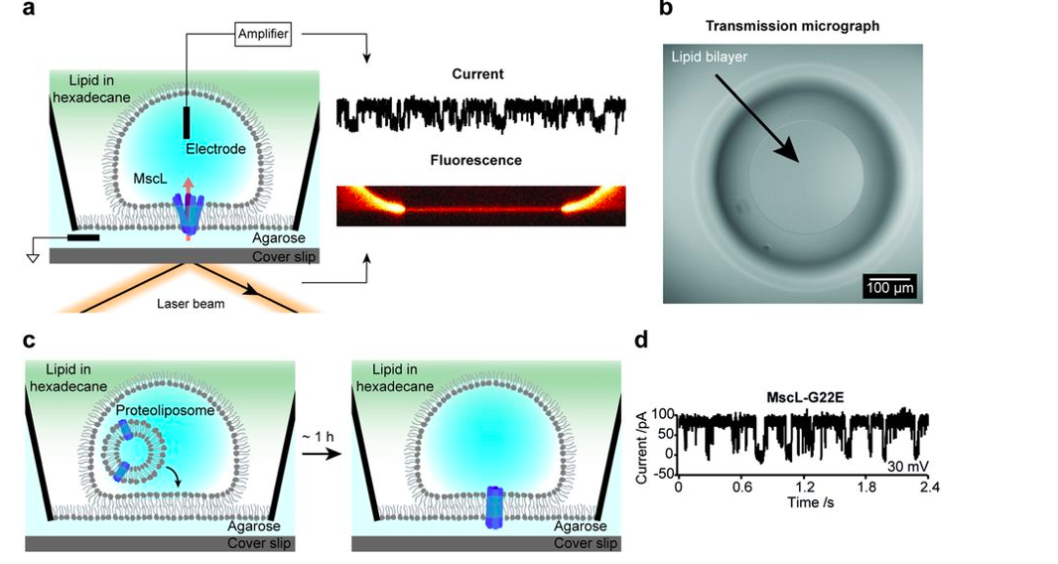
Novel investigation of MS channels

Slide 57
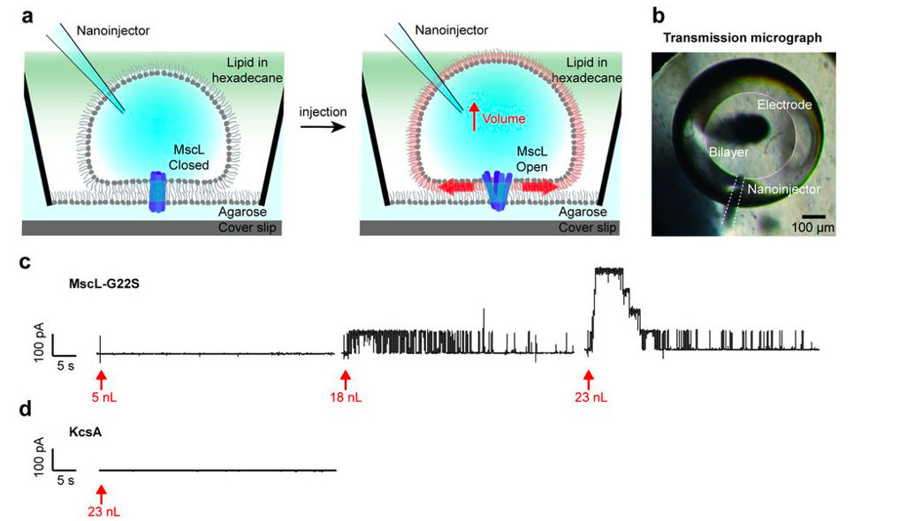
Activation of DHBs by buffer injection

Slide 58
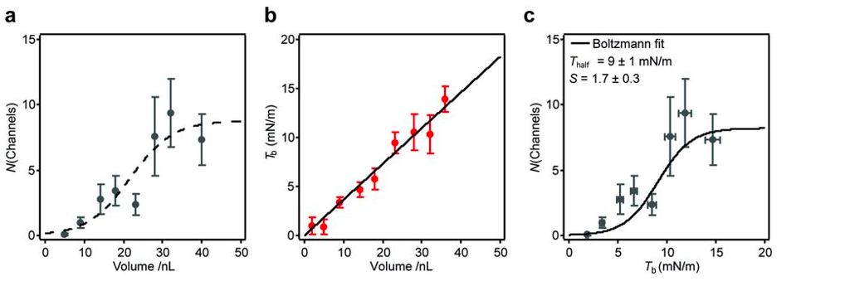
Quantifying channel activation

Slide 59
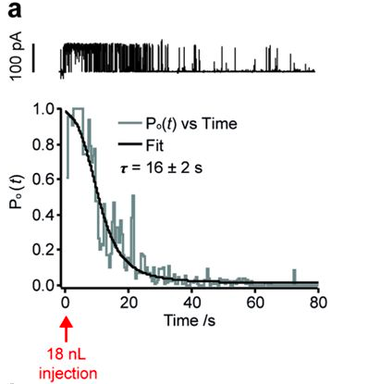
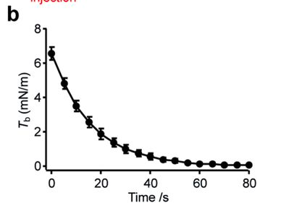
Model system of mechanosensation

Slide 60
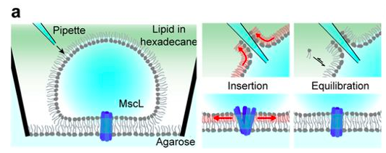
Model system of mechanosensation

Slide 61
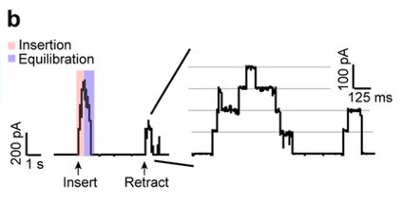
Model system of mechanosensation

Slide 62

MS channels?
Questions?

