Slide 1
NMR and MRI
Membrane Biophysics
Charles Holcombe and Jason Cote

Slide 2
Overview
Basics of NMR
Solution NMR Paper
SSNMR Paper
Review of MRI
MRI and TBI Paper
Diffusion Tensor Paper

Slide 3
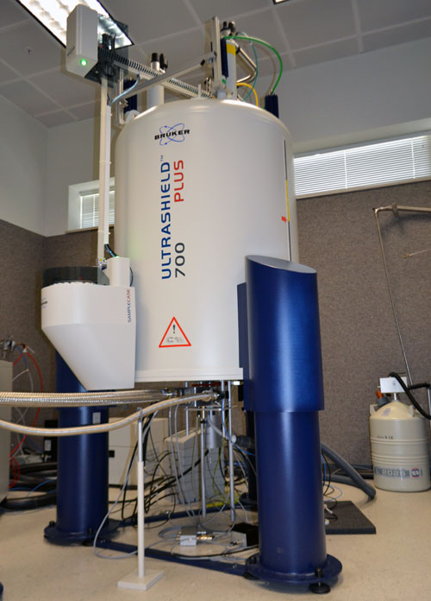
Introduction to Nuclear Magnetic Resonance
MagLab
700 MHz 52 mm solution state NMR system

Slide 4
Introduction to Nuclear Magnetic Resonance
Phenomenon of NMR was discovered by Purcell and Bloch in 1948
Based on interactions of magnetic moments of nuclei (nuclear spin) with magnetic fields
Odd number of protons means a non-zero spin (magnetic moment)
¹H, ¹³C, ¹⁵N have a spin of ½
Align parallel or antiparallel to a magnetic field (quantum numbers of +/- ½)
Notes:
Magnetic nuclei were able to absorb radio frequency energy when placed in a magnetic field of a strength that was specific to the nucleus. Upon absorption, the nuclei begin to resonate and different atoms within a molecule resonated at different frequencies. This observation allowed a detailed analysis of the structure of a molecule

Slide 5
Introduction to Nuclear Magnetic Resonance
dM/dt = -γM x B = -M x ω
γ - Gyromagnetic constant: nuclear magnetic moment/angular momentum
ω - Angular frequency (2πν) is referred to as Larmor frequency
ν is in Hz
Faraday’s Law – changing magnetic flux induces electromotive force in a coil
Right hand rule
RF Pulse in a coil perpendicular to the static magnetic field creates a secondary magnetic field at an arbitrary angle
≤ 90^{O} is excitation pulse
180º is inversion pulse
Notes:
RF Pulse ~several milliseconds, decaying electromotive force (free induction decay) in the coil which is the NMR signal
M is vector quantity

Slide 6
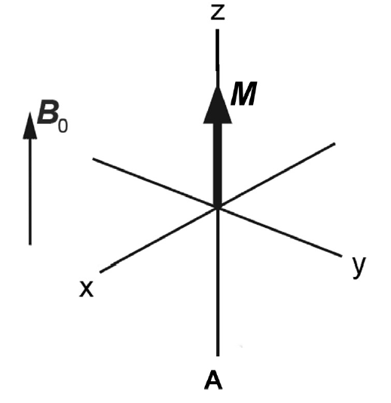
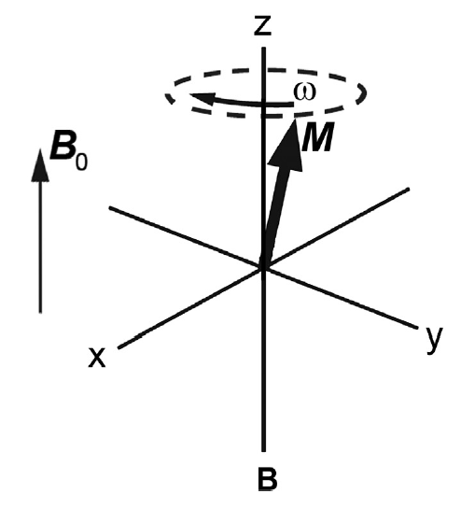
Introduction to Nuclear Magnetic Resonance
Notes:
The precessing component in the transverse plane decays in time, which is caused by the interaction of individual magnetic moments with local magnetic fields on a molecular level.

Slide 7
Introduction to Nuclear Magnetic Resonance
(MHz T ⁻¹
(MHz T ⁻¹
If there are 2 energy states, the amount of energy required to transition from one to the next is derived as follows:
ΔE= $\frac{γhB0}{2π}$
Since, $\text{E}\text{=}\text{h}\text{ν}$, then $ν= \frac{γB0}{2π}$
When the frequency matches the energy between the two states, resonance occurs
Example $γ$ $(\frac{\text{γ}}{2π}$(MHz T⁻¹))
¹H: 42.58
¹³C: 10.71
¹⁵N: -4.32
Notes:
In order for the NMR experiment to work, a spin flip between the energy levels must occur. The energy difference between the two states corresponds to the energy of the electromagnetic radiation that causes the nuclei to change their energy levels. For most NMR spectrometers, B0B0 is on the order of Tesla (T) while γγ is on the order of 107107. Consequently, the electromagnetic radiation required is on the order of 100's of MHz and even GHz. The energy of a photon is represented by
E=hν(1.4)(1.4)E=hν
and thus the frequency necessary for absorption to occur is represented as:
ν=γB02π(1.5)

Slide 8
Introduction to Nuclear Magnetic Resonance
Nuclear Relaxation:
Spin-spin or transverse relaxation time T₂ is the decay time constant of in the transverse plane
Spin-lattice or longitudinal relaxation time T₁
Dipolar Relaxation
Fluctuating magnetic fields from neighboring nuclei (e.g., ¹H)
Chemical Shift
Normalized standard resonance frequency – tetramethylsilane (TMS)
δ=(ν – ν_{ref})/ν_{ref}
Measured in ppm
Notes:
Chemical shift standardizes measurements taken in different magnetic field strengths

Slide 9
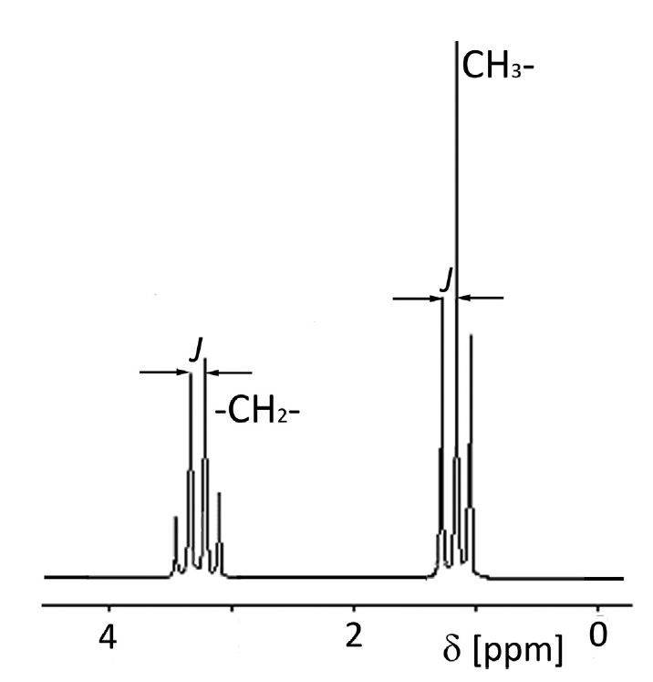
Introduction to Nuclear Magnetic Resonance
Spin-Spin Coupling or J-coupling
Spectral lines are split depending on the neighboring electrons/nuclei
Coupling constant J – magnitude of interaction (Hz)
Multiplicity is generally equal to n+1 where n is the number of neighboring nuclei
Very useful in structure analysis and determination!

Slide 10
Introduction to Nuclear Magnetic Resonance
Spectral line intensity
Line intensity proportional to molar concentration of ¹H nuclei
In summary, we gain information on how many different types of H, the type of H, how many of each type of H, and how many neighboring H
Notes:
# signals: how many different types of H, Position (Chemical Shift) is what type of H, Integrated area under the curve is how many of each type of H, and the splitting pattern show how many neighboring H

Slide 11
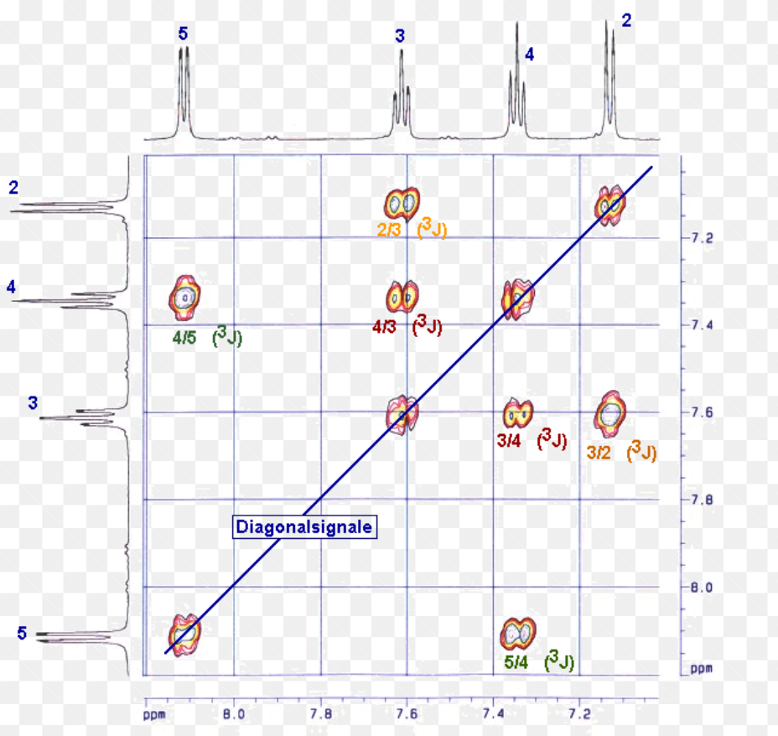
Introduction to Nuclear Magnetic Resonance
1D vs 2D NMR Spectrums (simplified)
1D: Pulse, observe, FT( time to frequency domain) and CS
2D: pulse, wait (t₁), pulse, observe (t₂), 2D FT and plot 3D in 2D (think topography)

Slide 12
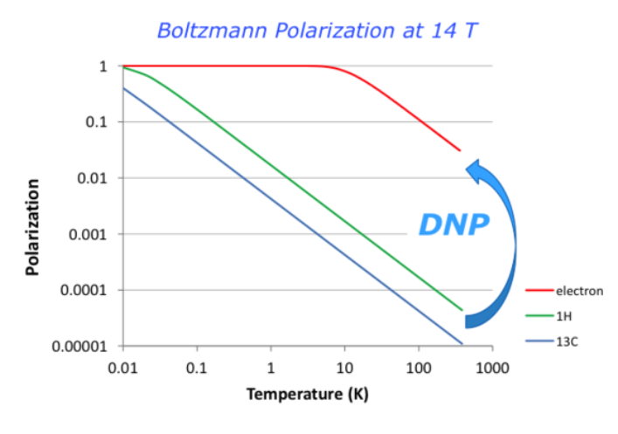
Types of Nuclear Magnetic Resonance
Solution NMR vs Solid State NMR
Chemical shift anisotropy (CSA) and dipolar coupling are averaged out due to random motion in solutions
CSA and dipolar coupling dominate in solid-state meaning increased complexity
SSNMR Provides more information on the spatial orientation of the molecules since the information is not lost to random motion.
Dynamic Nuclear Polarization (DNP)

Slide 13
Papers Reviewed
Solution NMR studies reveal the location of the second transmembrane domain of the human sigma-1 receptor
Jose Luis Ortega-Roldan ⇑, Felipe Ossa, Nader T. Amin, Jason R. Schnell
Membrane Protein Structure and Dynamics from NMR Spectroscopy
Mei Hong, Yuan Zhang, and Fanghao Hu

Slide 14
Solution NMR studies reveal the location of the second transmembrane domain of the human sigma-1 receptor

Slide 15
Solution NMR studies reveal the location of the second transmembrane domain of the human sigma-1 receptor
Sigma-1 receptor (S1R): membrane chaperone protein found in both ER and plasma membranes
Accessory protein to ion channels and receptors
Voltage-gated potassium, sodium, and calcium channels; IP3 receptors, acid sensing channels, and glutamate and dopamine receptors
Found in CNS and binds small molecules
Opiates, antipsychotics, antidepressants, antihistamines, phencyclidine-like compounds, β-adrenergic receptor ligands, cocaine, dimethyltryptamine, progesterone, and sphingosine
Potential therapeutic target
Schizophrenia, Alzheimer’s and Parkinson’s diseases, amnesia, depression, amyotrophic lateral sclerosis and addiction
Notes:
found everywhere and controls everything…?

Slide 16
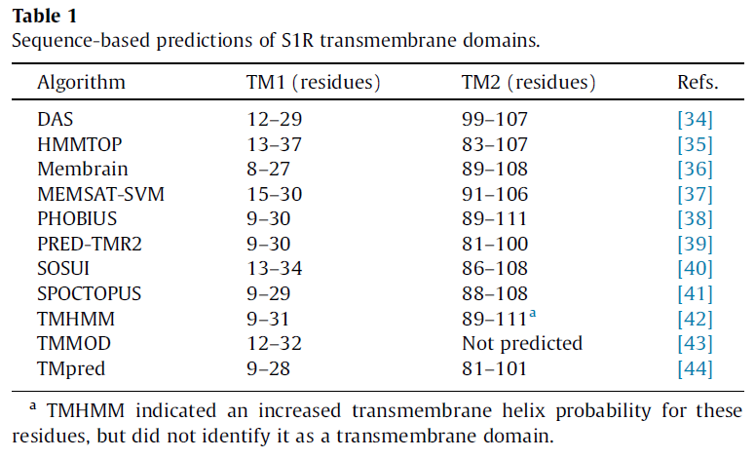
Solution NMR studies reveal the location of the second transmembrane domain of the human sigma-1 receptor
Complete structure and relationship to the membrane is not known
Contains 2 TM domains connected by a cytosolic domain and an ER-accessible C-terminal chaperone domain
Know only regions from residues (regions 91-109 and 176-194)
SBDL1 and 2 (Steroid Binding Domain Like) are located within S1R ligand binding site
Sequence based predictions
of TM helices are not
conclusive
Notes:
Known based on homology to the steroid binding regions of fungal sterol c7-c8 isomerases

Slide 17
Solution NMR studies reveal the location of the second transmembrane domain of the human sigma-1 receptor
Goal is to define residues that constitute TM2
Utilized solution NMR studies of novel S1R construct (S1R(Δ35)) in which the first TM has been removed
Enables description of residues within TM2 helix and secondary structure of cytosolic domain

Slide 18
Solution NMR studies reveal the location of the second transmembrane domain of the human sigma-1 receptor
Sample Prep
The S1R(Δ35) sample contained only the 36-223 residues of S1R and was confirmed by sequencing
C94A substitution was shown to have no effect on ligand binding and was introduced to prevent disulfide bonds during purification
Purified protein were incubated with 1% dodecylphosphocholine (DPC) and the lipid DPPC added the sample to a q ratio of 0.1 (lipid/detergent ratio)
Dodecylphosphocholine (DPC) micelles are useful as a model membrane system for solution NMR
Dipalmitoylphosphatidylcholine (DPPC) is a phospholipid

Slide 19
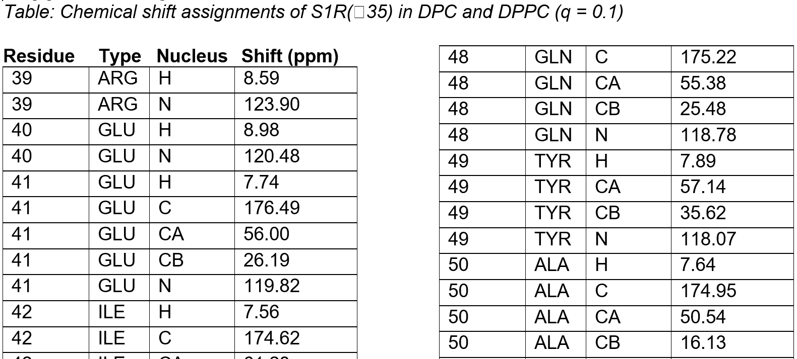
Solution NMR studies reveal the location of the second transmembrane domain of the human sigma-1 receptor
TROSY-HSQC spectrum 600 Mhz
Notes:
1H, 15N TROSY-HSQC spectrum 600 Mhz - Transverse relaxation-optimized spectroscopy (TROSY) Backbone amide resonance assignments are indicated
HSQC (heteronuclear single quantum correlation) - Each signal in a HSQC spectrum represents a proton that is bound to a nitrogen atom

Slide 20
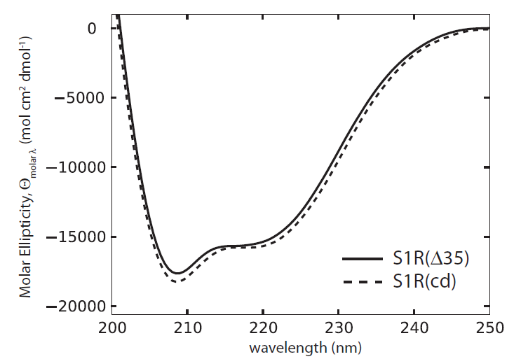
Solution NMR studies reveal the location of the second transmembrane domain of the human sigma-1 receptor
Far UV circular dichroism spectra – similar helical content per residue and consistent with NMR chemical shifts (42% and 46% for S1R(Δ35) and S1R(cd), respectively)

Slide 21
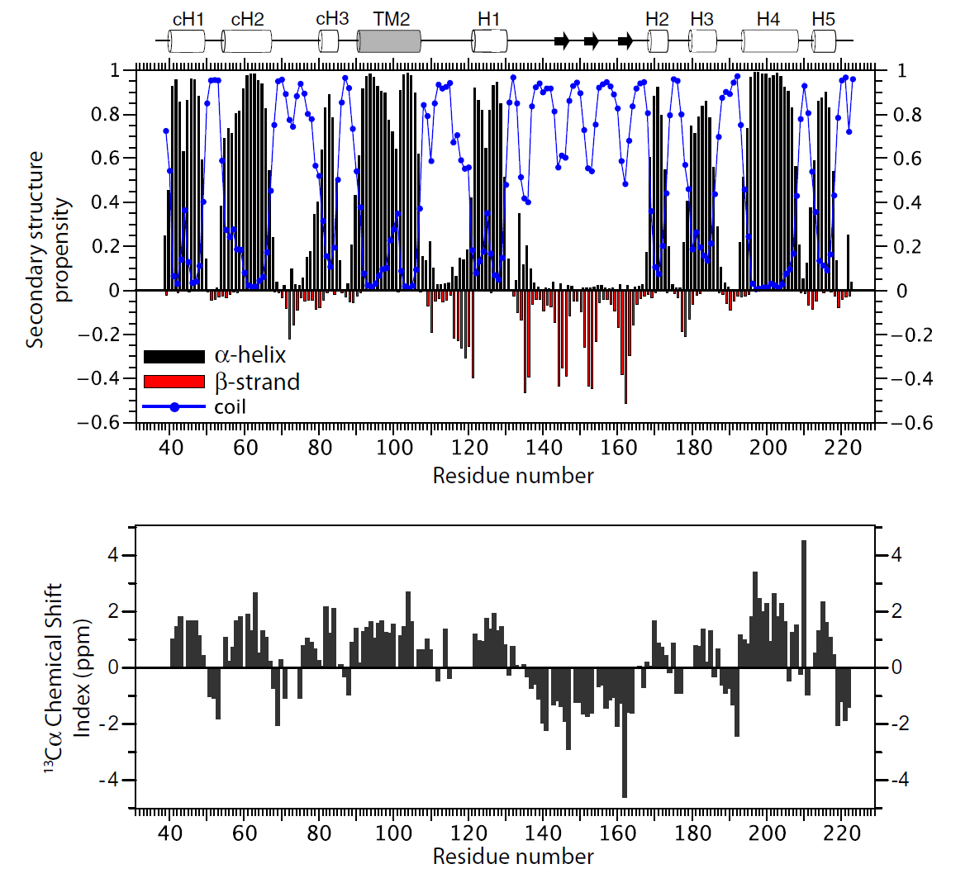
Solution NMR studies reveal the location of the second transmembrane domain of the human sigma-1 receptor
Chemical shift-based secondary structure analysis of S1R(Δ35)
¹³Cα chemical shift index
Notes:
Chemical shift-based secondary structure analysis of S1R(D35). In the top plot, the TALOS-N [26] outputs are shown, in which the magnitude of the black bars above or
red bars below zero on the y-axis indicate the propensities for a-helical or extended conformations, respectively, and the propensities for an unstructured coil conformation are shown as blue circles. In the bottom plot, the 13Ca chemical shift index is shown [45]. Above the top plot is shown schematically a summary of the a-helical (cylinders) or extended (arrow) regions.

Slide 22
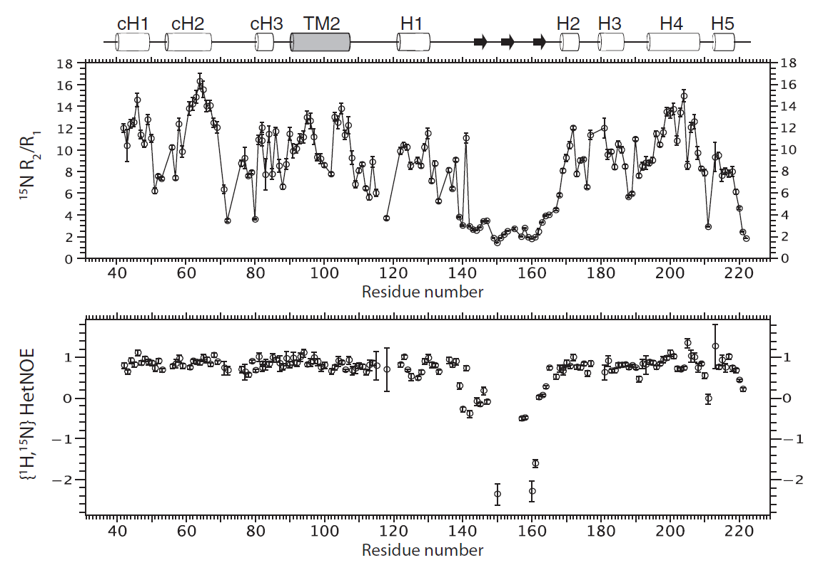
Solution NMR studies reveal the location of the second transmembrane domain of the human sigma-1 receptor
Dynamic properties of S1R(D35) from relaxation ratio collected at 600 MHz
¹H–¹⁵N heteronuclear NOEs
Notes:
NOE Nuclear Overhauser Effect > Dipolar coupling > Intermolecular distances and molecular motion (essentially measures spatial proximity)
R2 = transverse relaxation time and R1 = longitudinal relaxation time
Small heteronuclear NOEs and low R2/R1 values were observed for a large number of residues within the region 140–165, indicating that the fast, picosecond to nanosecond time scale motions that were previously observed here for the isolated chaperone domain [21] are maintained in the longer construct. In addition, lower than average R2/R1 values were found in the loops between the cytosolic helices cH1 and cH2, and between cH2 and cH3, indicating flexibility.

Slide 23
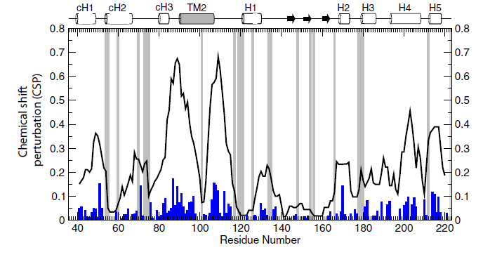
Solution NMR studies reveal the location of the second transmembrane domain of the human sigma-1 receptor
Chemical shift perturbations in the backbone amide 1H and 15N resonances of S1R(D35) in DPC upon addition of DPPC to a DPC:DPPC ratio of 1. The solid line indicates the sum of the absolute chemical shift perturbations (CSP) over a 7-residue window, with the magnitude of the CSP for each residue (blue bars). A gray bar indicates prolines or residues for which the chemical shift assignments could not be determined.
Notes:
Assuming that lipids preferentially solvate the natively transmembrane regions of the protein, the predominant chemical shift perturbations are expected to
occur at the edges of the transmembrane domain, where the phosphocholine headgroup of DPC is replaced by the phosphatidylcholine headgroup of DPPC. Similar to regions with no lipid contact, few changes would be expected in the center of the transmembrane domain because the hydrocarbon chains of the lipid and
the detergent are chemically similar. Upon addition of DPPC, the largest clusters of perturbations were centered on residues 89 and 109, consistent with residues 91–107 forming the hydrophobic core of TM2.

Slide 24
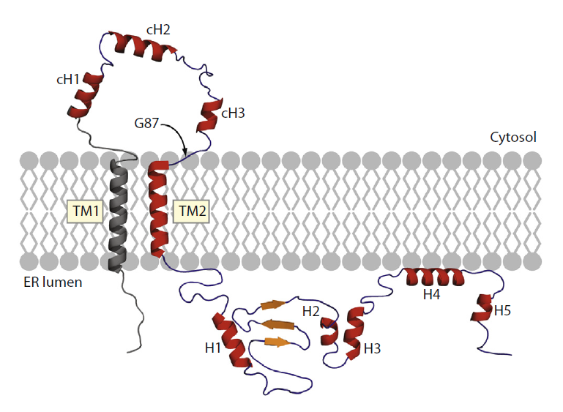
Solution NMR studies reveal the location of the second transmembrane domain of the human sigma-1 receptor
The characterized secondary structure of S1R missing only 8 residues N-terminus and the first transmembrane domain

Slide 25
Membrane Protein Structure and Dynamics from NMR Spectroscopy

Slide 26
Membrane Protein Structure and Dynamics from NMR Spectroscopy
Why SSNMR?
Membrane proteins solubilized only in detergents and lipids (which have large molecular weights) are difficult to resolve in solution based NMR
Large crystals are difficult to grow
SSNMR allows membrane proteins to be studied in phospholipid bilayers
Represents biological membrane much better than micelles
SSNMR gives precise information about protein orientation and dynamics

Slide 27
Membrane Protein Structure and Dynamics from NMR Spectroscopy
Two major advantages of SSNMR
“Magic-angle spinning (MAS) of the samples to obtain high-resolution spectra that reflect isotropic chemical shifts and recoupled, orientation-dependent (anisotropic), dipolar couplings and chemical shift anisotropy”
Read, use MAS to remove anisotropy and coupling complexity and then add coupling and anisotropy back to gain some additional information that was lost
Oriented Sample NMR
Align lipid membranes to determine protein orientation in the phospholipid bilayer
Dipolar coupling and chemical shift become well resolved
Difficult to align (either mechanically in glass plates or magnetically using liquid-crystalline media

Slide 28
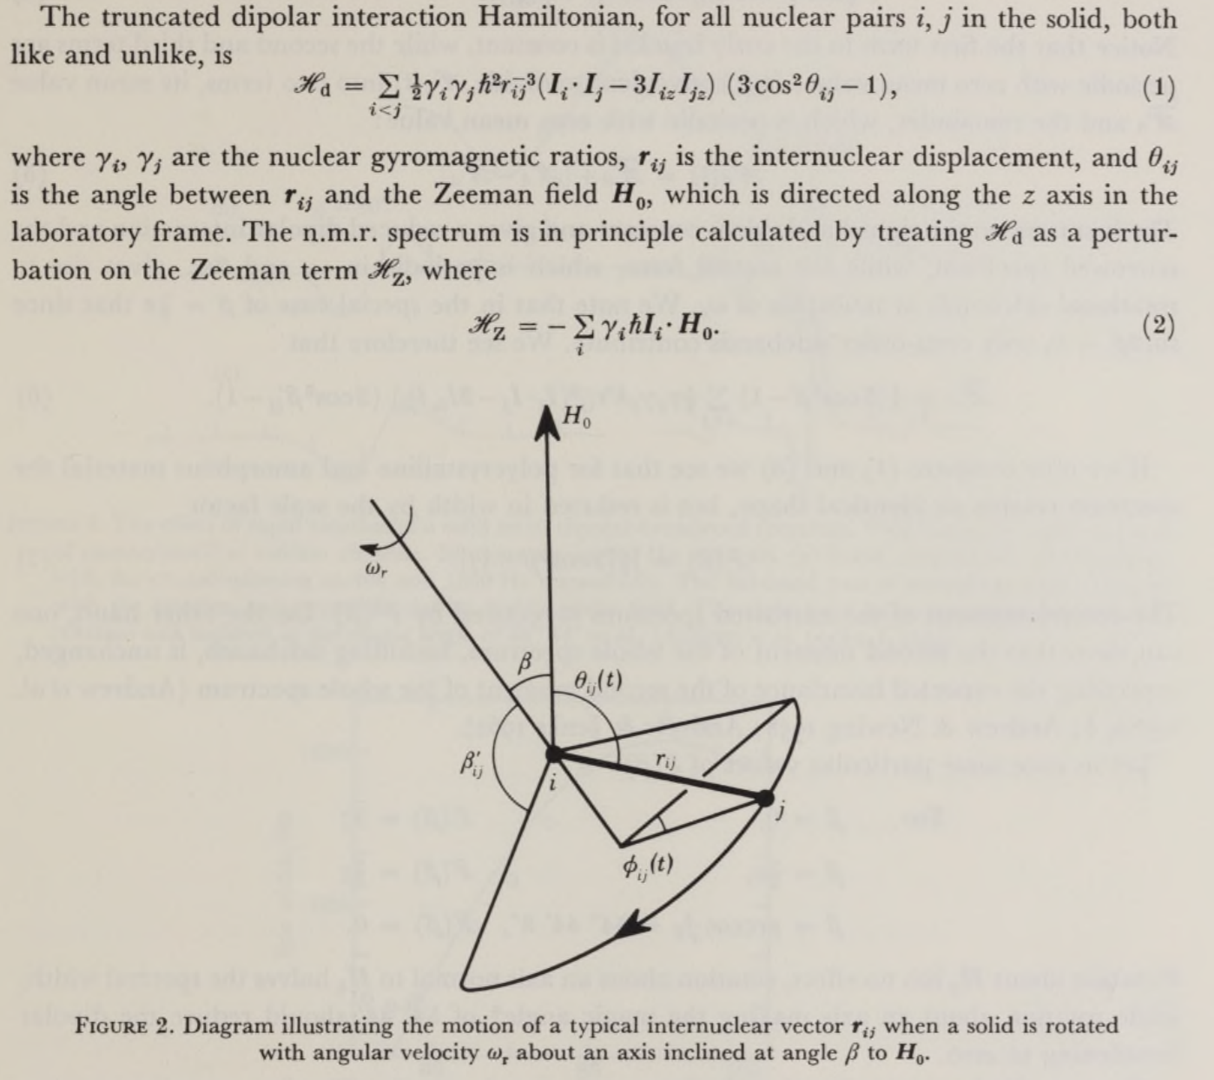
Membrane Protein Structure and Dynamics from NMR Spectroscopy
Notes:
Magic-angle spinning was first described in 1958 by Edward Raymond Andrew, A. Bradbury, and R. G. Eades^{[3]} and independently in 1959 by I. J. Lowe.^{[4]} The name "magic-angle spinning" was coined in 1960 by Cornelis J. Gorter at the AMPERE congress in Pisa
1981 Paper: Since the isotropic average cos2 6^ = it follows from (1) that the isotropic average of the
dipolar Hamiltonian, «#d = 0, and rapid isotropic motion in fluids therefore eliminates the
dipolar interaction from the n.m.r. spectrum.

Slide 29
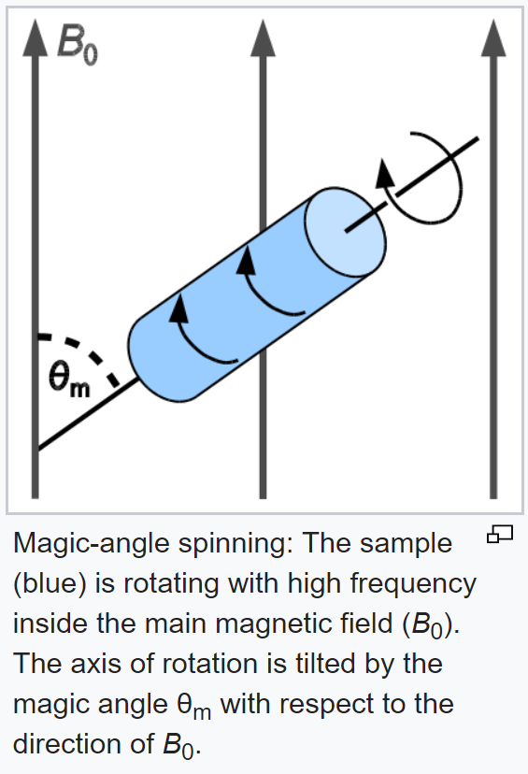
Membrane Protein Structure and Dynamics from NMR Spectroscopy
Magic Angle Spinning NMR
Simplify things… 54.74º
Notes:
Can eliminate dipolar coupling and CSA

Slide 30
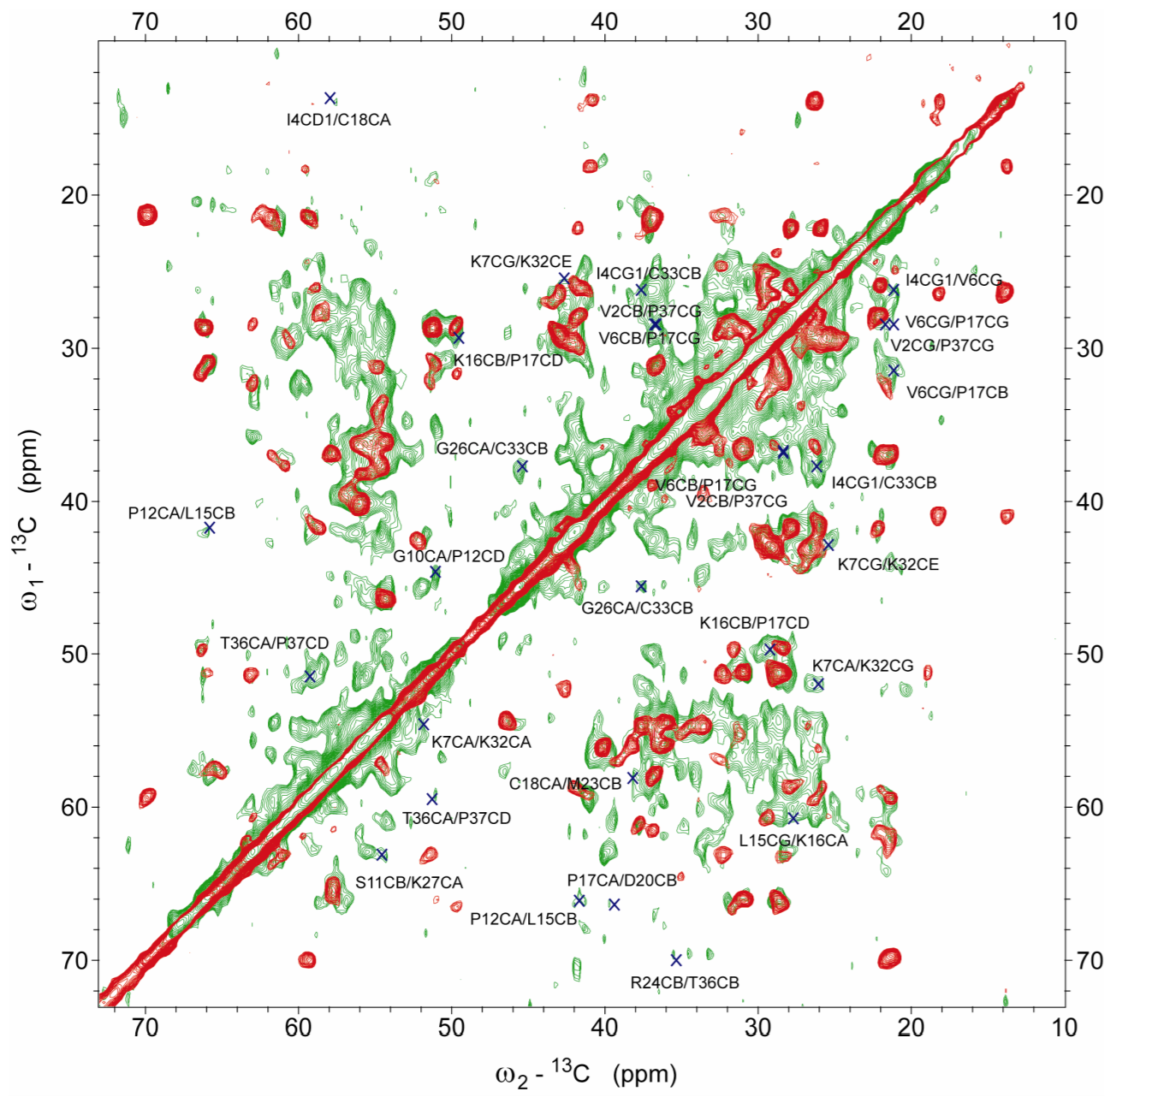
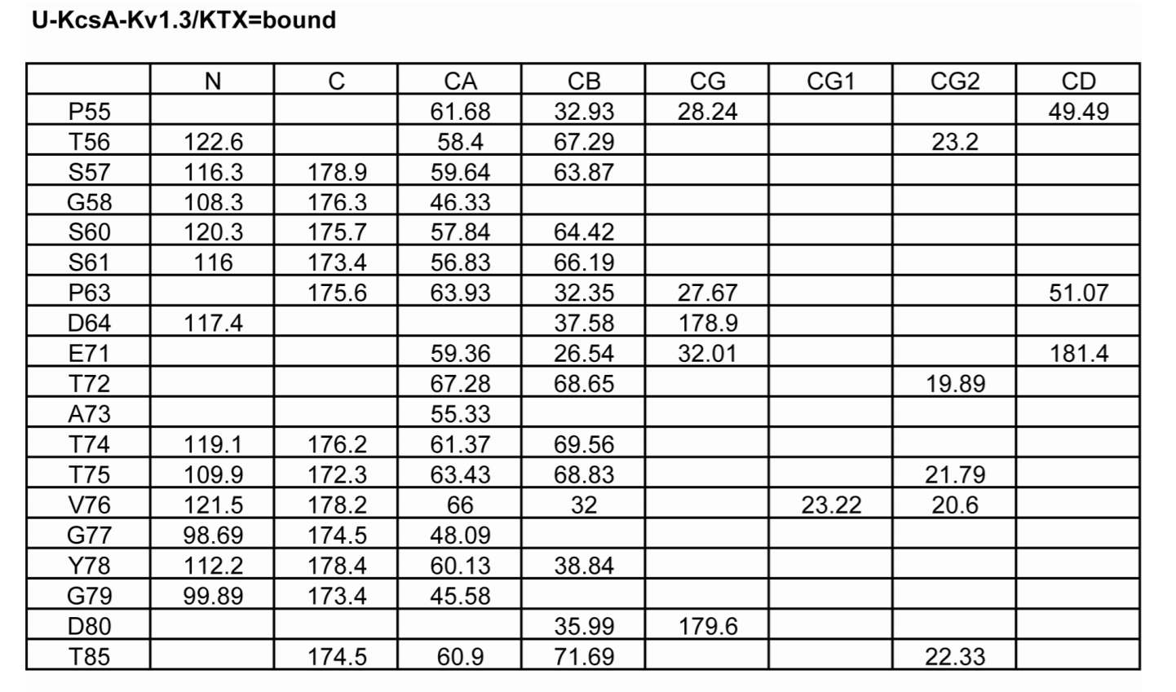
Membrane Protein Structure and Dynamics from NMR Spectroscopy
Potassium Channels
2D and 3D MAS to assign majority of residues and mapped out chemical shift changes channel activation, inactivation and inhibition
¹H-¹H distance measurements and chemical shifts showed how different scorpion toxins had different effects on channel
Kaliotoxin – perturbs upper region of filter, but leaves the filter in a conducting state which induces the closed confirmation of the intracellular activation gate
Tetraphenylporphyrin causes a collapsed selectivity filter and an open activation gate
Notes:
Lange A, Giller K, Hornig S, Martin-Eauclaire MF, Pongs O, et al. 2006. Toxin-induced conformational
changes in a potassium channel revealed by solid-state NMR. Nature 440:959–62

Slide 31
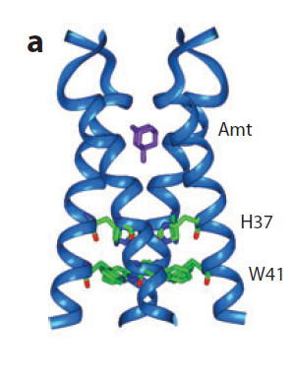
Membrane Protein Structure and Dynamics from NMR Spectroscopy
Proton Channel
M2 protein of the influenza A virus forms a tetrameric pH-activate proton channel important to virus life cycle
Used MAS SSNMR, Oriented-sample NMR and solution NMR
Overhausser effects – used in solution NMR to determine spatial proximity
¹³C-²H REDOR – Rotational Echo Double Resonance
Very accurate distance determination between C and H
0.3 A resolution structure
²H NMR – Dynamics information
H nuclei show quadrupolar splittings, which depend on the average orientation of the C-D bond in the magnetic field

Slide 32
Membrane Protein Structure and Dynamics from NMR Spectroscopy
Drug binding site in influenza M2 TM with ¹³C-²H REDOR

Slide 33
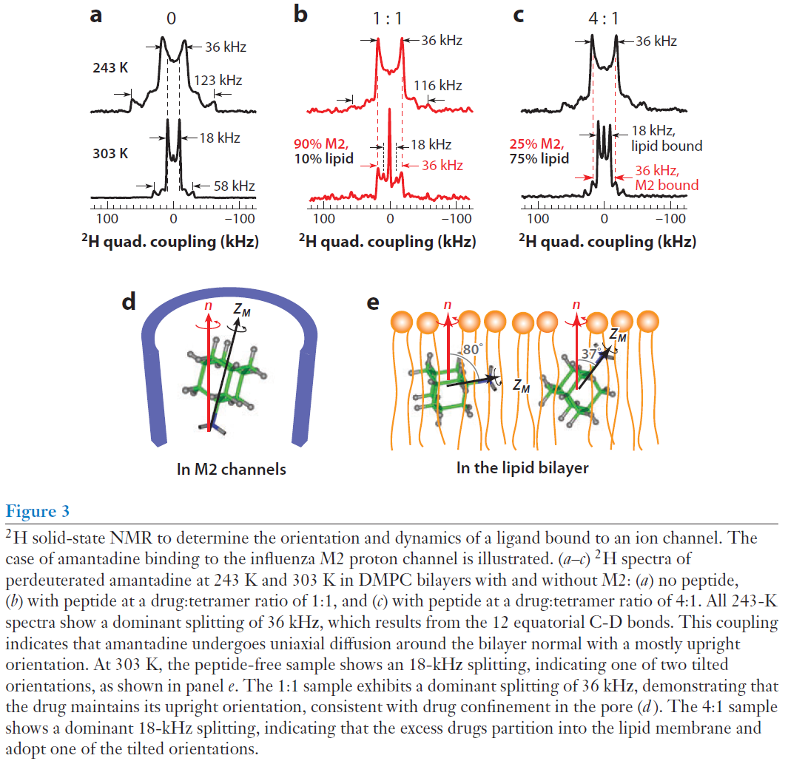
Membrane Protein Structure and Dynamics from NMR Spectroscopy
Orientation determination with ²H SSNMR
Orientation of the C-D bond in the magnetic field
Notes:
-30 deg above the top, +30 deg along bottom
No change across top, coupling changes on the bottom indicate orientation changes

Slide 34
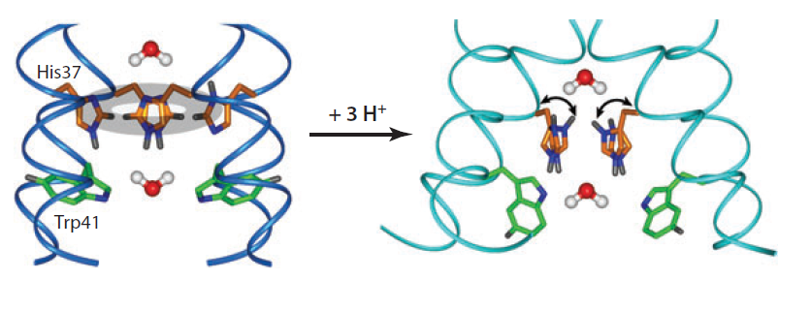
Membrane Protein Structure and Dynamics from NMR Spectroscopy
Conformational plasticity of M2 channel
Notes:
Proton-conduction mechanism of the influenza M2 channel. At high pH, the four histidine rings pack in an edge-face stacked fashion, disrupting Grotthuss hopping. Upon multiple protonation, the cationic histidines undergo microsecond ring reorientations that shuttle protons into the virion.

Slide 35
Membrane Protein Structure and Dynamics from NMR Spectroscopy
GPCRs
²H SSNMR – structural and dynamic changes of retinal upon light absorption
β-Sheet-Rich Proteins
Solution NMR – high resolution structure of human VDAC
Viral fusion proteins
Static ³¹P NMR to study HIV fusion peptide (gp41)
Phospholamban
Studied by OS, SS and solution NMR
Different structures of PLN cytoplasmic domain indicate dependence of protein structure on lipid composition, protein/lipid ratio, protein hydration
Notes:
GPCR G PROTEIN COUPLED RECEPTORS
Voltage gated anion channel
Fusion of the human immunodeficiency virus (HIV) membrane and the host cell membrane is an initial step of infection of the host cell. Fusion is catalyzed by gp41, which is an integral membrane protein of HIV.
Phospholamban (PLN) is a smallmembrane protein involved in the regulation of the cardiac cycle.
OS – oriented sample

Slide 37
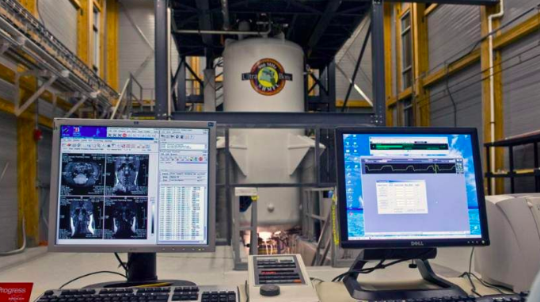
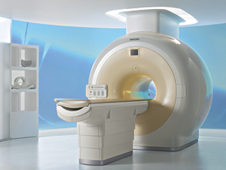
Magnetic Resonance Imaging

Slide 38
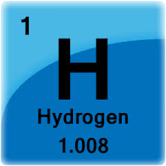
What is Magnetic Resonance Imaging (MRI)?
MRI is a non-invasive and versatile technique that allows for the imaging of bones, organs, and tissues without ionizing radiation
Application of the static or main magnetic field (B₀) and Radio Frequency (RF) Pulses
Uses inherent magnetic properties of human (and other animal) tissue to produce contrast
Taking advantage of the abundance of ¹H
“ Proton Imaging”

Slide 39
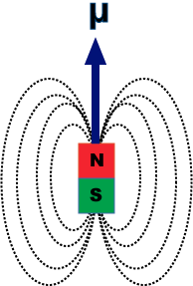
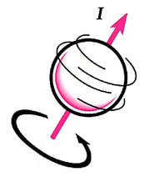
How does it work?
Spin
But it is the behavior of the averaged magnetic properties of each individual spin that matters for the resonance phenomenon

Slide 40
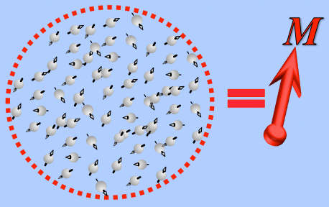
How does it work?
Net Magnetization (M)

Slide 41
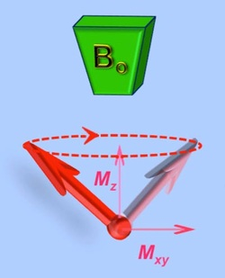
How does it work?
Application of RF pulses at the resonance (or Larmor) frequency results in precession of the net magnetization about B₀
f₀ Precession frequency
γ Gyromagnetic Ratio
B₀ Strength of the main magnetic field

Slide 42
T1/T2 Relaxation

Slide 43
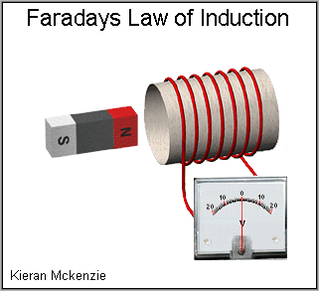
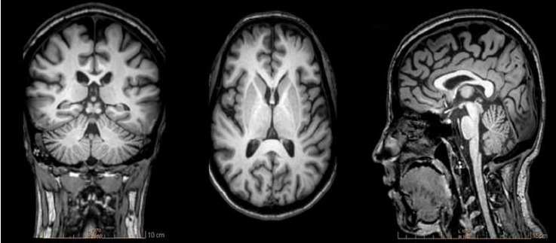
How does it work?
MR signal is the result of the precessing net magnetization inducing a current in receiver coils around the MRI machine
Faraday’s Law of Induction

Slide 45
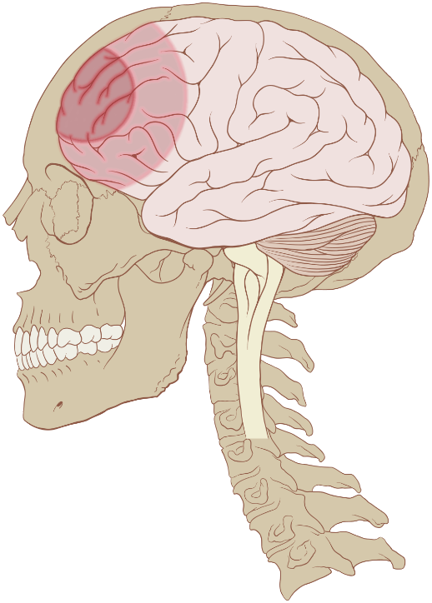
Traumatic Brain Injury? (TBI)
Damage to the brain from external mechanical force
Affects 1.7m annually, 52,000 deaths, over 250,000 hospitalized
Deficits include impaired learning and memory, and mood disorders such as depression and anxiety
Penumbra
Notes:
Only human, following slide, how to model in a rat.

Slide 46
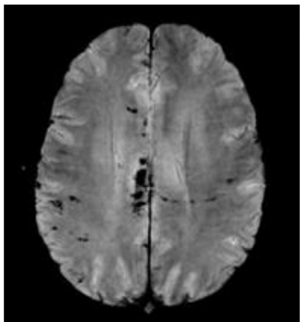
Diffuse Axonal Injury
The Adams Diffuse Axonal Injury Classification:
Grade 1: Mild diffuse axonal injury with microscopic white matter changes in cerebral cortex, corpus callosum, and brainstem
Grade 2: Moderate diffuse axonal injury with gross focal lesions in the corpus callosum
Grade 3: Severe diffuse axonal injury with finding as grade 2 and additional focal lesions in the brainstem.
Diffuse axonal injury is a clinical diagnosis
Notes:
The primary insults of diffuse axonal injury lead to disconnection or malfunction of neurons interconnection. This affects numerous functional areas of the brain. Usually, patients with diffuse axonal injury present with bilateral neurological examination deficits frequently affecting the frontal and temporal white matter, corpus callosum, and brainstem. The Adams classification of diffuse axonal injury utilizes pathophysiological lesions in the white matter tracts and clinical presentation.

Slide 47
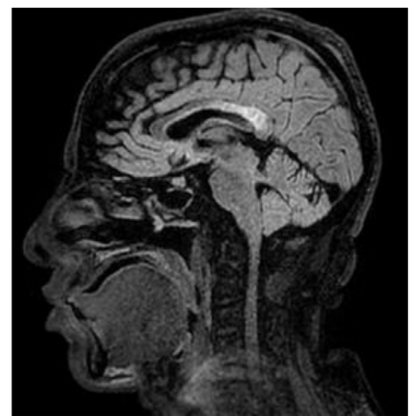
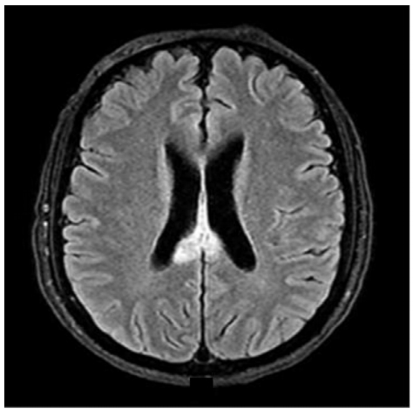
Sagittal FLAIR
Axial FLAIR
Can MRI’s sensitivity to DAI predict injury outcomes?
Notes:
Sagittal FLAIR
Axial FLAIR
SWI
DWI

Slide 48
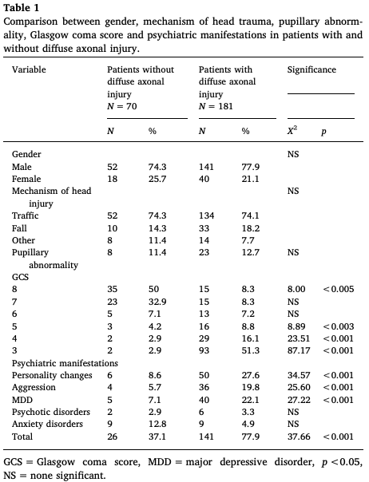

Slide 49
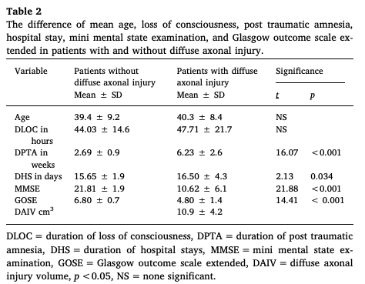

Slide 50
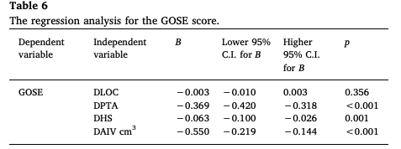
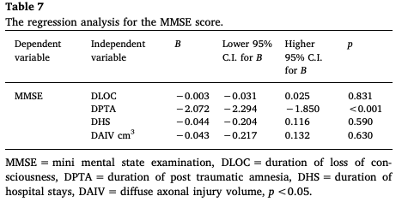
Notes:
Diffuse axonal injury is more common among patients with severe
brain injury.
Psychiatric manifestations are associated with the presence
of DAI.
Duration of post traumatic amnesia, and DAIV are considered
as independent predictors of neurocognitive impairments and poor
functional outcomes

Slide 51
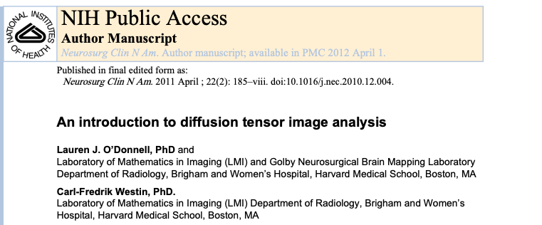

Slide 52
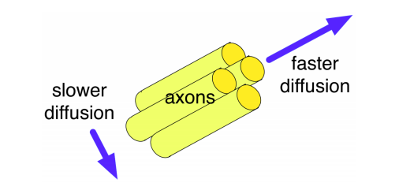
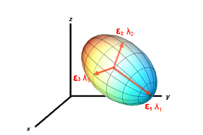
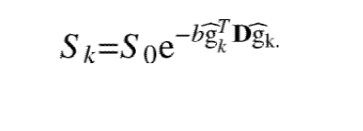
Diffusion Tensor Imaging
Diffusion tensor imaging (DTI) comprises a group of techniques where calculated eigenvalues (λ1, λ2, and λ3) and eigenvectors (ε1, ε2, and ε3) are used to create images reflecting various diffusion (water) properties of a tissue.
Solving of the Stejskal-Tanner equation
equation describes the signal intensity change at each voxel:
Notes:
]. The introduction of the diffusion tensor model allowed, for the first
time, a rotationally invariant description of the shape of water diffusion. The invariance to
rotation was crucial because it enabled application of the DTI method to the complex
anatomy of the fiber tracts in the human brain
Here S0 is the original image intensity at the voxel (measured with no diffusion-sensitizing
gradient) and Sk
is the intensity measured after the application of the kth diffusion sensitizing
gradient in the (unit) direction ĝk
. The product represents the diffusion
coefficient (diffusivity) in direction ĝk

Slide 53
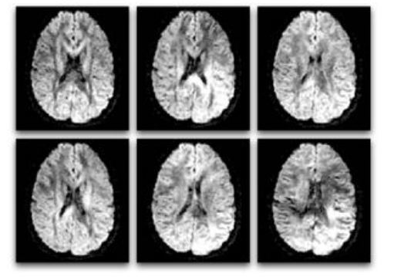
Diffusion weighted to Diffusion Tensor
The direction is different for each image, resulting in a different pattern
of signal loss (dark areas) due to anisotropic diffusion.
Notes:
In simplified terms, diffusion imaging works by introducing extra gradient pulses
whose effect “cancels out” for stationary water molecules, and causes a random phase shift
for molecules that diffuse. Due to their random phase, signal from diffusing molecules is
lost. This loss of signal creates darker voxels (volumetric pixels). This means that white
matter fiber tracts parallel to the gradient direction will appear dark in the diffusionweighted
image for that direction (Figure
Six diffusion-weighted images (the minimum number required for tensor calculation). In
diffusion MRI, magnetic field gradients are employed to sensitize the image to diffusion in a
particular direction. The direction is different for each image, resulting in a different pattern
of signal loss (dark areas) due to anisotropic diffusion.

Slide 54
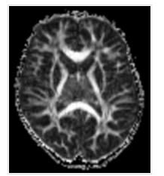
Fractional Anisotropy
Measuring diffusion asymmetry in a voxel
Notes:
The value of FA varies between 0 and 1. For perfect isotropic diffusion, λ1 = λ2 = λ3, the diffusion ellipsoid is a sphere, and FA = 0. With progressive diffusion anisotropy, the eigenvalues become more unequal, the ellipsoid becomes more elongated, and the FA → 1.

Slide 55
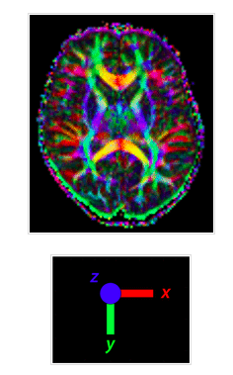
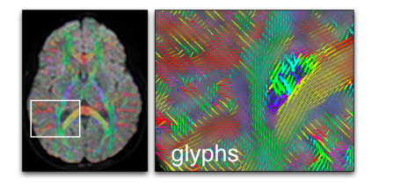
Notes:
This is a map that assigns colors to voxels based on a combination of anisotropy and direction. It is also called the colored fractional anisotropy map, fiber direction map or diffusion texture map. The color assignment is arbitrary, but the typical convention is to have the orientation of the principal eigenvector (ε1) control hue and fractional anisotropy (FA) control brightness. Specifically, if ε1 makes angles α, β, and γ with respect to the to the laboratory x-, y-, and z-axes, the color scheme might be apportioned in the ratios:
Red = FA • cos α
Green = FA • cos β
Blue = FA • cos γ

Slide 56
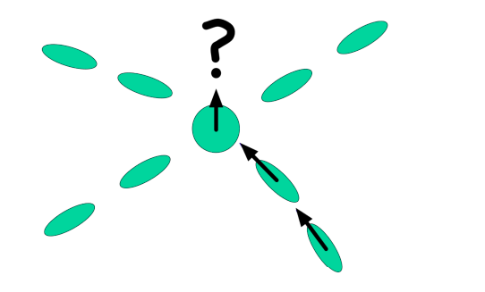
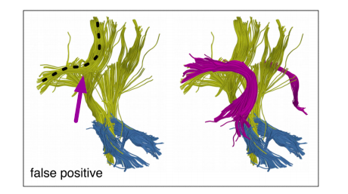
Issue of Crossing Fibers

