Slide 1
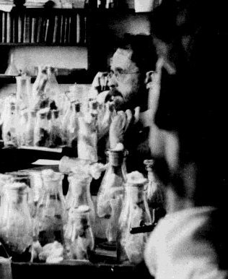
Chapter 7
Linkage, Crossing Over and Gene Mapping
Genes on the same
chromosome are said
to be “linked”
Because of crossing over
during meiosis, linkage is
usually less than 100%
Recombination
frequencies are used to
map the positions of
genes on chromosomes
T. H. Morgan, photo from Caltech Archives

Slide 2
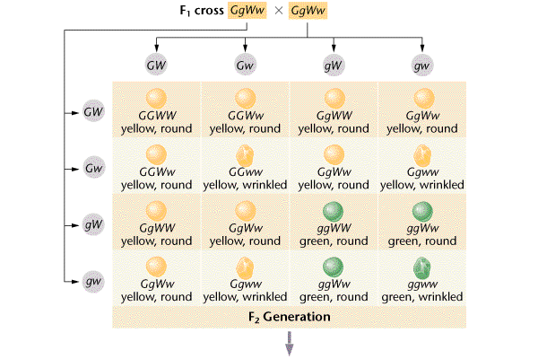
Dihybrid cross: why is a 9:3:3:1 ratio obtained
when two heterozygotes are crossed?

Slide 3
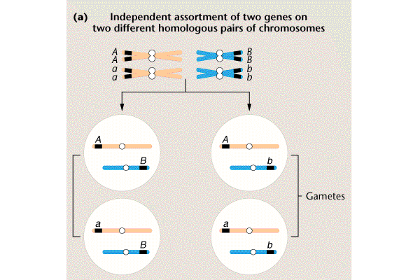
Independent Assortment:
four types of gametes made
each makes up 25% of the total

Slide 4
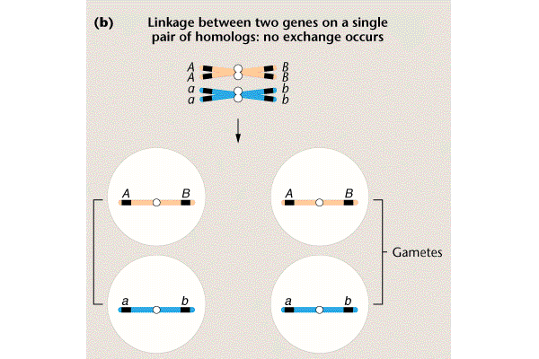
Complete Linkage:
two types of gametes made
each makes up 50% of the total

Slide 5
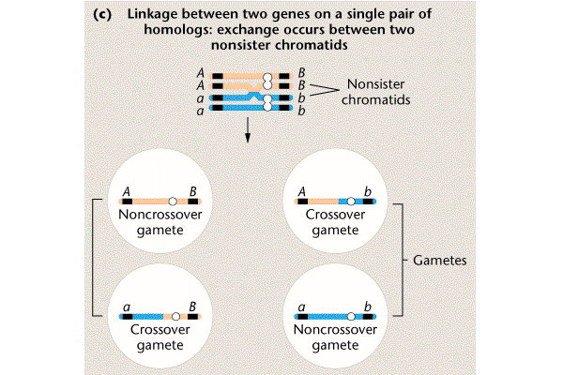
Linkage
with
Recombination
four types of
gametes
in two frequency
classes
Most Frequent
Most Frequent

Slide 6
Recombination is Reciprocal
Chromatids that do not cross over are called
“parental” or “nonrecombinant”
Chromatids that do cross over are called
“recombinant”
The recombinant
gametes can
never be more
than 50% of the
total

Slide 7
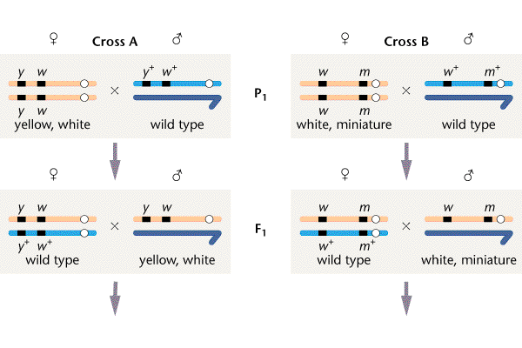
A. Yellow body (y) and white eye (w) recessive, X- linked mutations
(y+ and w+ indicate the dominant, wild type alleles)
B. Miniature wing (m) and white eye (w) mutations

Slide 8
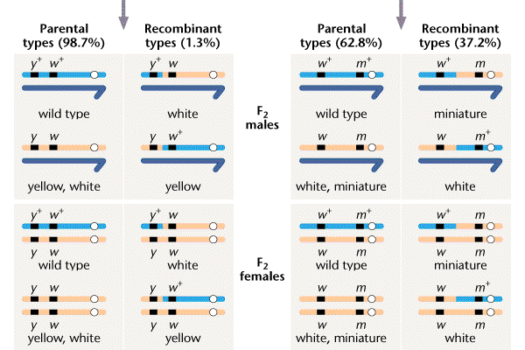

Slide 9
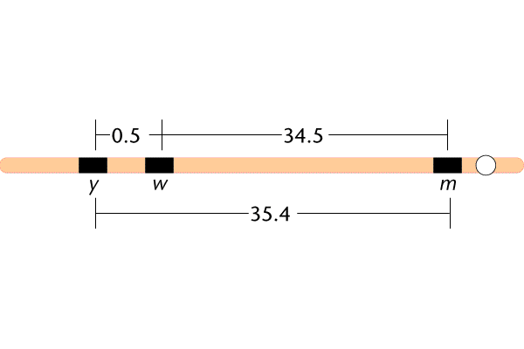
Map of the yellow, white and miniature loci
yellow x white -- 1.3% recombination
white x miniature -- 37.2%
yellow x miniature -- 38.5%
1.3
37.2
38.5
Recombination frequency reflects the distance
between two linked genes
The farther apart two genes are the more likely
crossing over will occur between them

Slide 10
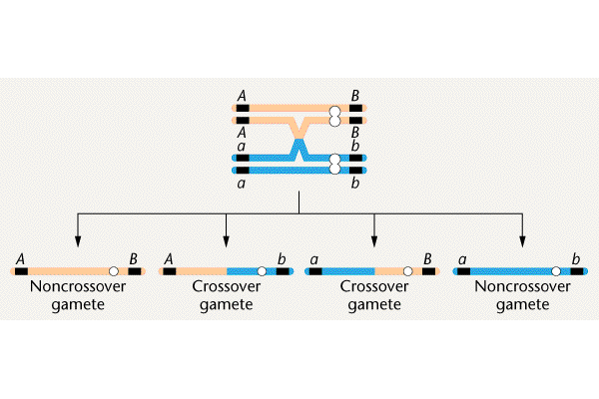
Results of a single crossover

Slide 11
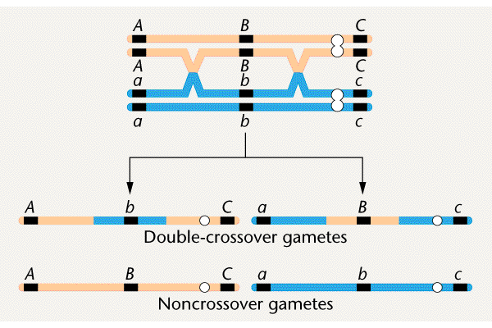
Results of a double crossover

Slide 12
Possible
crossover
outcomes
involving
three genes
No Crossover Single Double
(parental) Crossover Crossover
A B C
a b c
A b c
a B C
A B c
a b C
A b C
a B c
Most
frequent
Least
frequent

Slide 13
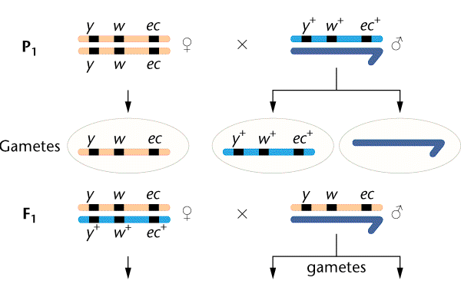
Cross between the yellow, white and echinus genes
on the X-chromosome in Drosophila
“THREE POINT CROSS”

Slide 14
To map genes by a three point cross
the parent producing the crossover
gametes must be heterozygous at all
loci.
Eg.
Triple heterozygote x homozygous recessive
y w ec x y w ec
y⁺w⁺ec⁺
female
male

Slide 15
F2 phenotype number
Step 1: Identify the progeny
with parental phenotypes,
single and double
crossover phenotypes
y w ec 4685
y+ w + ec + 4759
y w+ ec+ 80
y+ w ec 70
y w ec+ 193
y+ w+ ec 207
y w+ ec 3
y+ w ec+ 3
The parental
(nonrecombinant) types
are the most frequent
The double crossover
types are the
least frequent

Slide 16
Step 2. Determine the gene order
1. Identify the parental types
2. Identify the double crossover types
3. Determine which gene has moved
to convert the parental types into
the DCO types.
THIS GENE IS IN THE MIDDLE
4. Identify which gene has moved to make
each of the single crossover types

Slide 17
F2 phenotype number
y w ec 4685
y+ w + ec + 4759
y w+ ec+ 80
y+ w ec 70
y w ec+ 193
y+ w+ ec 207
y w+ ec 3
y+ w ec+ 3
Which gene is
in the middle?
y
w
ec

Slide 18
F2 phenotype number
Category
Percentage
y w ec 4685
y+ w + ec + 4759
y w+ ec+ 80
y+ w ec 70
y w ec+ 193
y+ w+ ec 207
y w+ ec 3
y+ w ec+ 3
No cross over
94.4
Single crossover
1.5
y x w
Single crossover
4.0
w x ec
Double crossover
0.06
w is in the middle

Slide 19
Step 3. Add up the cross over frequencies
to make the map:
y x w = 1.5 + 0.06 = 1.56 map units
w x ec = 4 + 0.06 = 4.06 map units
y
w
ec
1.56
4.06
1 map unit = 1% crossing over = 1 centimorgan (cM)

Slide 20
females males females males
P w sn x bar bar x w sn
F1 females males females males
+ + bar w sn + + + bar + + bar
w sn + Y w sn + Y
F2 females males females males
+ + bar + + bar + + bar + + bar
w sn + Y + + bar Y
w sn + w sn + w sn + w sn +
w sn + Y + + bar Y

Slide 21
F2 females males females males
+ + bar + + bar + + bar + + bar
w sn + Y + + bar Y
w sn + w sn + w sn + w sn +
w sn + Y + + bar Y
w + bar w + bar w + bar w + bar
w sn + Y + + bar Y
+ sn + + sn + + sn + + sn +
w sn + Y + + bar Y
+ sn bar + sn bar + sn bar + sn bar
w sn + Y + + bar Y
w + + w + + w + + w + +
w sn + Y + + bar Y
+ + + + + + + + + + + +
w sn + Y + + bar Y
w sn bar w sn bar w sn bar w sn bar
w sn + Y + + bar Y
no
x over
w x over
sn x over
bar x over

Slide 22
Cross w sn females Cross bar females
bar males w sn males
Females Males Females Males
1/2 bar bar bar bar
w sn w sn 1/2 bar w sn
w 1/2 bar w bar bar w bar
sn sn 1/2 bar sn
sn 1/2 bar sn bar bar sn bar
w w 1/2 bar w
wt wt bar wt
w sn 1/2 bar w sn bar 1/2 bar w sn bar

