Slide 1
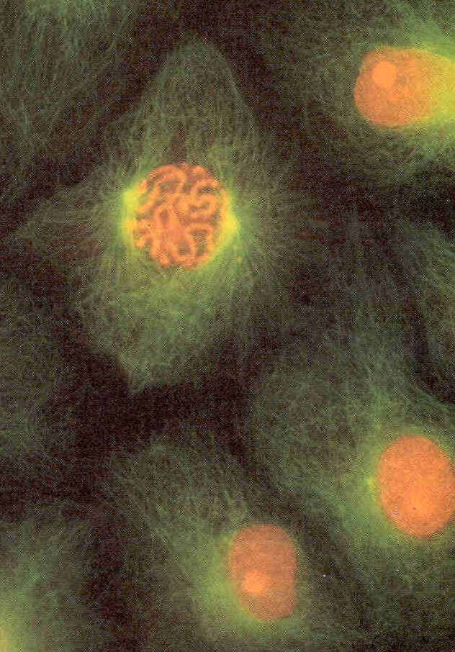
Chapter 12 -- Cell Division & Mitosis
Unicellular organisms
cell division = reproduction
Multicellular organisms
cell div. needed for development
& for reproduction (meiosis)
chromosomes
Mitosis vs. Meiosis
Mitosis gives each cell
complete set of genetic material
and cytoplasmic organelles
One cell divides to form two
genetically identical daughter cells
Nucleolus & Nucleus

Slide 2
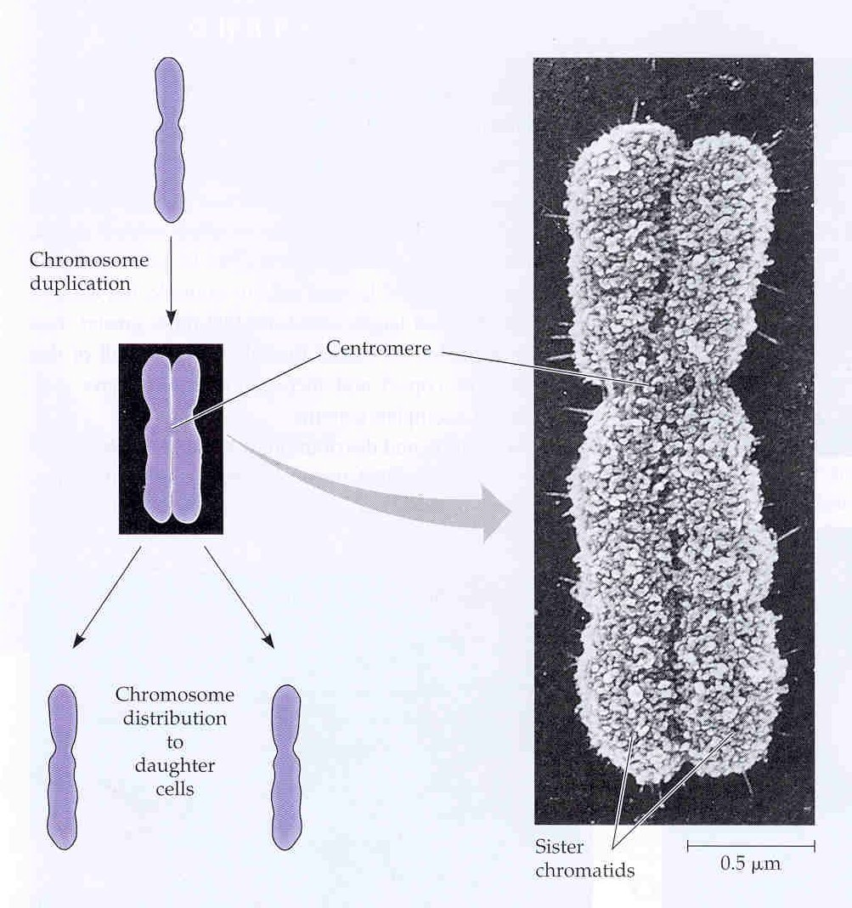
Before mitosis (interphase)
each chromosome is duplicated
Fig 12.4
A duplicated chromosome
has two sister chromatids
Each sister chromatid contains
exactly the same genes.
In mitosis each daughter cell
gets one sister chromatid
from each chromosome
Cell Cycle: ordered set
of events from one cell
division to the next
interphase - mitosis - interphase - etc.
centromere

Slide 3
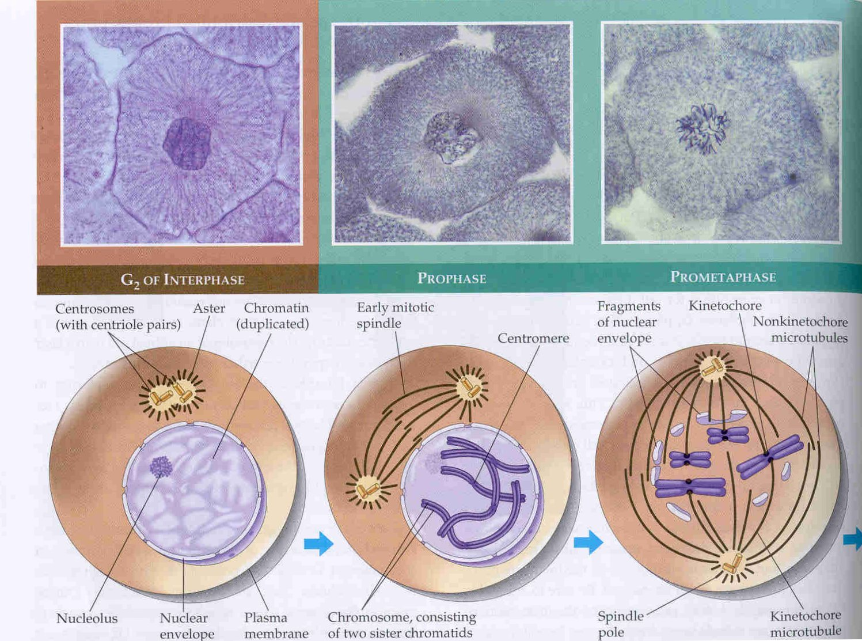
Prophase: condensation of chromosomes
formation of spindle
breakdown of nuclear envelope & nucleus
attachment of chromosomes to spindle
Centrosome
and
centrioles
organize
the spindle
(composed
of micro-
tubules)
Fig 12.7

Slide 4
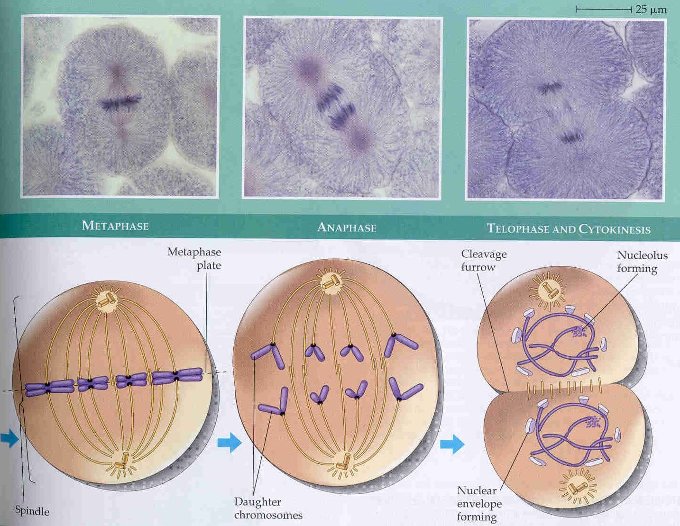
Metaphase: chromosomes align at center of cell
Anaphase: centromeres split - one sister chromatid from
each chromosome moves to one centromere
Telophase: reverses prophase
Cytokinesis: cell divides in two
Fig 12.7

Slide 5
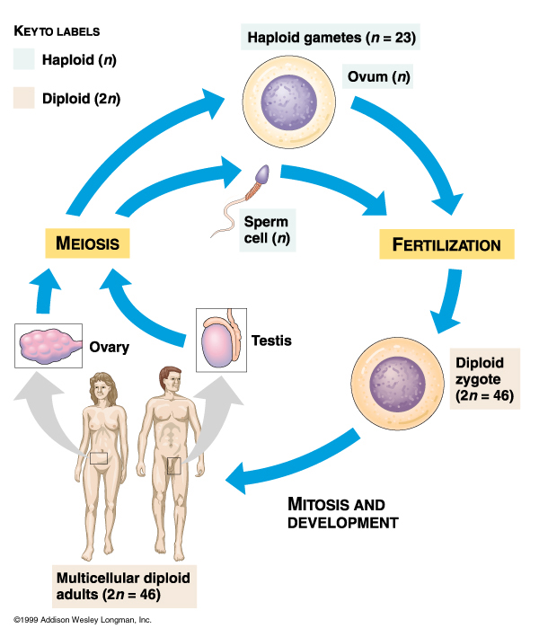
Meiosis -
Specialized cell
division for sexual
reproduction
Meiosis reduces
the chromosome
number by 2
Diploid (2n) cells
have two copies of
each chromosome
Haploid cells (n) have
one copy of each
chromosome.
Meiosis converts 2n
cells into n cells
(gametes)
Fig 13.5

Slide 6
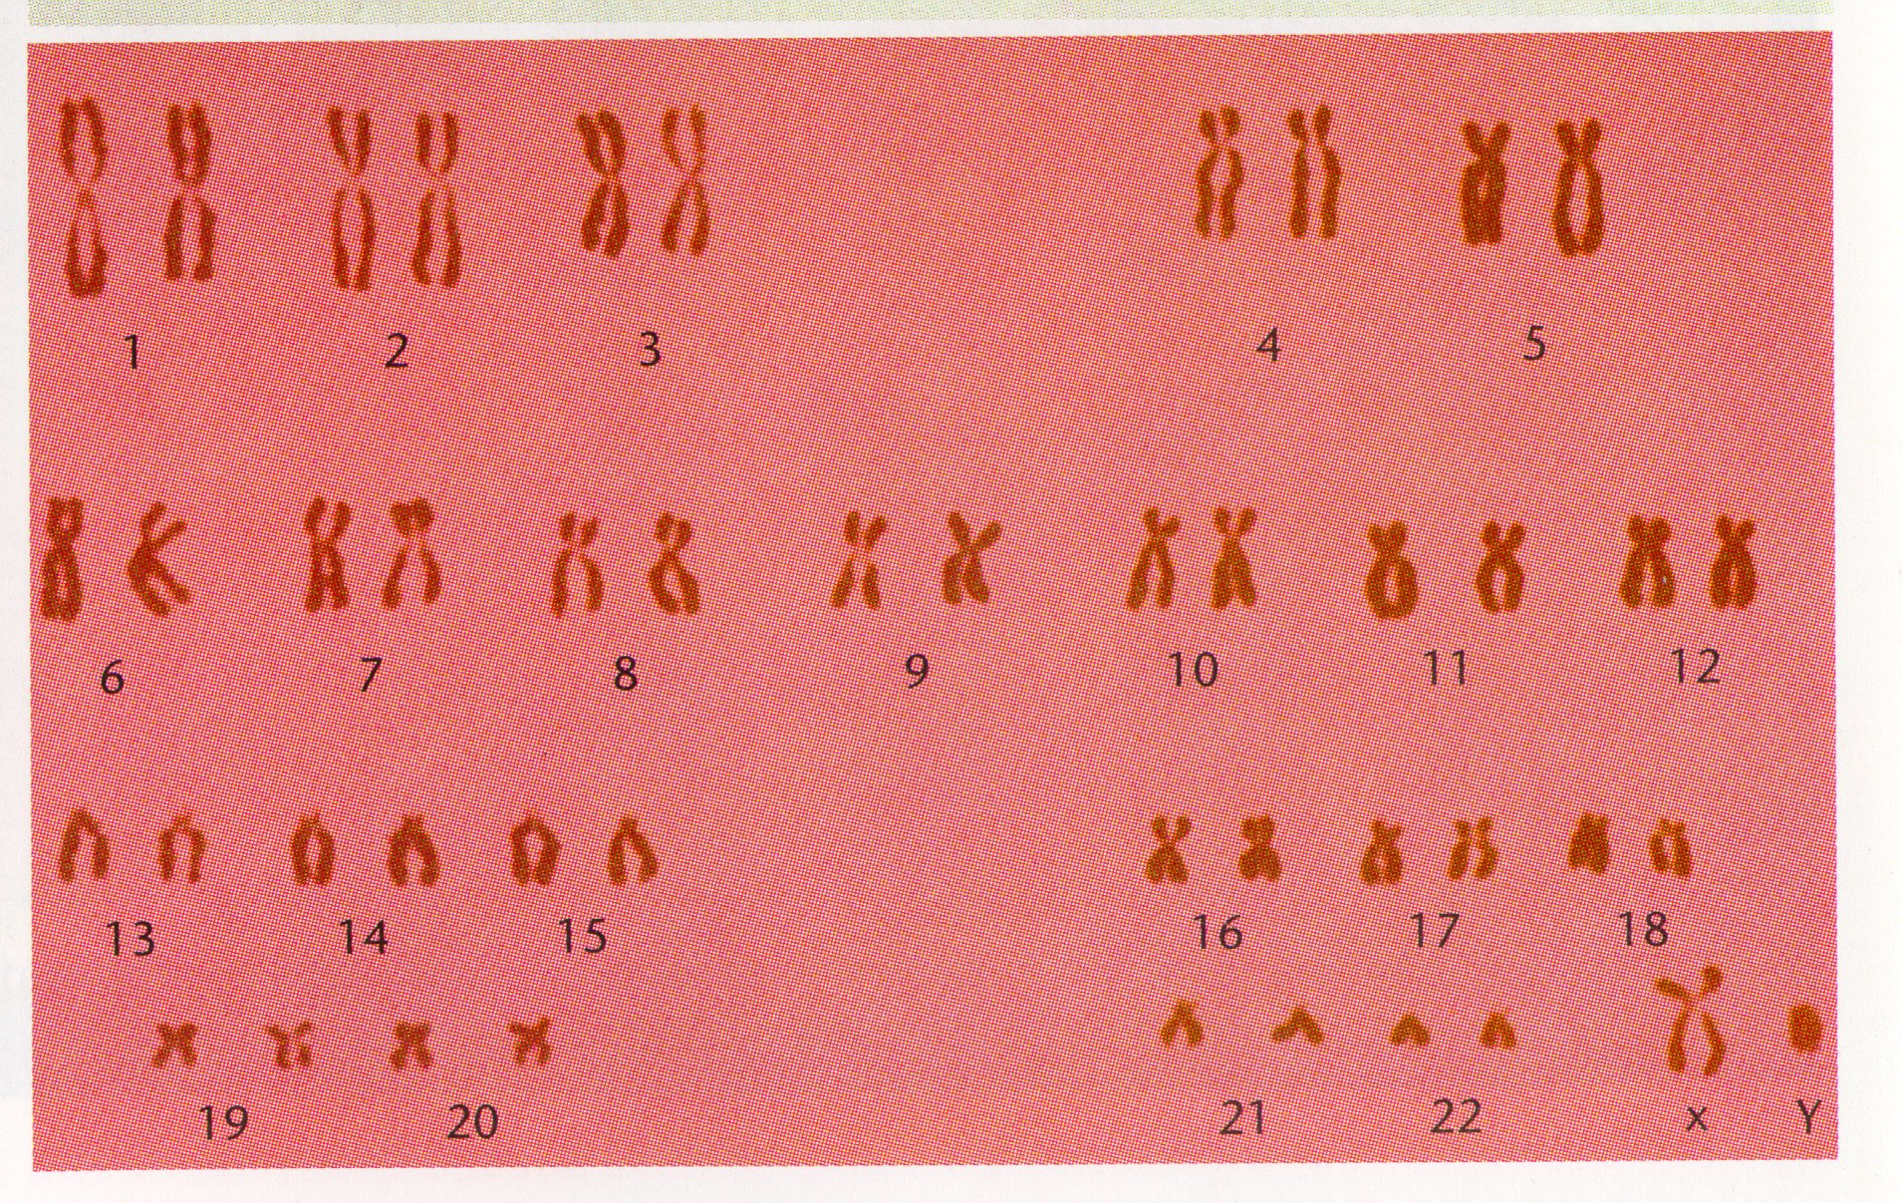
Diploid organisms have two copies of each chromosome
Similar
To
Fig 13.3
Human Karyotype: 46 chromosomes, 23 pairs
22 pairs of autosomes, one pair sex chromsomes (X & Y)

Slide 7
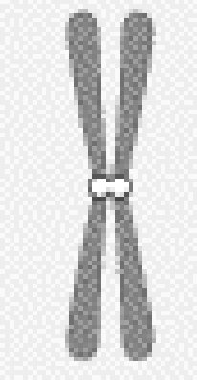
Most Organisms are Diploid (2N)
Homologous Chromosomes - - carry the same
genes but may have different alleles
A
A
a
a
B
B
b
b
C
C
C
C

Slide 8
MEIOSIS
One diploid cell divides twice and forms
4 haploid cells
Each daughter cell gets one chromatid from
each pair of homologous chromosomes

Slide 9
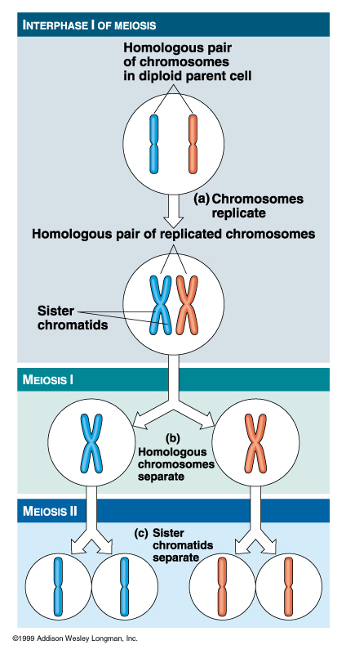
Meiosis
First Division (Meiosis I)
homologous chromosomes are separated into different daughter cells
chromosome recombination (crossing over) occurs
Second Division (meiosis II)
no DNA replication before division
sister chromatids are separated into different daughter cells
Fig 13.7

Slide 10
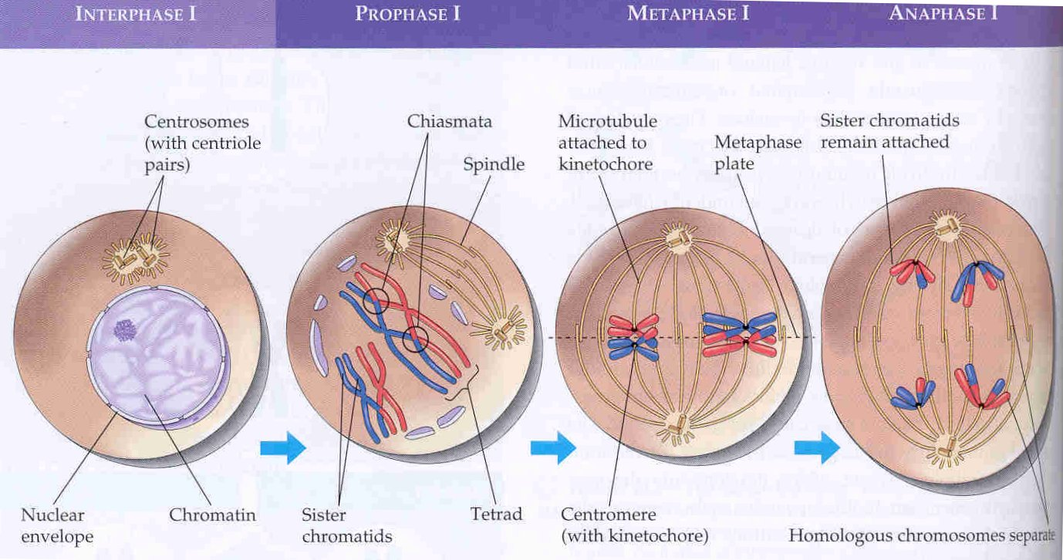
Meiosis I
Fig 13.8
Homologous chromosomes pair and crossover during Propohase I
Crossingover - reciprocal exchange of chromatid arms

Slide 11
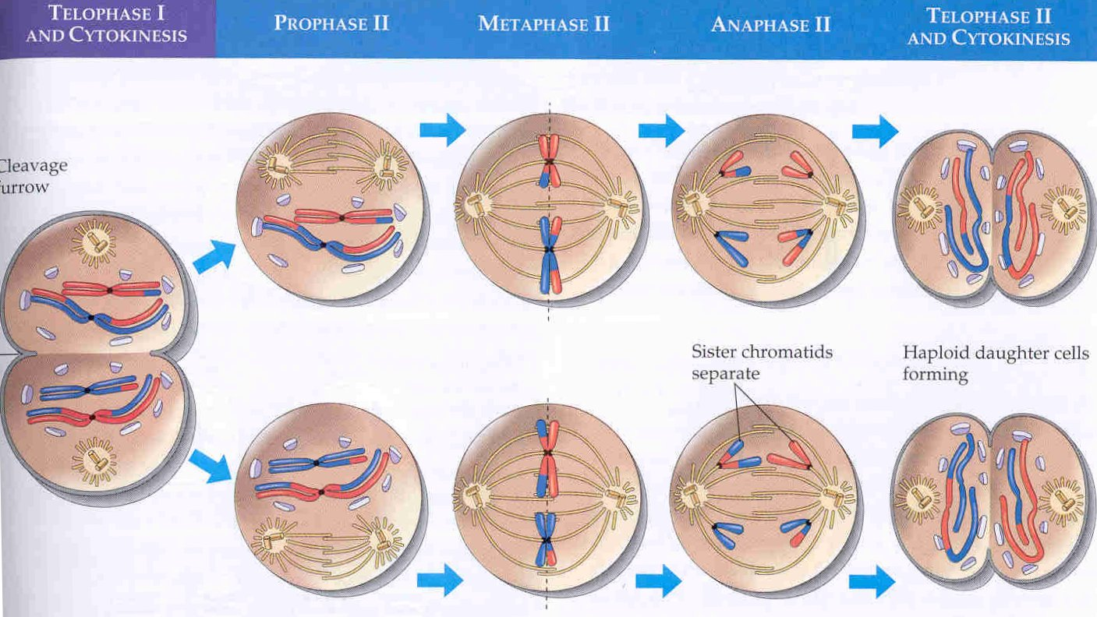
Meiosis II
Fig 13.8
Cells immediately divide again (no DNA replication)
Division is like mitosis (sister chromatids are separated)

Slide 12
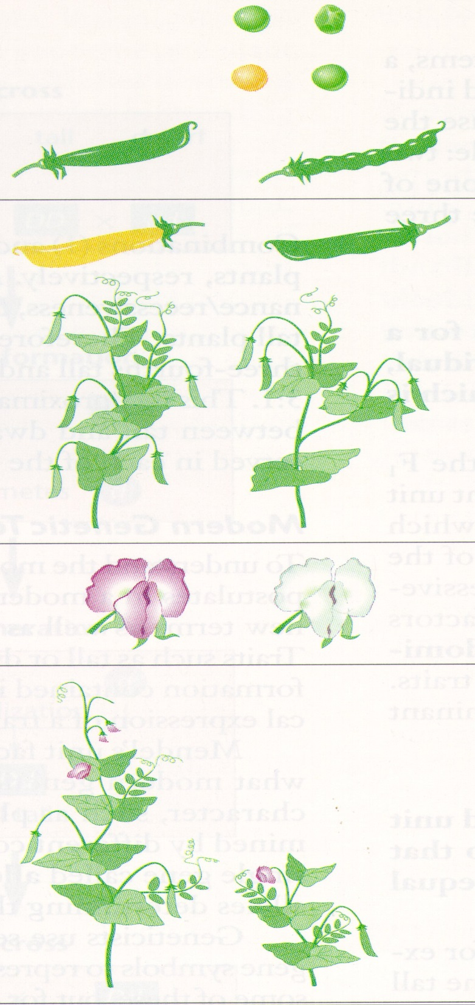
Pure-breeding peas
differing in 7 pairs of traits
Seed Shape - round vs. smooth
Seed Color - yellow vs. green
Pod Shape -
Flower color
etc.

Slide 13
Pure-Bred White
Flowers
X
Pure-Bred White
Flowers
X
100 % White Flowers
Pure-Bred Red
Flowers
X
Pure-Bred Red
Flowers
100 % Red
Flowers

Slide 14
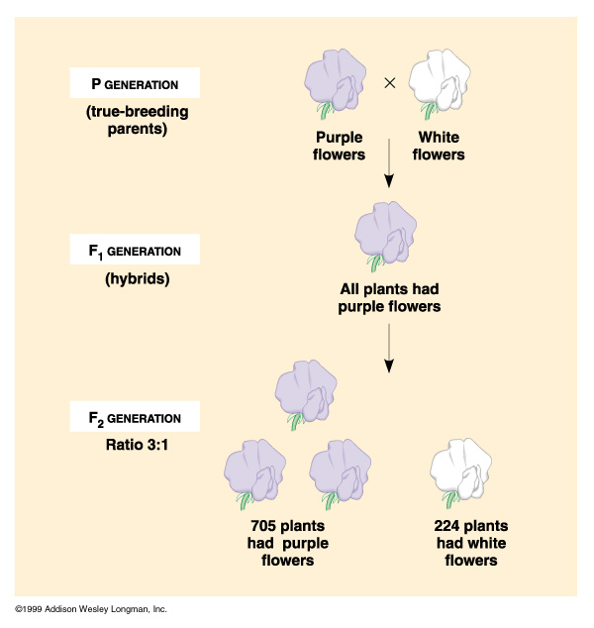
Pure breeding red X Pure breeding white
P
F1
F2

Slide 15
Mendel’s Law of Segregation
1. Each trait is controlled by a pair of
factors
GENES
2. When 2 different factors for a trait are
present in an individual on is
DOMINANT and one is RECESSIVE
ALLELES -- alternate forms of a gene
3. During gamete formation the paired factors
SEGREGATE RANDOMLY

Slide 16
Partial dominance and Codominance
Neither allele is dominant or recessive
Heterozygous individuals have
a distinct phenotype
Partial dominance - heterozygote has an
intermediate phenotype
Codominance - heterozygote expresses both alleles

Slide 17
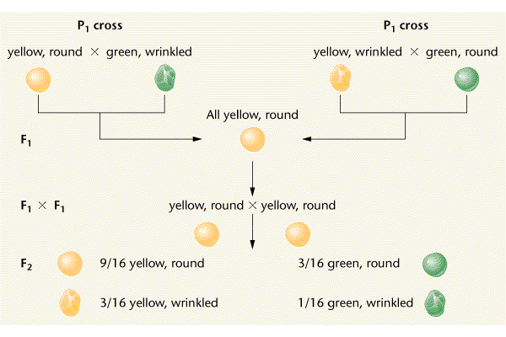
DIHYBRID CROSS

Slide 18
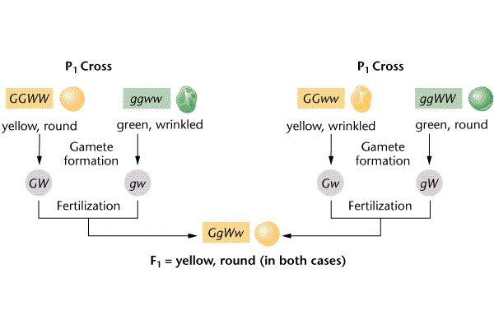

Slide 19
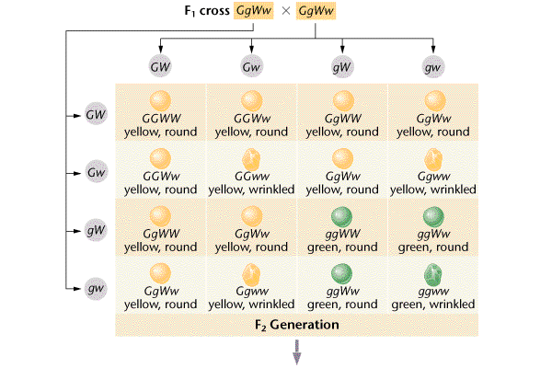
Punnett Square for a Dihybrid Cross

Slide 20
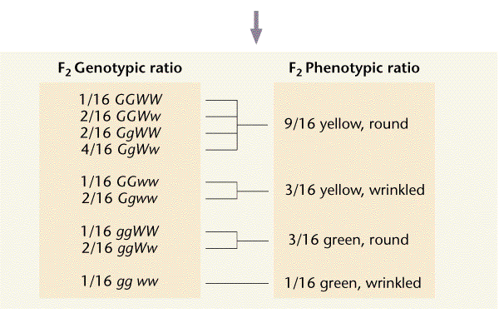
Outcome of the Dihybrid Cross

Slide 21
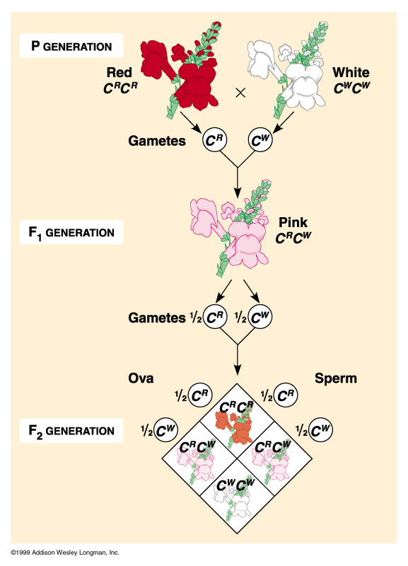
Inheritance of Flower
Color in Snapdragons
P1
Red X White
F1
Pink
F1
Pink X Pink
F2
1 Red : 2 Pink : 1 White
Partial Dominance
Aka Incomplete Dominance

Slide 22
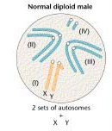
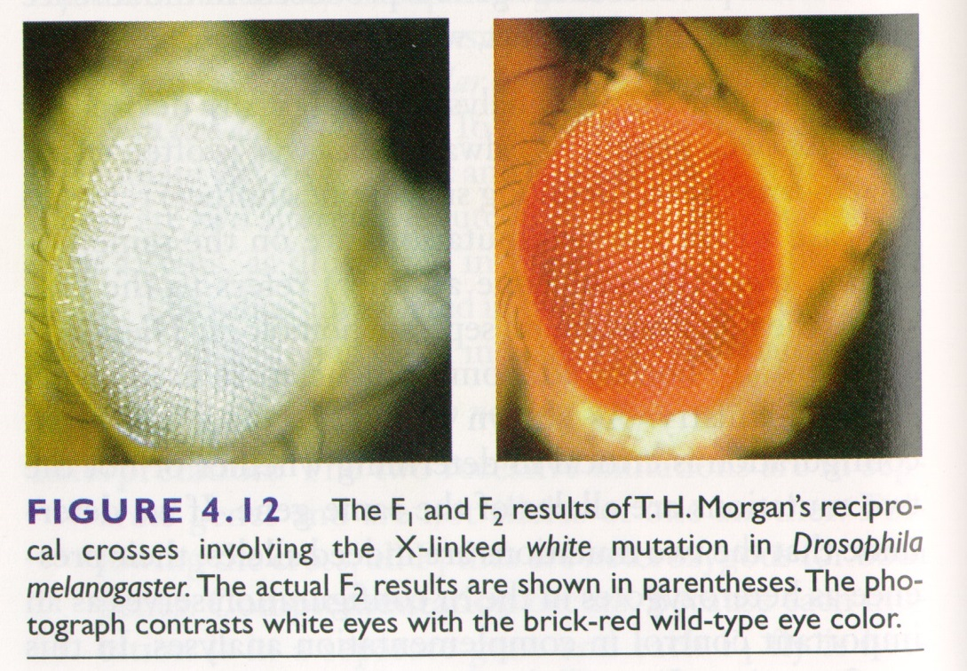
Discovery of linkage
The White eye mutation in Drosophila
is linked to inheritance of sex
Thomas Hunt Morgan -- 1910
Females are XX
Males are XY
White eyes are found more
often in males
White eye is due to a recessive gene on the X
The Y chromosome carries no corresponding allele

Slide 23
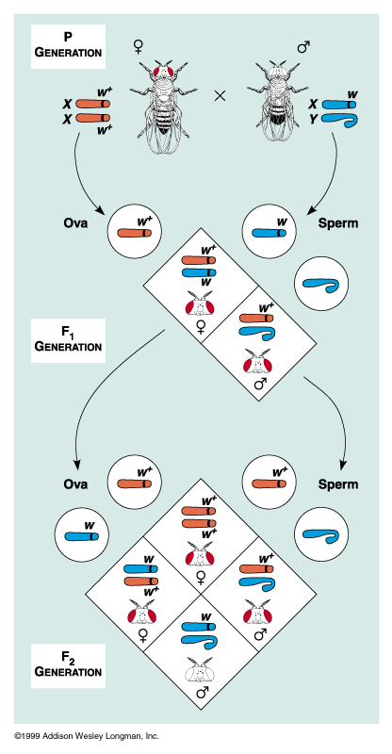
White-eyed male
X
wild type female
F1 - all wild type
F1 X F1
F2
all females wild
type
males are 50-50
wild type or
white eyed

Slide 25
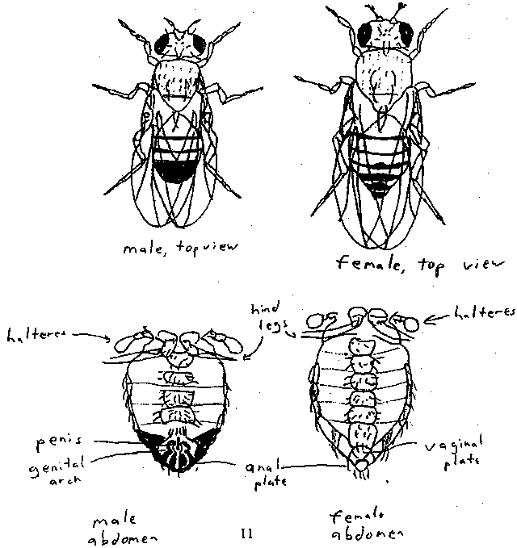
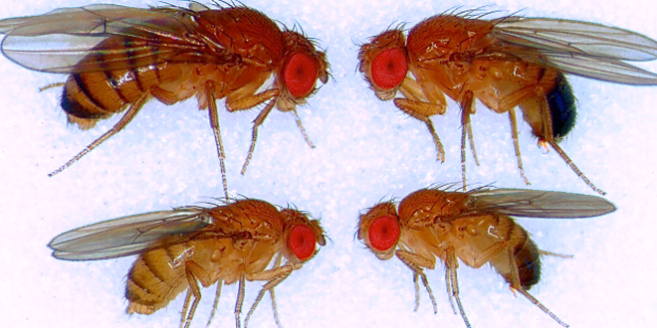
male
female

