Slide 2
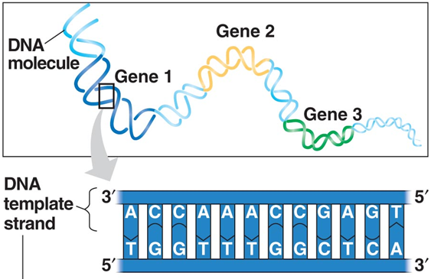

Slide 3
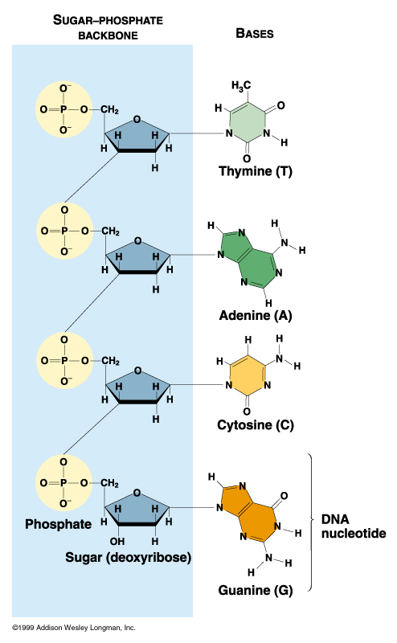
DNA is a linear polymer of nucleotide subunits joined together by phosphodiester bonds - covalent bonds between phosphate group at 5’ carbon and 3’ carbon of next nucleotide – uses oxygens as bridges.
Chain of nucleotides has alternating sugar and phosphate components, called the “sugar-phosphate backbone.” Nitrogenous bases stick off backbone at regular intervals.
Any linear chain of nucleotides has a free 5’ PO₄ on one end, and a free 3’ OH on the other. A chain of DNA thus has POLARITY
Different DNA molecules differ only in the identities of the nitrogenous bases at any given position – they have different DNA sequences. A simple way to represent this strand of DNA is: 5’-TACG-3’
Segments of this sequence, which can be 1000s of nucleotides long, are the genes that code for single, specific proteins.
5’ PO4 (free)
3’ C
5’ C
1’ C
3’ OH (free)

Slide 4
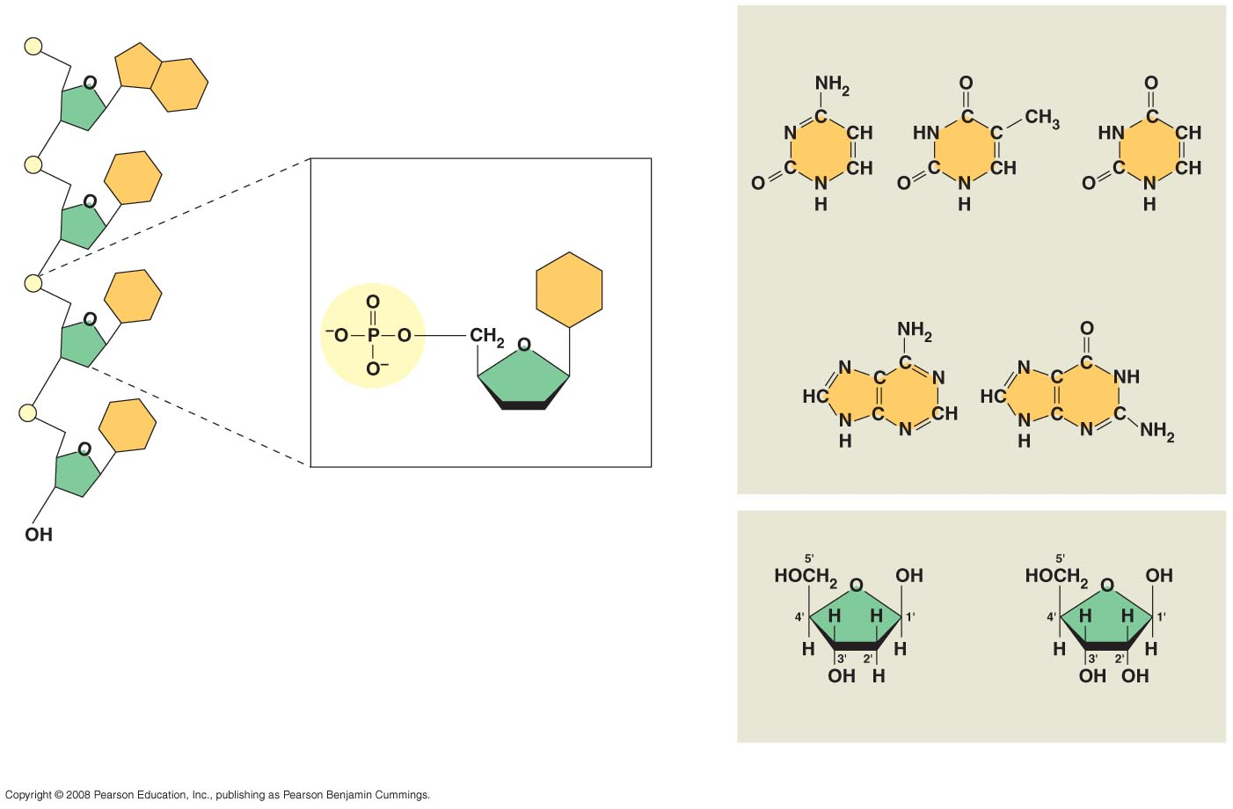
Making a nucleotide
5′ end
Nitrogenous bases
Pyrimidines
5′C
3′C
Nucleoside
Nitrogenous
base
Cytosine (C)
Thymine (T, in DNA)
Uracil (U, in RNA)
Purines
Phosphate
group
5′C
Sugar
(pentose)
Adenine (A)
Guanine (G)
3′C
(b) Nucleotide
Sugars
3′ end
(a) Polynucleotide, or nucleic acid
Nitrogenous base connected to 1’ carbon of sugar – nucleoside
Phosphate group added to 5’ carbon of sugar - nucleotide
Deoxyribose (in DNA)
Ribose (in RNA)
(c) Nucleoside components
Notes:
Figure 5.27 Components of nucleic acids

Slide 5
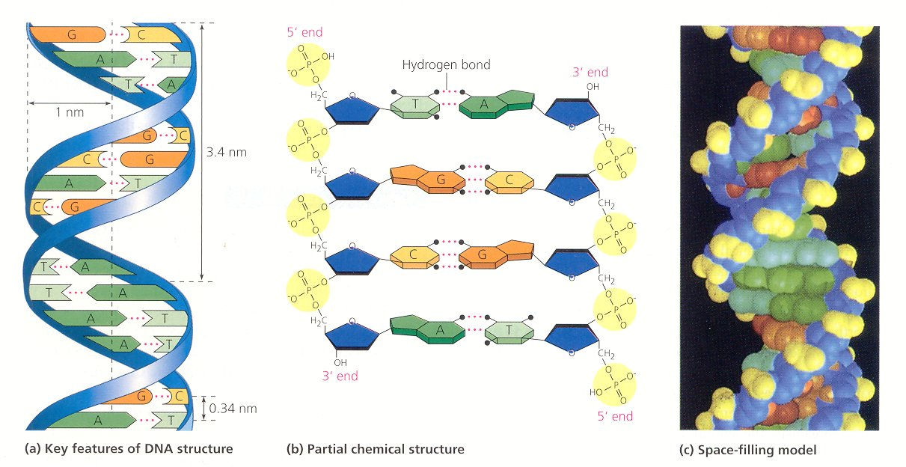
Fig. 16.7
In a double helix, 2 strands of DNA wrapped around each other in shape of helix
Strands are held together by hydrogen bonding between nitrogenous bases.
Only pairings that work are A with T and G with C. Strands held at constant distance from one another because of the similar geometry of A-T and G-C base pairs
Also, only way pairings will work is if strands have opposite polarity 5’ to 3’ “Antiparallel”

Slide 6
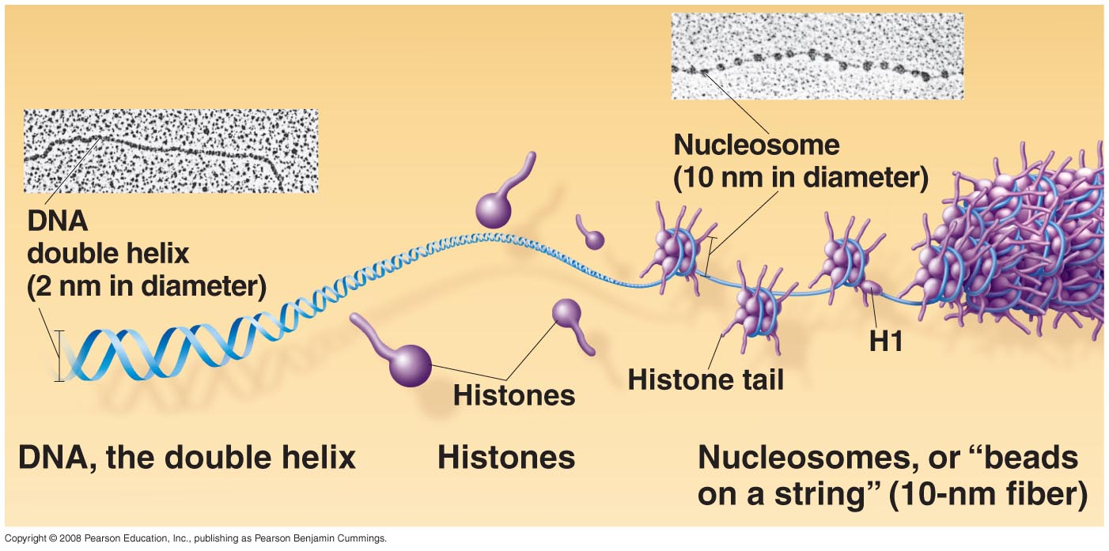
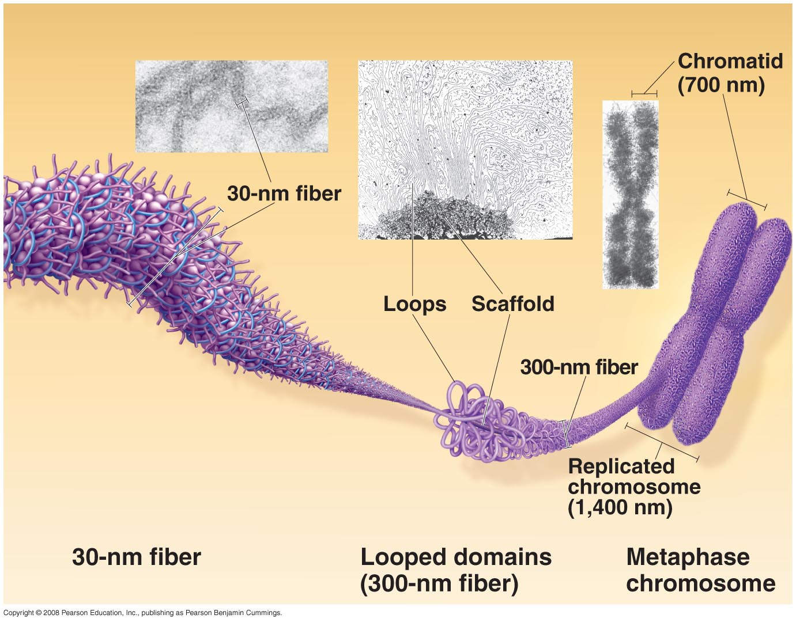
Eukaryotic Chromosomes
are linear DNA molecules
(human 3 billion base pairs)
and are packaged by
histone proteins
Chromatin – DNA
plus histone proteins

Slide 7
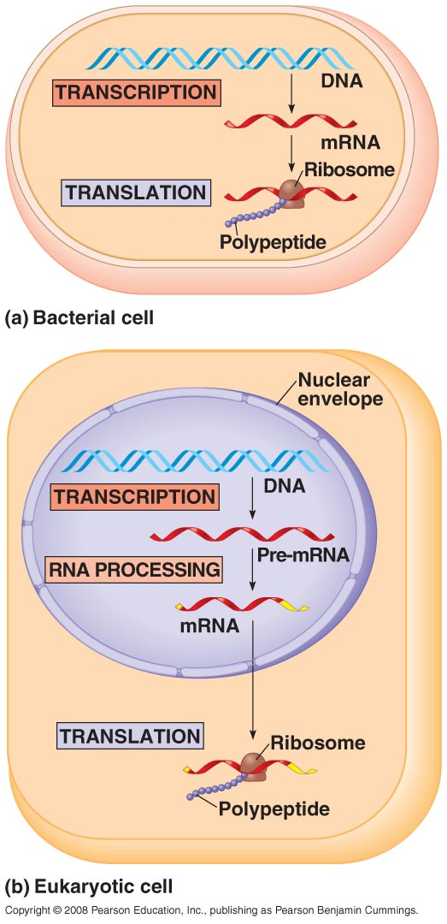
Information Flow
in the Cell
DNA
(genes)
RNA
Proteins
transcription
translation

Slide 8
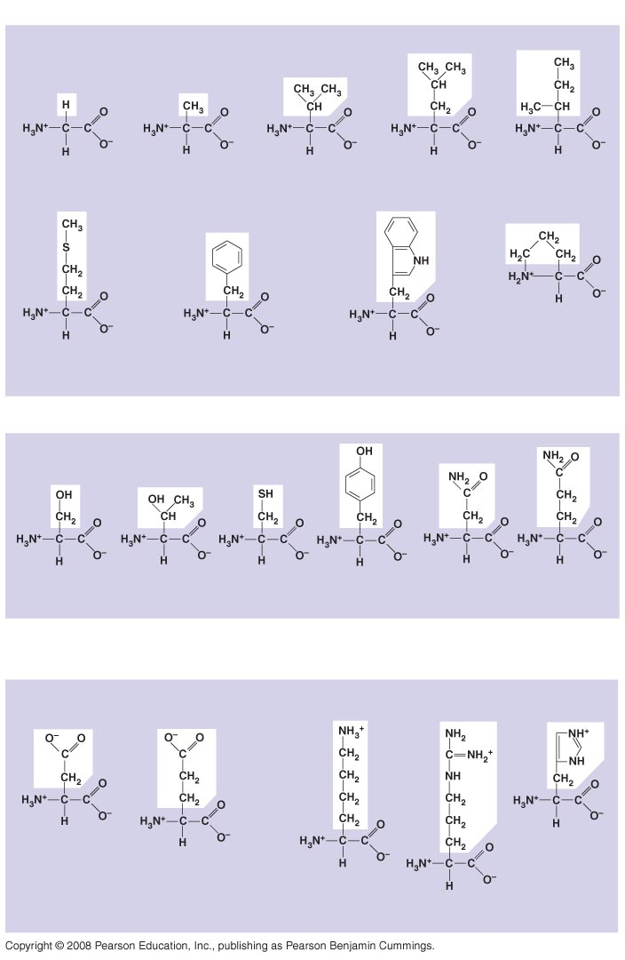
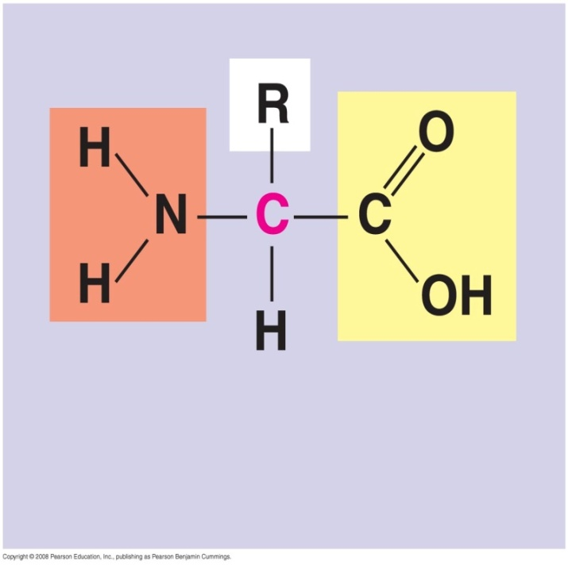
Fig. 5-17
Nonpolar
The 20 Naturally Occurring Amino Acids
Glycine
(Gly or G)
Alanine
(Ala or A)
Valine
(Val or V)
Leucine
(Leu or L)
Isoleucine
(Ile or I)
The different R groups have different sizes, shapes, and chemical properties.
Methionine
(Met or M)
Phenylalanine
(Phe or F)
Trypotphan
(Trp or W)
Proline
(Pro or P)
Polar
α carbon
Serine
(Ser or S)
Threonine
(Thr or T)
Cysteine
(Cys or C)
Tyrosine
(Tyr or Y)
Asparagine
(Asn or N)
Glutamine
(Gln or Q)
Electrically
charged
Acidic
Basic
Amino
group
Carboxyl
group
Aspartic acid
(Asp or D)
Glutamic acid
(Glu or E)
Lysine
(Lys or K)
Arginine
(Arg or R)
Histidine
(His or H)
Notes:
8
Figure 5.17 The 20 amino acids of proteins

Slide 9
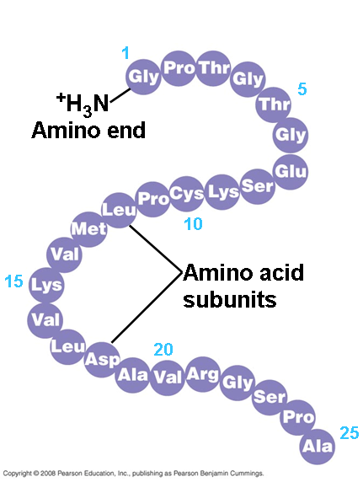
There is an almost infinite number of possible kinds of proteins
Each kind of protein has a
unique order of amino acids
most proteins consist of
200-400 amino acids
a protein’s function depends
on what amino acids it contains
and its overall 3-D shape

Slide 10
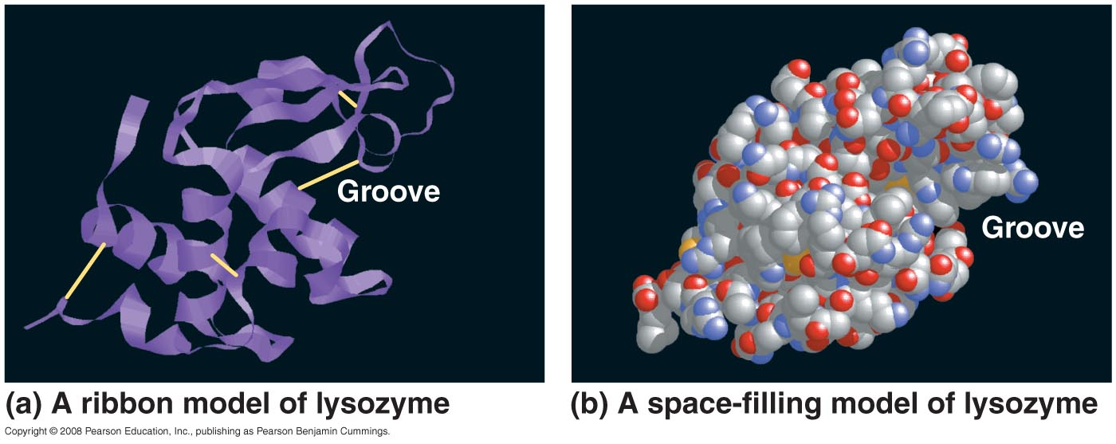
Different models of the structure
of the enzyme lysozyme

